Slide 1


Fresh Fruit
Detection Application
June 7, 2023
CONTACT
20161112 Jungmin Park
20181257 Chanhyeok Choi

Slide 2


3
Motivation
The motivation was one fact that a lot of foods especially fruits are wasted everyday. So we though that easy classification of fruit freshness might reduce the such waste in many ways such as farmers, markets and customers.
https://encyclopedia.pub/entry/21071

Slide 3
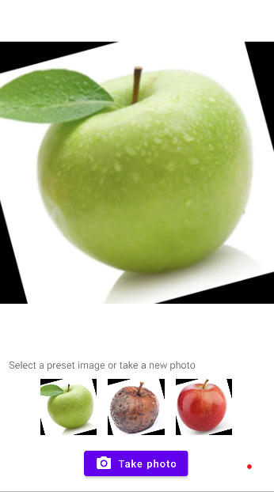
6
App design, running examples
We designed our app simple and clear as possible to focus on quick and easy freshness detection. This screen is our main screen. When user clicks the Take photo button then smartphone activates camera and ready to detect the freshness. Or try examples with given apple pictures.

Slide 4
8
the role of each member (in the case of a team with two members)
Jungmin Park : implement app
Chanhyeok Choi: implement tflite model

Slide 5
8
Conclusion
We developed a model with a high level of accuracy, although we failed to complete the app. We could complete the interface of the app, but applying the tflite model to the app was more difficult than we thought. If we proceed with a similar project next time, it will be helpful to proceed with the project easily by making it easy to apply to the app from the production stage of the model.

