Slide 1
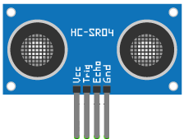
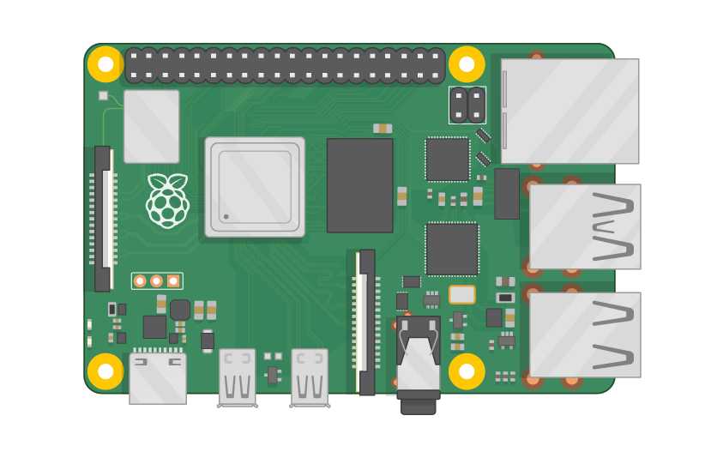

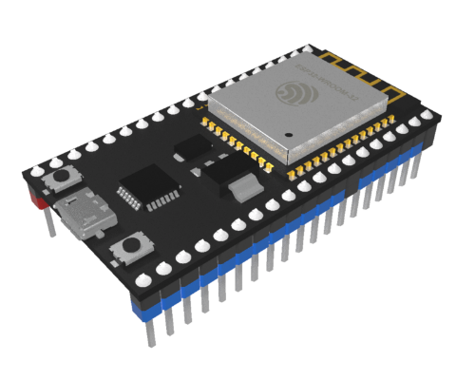
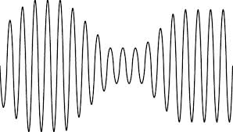
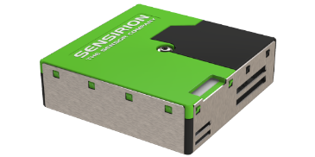
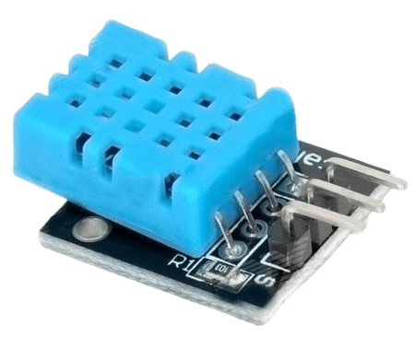



Distance (topic:dis)
Secure IoT Home
map
(MQTT)
(MQTT broker)
Raspberry Pi 3
Dust (PM)
(topic:pm, pmm)
Esp32 (Subscriber)
Controllor / Wifi
Temperatue, Humidity
(topic:temp, hum)
Web (Publisher)
Node-RED
App (Publisher)
MQTT Dashboard
App (Publisher)
Node-Red

