Slide 1


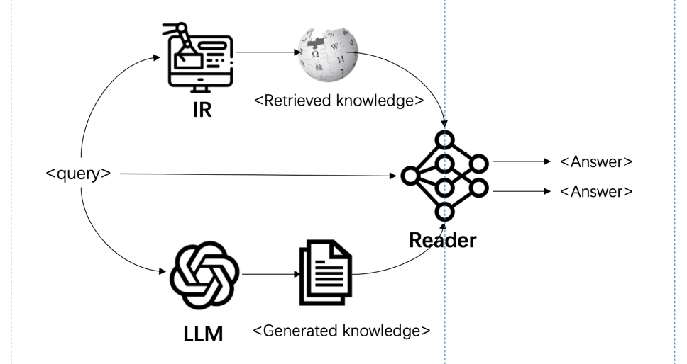
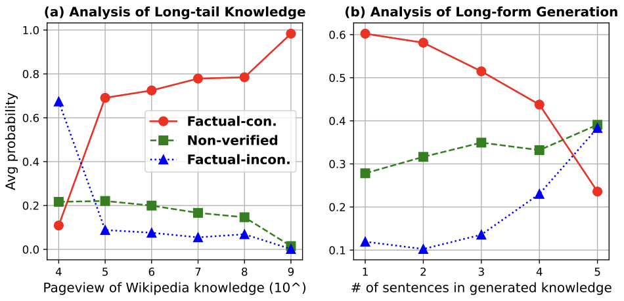
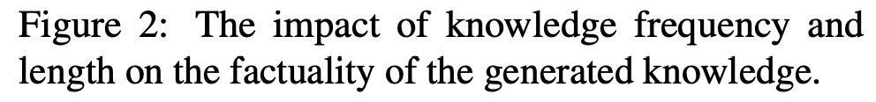
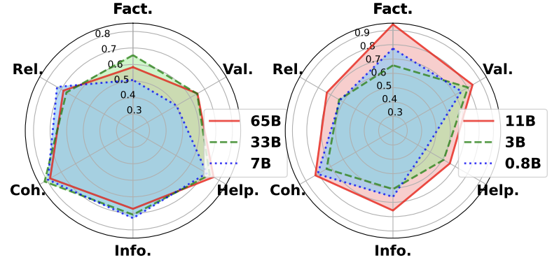


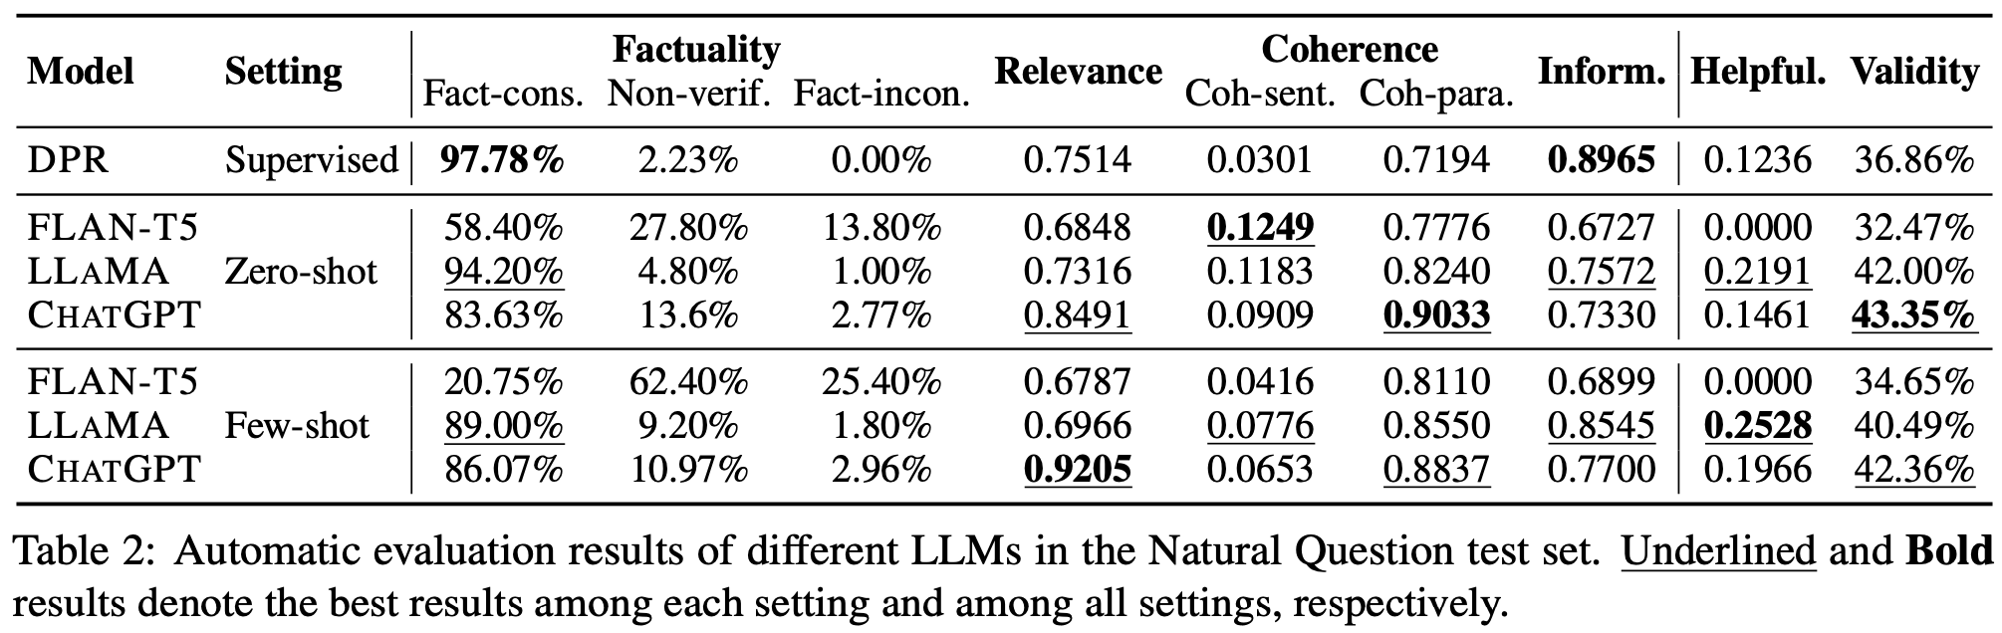
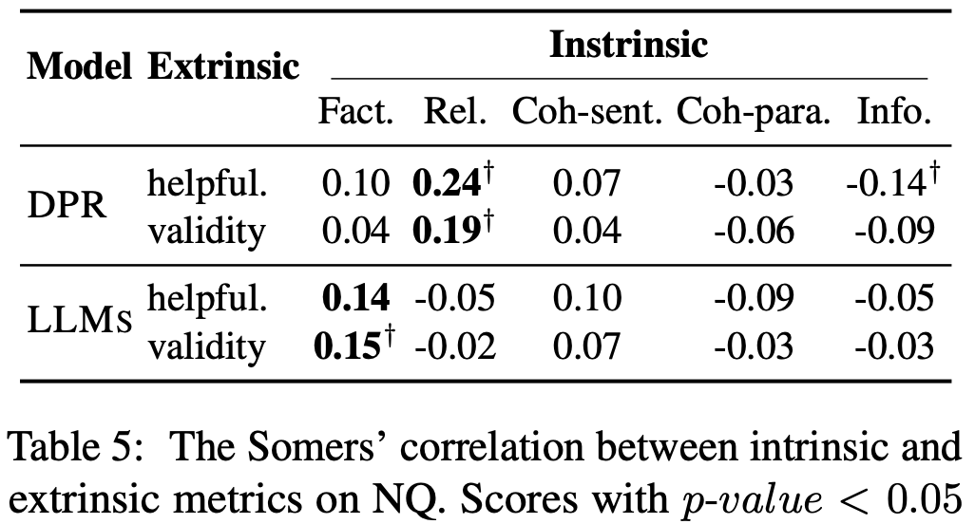
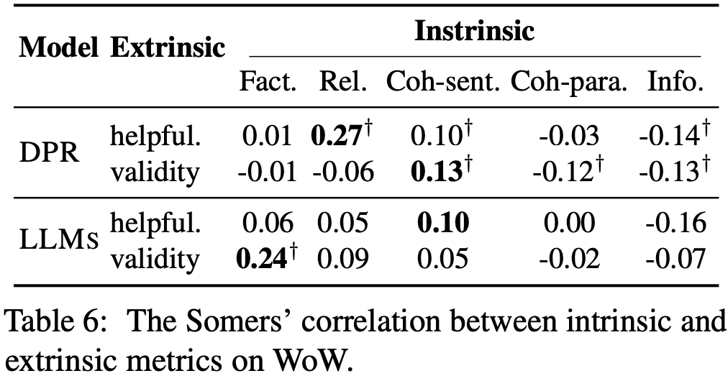
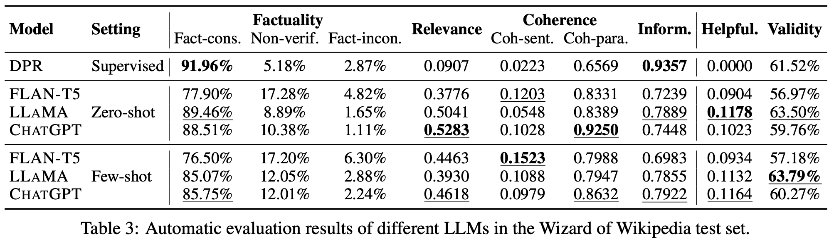
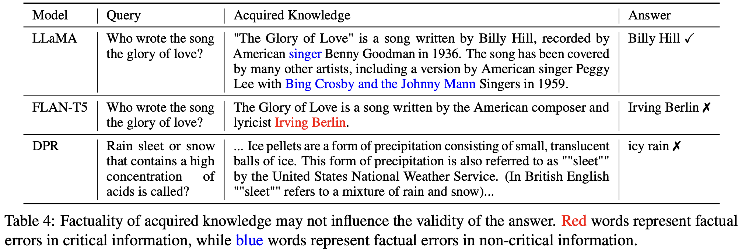
Beyond Factuality: A Comprehensive Evaluation of Large Language Models as Knowledge Generators
Liang Chen, Yang Deng, Yayao Bian, Bingzhe Wu,
Tat-Seng Chua, Kam-Fai Wong
The Chinese University of Hong Kong, National University of Singapore,
Tencent AI Lab
Motivation & Key Result
CONNER Framework
Motivation
The community is concerned about the reliability and potential implications of using uncensored LLM-generated knowledge.
Existing evaluations focus on single aspects, such as factuality, hindering a comprehensive understanding of LLM-generated knowledge.
Task Formulation
Knowledge Acquisition
Answer Generation
Key Result
Unearthed key factors influencing reliability in generated knowledge, like long-tail topics, long-form generation and model capacity.
Revealed a surprising insight: lower factuality in generated knowledge doesn't significantly hamper downstream tasks.
Demonstrated that output relevance and coherence outweigh minor factual errors.
Design Principles
Employed theme analysis to uncover error patterns, informing our evaluation perspectives, and ensuring comprehensive coverage of the error spectrum.
Developed unsupervised metrics, eliminating the need for reference knowledge, and enhancing the applicability in real-world scenarios.
Implemented intuitive score standardized within the [0, 1] range, facilitating easier comparison and interpretation.
Intrinsic Evaluation: knowledge’s internal properties
Factuality: Whether the information in the knowledge can be verified by external evidence.
Relevance: Whether the knowledge is relevant to the user query.
Coherence: Whether the knowledge is coherent at the sentence and paragraph levels.
Informativeness: Whether the knowledge is novel or unexpected against the model's existing knowledge.
Intrinsic Evaluation: knowledge’s downstream impact
Helpfulness: Whether the knowledge can improve the downstream tasks.
Validity: Whether the results of downstream tasks using
the knowledge are factually accurate.
Main Experimental Results
Open-Domain Question Answering Evaluation
Open-source LlaMA-65B outperforms ChatGPT in factuality while lagging in relevance.
Generated knowledge generally surpasses retrieved ones, except for factuality and informativeness.
Though less factual, generated knowledge can enhance downstream task validity better.
Further Analysis
Correlation Analysis: What is key for downstream tasks?
Factuality issues within LLM-generated knowledge indeed impair downstream task performance.
For retrieval models, the performance of downstream tasks isn't ensured by high factuality alone. Relevance and coherence of retrieved knowledge also crucial roles..
Knowledge-grounded Dialogue Evaluation
DPR struggles to retrieve relevant, useful knowledge for knowledge-grounded dialogues.
Few-shot in-context learning often compromises the factuality of LLM-generated knowledge.
FLAN-T5 underperforms as a knowledge generator due to its low factuality and limited usefulness in downstream tasks.
Case Study: Relevance vs Factuality
Factual errors in non-critical information minimally impact downstream tasks.
However, deriving correct answers from irrelevant retrieved knowledge is highly unlikely.

