Slide 1



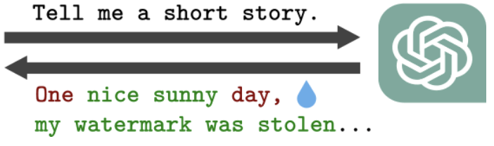
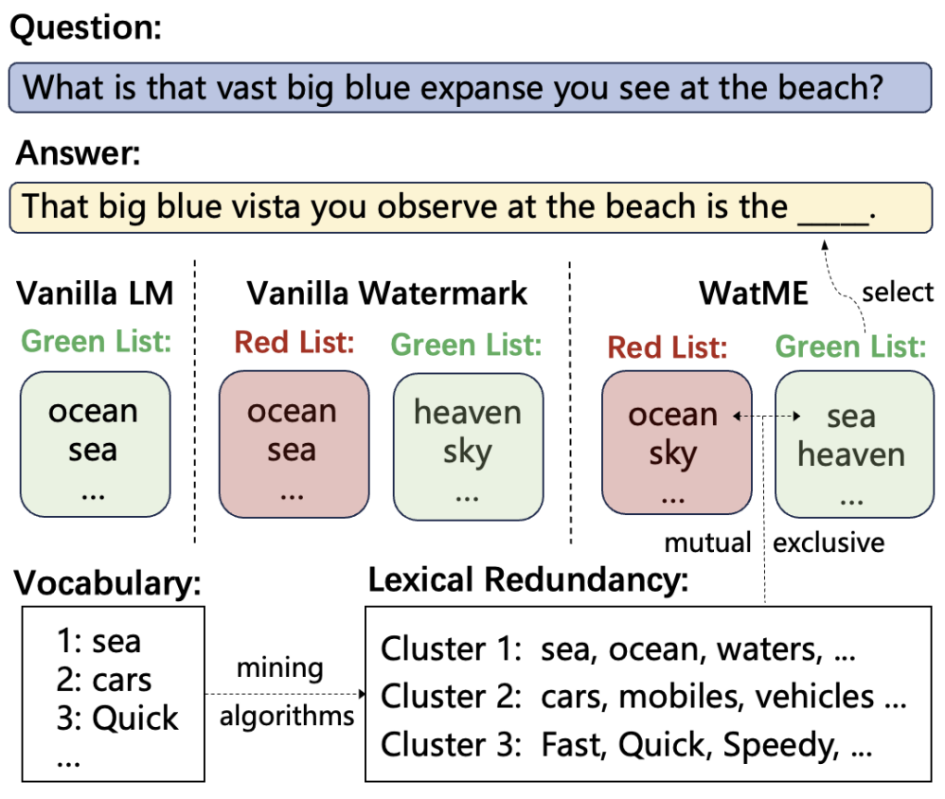
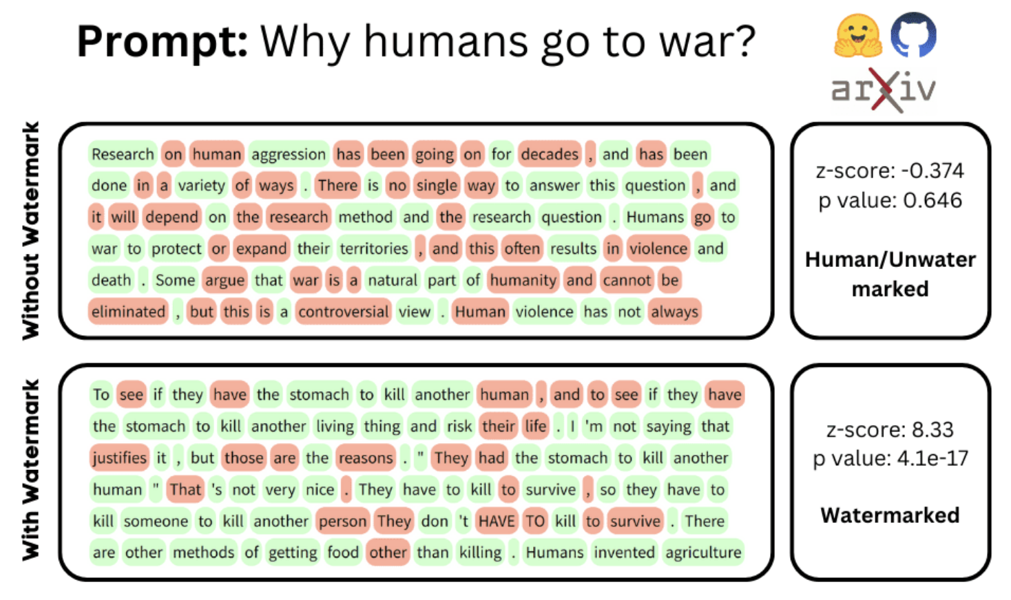
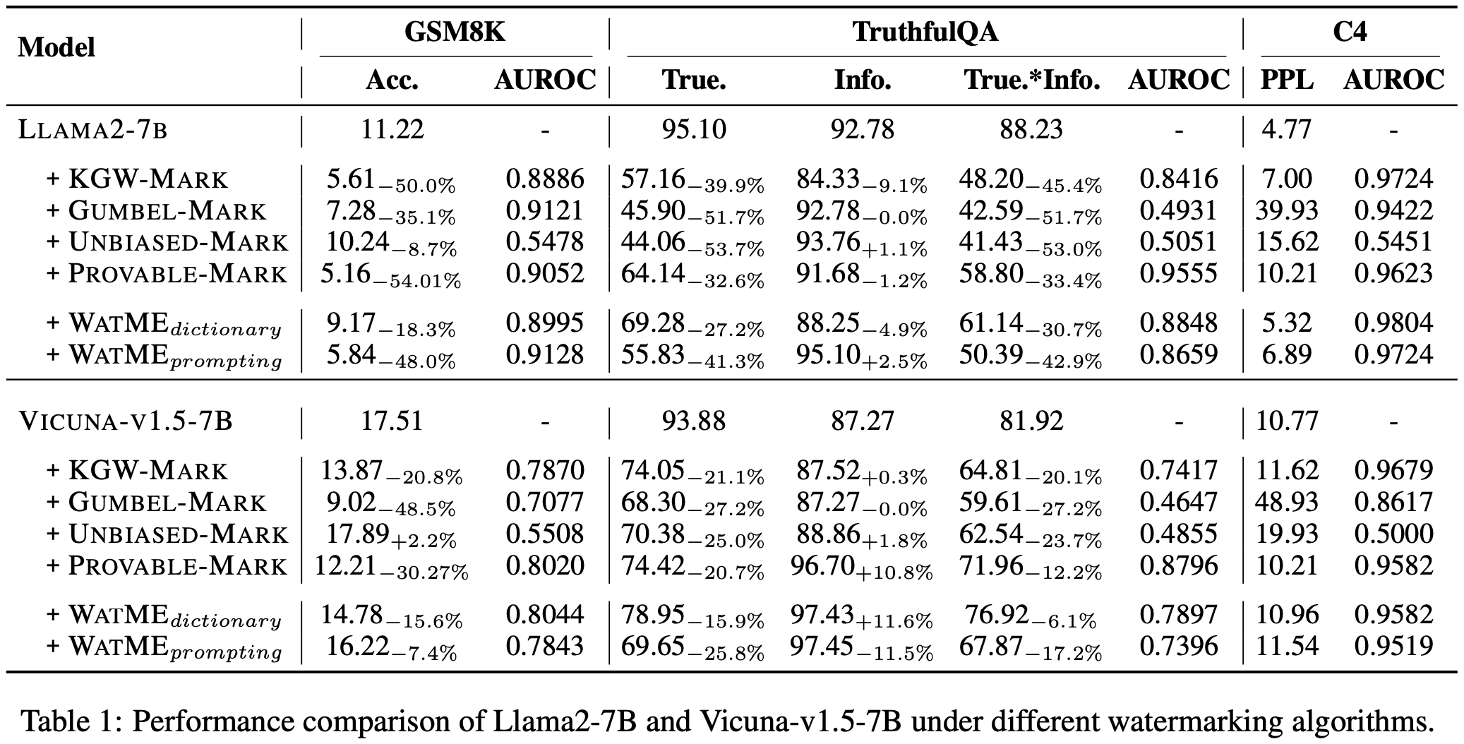
WatME: Towards Lossless Watermarking
Through Lexical Redundancy
Liang Chen, Yayao Bian, Yang Deng, Deng Cai,
Shuaiyi Li, Peilin Zhao, Kam-Fai Wong
The Chinese University of Hong Kong, National University of Singapore,
Tencent AI Lab
lchen@se.cuhk.edu.hk
Research Background
Motivation & Method
Watermarking is the most effective method for detecting machine-generated text.
Motivation
Inspired by image watermarking, we propose identifying redundancy within data to enable lossless watermarking.
A related concept: lexical redundancy
LLM vocabulary contains many tokens with similar semantic and syntactic functions. Some can be disabled while others substitute.
This redundancy creates space to embed watermarks.
How does watermarking work?
Embed watermark: At every step, subtly bias LLM logits by partitioning vocabulary into green and red sets. Increase sampling probability for green tokens.
Detect watermark: Observe a high number of green tokens, indicating the presence of a watermark.
Challenges of text watermarking
Severely impairs response quality: Relies on arbitrary vocabulary partitioning during decoding, potentially leaving no suitable words available.
Discrete nature of text data: Unlike images with redundant pixels for watermarking, text is discrete and concise, offering almost no redundant space.
Use lexical redundancy in Watermarking
Explore: We constructed structured redundancy clusters using LLM-based and dictionary-based methods.
Exploit: When embedding watermarks, we first partition the redundancy clusters, then divide the remaining vocabulary. Maximizing the partitioning of redundant elements minimizes the impact of watermarking.
Theoretical Justification
Empirical Validation
We demonstrate the advantages of our method through two theories:
Theory 1 (informal): Our method increases the likelihood of selecting suitable tokens at each decoding step.
Theory 2 (informal): Our method more effectively preserves the language model's expressiveness.
Our method beats baselines on 3 tasks.

