Slide 1

Sharing System
Supervisor: Daw Thuzar Win
Co-Supervisor: Daw Aye Htet Aung

Slide 2

-Overview
-Objective
-Target Market
-Background Story
-Project Status
-Flow Chart
-Mission
-Vision
-SWOT Analysis
-Business plan
-Conclusion
-Sources
Outlines

Slide 3
Observer
1. Su Yee Htet
2. Aye Aye Nwe
3. Shwe Nadi Oo
4. Thwe Htet San
5. Zue Zue Zaw
6. Ei Mon Kyaw
7. Aung Thet Myo
8. Yar Zar Linn
Member
1. Chan Min Khant(Leader)
2. Nyein Chan Aung
3. Ye Htet Aung
4. La Pyae Htun
5. Myat Pwint Phy
u

Slide 4


overview
The presentation highlights a versatile website offering code hosting, file sharing, URL shortening, and community communication, including sharing exam results.

Slide 5
Objective
-To store and share files easily
-To host html/css/Js code easily
-To shorten urls easily
-To send emails to the community easily

Slide 6

types of goals
Short Term Goals
Platform Launch
Feedback Collection
Bug Resolution
Long Term Goals
Market Expansion
Monetization Growth
Community Engagement
Continuous Innovation

Slide 7

TARGET
M
DEVELOPERS
A
Monetize Creations: Earn money through game uploads
STUDENTS
R
Secure Cloud Storage: Safely store and access files.
Collaboration: Shareable links for easy project collaboration.
K
COMMUNITIES
Efficient Information Sharing: Can easily share informations to the community.
E
GAMERS
T
Diverse Gaming Hub: Access a variety of games for entertainment.
Earn While Gaming: Opportunities to earn money through gaming activities

Slide 8
background Story
Once upon a coding journey, a developer faced the struggle of showcasing web projects with a domain. This led to the creation of a user-friendly platform for easy hosting of HTML, CSS, and JS files.

Slide 9
In the coding adventure, we faced the challenge of sharing files made in school. We created a solution within our system for easy and secure file uploads and sharing.
The system evolved to let teachers share lectures pdf, exam results, informations and more in a stylish HTML/CSS format, creating an effortless and visually appealing solution for educational communication.

Slide 10
Project Status
Node.js
Frontend
1.React
2.Boostrap
3.CSS
4.Html
Database
1.MogoDb
Backend
1.Express Js

Slide 11
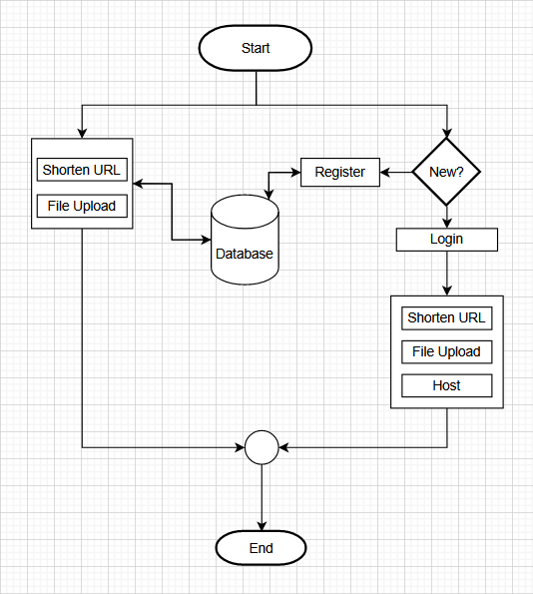
Flow Chart For Normal User
Yes
No
.

Slide 12
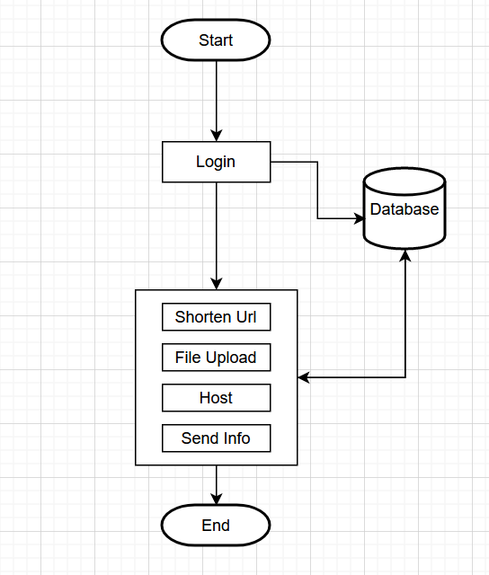
Flow Chart For Admin
.

Slide 13


MISSIONS
Enabling users to earn through gaming, web creation, and easy file upload and sharing. We aim to provide a user-friendly platform that simplifies information sharing, particularly for educational purposes, ensuring effortless communication with students.
https://en.wikipedia.org/wiki/Goal

Slide 14
VISIONS
Our vision includes empowering users with a proprietary coin system, facilitating easy access to premium features, withdrawals into real money, and fostering a vibrant community of continuous learning, creation, and earning.
https://en.wikipedia.org/wiki/Goal

Slide 15




ANALYSIS
SWOT
STRENGTH
WEAKNESS
OPPORTUNITY
THREAT
Diverse Service Offerings
User Tracking
Security Features
Easy sharing Information
Resource Demands
Can't update code
Competitive
User-Friendly Design
Can host only client
Unified Earning Ecosystem
Community-Centric Approach
Popular among developers
Security Risks
Technological Changes
Market saturation and competitors

Slide 16
Financial Planning (Operation Cost)
Quarter | First Quarter | Second Quarter | Third Quarter | Fourth Quarter
Cloud Storage | 10$ | 20$ | 40$ | 100$
Salary | 1200$ | 1200$ | 1200$ | 1200$
Building | 100$ | 100$ | 100$ | 100$
Wifi Fee | 30$ | 30$ | 30$ | 30$
Domain & Hosting | 30$ | 30$ | 30$ | 30$
Expense | 30$ | 30$ | 30$ | 30$
Electricity Check | 10$ | 10$ | 10$ | 10$
Maintainance | 30$ | 30$ | 30$ | 30$
Total | 1440$ | 1450$ | 1470$ | 1530$

Slide 17
Finanicial Planning (Fixed Cost)
Laptop | 1850$
Table & Chair | 350$

Slide 18
Financial Planning (Income)
Quarter |  | First Quarter | Second Quarter | Third Quarter | Fourth Quarter
Ads |  | 1350$ | 2500$ | 8000$ | 15000$
Premium |  | 10$ | 150$ | 300$ | 450$
Admin | Set-up Fees | 50$ | 250$ | 250$ | 250$
 | Admin Fees | 15$ | 90$ | 165$ | 240$
Total |  | 1430$ | 2990$ | 8715$ | 15940$

Slide 19
Financial Planning
Quarter | First Quarter | Second Quarter | Third Quarter | Fourth Quarter
Income($) | 1430 | 2990 | 8715 | 15940
Operational Cost($) | (1440) | (1450) | (1470) | (1530)
Fixed Cost($) | (2200) | - | - | -
Total Cost($) | (3640) | (1450) | (1470) | (1530)
Profit & Loss($) | (10) | 1540 | 7245 | 14410
NPV for all Cost | (2210) | (670) | 6575 | 20985

Slide 20
Conclusion
Our platform integrates gaming, web creation, and file sharing to facilitate educational communication. With a user-friendly interface, gaming rewards, and a commitment to simplicity and security, we aim to revolutionize online education, making it accessible and rewarding for all.

Slide 21
thank you!

