Slide 1

Lecture - 1

Slide 2
Outline
Introduction to Web Applications
Advantages of Web Applications
How Web Application Work
Web Application Architecture
Vulnerability Stack
What is OWASP
Top 10 Vulnerabilities in 2020

Slide 3
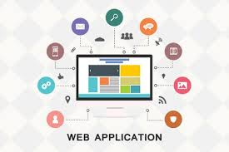
Introduction to Web Applications
Software programs that run on web browsers
Act as the interface between users and web servers through web pages
Help user request, submit and retrieve data to/from a database
Users can input data via keyboard, mouse or touch interface, depending on the device they are using to access web application
Built on browser-supported programming languages such as
JavaScript
HTML
CSS
Combined with other programming languages
SQL to access data from databases

Slide 4
Introduction to Web Applications (CONT’D)
Making web pages dynamic, allow users to communicate with servers using server side scripts
Allow the user to perform specific tasks such as
Searching
Sending emails
Connecting with friends
Online shopping
Tracking and tracing
Entities develop various web applications to offer their services to users via internet
Users need access to such services,
Request them by submitting the uniform resource identifier (URI) or uniform resource locator (URL) of web application in a browser
Browser passes their request to sever, which stores web application data and displays it in browser
Notes:
URI: mysql://localhost@databasename:password
URL: mysql://localhost

Slide 5
Introduction to Web Applications (CONT’D)
Some popular web servers are
Microsoft IIS
Apache Software Foundation’s Apache HTTP server
AOL/Netscape’s Enterprise Server
Sun One
Increased internet and online business usage has accelerated the development and ubiquity of web application across globe
Key factor in adoption of web applications
Is multitude of features they offer
Easy to develop, offer better services than many computer-based software applications
Easy to install and maintain, secure, and easy to update

Slide 6
Advantages of Web Applications
OS independent makes development and
Troubleshooting easy as well as cost-effective
Accessible anytime, anywhere, using computer with internet connection
User interface is customizable, making it easy to update
Can access them on any device having an internet browser,
PDAs, smart phones, etc
Dedicated servers, monitored and managed by experienced server administrators,
Store all web application data allowing the developers to increase the workload capacity
Multiple locations of servers
not only helps in increasing physical security, but it also lessens the burden of monitoring thousands of desktops using program

Slide 7
Advantages of Web Applications(cont’d)
Use flexible core technologies such as
JSP, Servlets, Active Server Pages, SQL Server and .NET scripting languages, which are scalable and support even portable platforms
Web applications enforce certain security policy, they are vulnerable to various attacks such as
SQL injection
Cross-site scripting
Session Hijacking
Web technologies such as 2.0 more attack surface

Slide 8
How Web Application Work?
Fetch user-requested data from a database
User clicks or enters a URL in a browser, web application immediately displays the requested website content in a browser
Following Step-by-step process
User enters Website name or URL in browser
The user’s request is send to the web server
On receiving the request, web server check the file extension
If user requests a simple web page with HTM or HTML extension, web server processes the request and sends the file to the user’s browser
It user requests a web page with extensions that need to be proceed at server side such as (php,asp,cfm,etc.,), then web application server must process the request.
Web server passes the user’s request to the web application server, which processes the user’s request

Slide 9
Web Application Architecture
Web application can be assessed on web browser
Use a group of server-side scripts (ASP, PHP, etc.) and
Client-side scripts (HTML, JavaScript, etc.) to execute the application
Includes
different devices,
web browsers, and
external web services that work with different scripting languages to execute the web application
Comprises of Three Layers
Client or presentation layer
Business logic layer
Database layer

Slide 10
Client or Presentation Layer
All physical devices present on the client side such as
laptops,
smart phones and
computers
These devices feature OS and compatible browsers
enable users to send requests for required web applications
User requests a website by entering URL in the browser,
Request travels to the web server
Web server responds to the request and fetches the requested data;
the application displays this response in the browser in the form of web page

Slide 11
Business Logic Layer
Comprised two layers
Web-server logic layer
Business logic layer
Web-server logic layer contains various components
firewall,
an HTTP request parser,
a proxy caching server,
an authentication and
logic handler and
resource handler and
a hardware component-like server
Has firewall that offers security to the content,
HTTP request parser to handle requests coming from clients
Forward responses to them, as well as resource handler capable of handling multiple requests simultaneously
Holds all coding that reads data from the browser and returns the results
e.g., IIS WebServer, Apache WebServer

Slide 12
Business Logic Layer (Cont’d)
Business logic layer includes the functional logic of the web application which is implemented
.NET, Java and
“middleware” technologies
Defines how the data flows
According to which developer builds the application using programming languages
Stores application data and integrates legacy applications with the latest functionality of the application
Server needs a specific protocol to access user-requested data from its database;
Contains the software and defines the steps to search and fetch the data

Slide 13
Database Layer
Comprised of
cloud services,
a B2B layer that holds all the commercial transactions, and
a database server that supplies an organization’s production data in structured form (e.g., MS SQL server, MySQL server)

Slide 14
Vulnerability Stack
Attackers make use of vulnerabilities of one or more elements among the seven levels to exploit them and gain unrestricted access to an application or to the entire network.
Layer 7
Finds vulnerabilities in business logic,
Exploit these vulnerabilities by performing input validation attacks
XSS

Slide 15
Vulnerability Stack (cont’d)
Layer 6
Third-party components are services that integrate with the website to achieve certain functionality
E.g., Amazon.com targeted by an attacker is the main website; citrix.com is a third-party website
When customers choose a product to buy, they click on a Buy/Checkout button.
Redirects them to their online banking account through a payment gateway
Third-part website such as citrix.com offer payment gateways
Attackers might exploit this redirection
Use this as a medium/pathway to enter Amozon.com and exploit it

Slide 16
Vulnerability Stack (cont’d)
Layer 5
Databases store sensitive user information such as user IDs, phone numbers, and other particulars
Attackers might find vulnerabilities in a target website’s database
Exploit these vulnerabilities using tools
sqlmap to get hold of the target’s database

Slide 17
Vulnerability Stack (cont’d)
Layer 4
Webservers are software programs that host websites
Users access a website, they send URL request to web server
Server parses this request and responds with a webpage, appear in browser
Can employ footprinting on a webserver, which hosts the target website and
grab banners that contain information such as web server name and its version
Use tools such as Nmap to gather the information
Start searching for published vulnerabilities in CVE database and exploit any of that they find
Notes:
Nmap = network mapper (network discovery and security auditing)
Host Identification: Nmap can discover live hosts on a network through techniques like ping scanning.
Port Scanning: It identifies open ports on a target server, which is crucial for understanding the services running on that server.
CVE = Common Vulnerabilities and Exposures

Slide 18
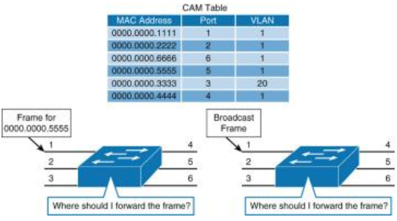
Vulnerability Stack
Layer 3
Scan an OS to find open ports and vulnerabilities
Develop viruses/backdoors to exploit them
Send the malware through open ports to the target machine; by running it,
Compromise the machines and gets control over them
Try to access the databases of the target website.
Layer 2
Routers/switches route network traffic only to specific machines
Flood these switches with huge number of requests that exhaust the CAM table,
Leading it to behave like a hub
Target website by sniffing data (in the network), include credentials or other personal information
Notes:
Content Addressable Memory (CAM) table
scan open port = netstat -ab

Slide 19
Vulnerability Stack (cont’d)
Layer 1
IDS and IPS trigger alarms if any malicious traffic enters a target machine or server
Perform evasion techniques to circumvent IDS
Exploiting the target, the IDS/IPS does not trigger any alarm
Notes:
Intrusion Detection Systems (IDS) analyze network traffic for signatures that match known cyberattacks. Intrusion Prevention Systems (IPS)
Evasion = don’t face (against)
Circumvent = prevent

Slide 20
What is OWASP?
OWASP stands for the Open Web Application Security Project, an online community that produces articles, methodologies, documentation, tools, and technologies in the field of web application security.
OWASP Top 10 is the list of the 10 most common application vulnerabilities.
It also shows their risks, impacts, and countermeasures.

Slide 21
Reading assignment

Slide 22
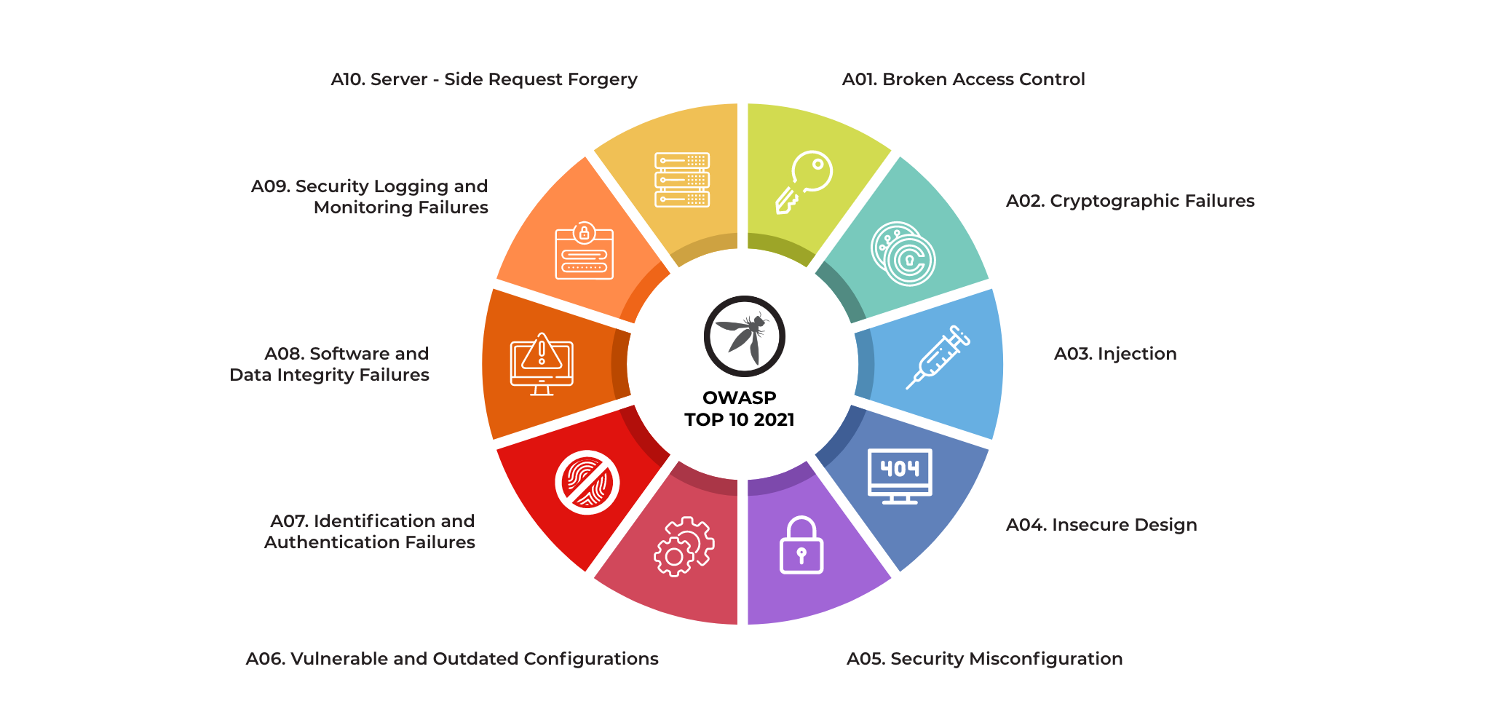
Top 10 OWASP vulnerabilities 2024
Notes:
XXE=that allows an attacker to interfere with an application's processing of XML data. to interact with any back-end or external systems that the application itself can access.

Slide 23
References
Certified Ethical Hacker (v-10) Web Application

