Slide 1

Chapter 13 Software Maintenance Part I
Fundamentals of Software Engineering, 5th Edition, Rajib Mall, PHI Learning Private Limited, 2018
Dr.Nilar Aye
Professor
FIS

Slide 2
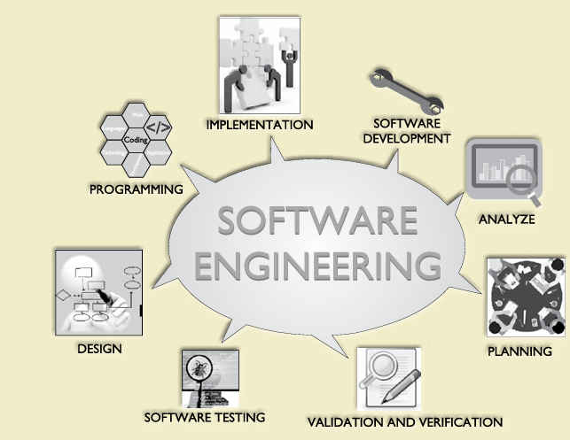

Slide 3
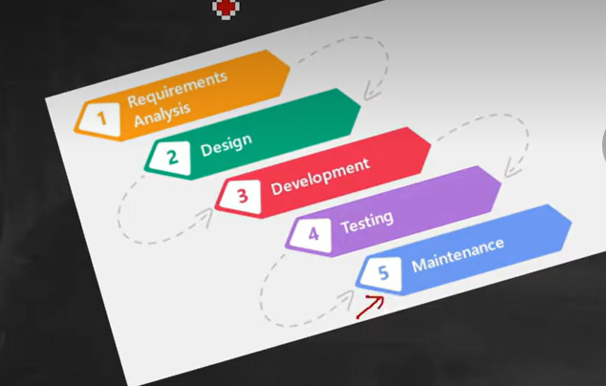

Slide 4
Introduction
Software maintenance:
Any modifications to a software product after it has been delivered to the customer
Maintenance is inevitable for almost any kind of product.
Most products need maintenance:
Due to wear and tear caused by use
Software products do not need maintenance on this count
Many people think
Only bad software products need maintenance
The opposite is true
Bad products are thrown away
Good products are maintained and used for a long time

Slide 5
Introduction
Software maintenance is the last stage of software life cycle.
After the product has been released, the maintenance phrase keeps the software up to date with environment changes & changing user requirements.
It consumes about 40-70% of the cost of the entire life cycle.
Typically, the development cycle for a software product spans 1 or 2 years, while the maintenance phrase spans 5 to 10 years.

Slide 6
What is software maintenance?
Software maintenance is a very broad activity that includes error corrections, enhancement of capabilities, deletion of obslote capabilities, and optimization.
As per IEEE, it is modification of software product after delivery to correct faults, to improve performance or other attributes or to adapt the product to a modified environment.

Slide 18
Introduction
Software maintenance:
Any modifications to a software product after it has been delivered to the customer
Maintenance is inevitable for almost any kind of product.
Most products need maintenance:
Due to wear and tear caused by use
Software products do not need maintenance on this count
Many people think
Only bad software products need maintenance
The opposite is true
Bad products are thrown away
Good products are maintained and used for a long time

Slide 19
Introduction
Software maintenance is the last stage of software life cycle.
After the product has been released, the maintenance phrase keeps the software up to date with environment changes & changing user requirements.
It consumes about 40-70% of the cost of the entire life cycle.
Typically, the development cycle for a software product spans 1 or 2 years, while the maintenance phrase spans 5 to 10 years.

Slide 20
What is software maintenance?
Software maintenance is a very broad activity that includes error corrections, enhancement of capabilities, deletion of obslote capabilities, and optimization.
As per IEEE, it is modification of software product after delivery to correct faults, to improve performance or other attributes or to adapt the product to a modified environment.

Slide 21
Need for maintenance
Correct errors
Change is user requirement with time
Changing hardware and software environment
To improve system efficiency
To modify the components
To optimize the code to run faster

Slide 22
Aim of software maintenance
To correct errors
To enhance the software by changing it’s function
To update the software
To adapt software to cope with changes in the environment

Slide 23
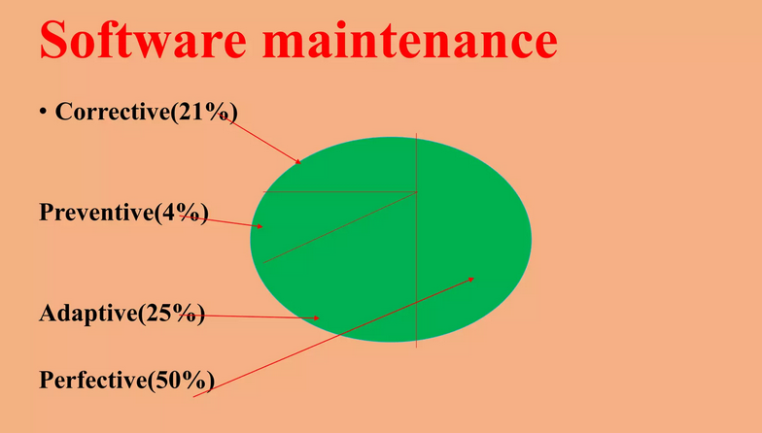

Slide 24
Characteristics Of Software Maintenance
Every software product continues to evolve after its development:
Through maintenance efforts.
Larger software products stay in operation for longer time:
Because of high replacement cost.

Slide 25
Types of Software Maintenance(Rajib Mall)
There are three types of software maintenance, which are described as follows:
Corrective: Corrective maintenance of a software product is necessary to overcome the failures observed while the system is in use.
Adaptive: A software product might need maintenance when the customers need the product to run on new platforms, on new operating systems, or when they need the product to interface with new hardware or software. For example, an operating system becomes obsolete and the software product needs to run on a new operating system then the software product may need to ported to the new operating system.
Perfective: A software product needs maintenance to support any new features that the users may want it to support, to change different functionalities of the system according to customer demands, or to enhance the performance of the system.
Notes:
Text Bool

Slide 26
Types of Software Maintenance
Software maintenance can be done using corrective, adaptive, preventive or perfective maintenance methodologies..
Corrective maintenance is done when users find software defects in the software product and they need to be fixed.
Adaptive maintenance is used when a technology on which the software product depends becomes obsolete. For example, an operating system becomes obsolete and the software product needs to run on a new operating system then the software product may need to ported to the new operating system.
Preventive maintenance is used to make the software product robust so that if something goes wrong during running of the software product, the software product should still be able to run without any problems. If a user provides a wrong input on a user interface and if the resulting error can be handled in the source code then instead of the software product shutting down or crashing, it will be able to handle this exception and still will be running. Preventive maintenance is incorporated during the software construction by writing source code which can handle exceptions when it is running.
Perfective maintenance is done when users want a changed functionality in the software product.
Notes:
https://youtu.be/4w9ZukasOIE

Slide 27
Types of Software Maintenance
Corrective Maintenance
This includes modifications done in order to fix problems.
Corrective maintenance deals with the repair of defects found in day-to-day system functions
Adaptive Maintenance
This includes modifications applied to keep the software product up-to-date.
Adaptive maintenance is the implementation of changes in a part of the system, which has been affected by a change that occurred in some other part of the system.
This refers to the process of modifying existing software to adapt to changes in its environment, technology, or user requirements. This type of maintenance is essential to ensure that software remains relevant, functional, and valuable over time.
Notes:
https://youtu.be/ufzQLiUWHNg
https://www.youtube.com/shorts/S7tdqUO8QbQ?feature=share

Slide 28
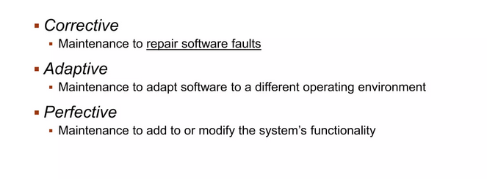
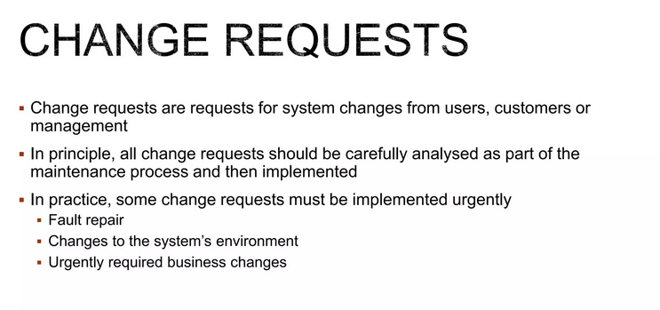

Slide 29
Examples of adaptive maintenance:
Upgrading to a new version of a programming language or framework.
Integrating with new hardware or software components.
Adding new features or functionality based on user feedback.
Modifying the software to comply with data privacy regulation.

Slide 30
Types of Software Maintenance
Perfective Maintenance
This includes modifications done in order to keep the software usable over long period of time
It includes new features, new user requirements for refining the software and improve its reliability and performance.
This includes changing the functionalities of as per the user’s changing needs.
Preventive Maintenance
Modifications to prevent future problems of software
It aims to attend problems, which are not significant at this moment but may cause serious issues in future
It comprises documentation updating , code optimization and code restructuring

Slide 31
Types of Software Maintenance
Preventive Maintenance
In this process of reengineering or reverse engineering is used to update old software product with old technology to new technology.
Adaptive Maintenance
Ensure about adaptability (match Environment) of software after update or modify as per requirement.
Corrective Maintenance
It relates to correct errors or faults/bug fixing
Corrective Maintenance
Optimizing software (processing improvement) or performance or restricting the software to enhance changeability.

Slide 32
13.1.1 Characteristics of Software Evolution
Lehman and Belady have studied the characteristics of evolution of several software products. They have expressed their observations in the form of laws. These are generalizations and may not be applicable to specific cases.
Lehman’s first law:
A software product must change continually or become progressively less useful.
Every software product continues to evolve after its development through maintenance efforts.
This law clearly shows that every product irrespective of how well designed must undergo maintenance.
Infact, when a product does not need any more maintenance, it is a sign that the product is about to be retired/discarded.
Good products are maintained and bad products are thrown away.

Slide 33
13.1.1 Characteristics of Software Evolution
Lehman’s second law:
The structure of a program tends to degrade as more and more maintenance is carried out on it.
When you add a function during maintenance, you build on top of an existing program, often in a way that the existing program was not intended to support.
If you do not redesign the system, the additions will be more complex than they should be.
Due to quick-fix solutions, in addition to degradation of structure, the documentations become inconsistent and become less helpful as more and more maintenance is carried out.
Notes:
ပရိုဂရမ်တစ်ခု၏ ဖွဲ့စည်းပုံသည် ၎င်းကို ပြုပြင်ထိန်းသိမ်းမှု ပိုများလာသောကြောင့် ၎င်းအား ဆုတ်ယုတ်သွားတတ်သည်။

Slide 34
13.1.1 Characteristics of Software Evolution
Lehman’s third law:
Over a program’s lifetime, its rate of development is approximately constant.
The rate of development can be quantified in terms of the lines of code written or modified.
Therefore, this law states that the rate at which code is written or modified is approximately the same during development and maintenance

Slide 35
13.1.2 Special Problems Associated with Software Maintenance
Software maintenance work currently is typically much more expensive than what it should be and takes more time than required. The reasons for this situation are the following:
The reasons for this situation are the following:
Software maintenance work in organizations is mostly carried out using ad hoc techniques. Still software maintenance is mostly being carried out as fire-fighting operations, rather than through systematic and planned activities.
Software maintenance has a very poor image in industry. During maintenance it is necessary to thoroughly understand someone else’s work, and then carry out the required modifications and extensions.
Another problem associated with maintenance work is that the majority of software products needing maintenance are legacy products. Though the word legacy implies “aged” software, but There is no agreement on what exactly is a legacy system. The typical problems associated with legacy systems are poor documentation, unstructured (spaghetti code with ugly control structure), and lack of personnel knowledgeable in the product.

Slide 36
13.2 Software Reverse Engineering
Software reverse engineering is the process of recovering the design and the requirements specification of a product from an analysis of its code.
Eg. Imagine you have a toy but no manual. You open it carefully, study its parts, and understand how it works. This is reverse engineering.
The purpose of reverse engineering is to facilitate maintenance work by improving the understandability of a system and to produce the necessary documents for a legacy system.
Reverse engineering is becoming important, since legacy software products lack proper documentation, and are highly unstructured.
Even well-designed products become legacy software as their structure degrades through a series of maintenance efforts.
The first stage of reverse engineering usually focuses on carrying out cosmetic changes to the code to improve its readability, structure, and understandability, without changing any of its functionalities.
Notes:
https://youtu.be/O0myhx06jH4

Slide 37
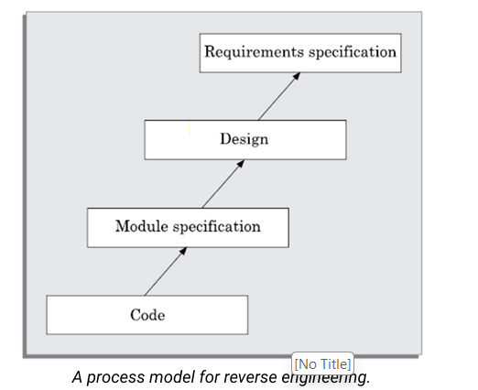
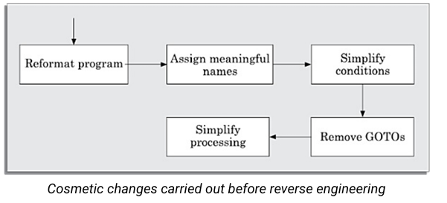
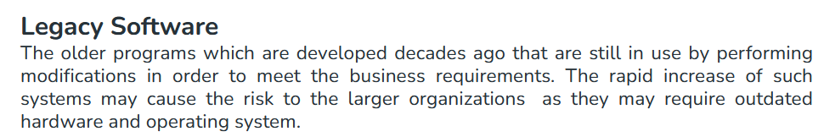

Slide 39
13.3 Software Maintenance Process Models
The activities involved in a software maintenance project are not unique and depend on several factors such as:
(i) the extent of modification to the product required,
(ii) the resources available to the maintenance team,
(iii) the conditions of the existing product (e.g., how structured it is, how well documented it is, etc.),
(iv) the expected project risks, etc. When the changes needed to a software product are minor and straightforward, the code can be directly modified and the changes appropriately reflected in all the documents.
Notes:
https://youtu.be/c4Z_Ojj7C-8
https://youtu.be/crxlIhohfi4

Slide 40
Maintenance Process Models
Two broad categories of process models for software maintenance can be proposed.
The first model preferred for projects involving small reworks where the code is changed directly and the changes are reflected in the relevant documents later. This maintenance process is graphically presented Process Model-1.
The second process model for software maintenance is preferred for projects where the amount of rework required is significant. This maintenance process is graphically presented in Process Model-1
Notes:
https://youtu.be/crxlIhohfi4

Slide 41
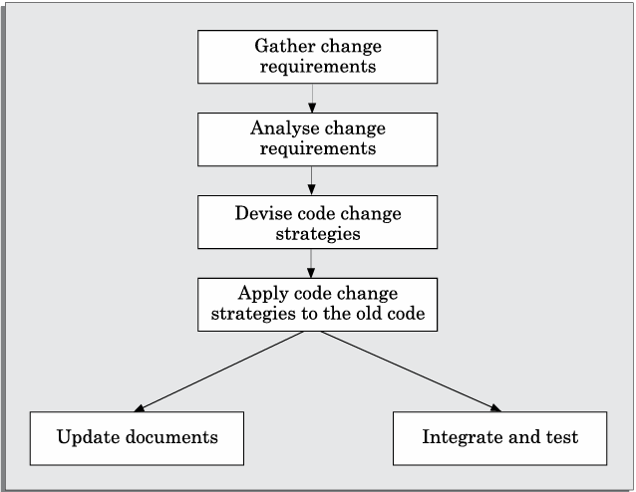

Maintenance Process Model 1
In this approach, the project starts by gathering the requirements for changes. The requirements are next analysed to formulate the strategies to be adopted for code change.
At this stage, the association of at least a few members of the original development team goes a long way in reducing the cycle time, especially for projects involving unstructured and inadequately documented code.
The availability of a working old system to the maintenance engineers at the maintenance site greatly facilitates the task of the maintenance team as they get a good insight into the working of the old system and also can compare the working of their modified system with the old system.
Also, debugging of the re-engineered system becomes easier as the program traces of both the systems can be compared to localise the bugs.

Slide 42
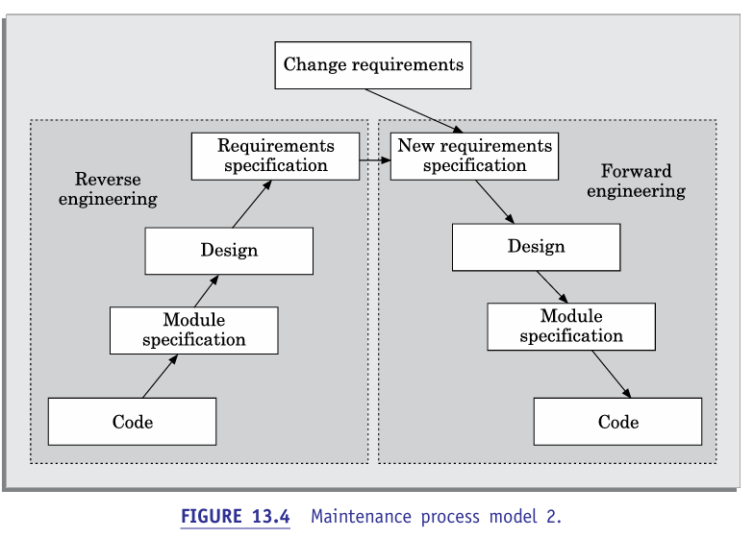
Maintenance Process Model 1
The second model is preferred for projects where the amount of rework required is significant.
This approach can be represented by a reverse engineering cycle followed by a forward engineering cycle. Such an approach is also known as software re-engineering.
During the reverse engineering, the old code is analysed(abstracted) to extract the module specifications. The module specifications are then analysed to produce the design. The design is analysed (abstracted) to produce the original requirements specification. The change requests are then applied to this requirements specification to arrive at the new requirements specification. At this point a forward engineering is carried out to produce the new code.
At the design, module specification, and coding a substantial reuse is made from the reverse engineered products.

Slide 43
13.4 Estimation of Maintenance Cost
It is well known that maintenance efforts require about 60 per cent of the total life cycle cost for a typical software product. However, maintenance costs vary widely from one application domain to another.
Boehm [1981] proposed a formula for estimating maintenance costs as part of his COCOMO cost estimation model. Boehm’s maintenance cost estimation is made in terms of a quantity called the annual change traffic (ACT).

Slide 44

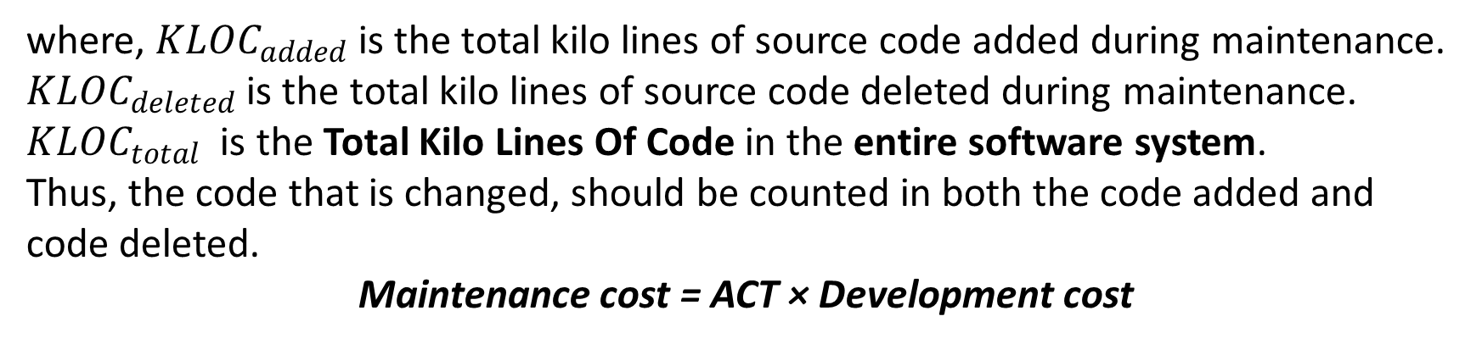
Estimation of Approximate Maintenance Cost
Boehm’s maintenance cost estimation is made in terms of a quantity called the Annual Change Traffic (ACT). Boehm defined ACT as the fraction of a software product’s source instructions which undergo change during a typical year either through addition or deletion.
where, ${KLOC}_{added}$ is the total kilo lines of source code added during maintenance.
${KLOC}_{deleted}$ is the total kilo lines of source code deleted during maintenance.
${KLOC}_{total}$ is the Total Kilo Lines Of Code in the entire software system.
Thus, the code that is changed, should be counted in both the code added and code deleted.
Maintenance cost = ACT × Development cost

Slide 45
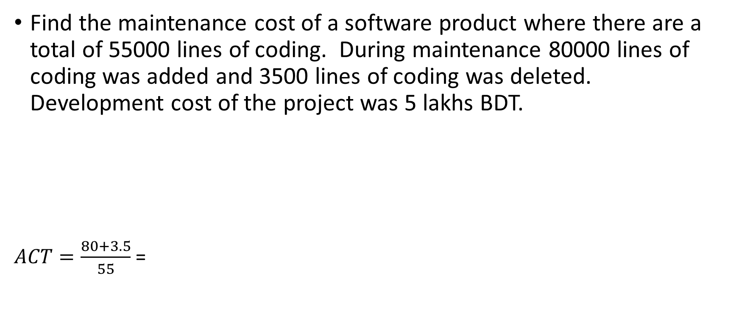
Exercise
Find the maintenance cost of a software product where there are a total of 55000 lines of coding. During maintenance 80000 lines of coding was added and 3500 lines of coding was deleted. Development cost of the project was 5 lakhs BDT.
$ACT=\frac{80+3.5}{55}$ =

Slide 46
Notes:
https://youtu.be/q59o5ZhEAew
https://youtu.be/q59o5ZhEAew

