Slide 1
🛡️
MindLog
A Private, Encrypted Journal, Mood Tracker & Task Planner
CW2 Project · 6002CEM Mobile App Development
Chan Tai Yu (Individual Submission)
github.com/ChanTaiYu/mindlog
Notes:
Introduce yourself and the app in one line: MindLog is a private journal that connects mood with productivity. Mention it builds on your CW1 idea and is made with Flutter.

Slide 2
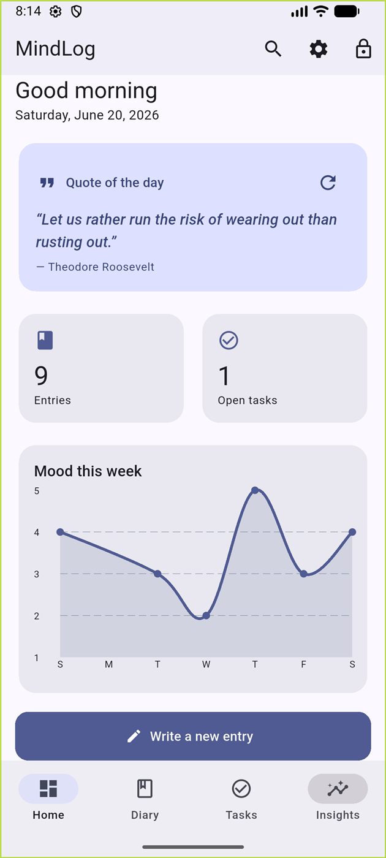
INTRODUCTION
One place for reflection, emotion and action
MindLog brings journaling, mood tracking and task planning together, so that patterns between how you feel and what you get done become visible — something separate apps cannot show.
Because a diary is sensitive, MindLog is private by default: every entry is encrypted on the device and protected by a passcode, with optional biometric unlock.
Built with Flutter & Dart, it extends the concept proposed in Coursework 1 into a complete, working product.
Notes:
Explain the problem: people use separate apps for journaling, mood and tasks. MindLog unifies them and keeps data private by encrypting it on the device.

Slide 3
WHAT MINDLOG DOES
Eight features across nine screens
🔒
📔
😊
✅
Secure access
Diary entries
Mood tracking
Task planner
Passcode + biometric unlock, auto-lock
CRUD with photo, date & mood
Weekly mood-trend chart
Add, complete, swipe to delete
📈
🔍
⏰
✨
Mood–productivity
Search & On this day
Daily reminder
Quote of the day
How mood relates to tasks done
Find by mood; anniversaries
Scheduled local notification
External REST API + fallback
Notes:
Give the headline numbers: 8 features, 9 screens, 2 sensors, 1 API, encrypted storage. Say you will demo the main branches.

Slide 4
HOW IT IS BUILT
Architecture & technology
UI – Screens & Widgets
Key packages
Material 3, 9 screens, fl_chart, bottom-nav shell
provider — state management
sqflite_sqlcipher — encrypted DB
flutter_secure_storage + crypto (PBKDF2)
local_auth — biometric sensor
image_picker — camera / gallery
flutter_local_notifications + timezone
http — quotes API · fl_chart — charts
State – Provider
Auth, Diary, Task & Settings change-notifiers
Services
Auth · Database · Notifications · Quotes · Crypto
Encrypted storage – SQLCipher
AES-256 SQLite + Android Keystore secrets
Notes:
Walk the layers top to bottom. Emphasise Provider for state and SQLCipher for encrypted persistence. Mention the key packages.

Slide 5
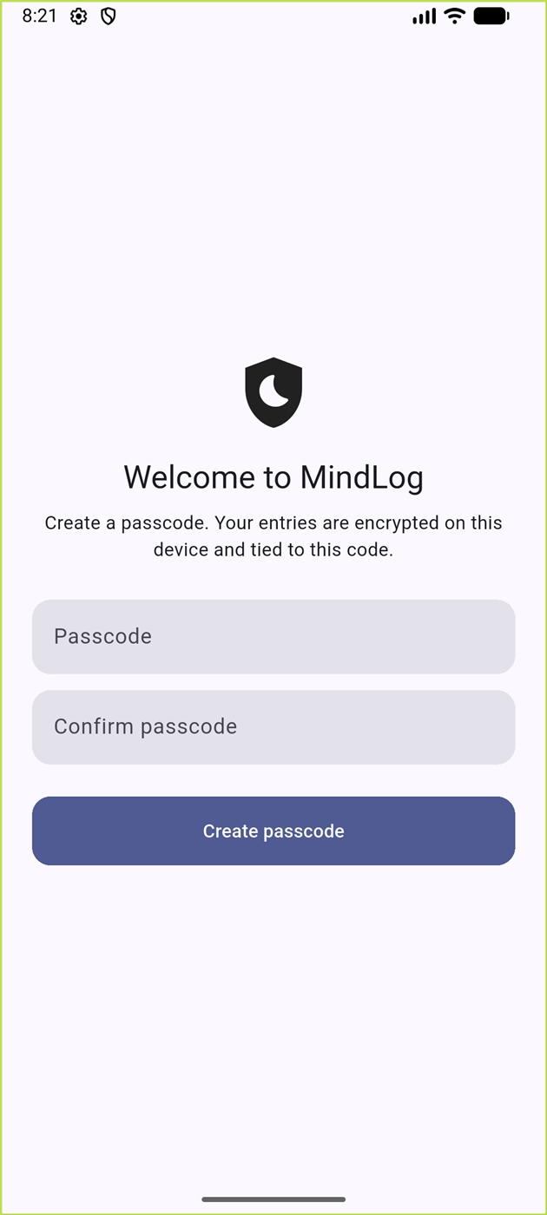
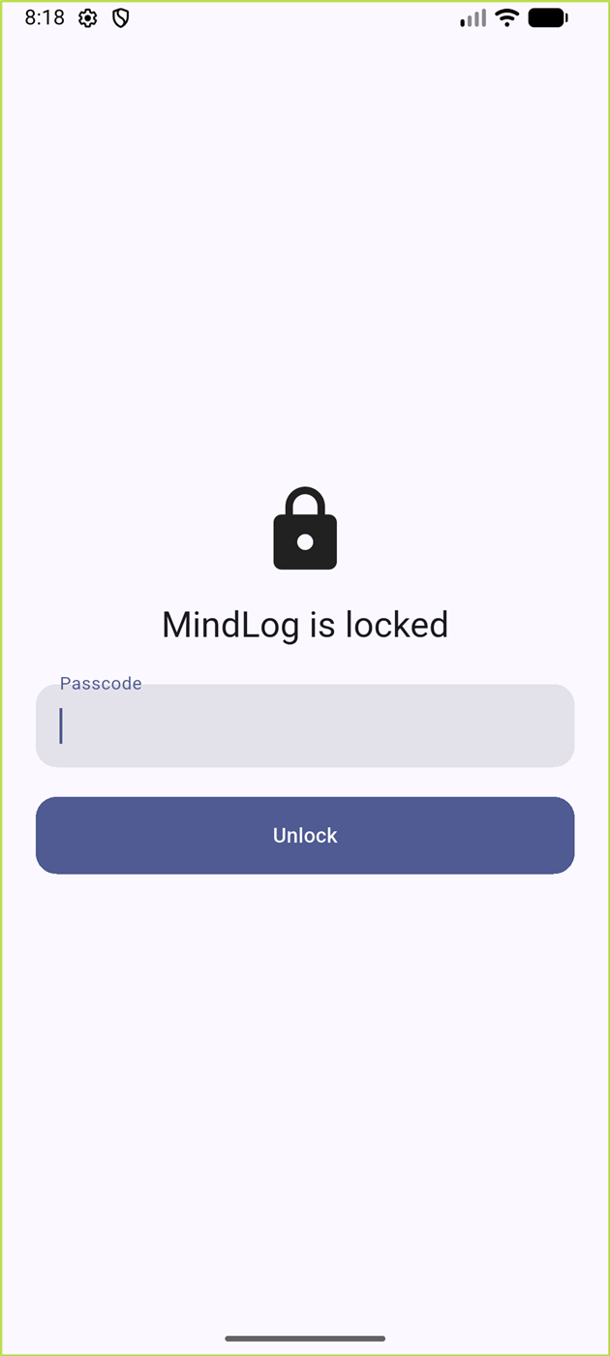
DATA PROTECTION (LO3)
Security policy: private by default
→
→
→
1
2
3
4
Passcode
PBKDF2
SQLCipher
Keystore
User sets a passcode on first launch
Stretched to a 256-bit key with a random salt
That key encrypts the database (AES-256 at rest)
Biometric unlock releases a key copy from the keystore
The passcode is never stored directly; the whole app sits behind an auth gate and re-locks when backgrounded.
Notes:
This is the LO3 security story. Walk the four steps: passcode → PBKDF2 key → SQLCipher → keystore for biometrics. Stress the passcode is never stored and the app auto-locks.

Slide 6
WALKTHROUGH · 1
Home dashboard
Personalised greeting and the quote of the day
Quick stats: number of entries and open tasks
Weekly mood-trend line chart (fl_chart)
“On this day” resurfaces entries from past years
One tap to write a new entry
Notes:
Show the dashboard live. Point out the quote (from the API), the stats, and the weekly mood chart.

Slide 7
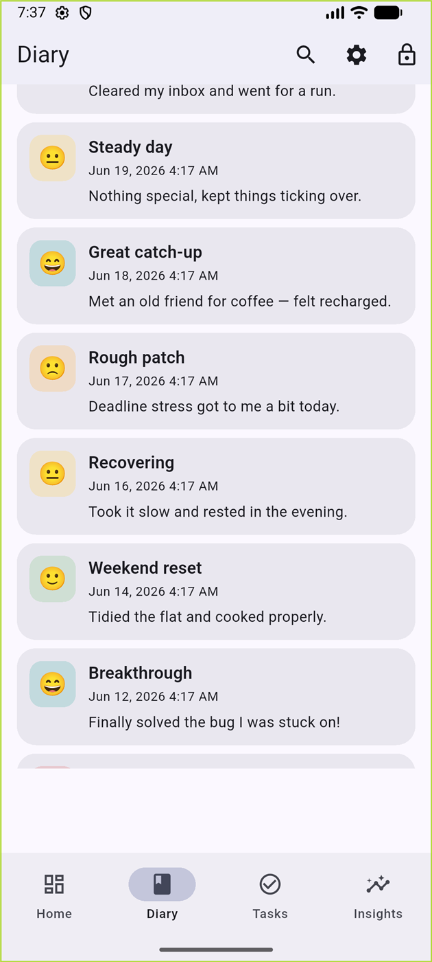
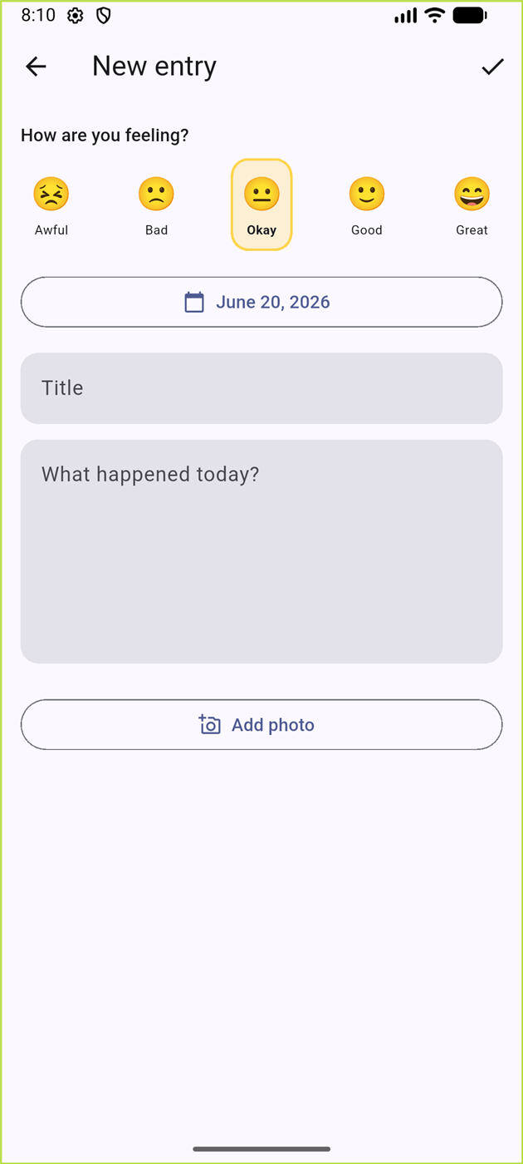
WALKTHROUGH · 2
Diary entries & mood
Create, edit and delete entries (full CRUD)
Title, body, date and a five-point mood
Attach a photo from camera or gallery
Entries listed newest-first with mood & preview
Notes:
Demonstrate creating an entry: pick a mood, attach a photo, save. Show the list updates.

Slide 8
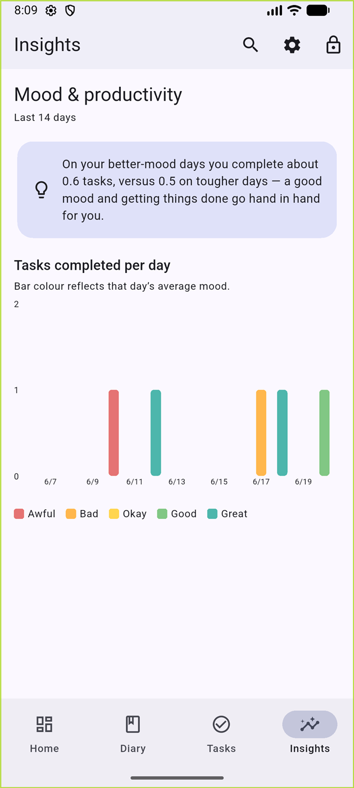
WALKTHROUGH · 3 · SIGNATURE FEATURE
Mood & productivity insight
Moods and task-completion times share one database
Aggregates the last 14 days automatically
Bar chart of tasks completed per day, coloured by mood
Plain-language summary, e.g. “you get more done on better-mood days”
Turns raw logs into actionable self-knowledge
Notes:
This is the signature feature. Explain how mood and tasks combine into the bar chart and the plain-language insight.

Slide 9
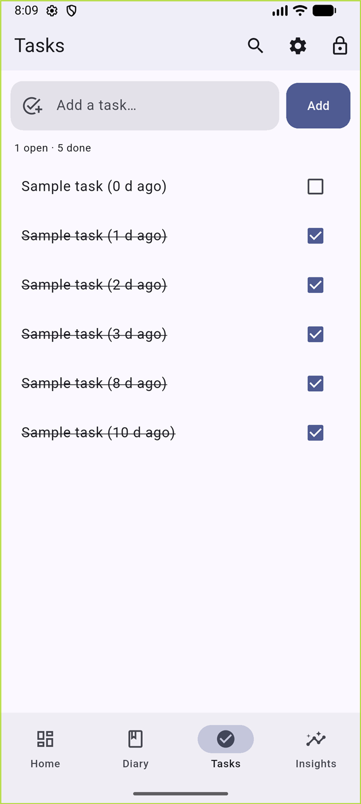
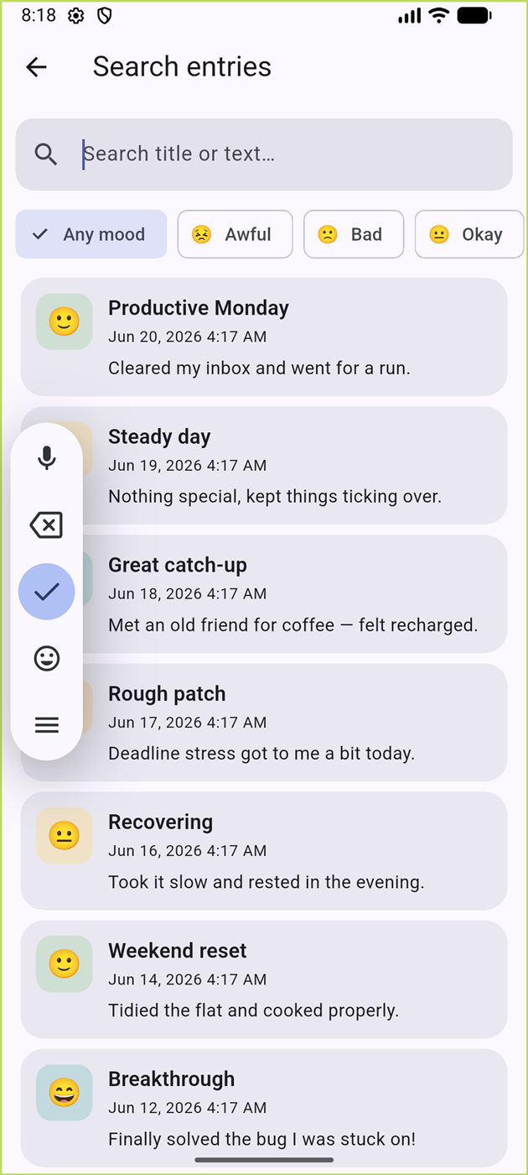
WALKTHROUGH · 4
Task planner & search
Add tasks, tick to complete, swipe to delete
Open / done counts at a glance
Search entries by free text…
…and filter by a specific mood (e.g. “anxious”)
Notes:
Show adding and completing a task, then searching entries and filtering by a mood.

Slide 10
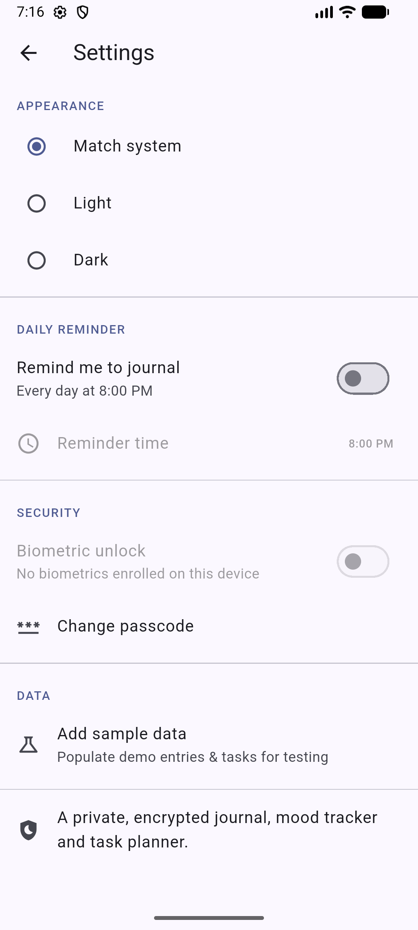
UNDER THE HOOD
Persistent, encrypted storage
All data persists in a local SQLCipher (encrypted SQLite) database
Two tables: entries (title, body, date, mood, photo) and tasks (title, done, created_at, completed_at)
Indexed by date and mood for fast trend and search queries
Survives app restarts; demonstrated live by adding and updating data
On disk the file is ciphertext — it cannot be opened without the passcode-derived key
Notes:
Open Settings → Add sample data to show persistence; mention the two encrypted tables and that the DB file is ciphertext on disk.

Slide 11
BEYOND THE BASICS
Sensors & external API
🔐
📷
☁️
Biometric sensor
Camera & gallery
Quotes REST API
local_auth — fingerprint / face unlocks the app and releases the database key.
image_picker — capture or choose a photo to attach to an entry.
http — fetches a daily quote from ZenQuotes, with an offline fallback.
Two device sensors and one external API — used in service of real features.
Notes:
Trigger biometric via the emulator extended controls if asked; show a photo attach; mention the quote API with offline fallback.

Slide 12
LIVE DEMO
Let’s see it running
Create a passcode → unlock (incl. biometric)
Settings → Add sample data to populate test data
Write an entry with a mood and a photo
Watch the dashboard chart and insight update
Add / complete a task, then search by mood
Schedule the daily reminder; lock & re-unlock
Notes:
Switch to the running app now and follow these demo steps with test data.

Slide 13
CRITICAL EVALUATION
Strengths & limitations
Strengths
Limitations
Security by default (encryption, PBKDF2, biometrics)
Breadth & cohesion — 8 interconnected features
Real use of 2 sensors + an external API
Clean, consistent Material 3 UI
Fast: analytics computed in memory
Unit & widget tested; analyzer clean
Local-only: no cloud backup or sync yet
Single device / single user; numeric passcode
Biometric stores a key copy in the keystore
Plain text + one photo; substring search only
Quote relies on one third-party service
Built & tested on Android (iOS unverified)
Notes:
Be honest and balanced: strengths first, then limitations. This shows critical evaluation, which the rubric rewards.

Slide 14
WHERE NEXT
Future enhancements
End-to-end encrypted cloud backup & multi-device sync
Richer entries: multiple photos, formatting, voice notes, tags
Full-text search and export-to-PDF
Location & weather tagging (adds a second API/sensor)
Home-screen widget and quick-add shortcut
Localisation & accessibility improvements
Notes:
Briefly outline realistic next steps, led by encrypted cloud sync.

Slide 15
Thank you
Questions & discussion
MindLog · Chan Tai Yu · 6002CEM
github.com/ChanTaiYu/mindlog
Notes:
Thank the panel and invite questions. Have the GitHub repo open.

