Slide 1
Artifacts in BH simulation
Note:
all graphs here are second output file (fm_torus.prim.00001.athdf)
except the setting of MeshBlock, all setting is the same as the default
the flag --logc is inactive such that the artifacts can be easily observed

Slide 2
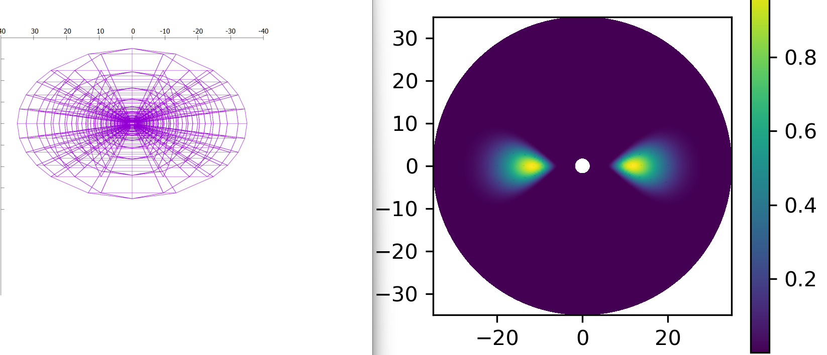


refinement | Lvevl2
nproc | 2x72
Cells in each meshblock | 16^3

Slide 3
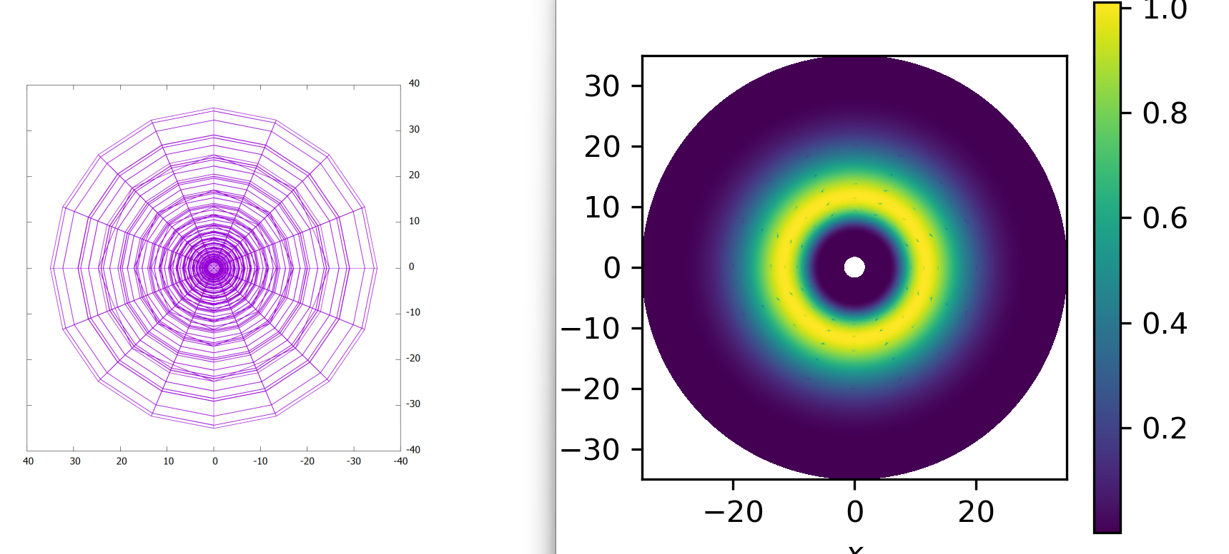



refinement | Lvevl2
nproc | 2x72
Cells in each meshblock | 16^3

Slide 4
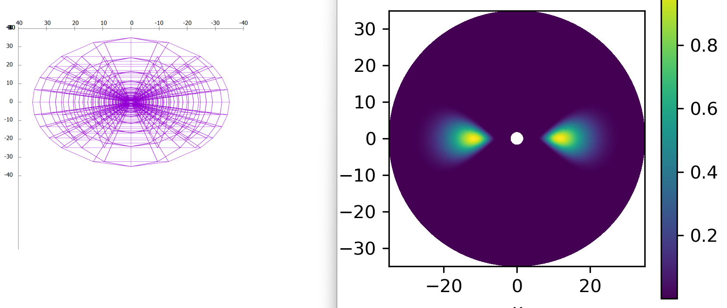
refinement | Lvevl2
nproc | 1x72
Cells in each meshblock | 16^3

Slide 5
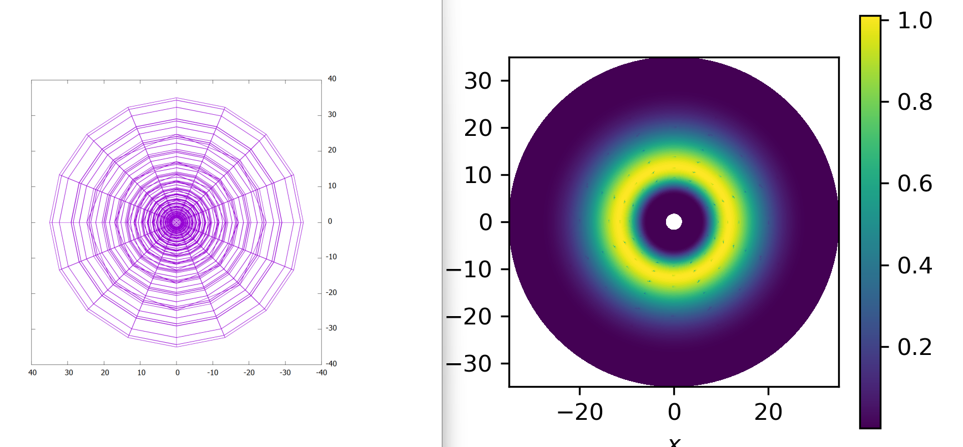
refinement | Lvevl2
nproc | 1x72
Cells in each meshblock | 16^3

Slide 6
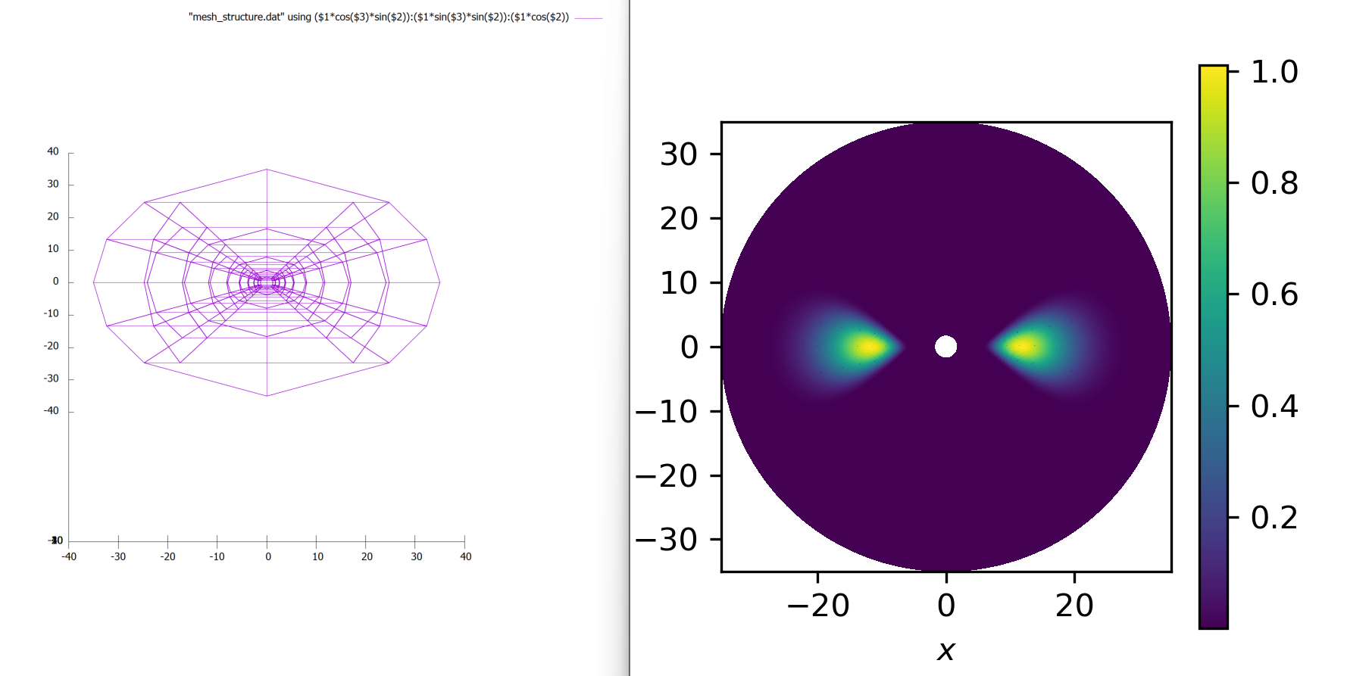
refinement | Lvevl2
nproc | 1x72
Cells in each meshblock | 32^3

Slide 7
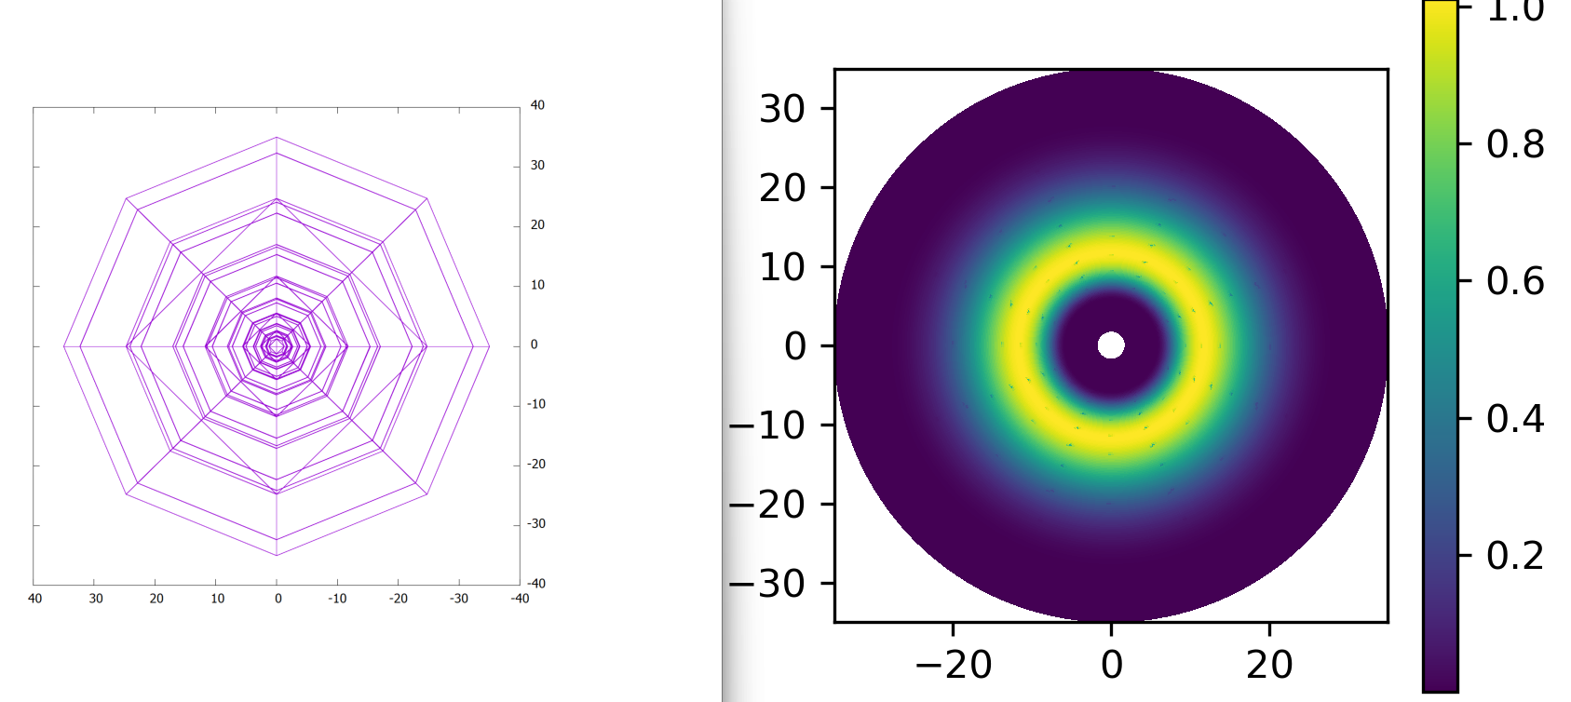
refinement | Lvevl2
nproc | 1x72
Cells in each meshblock | 32^3

Slide 8
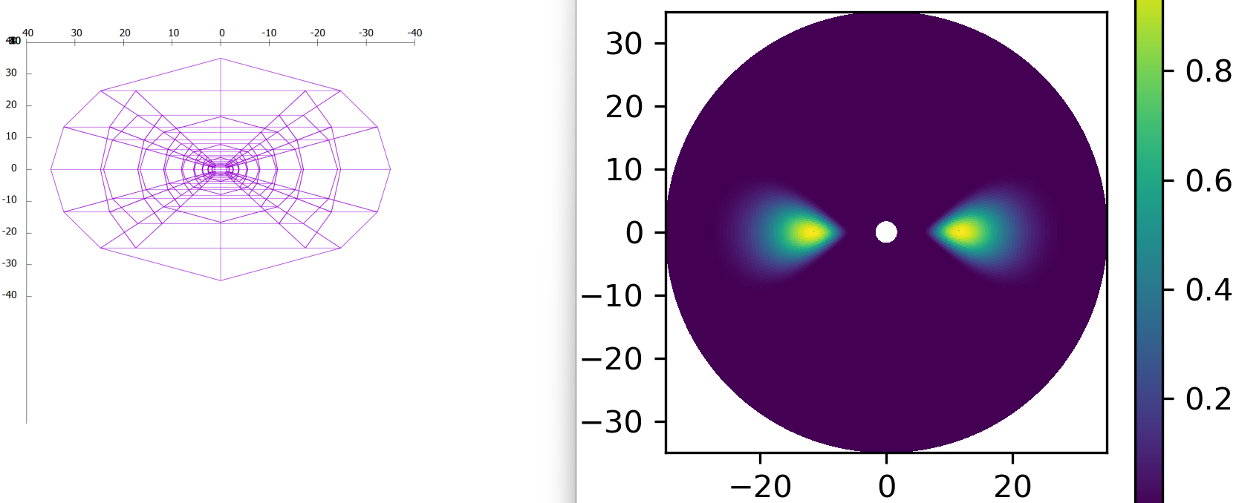
refinement | Lvevl1
nproc | 2x72
Cells in each meshblock | 16^3

Slide 9
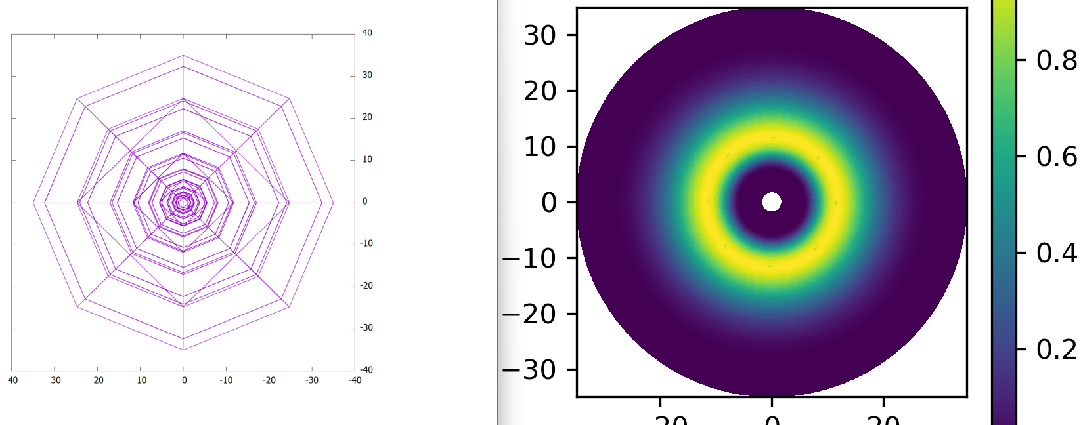
refinement | Lvevl1
nproc | 2x72
Cells in each meshblock | 16^3

Slide 10
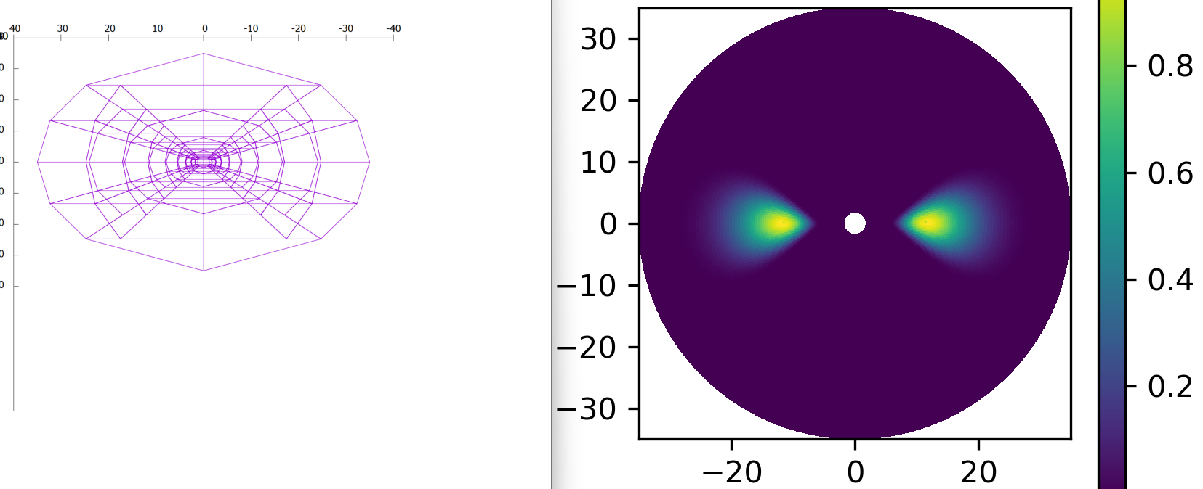
refinement | Lvevl1
nproc | 1x36
Cells in each meshblock | 16^3

Slide 11
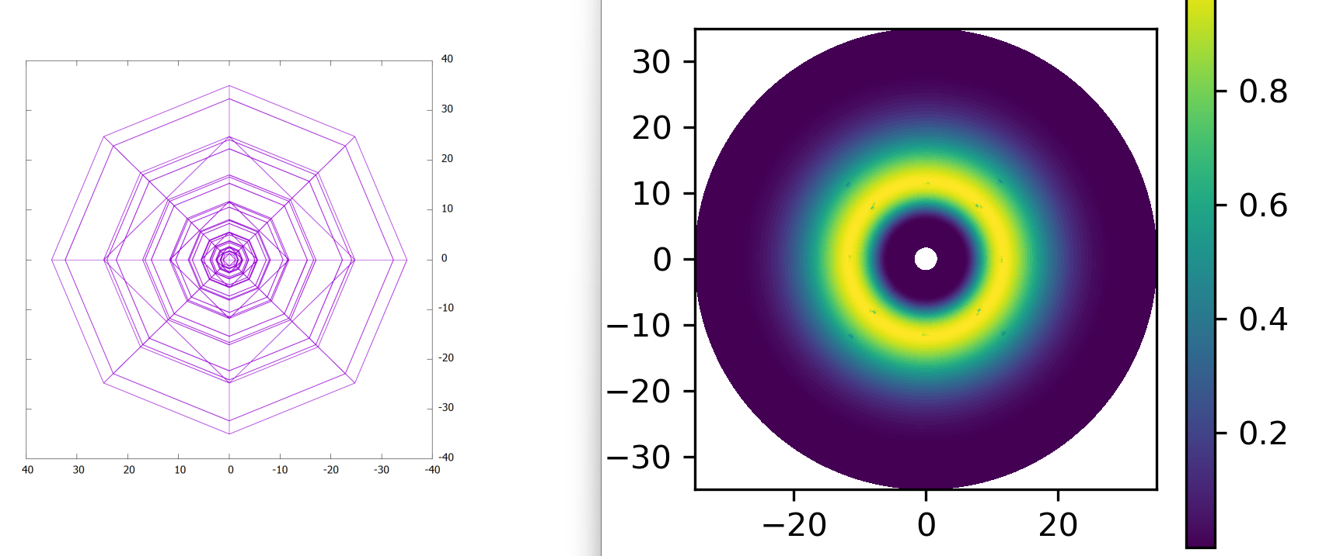
refinement | Lvevl1
nproc | 1x36
Cells in each meshblock | 16^3

Slide 12
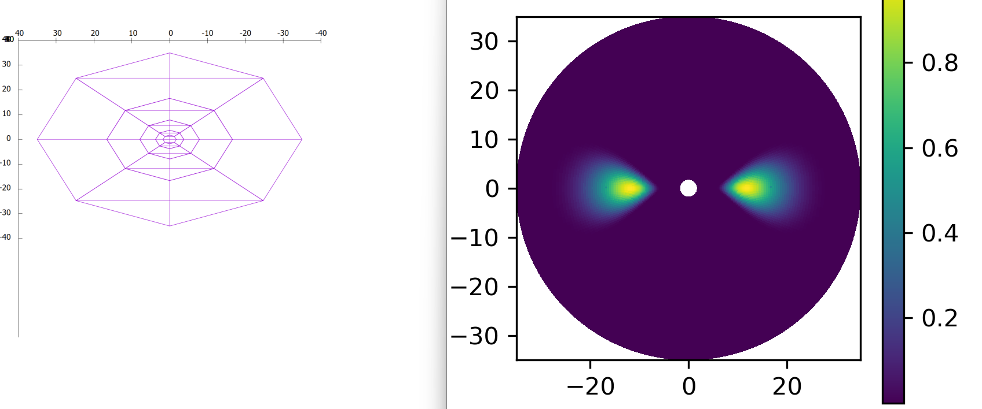
refinement | Lvevl1
nproc | 1x36
Cells in each meshblock | 32^3

Slide 13
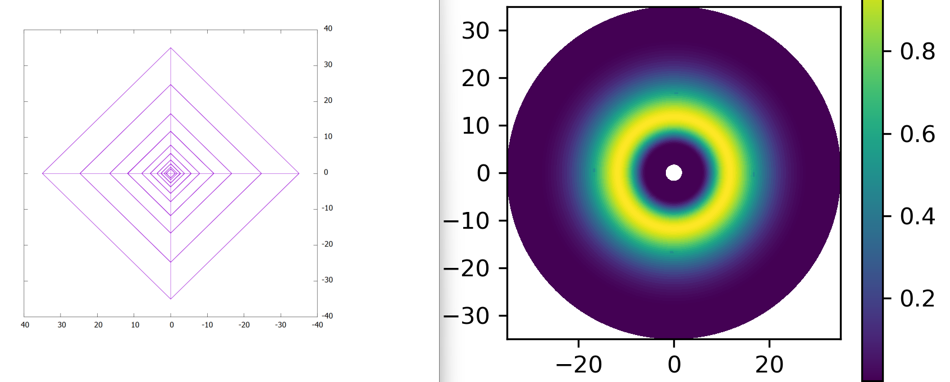




refinement | Lvevl1
nproc | 1x36
Cells in each meshblock | 32^3

