Slide 1
TELECOM CUSTOMER CHURN ANALYSIS
A Machine Learning Project on Customer Retention
Prepared by: CHANASYA G
Tools: Python • SQL • Scikit-learn • SHAP Dataset: IBM Telco Customer Churn

Slide 2
Project Objective
Predict whether a telecom customer is likely to churn
Understand the key business and behavioral drivers of churn
Segment customers by churn risk for targeted action
Provide clear, data-backed recommendations to improve retention
1
Data Cleaning
2
EDA & SQL
3
Model Building
4
SHAP + Segmentation
Telecom Customer Churn Analysis
2

Slide 3
Dataset Overview
IBM Telco Customer Churn dataset
7,043
21
26.5%
$64.76
Total customers
Columns / features
Overall churn rate
(1,869 of 7,043)
Average monthly
charge
No missing values were found; duplicate records were removed and categorical fields were label-encoded before analysis.
Key fields
Demographics (gender, senior citizen, partner, dependents) • Account info (tenure, contract, billing) • Services (phone, internet, streaming, security, support) • Charges (monthly, total) • Churn (target)
Telecom Customer Churn Analysis
3

Slide 4
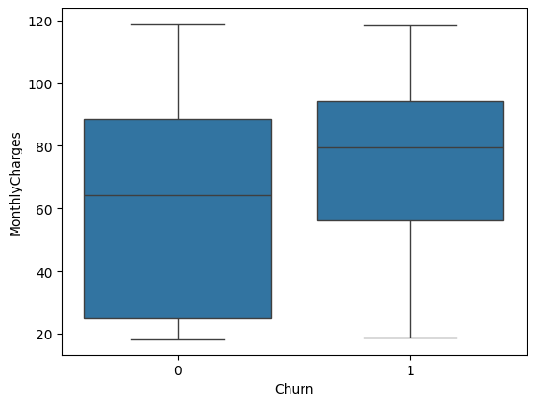
Churn Overview
How many customers are leaving, and what they pay
Monthly charges are noticeably higher among churned customers
Telecom Customer Churn Analysis
4

Slide 5
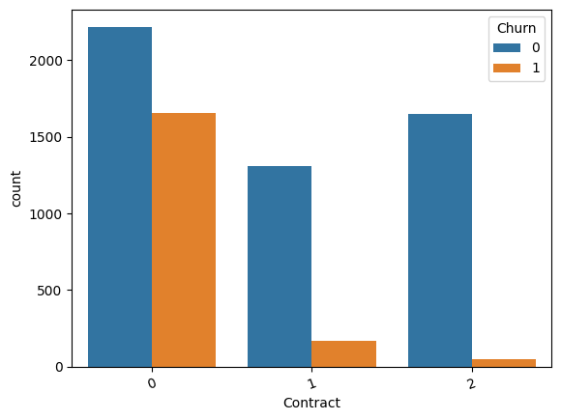
Contract Type Drives Churn
Month-to-month customers churn far more than contracted customers
Of all churned customers, 88.5% were on month-to-month contracts.
Telecom Customer Churn Analysis
5

Slide 6
SQL Insights
Querying the customer base directly
Metric | Value
Total retained customers (Churn = No) | 5,174
Total churned customers (Churn = Yes) | 1,869
Average monthly bill (all customers) | $64.76
Churned — Month-to-month contract | 1,655
Churned — One year contract | 166
Churned — Two year contract | 48
Analysis performed with SQLite via Python (sqlite3), querying the cleaned customer table directly with SQL for aggregate business metrics.
Takeaway
Contract type and monthly charges stand out early as the strongest churn signals in the raw data.
Telecom Customer Churn Analysis
6

Slide 7
Predictive Model
Logistic Regression trained on an 80/20 train-test split
81.7%
68%
57%
Overall accuracy
Precision — churn class
Recall — churn class
Confusion Matrix
Classification Report
 | Predicted: No | Predicted: Yes
Actual: No | 938 | 98
Actual: Yes | 160 | 213
Class | Precision | Recall | F1
No churn | 0.85 | 0.91 | 0.88
Churn | 0.68 | 0.57 | 0.62
Model reliably identifies loyal customers, but recall on churners (57%) leaves room to improve — SHAP is used next to interpret its decisions and guide targeted action.
Telecom Customer Churn Analysis
7

Slide 8
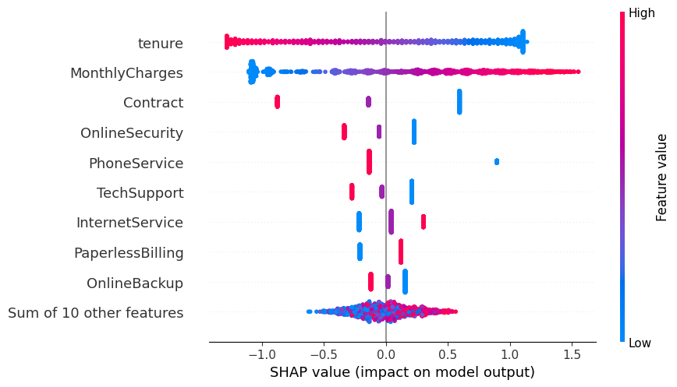
What Drives Churn? (SHAP)
Feature impact on the model's churn predictions
Interpretation
Each dot is a customer; red = high feature value, blue = low. Position shows whether that value pushed the prediction toward churn (right) or retention (left).
Telecom Customer Churn Analysis
8

Slide 9
Customer Segmentation
Customers grouped by predicted churn probability
Segment | Customers | Definition
Loyal | 4,358 | Churn probability < 30%
Dormant | 2,250 | Churn probability 30–70%
At Risk | 435 | Churn probability ≥ 70%
At-risk customers (6.2% of the base) represent the highest-priority group for immediate retention action.
Telecom Customer Churn Analysis
9

Slide 10
Business Recommendations
Encourage month-to-month customers to switch to annual plans through incentives and loyalty pricing.
1
Reward loyal, low-risk customers with exclusive offers to reinforce retention.
2
Provide personalized discounts and proactive outreach to customers flagged as "At Risk."
3
Monitor customers with high monthly charges and offer better-value plan alternatives.
4
Improve customer support quality to reduce churn driven by service dissatisfaction.
5
Telecom Customer Churn Analysis
10

Slide 11
Conclusion
This project successfully predicted customer churn using a Logistic Regression model (81.7% accuracy). SQL analysis, exploratory data analysis, SHAP explainability, and customer segmentation together provided clear, actionable insight into customer behavior — showing that contract type and monthly charges are the leading drivers of churn. The resulting recommendations give the business a concrete, data-backed path to improve customer retention and reduce revenue loss.
Thank you
Telecom Customer Churn Analysis
11

