Slide 1
Evaluating Test-Time Adaptation for CIFAR-10
Submission deck
Final 50-epoch full-test results under synthetic corruption shift
Source-only corrupted accuracy
59.05%
Distribution shift is the test. Adaptation is the intervention.
79.08%
Entropy minimization
Best gated TTA (tau=0.9)
79.18%
The project compares source-only inference, BatchNorm adaptation, entropy minimization, and confidence-gated entropy minimization without using target labels.
Best clean
Final epoch clean
CIFAR-10
Synthetic corruptions
Single seed
93.78%
93.66%
epoch 48
source model

Slide 2
Problem and Motivation
A model trained on clean images can face noisy, blurred, compressed, or shifted inputs at deployment.
Clean source model
93.78%
best clean accuracy
Train
Deploy
Clean CIFAR-10 images with labels
->
Unlabeled corrupted test stream
Source-only under shift
59.05%
average corrupted accuracy
Target labels are unavailable during evaluation.
Static source inference does not adjust to the incoming stream.
Accuracy drop
TTA asks whether unlabeled test batches can support useful updates.
34.72 pp
clean to corrupted

Slide 3
Background: Distribution Shift and TTA
Distribution shift changes the input statistics; test-time adaptation updates the model during evaluation.
Distribution shift
Test-time adaptation
Entropy minimization
The training and deployment image distributions differ because of corruption, blur, lighting, or compression.
The model uses unlabeled target batches to update selected parameters while predictions are being produced.
A common TTA objective encourages confident predictions, but confident mistakes can still drive updates.

Slide 4
Method Overview
All methods use the same trained ResNet18 and the same corrupted CIFAR-10 test streams.
Source-only
BatchNorm adaptation
No test-time updates; the trained source checkpoint is evaluated as-is.
Run in train mode so BatchNorm running statistics update from the test stream; weights stay frozen.
Entropy minimization
Confidence-gated TTA
Update only BatchNorm affine parameters by minimizing prediction entropy on each test batch.
Use the same entropy objective, but mask out samples below a maximum-softmax confidence threshold.

Slide 5
Confidence-Gated TTA
The gate changes which samples contribute to the entropy loss; labels are never used during adaptation.
Confidence score
s_i = max_c p_theta(c | x_i)
Selected-sample fraction fell as the threshold increased, while average accuracy stayed near entropy minimization.
Gate rule
tau=0.5
tau=0.7
tau=0.9
use sample if s_i >= tau
97.5%
90.3%
80.4%
79.04% avg acc.
79.04% avg acc.
79.18% avg acc.
Thresholds tested
The best gated result is only 0.10 percentage points above entropy minimization, so the result should be treated as marginal.
tau = 0.5, 0.7, 0.9

Slide 6
Experimental Setup
The final run uses synthetic corruptions generated from CIFAR-10 test images, not CIFAR-10-C.
Clean accuracy
93.78%
Dataset
CIFAR-10 test images
best checkpoint used for evaluation
Source model
CIFAR-style ResNet18
Final epoch clean
93.66%
Training
50 epochs, seed 3830
training log value
Evaluation
Full 10,000-image test set
Shifts
7 synthetic corruptions x 5 severities
CIFAR-10-C support exists in code, but those results were not executed or reported.
Adaptation
One step per batch, lr 0.001
The final reported results are single-seed; no multi-seed claim is made.

Slide 7
Main Result Table
TTA substantially improves corrupted accuracy; gating is close to entropy minimization.
Method
Avg. acc.
Gain vs source
Gain vs entropy
Selected
sec/batch
Source-only
59.05%
0.00 pp
-20.02 pp
0.0%
0.134
BatchNorm adaptation
76.56%
17.51 pp
-2.51 pp
100.0%
0.132
Entropy minimization
79.08%
20.02 pp
0.00 pp
100.0%
0.223
Gated TTA 0.5
79.04%
19.98 pp
-0.04 pp
97.5%
0.227
Gated TTA 0.7
79.04%
19.99 pp
-0.03 pp
90.3%
0.228
Gated TTA 0.9
79.18%
20.12 pp
0.10 pp
80.4%
0.226
Best corrupted avg.
Gain vs source
Gain vs entropy
79.18%
+20.12 pp
+0.10 pp
Gated TTA tau=0.9
best gated setting
marginal difference

Slide 8
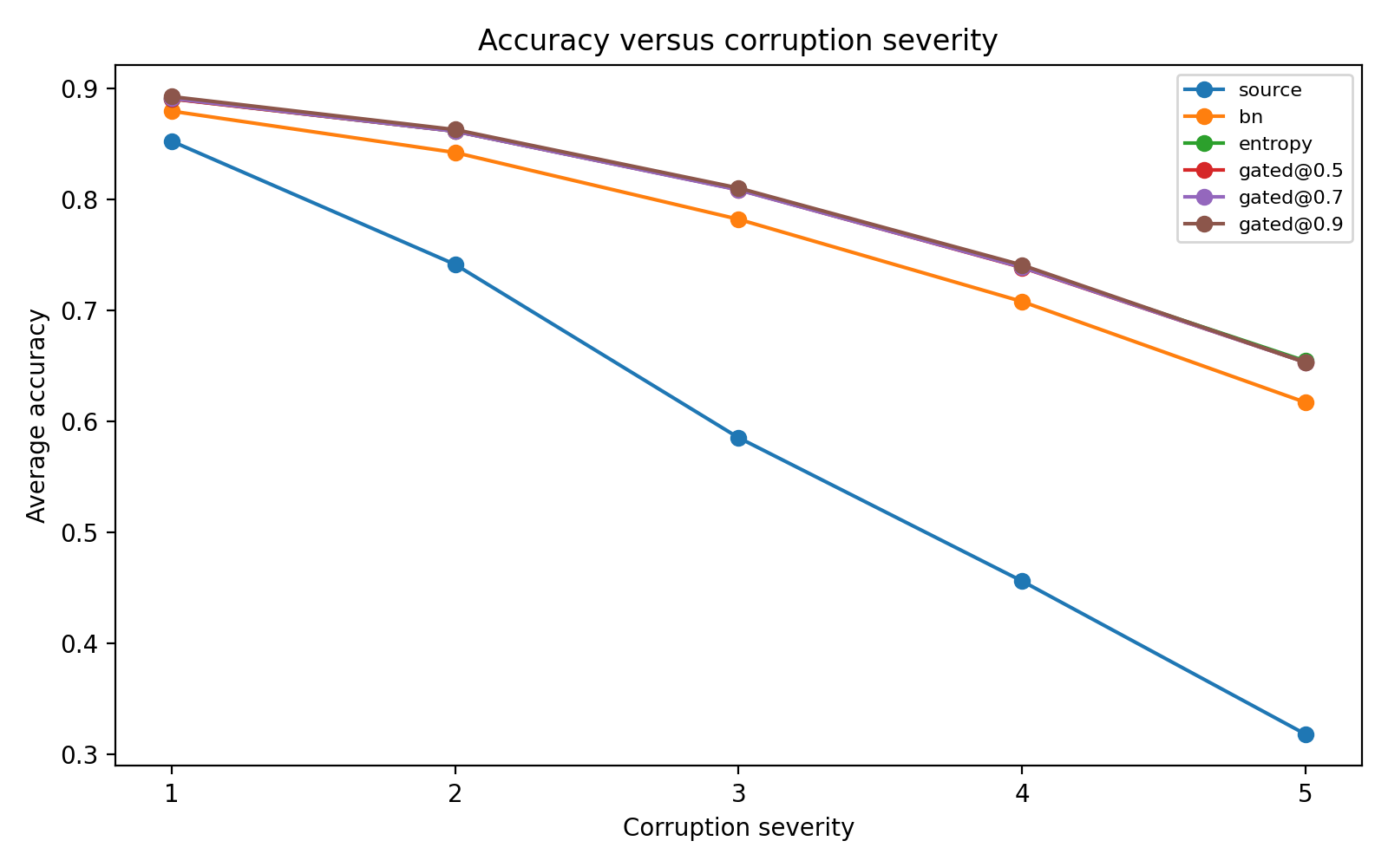
Accuracy by Severity
All methods degrade as corruption severity increases, but adapted methods keep a clear gap over source-only.
Severity separates the methods.
Source-only accuracy falls steeply as severity increases.
BatchNorm adaptation recovers a large share of the lost accuracy.
Entropy and gated TTA are strongest across most severity levels.

Slide 9
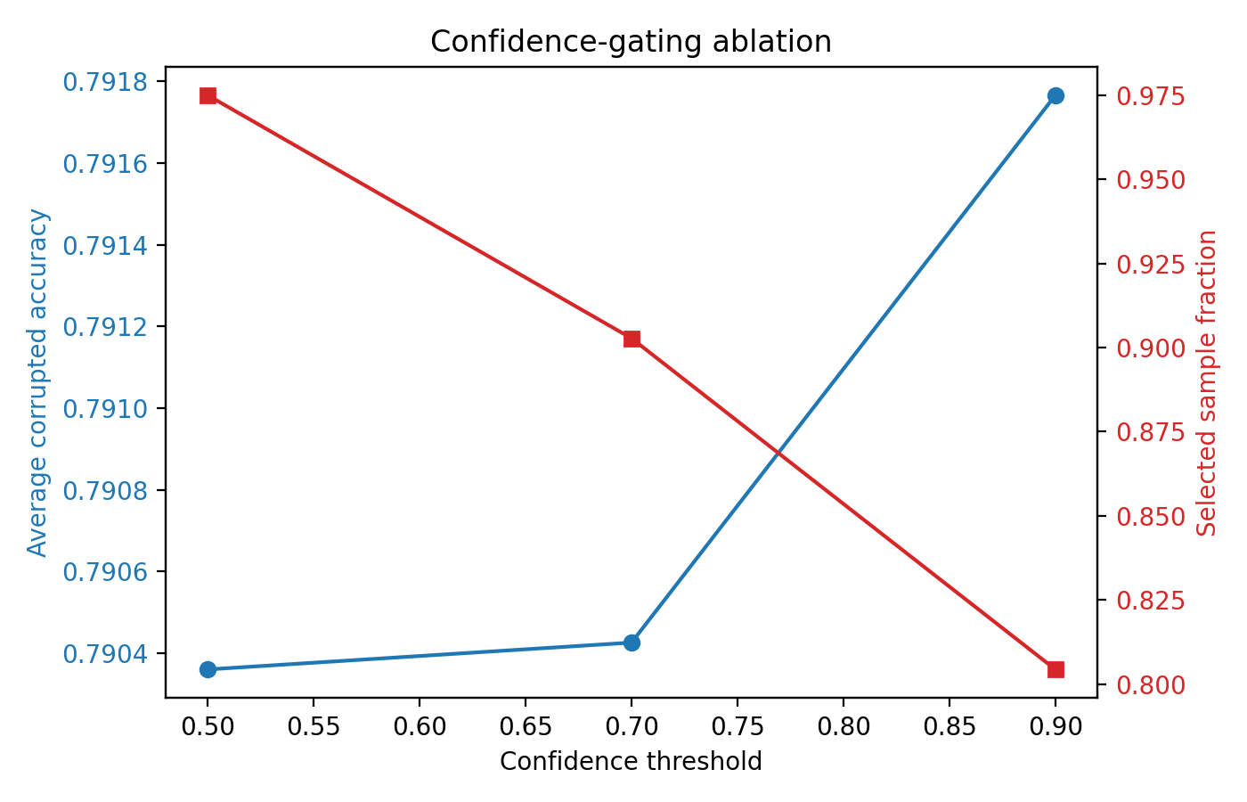
Threshold Ablation
Higher thresholds select fewer samples; the final accuracy differences are small.
tau=0.5
79.04%
97.5% selected
tau=0.7
79.04%
90.3% selected
tau=0.9
79.18%
80.4% selected
This supports a conservative read: the gate is reproducible and diagnostic, but it does not clearly beat entropy minimization.

Slide 10
Limitations
The strongest claims are bounded by the exact final experiment that was run.
Synthetic corruptions
Single seed
The final numbers are from generated CIFAR-10 corruptions; CIFAR-10-C was not used.
The evaluation has one training seed and one evaluation seed; no standard deviation is reported.
Narrow model scope
No runtime reduction
The conclusions are limited to CIFAR-10, a CIFAR-style ResNet18, and BatchNorm-parameter adaptation.
Gating changes the loss mask, but the full batch is still forwarded and backpropagated in this implementation.

Slide 11
Conclusion
The project supports a conservative conclusion: TTA helps a lot; confidence gating changes little in this final run.
Source-only
59.05%
average corrupted accuracy
Test-time adaptation substantially improves corrupted-image accuracy on the final full-test synthetic corruption benchmark.
Entropy minimization
79.08%
BatchNorm adaptation and entropy minimization recover much of the source-only drop.
+20.02 pp vs source
Confidence gating is threshold-sensitive and only marginally above entropy in the best setting.
Stronger evidence would require CIFAR-10-C, repeated seeds, stronger backbones, and adaptive thresholds.
Best gated TTA
79.18%
+0.10 pp vs entropy

