Slide 1
Game Software Engineering:
A Controlled Experiment Comparing Automated Content Generation Techniques.
Keywords; Empirical Study, Game Software Engineering, Video Game
Mar Zamorano
University College London
United Kingdom
maria.lopez.20@ucl.ac.uk
Carlos Cetina
Universitat Politècnica de València
Spain
University College London
United Kingdom
cetina@upv.es
África Domingo
Universidad San Jorge
Spain
adomingo@usj.es
Federica Sarro
University College London
United Kingdom
f.sarro@ucl.ac.uk
Presented by; Chance Womack

Slide 2
Participant Breakdown
46 Initial Participants, 2 chose not to continue their participation
12 Professional Video Game Developers
34 Third year undergraduate students

Slide 3

KROMAIA
A Spaceship based Shooter Game
Utilizes both Procedural and Re-Use Based content Generation
Test was conducted using a “Test Scenario”

Slide 4
Tested Dimensions
Difficulty
Game Duration
Won Rate
Boss Difficulty
Fun
Design
Immersiveness

Slide 5
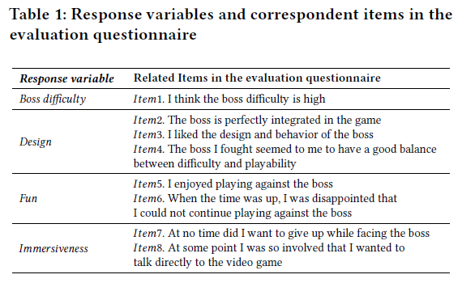
7-Item Likert-Style Questionnaires

