Slide 1
What am I lecturing on?

Slide 2
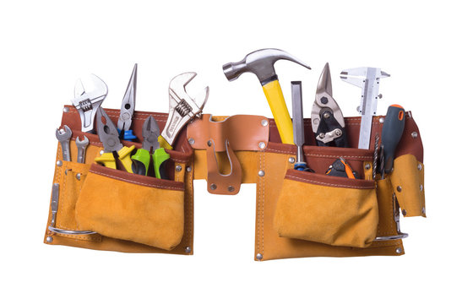
Tool Belts!
By Chance Womack

Slide 3
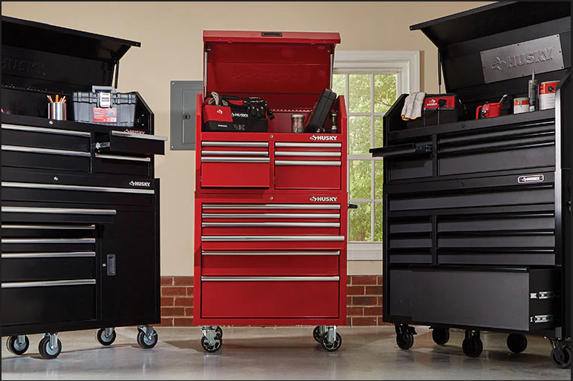
Wait…TOOLBARS…my bad…
However…
Foreshadowing

Slide 4
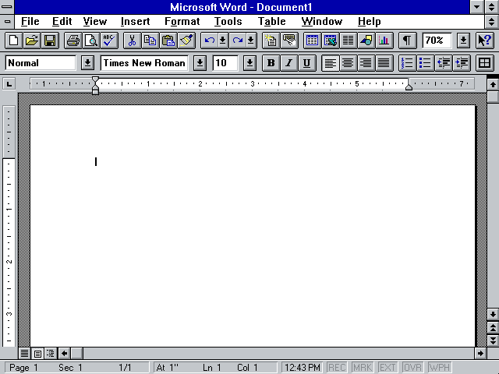
Toolbars
Originally called “Ribbons” here is an early example…
Word 6.0a (1994)

Slide 5
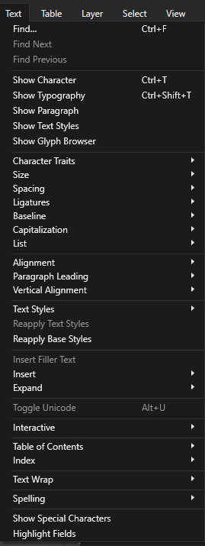
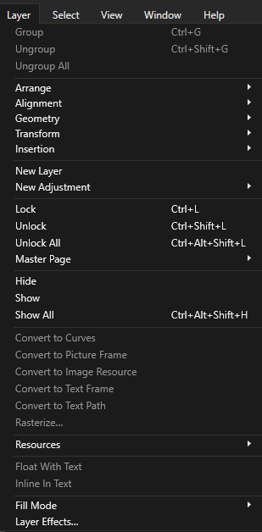
Why use Toolbars
Menus have grown cluttered and multi-layered as software functionality has advanced over the years

Slide 6
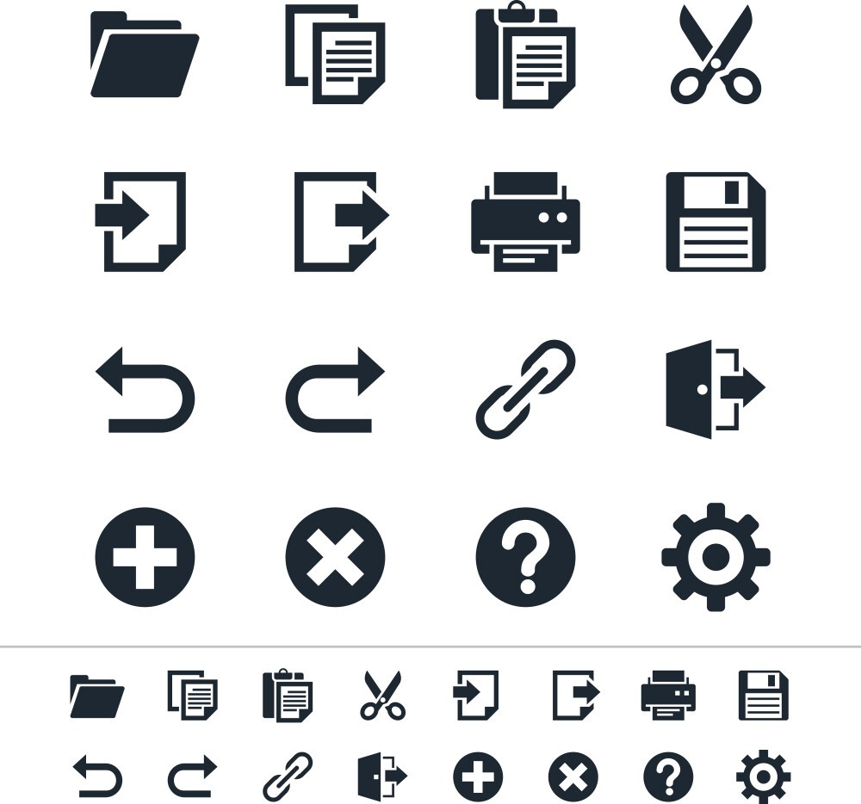
Use of Metaphors
Regular use of metaphors for the icons on a toolbar
Here are some fairly common example Icons
Designed for Experienced Users to quickly recognise, not for New Users to learn

Slide 7
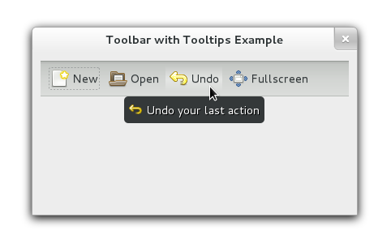
Tooltips
Labels are expensive in terms of screen space and pixel count when compared to just using Icons
Tooltips are a bridge between labeled and unlabeled toolbar design
Supports Intermediate Users

Slide 8
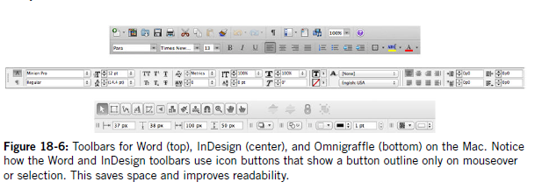
Advancing the Toolbar
Disabling Toolbar Options Moveable Toolbars
Combo Boxes Contextual Toolbars
Icon States Customizable Toolbars

Slide 9


Ex. Disabled Toolbar Options
Ex. Icon States

Slide 10
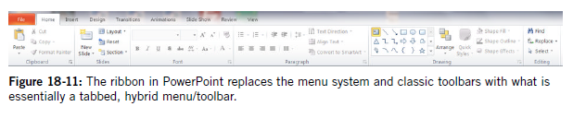
The Modern Ribbon
Introduced in Microsoft Office 2007
Combines the Menu with the Toolbar

Slide 11

Tool Palettes
Older than Toolbars, being featured in the original MacPaint software (1984)
Set of Mutually Exclusive Functions

Slide 12
In-Class Activity - Make a Toolbar
Each Team will draw a Toolbar on the board for a given software
Identify one feature to create a tooltip for, drawn in its own little box near the Icon
Team 1 - A Sketchbook App
  Matthew & Somervell
Team A - A Photo Editor
  Gage, Nathan, & Autumn
Team i - A Social Media App
  Ethan, Dallas, & Jerrick
Team Alpha - A Video Editor
  Creed, Jaden, & Kaylee

