Slide 1


Cryptocurrency: Bitcoin
TPPE 000 Technical Presentation Proficiency Examination
Sieyor T. Roach
Department of Electrical and Computer Engineering
University of Waterloo
3A Candidate for B.A.Sc. in Computer Engineering
May 21st, 2013
Copyright © 2013 by Sieyor T. Roach. All rights reserved.

Slide 2

Outline
What is Bitcoin?
How does Bitcoin work?
Negative Press
Differentiation of Bitcoin and Paper Money
  Security
  Reliability
  Tracking
  Usability
Conclusion

Slide 3
What is Bitcoin?
Electronic currency introduced in 2009 by Satoshi Nakamoto
  Decentralized
  Open source
Two main reasons why Bitcoin is used
  No central authority (Peet-to-peer)
  Anonymous

Slide 4
How does Bitcoin work?
Bitcoin Client (Wallet) acts as a window to the peer-to-peer network
Bitcoin client assigns a unique ECDSA Key
  (Elliptic Curve Digital Signature Algorithm) Key
  Alphanumeric characters

Slide 5
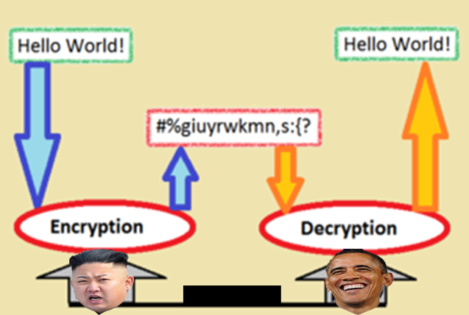
Cryptogrophy
modified from http://38north.org/wp-content/uploads/2013/04/kim-jong-un.jpg
modified from http://upload.wikimedia.org/wikipedia/commons/thumb/f/f8/Crypto.png/300px-Crypto.png
modified from http://thinkprogress.org/wp-content/uploads/2012/11/barack-obama-re-elected-as-us-president-pg.jpg

Slide 6
What is Bitcoin?
Mining client calculates solution to difficult mathematical problem
  6 Solutions or blocks found per hour
  Currently a block contains 50 Bitcoins
  Bitcoins in block reduce by 50% every 4 years or every 210,000 blocks
Maximum of 21 million Bitcoins
  Prevents inflation

Slide 7
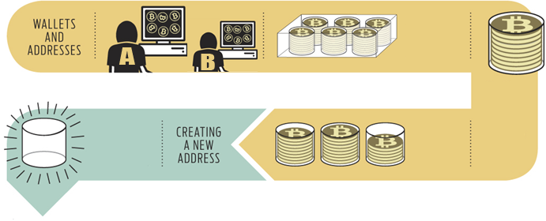
How a Bitcoin Transaction Works
modified from http://spectrum.ieee.org/computing/software/bitcoin-the-cryptoanarchists-answer-to-cash/0
Merchant and buyer must have Bitcoin wallet
Wallet can contain multiple addresses
  All transactions are public
  Users encouraged to create new address after every transaction

Slide 8
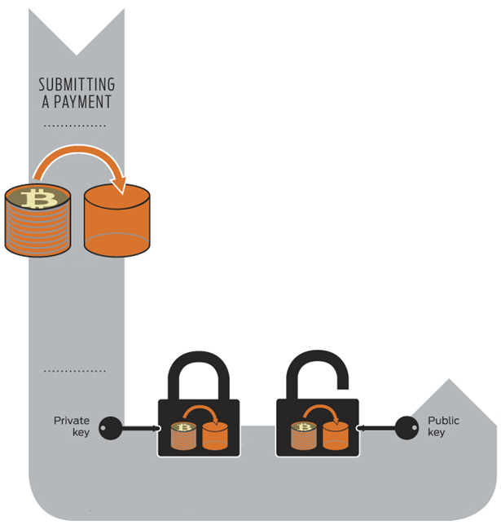
How a Bitcoin Transaction Works
Alice indicates the address to send the Bitcoin
Each address (public key) is associated with a private key
The private key used to validate the account owner
modified from http://spectrum.ieee.org/computing/software/bitcoin-the-cryptoanarchists-answer-to-cash/0

Slide 9
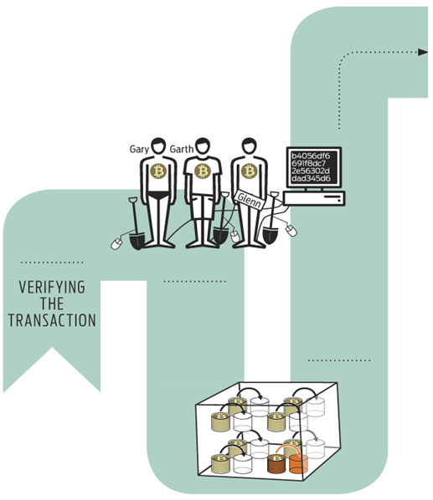
How a Bitcoin Transaction Works
Transations in the past 10 minutes is placed into one transaction block
Miners provide computing power to network
Mining software calculates cryptographic hash functions
modified from http://spectrum.ieee.org/computing/software/bitcoin-the-cryptoanarchists-answer-to-cash/0

Slide 10
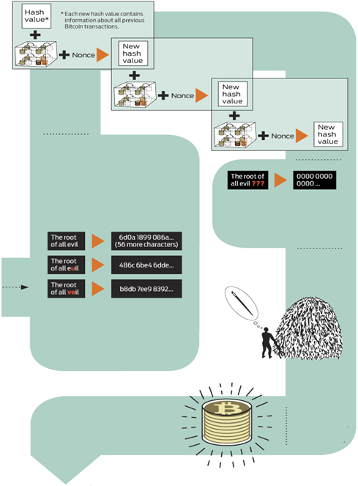
How a Bitcoin Transaction Works
Cryptographic hash functions convert data to alphanumeric string
  Fixed length
Nonces is a random number added to data
The miners work to produce a new hash
  Previous hash value
  Transaction block
  Nonce
User with correct hash value is rewared 50 bitcoin
9
modified from http://spectrum.ieee.org/computing/software/bitcoin-the-cryptoanarchists-answer-to-cash/0

Slide 11
Negative Press: Ponzi Scheme
Bitcoin has been accused of being a Ponzi Scheme
Elements of Ponzi Scheme
  Request money with the promise of high return.
  Early investors benefit at the expense of late investors
Bitcoin fails to pass Ponzi Scheme test

Slide 12
Advantages
Bitcoin | Paper Money
Cannot be stolen (extremely difficult) Decentralized Anonymity | Reliable Trusted Cashback

Slide 13
Disadvantages
Bitcoin | Paper Money
Coins can be lost Future unpredictable Requires a lot of time and dedication Essentially a waste of power | Taxing Theft No privacy

Slide 14
Conclusion
Currently many businesses accept Bitcoin
Bitcoin is the best alternative to physical money
Higher interest equates to higher Bitcoin prices
Future of cryptocurrency is unpredictable

Slide 15
References
http://blockchain.info/charts/n-transactions?timespan=30days&showDataPoints=false&daysAverageString=1&show_header=true&scale=0&address=
https://en.bitcoin.it/wiki/Introduction
http://spectrum.ieee.org/computing/software/bitcoin-the-cryptoanarchists-answer-to-cash/0
https://en.bitcoin.it/wiki/Transactions
http://www-cs-faculty.stanford.edu/~eroberts/cs181/projects/2010-11/DigitalCurrencies/index.html
https://en.bitcoin.it/wiki/Myths

