Slide 1
Hello.
Notes:
Title of class wot kim would have told me

Slide 2
Object Oriented Programming
The official definition…
“A programming paradigm based on the concept of "objects", which may contain data, in the form of fields, often known as attributes; and code, in the form of procedures, often known as methods.”
… but what is it, really?
Notes:
Objects and Classes Slide

Slide 3

Object Oriented Programming
Attributes
Radius
Surface area
Volume
Methods
Bounce
Burst

Slide 4
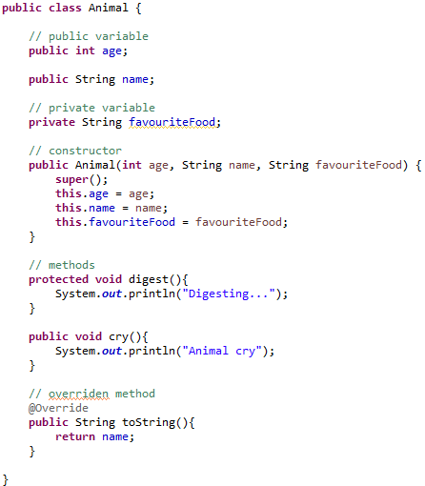
Object Oriented Programming

Slide 5
Privacy
Privacy is a big part of OOP – it allows or disallows easy editing or sight of certain variables…
Bear with me and look at this again…

Slide 6
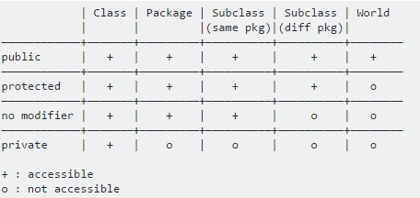
Privacy

Slide 7
Privacy works differently in Java than C++ btw
Public variable
- Anyone in and outside the class can access, edit and see it – yes, even the entire project workspace.
Protected variable
- The class, classes within the package, as well as subclasses can access, edit and see it.
Private variable
- Only the class itself can access, edit and see it. Not even the class can allow others to see it.

Slide 8
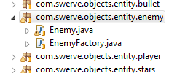
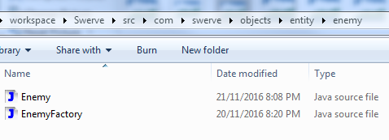
Packages
… I like to call them superfolders… for some reason.

Slide 9
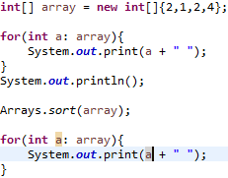

Packages
Java ships with a lot of packages as well… just import them.

Slide 10


Overriding
A quick prelude into what we will be doing next time…
Overriding is when you think you have a better idea of what a method should do.
Without override
With override

Slide 11
Next week:
Abstract Classes - Dealing in Ideas
Inheritance – The Child Gets Everything
Polymorphism (and the Idea That Something Can be Something Else (Related))

Slide 12
But wait, I have more…
Perhaps you’ve heard of GitHub? Open Source?
This is a small game in Java. A tiny project I am currently working on. Feel free to edit it to your liking!
https://github.com/Chances-1/Swerve
Steps
Fork this repository to your GitHub account.
Link the repo to your computer. Learn a bit of Git too.
Edit it- smoosh it, mangle it, add many, MANY different things!
Send me a pull request when you’re ready to share!
We’ll have a look at your code next week ☺

