Slide 1
Hi.

Slide 2
Abstract - Dealing in Ideas
The abstract keyword is used to define a class or method that is abstract.
What it does in human terms: it turns the class BaseGame into an idea.
An idea, no more, no less. It cannot be instantiated, only extended.
I mean, if you don't believe me...
If the idea analogy doesn't help, think of abstract classes as ideas that need to be filled with execution.
“But how do you deal in ideas? We're not IP lawyers...”

Slide 3

Abstract - Dealing in Ideas
Once you extend the abstract class...
You may use all the methods and attributes as determined by their privacy factor in the abstract class.
In fact, it ties fairly well into what we'll be talking about next, but a (probably the most) important note on abstract before we leave...
You can make methods abstract. :O
Abstract methods require definition in their child classes, and is best used when you're sure a child will NEED this method but aren't sure how each child will implement them.

Slide 4
Inheritance
The word is misleading, since no one - or in our case, nothing - dies.
Inheritance is the idea that a child (sub) class can inherit certain properties and methods from the parent (super) class.
The will analogy doesn't hold up - it's better to think of children inheriting certain properties from their parents (blue eyes, wide nose, big lips).
Private properties don't get passed down to the child class either.
This ties into our main meaty topic...

Slide 5
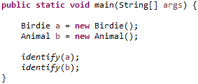
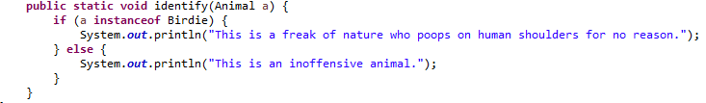
Polymorphism and Casting
We touched on this briefly last week - the idea that something can be considered something else. Let's look at Birdie and Animal again...
Really, these three pictures tell you all you need to know, but just in case:
Birdie is a child of Animal, and can be considered an Animal class.
Therefore, when in the identify method, both cases pass through.
You may have noticed the word instanceof in there as well, if the LHS class is part of the family tree of the RHS argument of instanceof, then it returns true.

Slide 6
Polymorphism and Casting
Let's talk about casting. If you've played Runescape at any point in your life, you may have come across moulds.
Bars of silver are a key component in making holy symbols, but to do that you need a holy mould. Once you pour molten silver into the mould - or cast - it becomes a holy symbol.
Casting in Java is basically like that, but with a lot more qualifying statements.

Slide 7
Thenks.

