Slide 1
Problem Statement: Enron Email Dataset
Name: Chanchal Sharma
PRN: 202401100098
CS5-27
Division: CS5 , Batch: C52

Slide 2
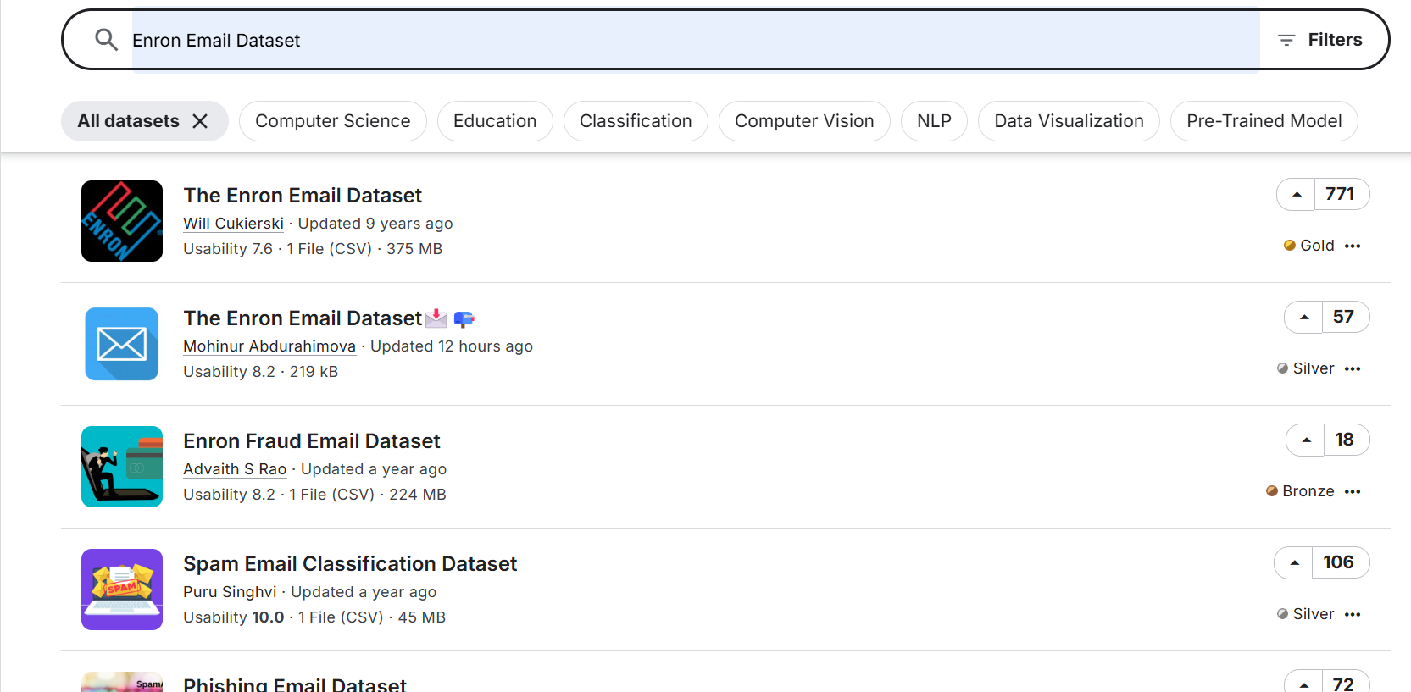
Selecting Dataset:

Slide 3
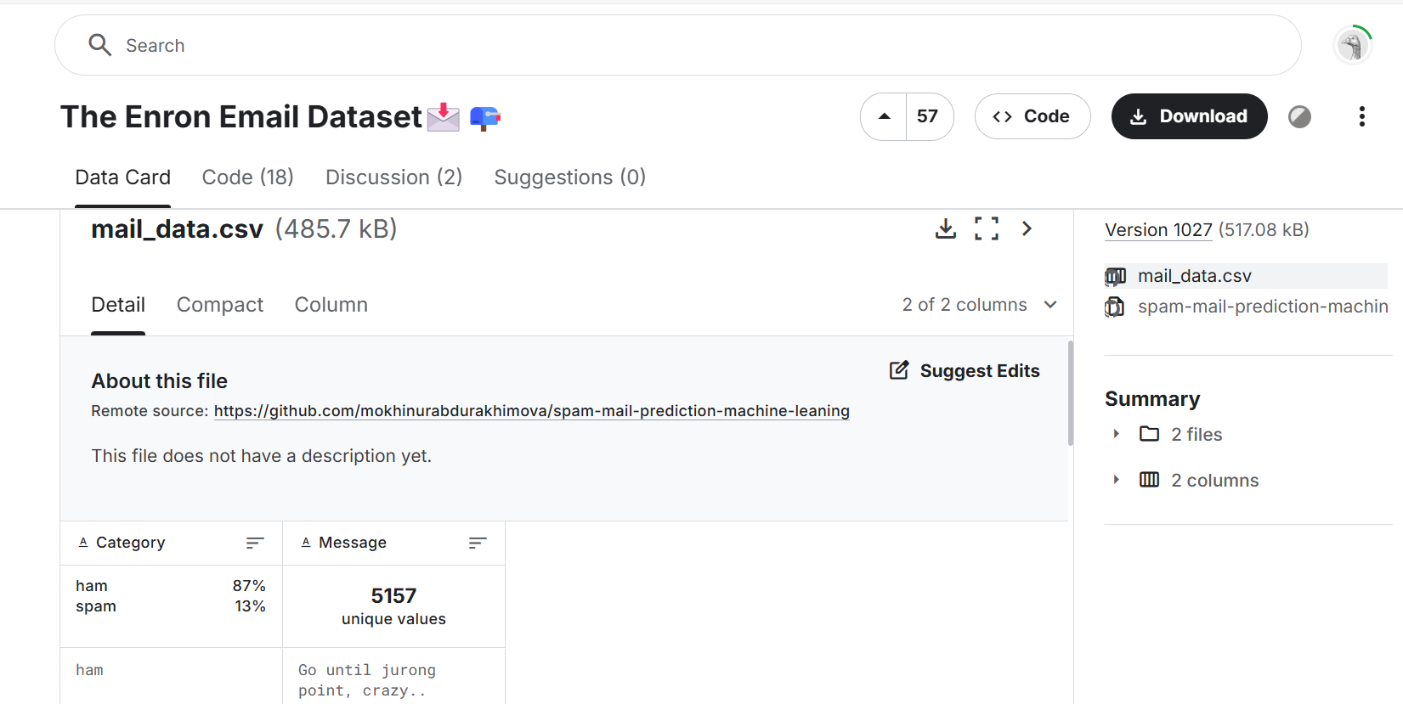
Selecting suitable Dataset:

Slide 4
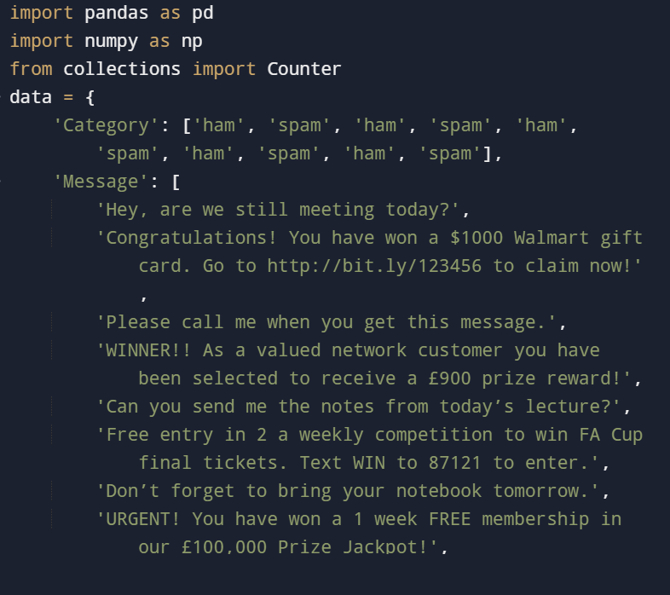
Program

Slide 5
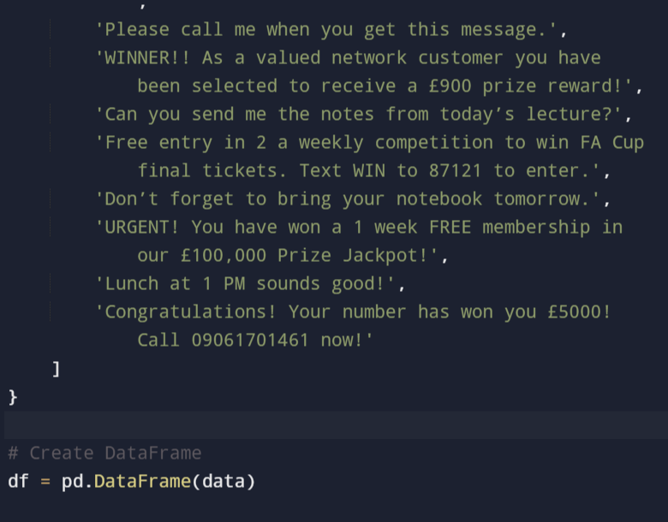

Slide 6
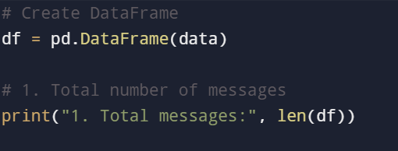

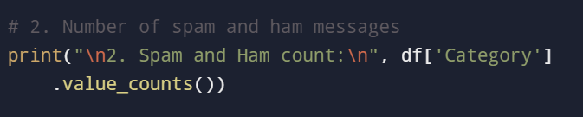
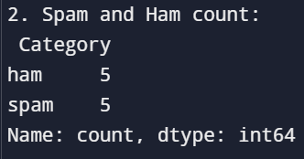
20 Question
1. Create DataFrame
Output:
2. Number of spam and ham messages
Output:

Slide 7
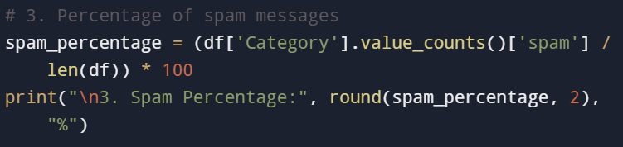

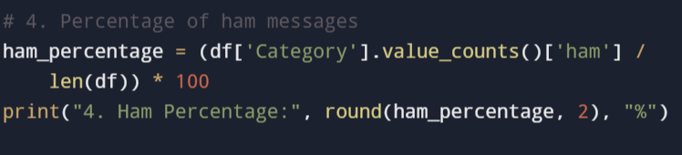

3. Percentage of spam messages
Output
4. Percentage of ham messages
Output

Slide 8
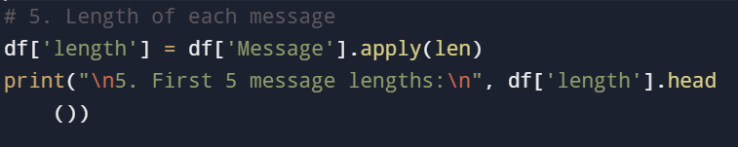
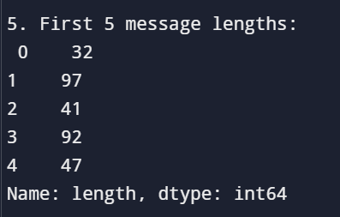
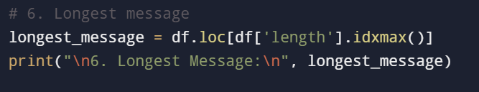
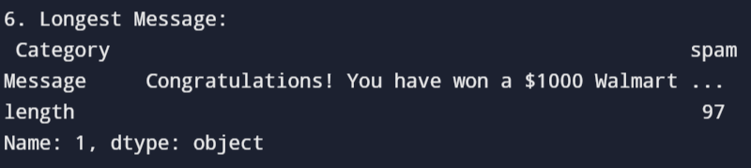
5. Length of each message
Output
6. Longest message
Output

Slide 9
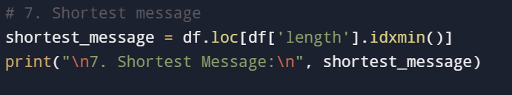
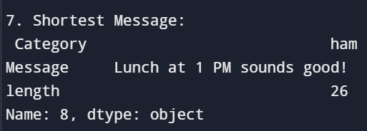
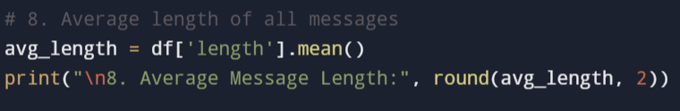

7. Shortest message
Output
8. Average length of all messages
Output

Slide 10
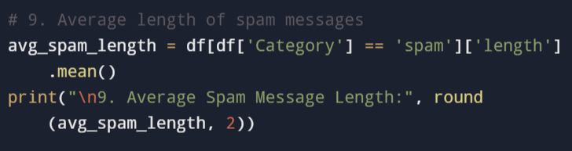
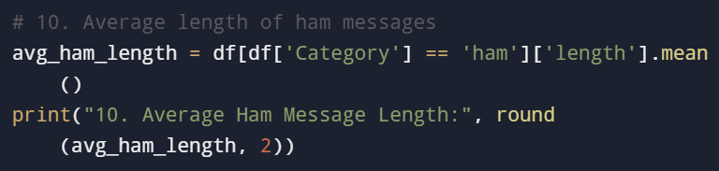
9. Average length of spam messages
Output:
10. Average length of ham messages
Output:

Slide 11
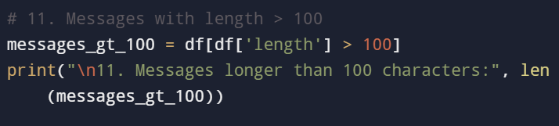
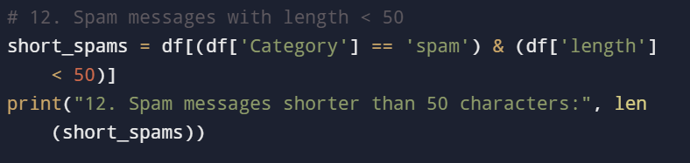
11. Messages with length > 100
Output:
12. Spam messages with length < 50
Output:

Slide 12
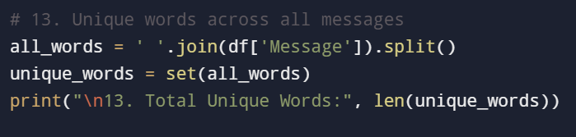

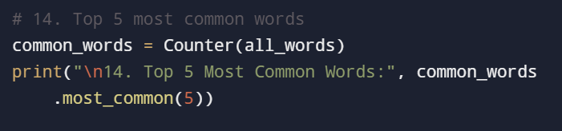
13. Unique words across all messages
Output:
14. Top 5 most common words
Output:

Slide 13
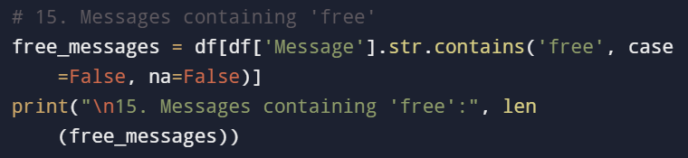
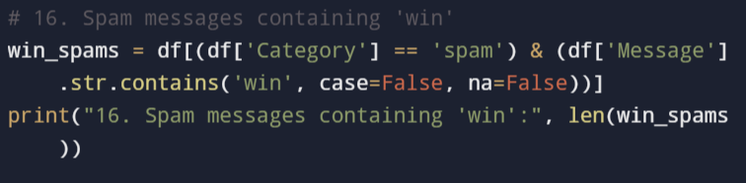
15. Messages containing 'free'
Output:
16. Spam messages containing 'win'
Output:

Slide 14
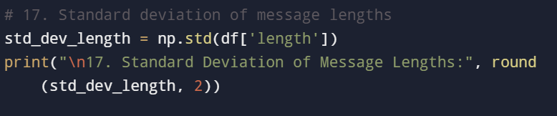
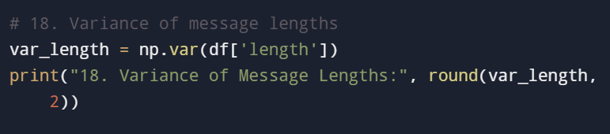

17. Standard deviation of message lengths
Output:
18. Variance of message lengths
Output:

Slide 15
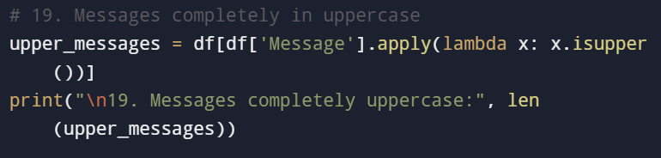
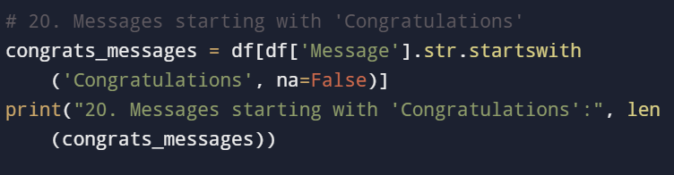
19. Messages completely in uppercase
Output:
20. Messages starting with 'Congratulations'
Output:

Slide 16
Thank you

