Slide 1
AI Resume Parser
ATS Score, Skills Extraction, Job Prediction & Course Suggestions
Team Members
Chanchreek Jain (R2142220468)
Anuj Dhasmana (R2142220036)
Siddharth Joshi (R2142220664)
Saksham Siwach (R2142220937)
Devansh Goyal (R2142220249)
Mentor: Santosh Kumar Panda

Slide 2



Introduction
Traditional resume screening is inefficient and time-consuming for HR teams
AI technologies are transforming recruitment, bringing automation and objective analysis Our project aims to create a complete solution for both job seekers and recruiters

Slide 3


Problem Statement
Recruiters spend hours screening hundreds of CVs manually
Manual evaluation process is prone to bias and inconsistency
Job seekers suffer from lack of instant feedback on their applications

Slide 4
Objectives
Extract resume details automatically from uploaded PDF documents
Calculate ATS score based on technical and soft skills detection Recommend skill-development courses based on identified gaps
Suggest appropriate job roles based on candidate's skill profile

Slide 5










Scope of the Project
For Job Seekers
For Recruiters
Improve resume quality and increase interview chances
Faster screening of candidate applications
Identify skill gaps to focus development efforts
Reduce bias with objective skill assessment
Match skills to ideal job roles with personalized recommendations
Efficiently filter candidates based on ATS scores
Quickly identify candidates with specific skill combinations
For Institutions
Reduce time-to-hire with automated initial screening
Track student skill readiness for industry roles
Plan curriculum aligned with market demand

Slide 6







Technologies Used
Languages & Libraries
Python
Core programming language for backend processing and algorithm development
Streamlit
Frontend framework for building interactive web applications
spaCy
Natural language processing library for text analysis and tokenization
Models
spaCy en_core_web_sm
English language model for linguistic analysis and named entity recognition
Document Processing
PyMuPDF
PDF processing library for text extraction from résumé documents
pytesseract & PIL
Image processing libraries for optical character recognition from résumé images
Tools & Techniques
Tesseract OCR
Optical Character Recognition engine for extracting text from images
Regex
Regular expressions for pattern matching in contact information extraction

Slide 7

System Workflow
A streamlined 5-step process from document upload to personalized recommendations
1
2
3
4
5
Upload Résumé
User uploads PDF document to the system
Extract Information
System extracts text and contact details
Detect Skills
AI identifies technical and soft skills
Calculate ATS Score
System computes ATS compatibility score
Recommend
Suggest courses and potential job roles

Slide 8


Module Breakdown
PDF Processing - Extract raw text from resume documents
OCR-based name extraction - Identify candidate names
Regex-based email & phone detection - Extract contact information Skill matching - Identify technical and soft skills
ATS scoring - Calculate compatibility score
Recommendations - Suggest courses and job roles

Slide 9
Data Extraction (Text)
PyMuPDF library efficiently extracts text from PDF resumes
Converts each page to plain text while maintaining content structure Handles multiple-page résumés and various PDF formatting styles

Slide 10

Data Extraction (OCR)
pytesseract converts PDF images to text using Optical Character Recognition
Filters out common résumé section headings and formatting elements Identifies and returns probable candidate name from document header

Slide 11

Contact Information Extraction
Email: Regex pattern matching
[a-zA-Z0-9._%+-]+@[a-zA-Z0-9.-]+\.[a-zA-Z]{2,}
Phone: Regex pattern matching
(\+\d{1,3}[-\s]?)?(\d{3}[-\s]?\d{3}[-\s]?\d{4})
Name: Extracted from OCR module after filtering section headings

Slide 12











Skill Categories
Technical Skills
Soft Skills
Python - Data processing, web development
Communication - Verbal, written, presentation
Java - Enterprise applications, Android
Teamwork - Collaboration, cooperation
SQL - Database queries, data manipulation
Problem-solving - Critical thinking, analysis
HTML/CSS - Frontend development
Leadership - Team management, delegation
JavaScript - Web applications, React, Node.js
Time management - Organization, prioritization
AWS - Cloud infrastructure, services
Adaptability - Flexibility, resilience
Skills are stored as predefined keyword lists that are regularly updated to match industry trends.
12

Slide 13
Skill Extraction Process
1
Convert résumé text to lowercase for standardization
2
Tokenize using spaCy natural language processing
3
Match tokens against predefined skill lists
Standardization
Normalize text for consistent processing
NLP Processing
Break text into meaningful tokens
Skill Identification
Compare with skill database

Slide 14

ATS Scoring Logic
Technical Skills Weight: 85% - Programming languages, frameworks, tools
Soft Skills Weight: 15% - Communication, leadership, teamwork
Formula ensures balance between technical proficiency and interpersonal abilities
Technical Skills (85%) Soft (15%)
Higher weight for job-specific technical requirements Complementary skills

Slide 15

Course Recommendations
System identifies skill gaps by comparing resume skills with job requirements
Suggests personalized online courses from leading platforms
LinkedIn Learning: Python for Data Science Coursera: Machine Learning Fundamentals Udemy: AWS Certification Prep
Provides clickable URLs for immediate enrollment and skill development

Slide 16


Job Role Prediction
Skill-to-job mapping using predefined keyword associations
Suggests career paths based on detected skills in the resume
Example Mappings:
Python, Django, Flask
Backend Developer
Machine Learning, TensorFlow
ML Engineer
React, JavaScript, CSS
Frontend Developer

Slide 17
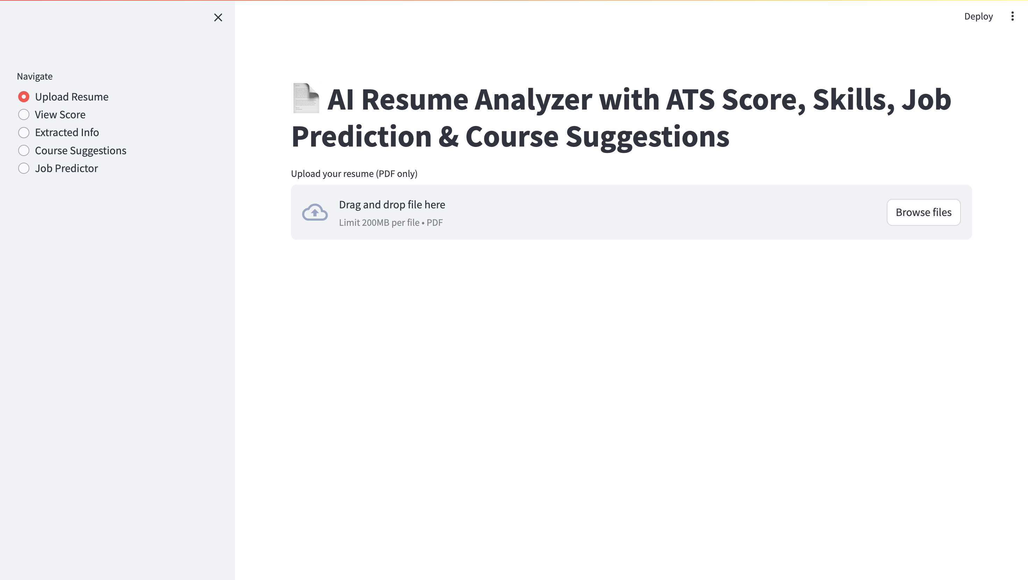
Streamlit User Interface
Intuitive web interface with easy navigation between modules

Slide 18

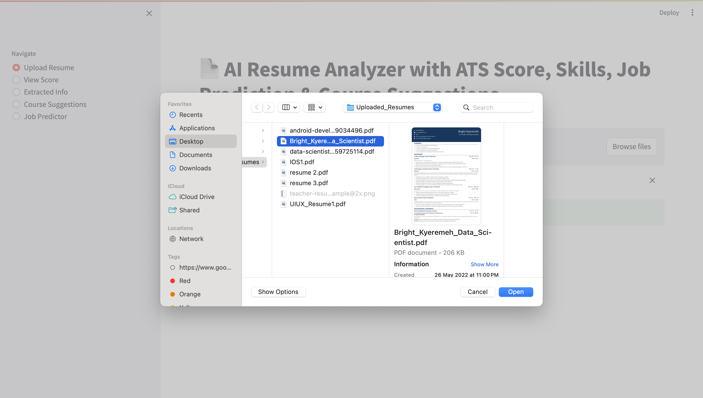
Module 1: Upload Resume
Accepts PDF format only to ensure consistent text extraction across platforms
User-friendly interface with drag-and-drop functionality and file validation
Stores file in session for later processing by other modules without repeated uploads

Slide 19
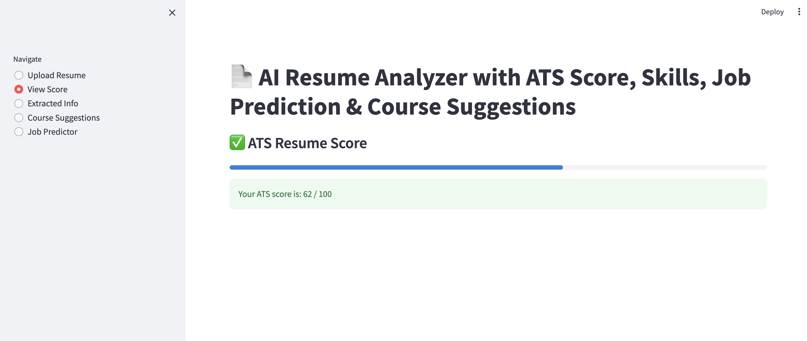
Module 2: View Score
Interactive progress bar visualization provides immediate visual feedback
78/100
Shows ATS score out of 100, indicating resume's compatibility with job requirements Scores are calculated based on the technical and soft skills detected in the resume

Slide 20
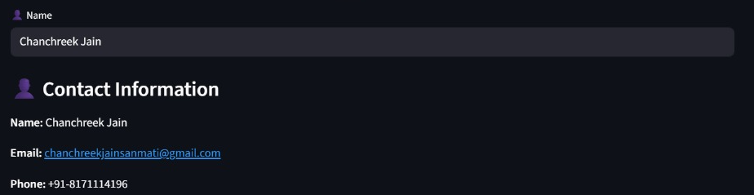


Module 3: Extracted Info
Displays candidate details extracted from resume
Lists extracted skills by category

Slide 21

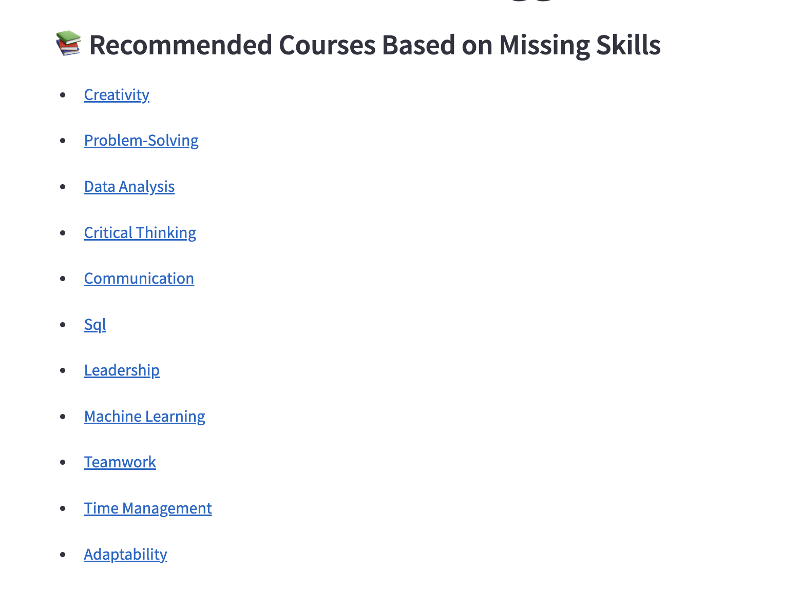
Module 4: Course Suggestions
Automatically identifies skill gaps by comparing detected skills with job requirements
Suggests relevant online courses from platforms like Coursera, Udemy, and LinkedIn Learning
Provides direct clickable URLs to help users quickly access learning resources

Slide 22


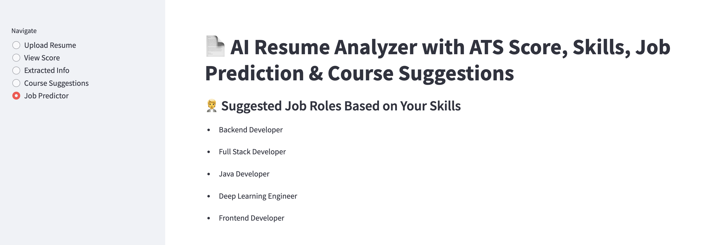
Module 5: Job Predictor
Lists suggested job roles based on candidate's extracted skills
Helps candidates align skills with potential career paths
Python, Django, Flask Backend Developer TensorFlow, PyTorch, Statistics ML Engineer React, Angular, UI/UX Design Frontend Developer

Slide 23







Advantages, Limitations & Future Scope
Advantages Future Scope
Saves time by automating resume screening process AI-based semantic analysis for contextual understanding Objective scoring with consistent evaluation criteria Multilingual support for global candidate pools
Creates feedback loop for continuous improvement Industry-specific skill taxonomy development
Enhanced analytics dashboard for recruiters
Limitations
Integration with applicant tracking systems (ATS)
Primarily keyword-dependent matching system
Variable OCR accuracy with complex document formats

Slide 24

Conclusion
AI-powered resume parsing improves recruitment speed and accuracy, reducing hiring time and costs
Encourages skill improvement & career growth through targeted feedback and recommendations
Creates a win-win ecosystem beneficial for both job candidates and recruiters

