Slide 1
PHASE 1 | MACHINE LEARNING
Card Fraud
Triage
Learning normal activity with a Gaussian Mixture Model
Our goal: decide which transactions a person should review first.
TEAM T011 | SECTION A | PROJECT 26
H Maheshwari 2401010174
Keshav 2401010222
Vaibhav 2401010486
Mitul Bhatia 2401010279
Mayank 2401010267
Newton School of Technology, Rishihood University
Notes:
Say: We built a system that learns what legitimate card transactions look like, then places the less usual later transactions at the front of a review queue. Our goal is triage: deciding what a person should look at first, because nobody can inspect every transaction. An unusual transaction is a reason to investigate, not proof of fraud. This is Phase 1 (machine learning) only; the autoencoder is Phase 2.
Team T011, Section A, Project 26: H Maheshwari 2401010174, Vaibhav 2401010486, Mayank 2401010267, Keshav 2401010222, Mitul Bhatia 2401010279.

Slide 2



Literature behind the method
EM algorithm
Precision-recall
AIC and BIC
Dempster, Laird & Rubin, 1977
Saito & Rehmsmeier, 2015
scikit-learn mixture guide
EM explains how the hidden component memberships are fitted.
They expose the burden of false alerts when fraud is rare.
They balance legitimate density fit against extra parameters.
Our results come from our own experiment, not from another paper.
Notes:
Three readings explain our design. Dempster, Laird and Rubin (1977) explain EM, the method that alternates between estimating hidden memberships and updating parameters, which is how a GMM learns. Saito and Rehmsmeier (2015) show why precision-recall measures reveal the burden of false alerts when positives are rare, so we emphasize PR area, recall, precision and review workload. The scikit-learn mixture guide describes GMM settings and AIC/BIC selection. The dataset is the ULB/Worldline credit card data.
The key point: these sources explain methods. Every result number on later slides comes from our own run. The assignment's suggested autoencoder reading (Sakurada and Yairi, 2014) is reserved for Phase 2.

Slide 3
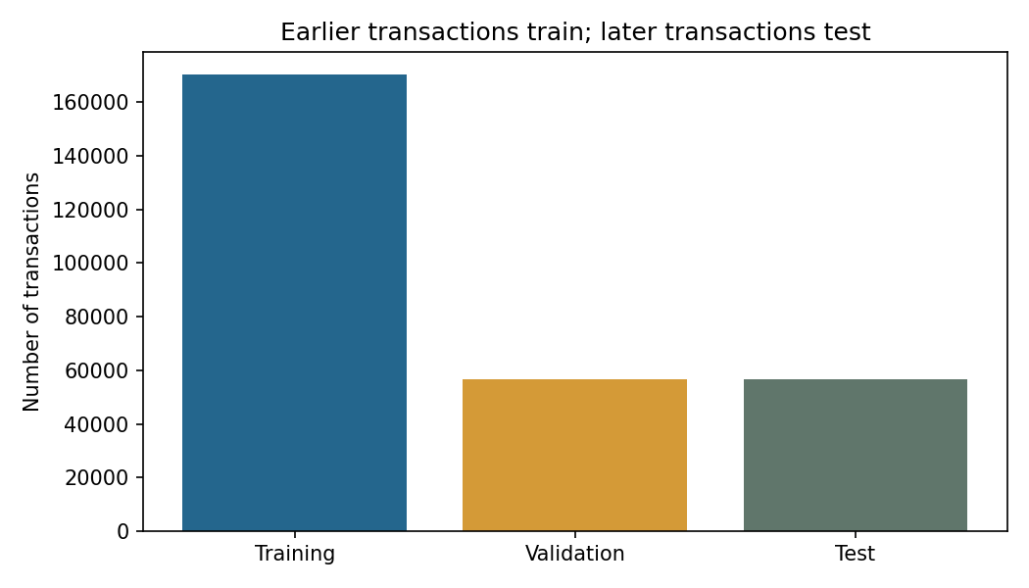
Data and three time periods
Period | Transactions | Legitimate | Fraud
Training | 170,235 | 169,893 | 342
Validation | 56,745 | 56,688 | 57
Test | 56,746 | 56,672 | 74
283,726
473
Split by time: training learns, validation picks cutoffs, test checks later results.
transactions after removing 1,081 exact repeats
frauds (0.17%). Class 0 = legitimate, 1 = fraud
Only the 169,893 legitimate training rows teach the model.
Notes:
The original file has 284,807 transactions and 492 frauds. We found no missing or infinite cells and removed 1,081 exact repeated rows, 19 of which were fraud, leaving 283,726 transactions and 473 frauds. There is no transaction ID, so duplicate removal is an explicit assumption.
We split by time, not at random: roughly 60% training, 20% validation, 20% test, with equal timestamps kept together (boundaries at 120,393 and 145,234 elapsed seconds). Training learns, validation picks the alert cutoffs, test checks later results. Test labels never choose inputs, K or cutoffs. Only the 169,893 legitimate training rows fit the scaler and the GMM.
The bar chart is the real figure produced by notebook 02 (figures/01_split.png).
Sources: Kaggle ULB/Worldline dataset (kaggle.com/datasets/mlg-ulb/creditcardfraud), mirrored in the TensorFlow imbalanced-data tutorial.

Slide 4
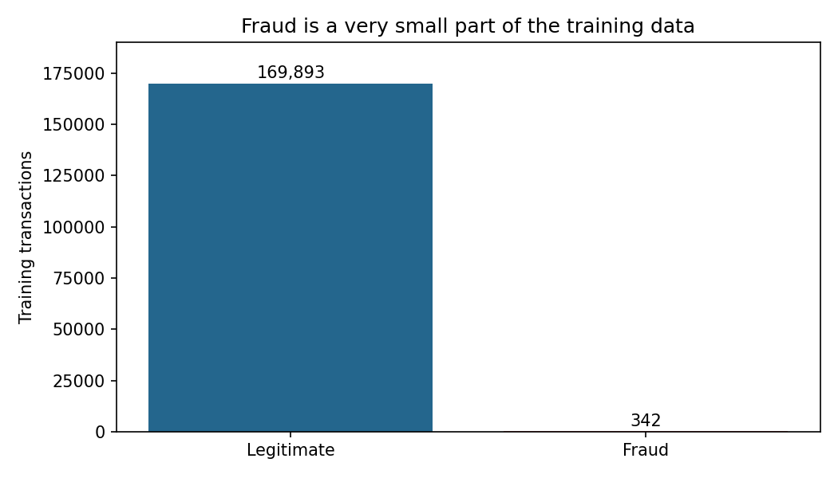
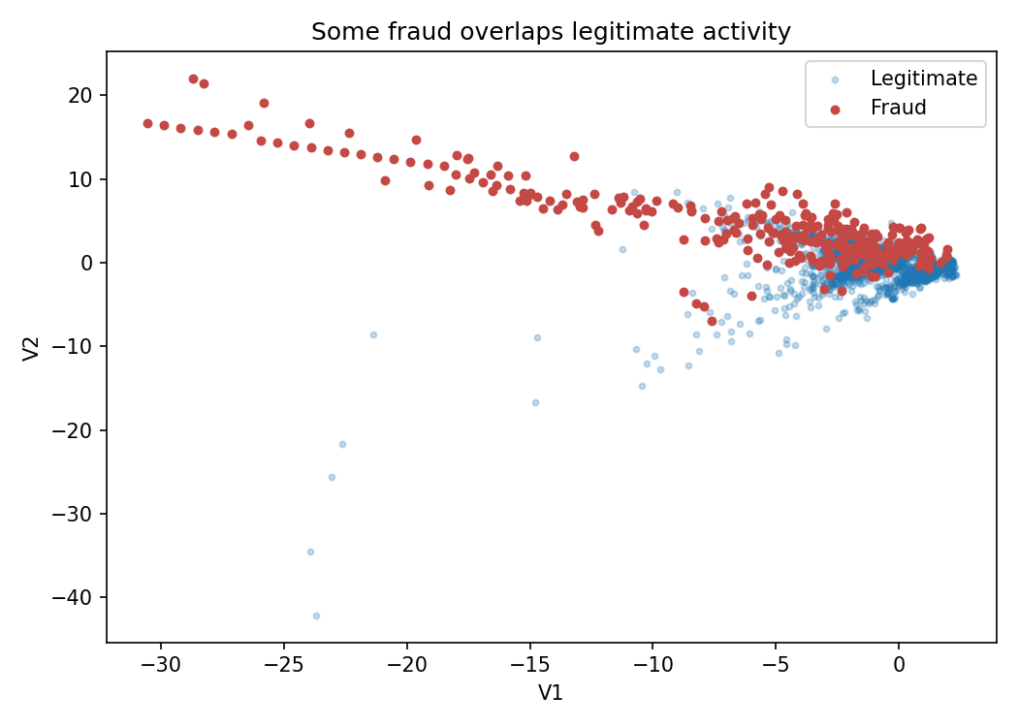
What the data looks like
Fraud is rare: 342 of 170,235 training rows. Predicting "all legitimate" is 99.87% accurate on test and catches no fraud.
The classes overlap, so some fraud looks like legitimate activity.
Notes:
Both charts are the real figures from notebook 02 (figures/02_class_balance.png and figures/05_overlap.png).
Left: fraud is a tiny slice of the training data. A policy that predicts every test row as legitimate would be about 99.87% accurate and would catch no fraud, which is why we do not use accuracy as the headline result.
Right: V1 against V2. Fraud (red) overlaps legitimate activity (blue), so no simple cutoff separates them perfectly. This foreshadows the false alerts and missed frauds in the results. The V1/V2 plot is sampled for readability only; sampling does not affect model fitting.
Notebook 02 also contains charts for hourly transaction volume, amount distributions and legitimate-feature correlation. Correlation is descriptive: low global correlation does not prove independence inside every mixture component.

Slide 5
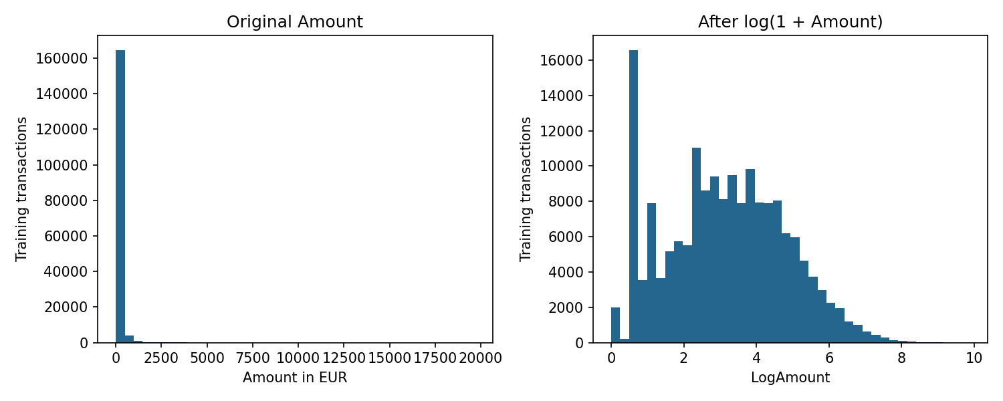



The 29 model inputs
Build LogAmount
LogAmount = log(1 + Amount): 9 becomes 2.30, 999 becomes 6.91.
Scale every input
Use the mean and standard deviation of legitimate training rows only.
Real figure from notebook 02: the log transform compresses Amount's long right tail.
29
inputs per transaction: V1 to V28 plus LogAmount
Keep the guardrails
Class stays out of the inputs. Time is used only for splitting.
Notes:
The model sees 29 inputs: the 28 anonymous provider features V1 to V28 plus LogAmount. LogAmount is log(1 + Amount): it accepts zero amounts and compresses the long right tail without removing large amounts. For example an amount of 9 becomes 2.30 and 999 becomes 6.91. The figure is the real one from notebook 02 (figures/03_amount.png): left is the original Amount, right is after log(1 + Amount).
StandardScaler subtracts the mean and divides by the standard deviation of each input, with those numbers learned only from legitimate training rows (notebook 03) and then applied unchanged to validation and test. Learning them from test data would leak future information.
Guardrails: Class is the answer, so it is never an input. Time only determines the split. We do not know the business meaning of the V columns, and we do not run any new PCA.

Slide 6
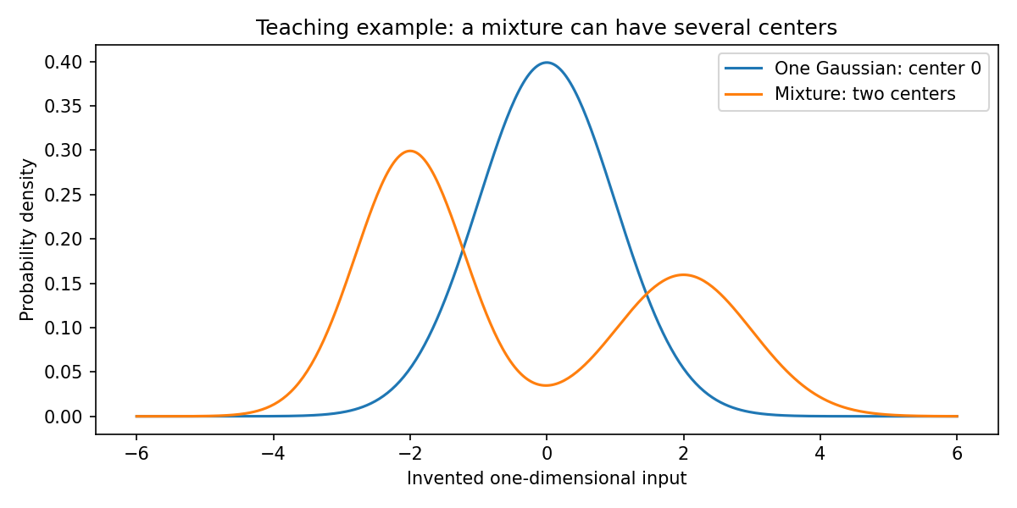
How the GMM learns
E-step
Estimate each transaction's membership in each component.
Repeat until converged
Real teaching figure from notebook 04: a mixture can have several centers.
M-step
p(x) = Σ π_{k} N(x | μ_{k}, Σ_{k})
Update the centers, spreads and weights using those memberships.
Diagonal covariance | 3 starts | seed 42
Notes:
A single Gaussian is a bell-shaped pattern with a center and a spread. A GMM adds up K such patterns, each with a weight (the weights sum to one), a center and a spread. The figure (notebook 04, figures/gmm_teaching.png) uses an invented one-dimensional input to show that a mixture can have several centers where one Gaussian has only one. Components are mathematical patterns, not verified customer categories.
EM repeats two steps. E-step: estimate how much each transaction belongs to each component (a soft membership; the memberships for one transaction sum to one). M-step: update the weights, centers and spreads using those memberships. Repeat until it stops improving.
Settings: diagonal covariance (separate variance per input inside each component; it misses some relationships between inputs), three initializations with seed 42, up to 200 iterations, and a tiny variance addition of 1e-6 so no spread collapses to zero. All four candidates reached their stopping rule, but that does not prove a global optimum. Labels were used only to select the legitimate training rows; GMM fitting itself receives no target labels.
Sources: Dempster, Laird and Rubin (1977); scikit-learn Gaussian mixture models guide.

Slide 7
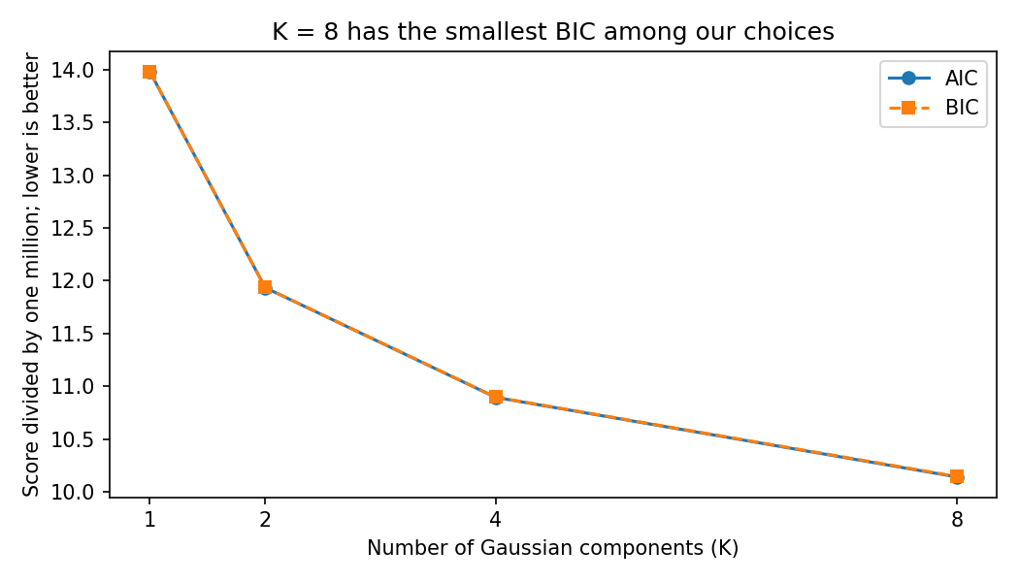
Choosing the component count
K = 8
has the smallest BIC (10.1449 million)
We tried K = 1, 2, 4 and 8 on the same legitimate rows and chose the smallest BIC.
Eight is the largest K tried and scores still fall, so it is best in this grid, not proven best overall.
Notes:
The chart is the real figure from notebook 04 (figures/06_aic_bic.png). We fitted K = 1, 2, 4 and 8 components on the same legitimate training rows. AIC = 2q - 2L and BIC = q log N - 2L balance a better fit against extra adjustable parameters; lower is better. We pick the smallest training BIC and report AIC alongside it. The two curves nearly coincide.
Results (millions): K=1 BIC 13.9826, K=2 11.9360, K=4 10.8968, K=8 10.1449. K=8 wins. With diagonal covariance and 29 inputs the free parameters are q = K(2d+1) - 1, so K=8 has 471.
Be careful with the claim: eight is the largest value we tried and both curves are still falling at the edge of the grid, so it is best within this grid, not proven best among every possible K. Also, a better legitimate density fit does not guarantee better fraud recall; AIC/BIC measure density fit only.

Slide 8
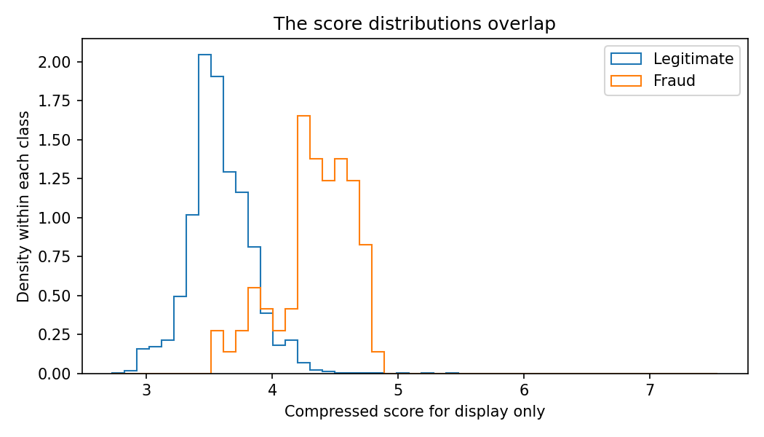
From score to review alert
score(x) = −log p(x)
Larger score = less typical transaction.
It is not a probability of fraud. An alert fires when the score is strictly above the cutoff.
CUTOFFS FIXED ON VALIDATION DATA
0.1% budget
112.9651
Real figure from notebook 05: the two score distributions overlap, so no cutoff is perfect. (Horizontal scale compressed for display only.)
0.5% budget (default)
75.8942
1.0% budget
68.9345
Notes:
We score each transaction with s(x) = -log p(x), where p is the density learned from legitimate training data. A low legitimate density gives a large score, meaning less typical. The score is NOT a probability of fraud. In code we negate scikit-learn's score_samples (which returns log density).
An alert fires when the score is strictly above the cutoff. We fixed three validation false-positive budgets before test evaluation: 0.1% gives cutoff 112.9651, 0.5% gives 75.8942 and 1.0% gives 68.9345 (validation FPRs 0.0988%, 0.4992% and 0.9984%). The default 0.5% cutoff is the 99.5th percentile of legitimate validation scores using the conservative 'higher' percentile method. We carry each cutoff unchanged into test, so test FPR can differ. The 0.5% default is an illustrative classroom choice fixed before test evaluation.
The figure is the real one from notebook 05 (figures/13_score_overlap.png). Each class has its own density normalization, and the horizontal scale is compressed for readability only; ranking and cutoff scores are unchanged. The overlap shows why any cutoff produces both false alerts and missed fraud.

Slide 9
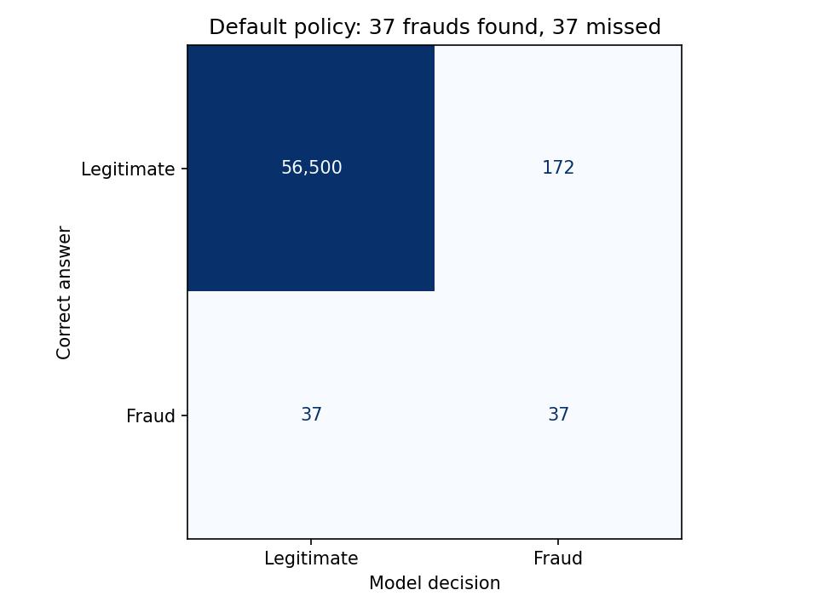
The default test result
50%
Recall
37 / 74 frauds found
17.70%
Precision
37 / 209 alerts are fraud
0.3035%
False-positive rate
172 / 56,672 legitimate
209 reviews: we find 37 frauds and miss 37.
Notes:
The confusion matrix is the real figure from notebook 05 (figures/07_confusion.png). At the default cutoff the test set gives TN = 56,500, FP = 172, FN = 37, TP = 37. TN: legitimate with no alert. FP: a legitimate false alert. FN: missed fraud. TP: fraud found.
Recall = 37 / 74 = 50%. Precision = 37 / 209 = 17.70%. FPR = 172 / 56,672 = 0.3035%. Each uses a different denominator: recall divides by all frauds, precision by all alerts, FPR by all legitimate transactions.
Workload is 209 alerts. We find half the fraud, miss half, and send 172 legitimate transactions for review. Most alerts are legitimate. The validation budget was 0.5% but the test FPR came out at 0.3035%, so a validation budget does not guarantee the same test FPR.
With only 74 test frauds, one decision moves recall by about 1.35 percentage points.

Slide 10
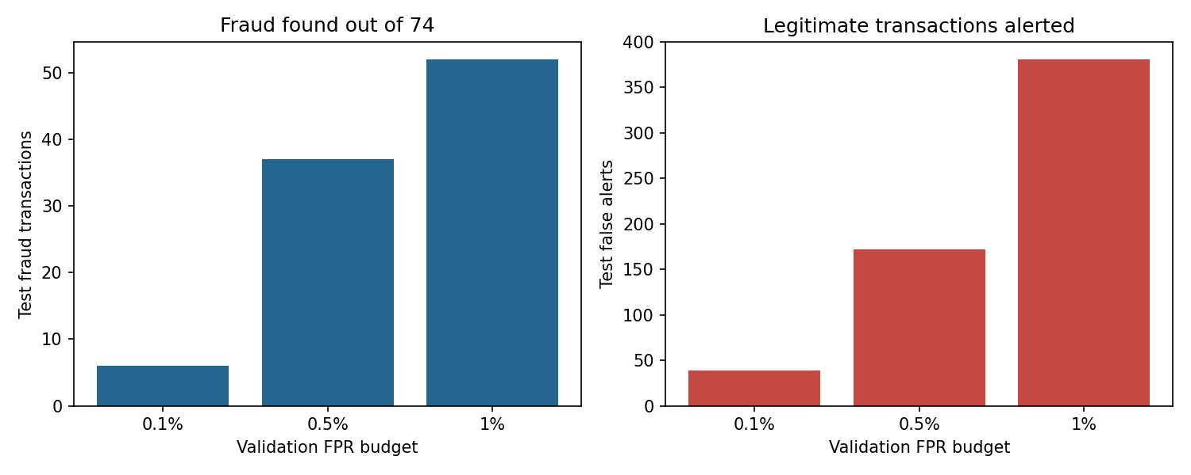
More review, more false alerts
A looser cutoff catches more fraud, and sends more legitimate transactions for review.
All three cutoffs were fixed on validation data, then applied unchanged to the test period.
8.11%
50.00%
70.27%
recall at 0.1% budget
recall at 0.5% budget
recall at 1.0% budget
Notes:
The charts are the real figure from notebook 05 (figures/08_tradeoff.png). These are the three validation false-positive budgets we fixed in advance (0.1%, 0.5%, 1%), applied unchanged to the test period. At 0.1% we find 6 frauds with 39 false alerts (recall 8.11%). At 0.5% we find 37 with 172 false alerts (recall 50.00%). At 1% we find 52 with 381 false alerts (recall 70.27%).
Takeaway: a more permissive policy finds more fraud here, but also creates many more false alerts. These are validation budgets, not guaranteed test FPRs. We do not pick the 'best' policy by looking at test outcomes.

Slide 11
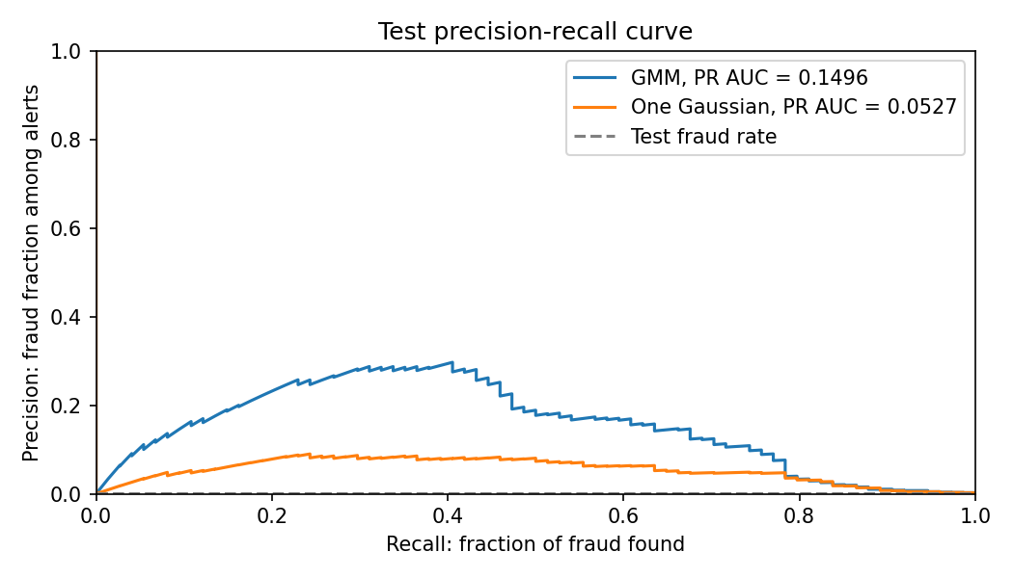
Ranking quality
PR AREA (TEST)
0.1496
Selected GMM
One Gaussian reference: 0.0527
TEST FRAUD RATE
0.1304%
74 of 56,746 test transactions: the baseline a random ranking would match.
Notes:
This is the real precision-recall figure from notebook 05 (figures/09_precision_recall.png). It shows precision against recall across all score cutoffs. The area under it (trapezoidal) is 0.1496 for the selected GMM on this test period, versus 0.0527 for a one-Gaussian (K = 1) reference built on the same data, scaler, score definition and test period. The dashed line in the figure is the test fraud rate, 0.1304% (74 of 56,746). PR area is not accuracy and not precision at the default cutoff. We compare ranking under one area definition, and the mixture ranks fraud better in this run; this is not a universal guarantee that adding components improves detection.
Source: Saito and Rehmsmeier (2015) on why PR plots suit rare positives.

Slide 12
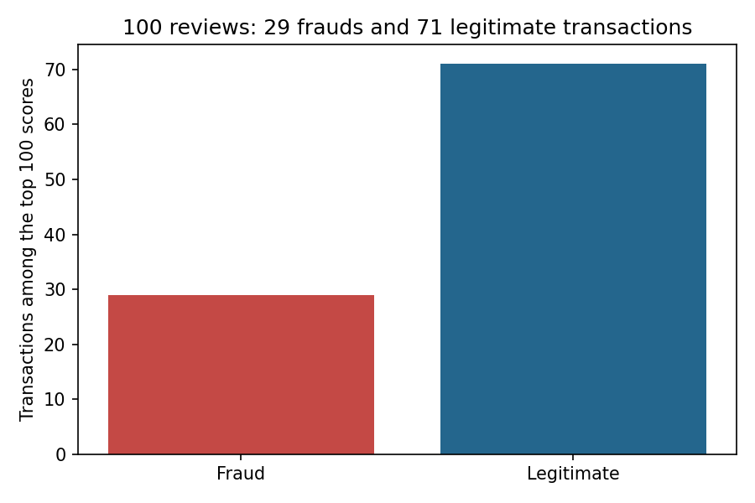
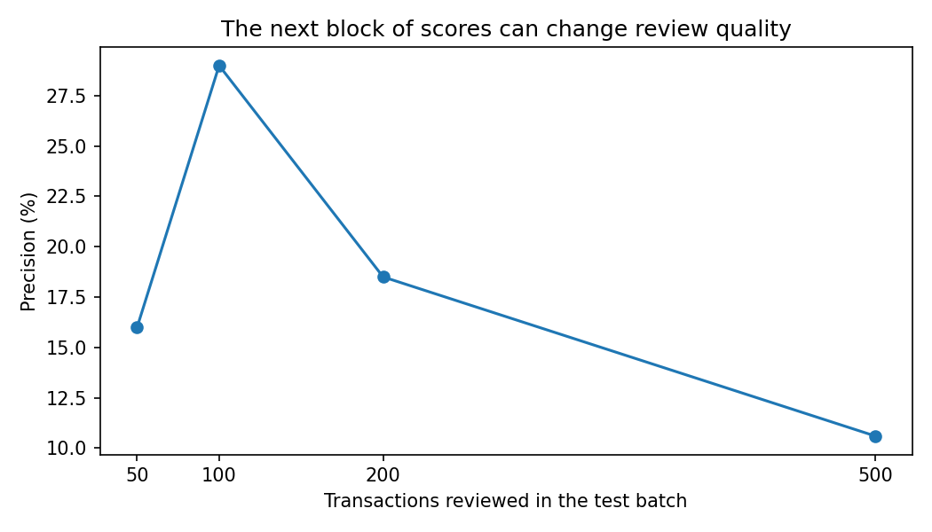
Fixed review capacity
Top 100 reviews: 29 frauds, 71 legitimate. Precision@100 = 29%.
Precision need not fall at every larger capacity, because the next ranked block may hold more or fewer frauds.
Notes:
Both charts are real figures from notebook 05 (figures/10_capacity.png and figures/12_review_capacities.png).
For a fixed batch capacity, sort by decreasing anomaly score and review exactly 100 rows. We find 29 frauds and 71 legitimate transactions, so precision@100 = 29%. Tied scores keep chronological order. This is a capacity for the whole test batch, not a daily workload claim.
Supporting capacities: 50 reviews find 8 frauds (16.0% precision, 10.81% recall); 100 find 29 (29.0%, 39.19%); 200 find 37 (18.5%, 50.00%); 500 find 53 (10.6%, 71.62%). Precision need not decrease at every larger capacity because the next ranked block may contain more or fewer frauds.

Slide 13



Reproducible by design
01
02
03
04
05
Project and literature
Quality and EDA
Feature engineering
GMM training
Evaluation
READ
RUN
RUN
RUN
RUN
Run 02 to 05 in order: restart the kernel, then Run All.
Built-in checks
Evidence checklist
Team accountability
Time split, scaler fit, convergence and validation budgets.
Links all nine Phase 1 areas to evidence.
Every member explains the full project and records actual contributions.
Notes:
Five ordered notebooks hold the whole analysis: 01 project and literature, 02 data quality and EDA, 03 feature engineering, 04 GMM training, 05 evaluation. They exchange saved local files rather than a shared Python session. Read 01, then run 02 to 05 in order, restarting each kernel and using Run All. All analysis and saving code is visible in the cells.
Inline checks cover schema, finite values, labels, time separation, feature exclusion, scaler fitting rows, convergence, empirical validation budgets and consistency of the final confusion counts. The run records the input checksum, feature list, model settings, thresholds and software versions (Python 3.12.4, NumPy 1.26.4, pandas 2.2.2, scikit-learn 1.4.2).
FILE_MAP.md links each result and chart to its notebook; docs/CODE_GUIDE.md explains the functions; docs/PHASE1_CHECKLIST.md maps all nine assessment areas to evidence. Raw data and model binaries stay outside Git and are recreated by the notebooks. Each team member must understand the whole project and record their actual contribution in docs/TEAM_CONTRIBUTIONS.md.

Slide 14

What we can conclude
50%
172
29 / 100
of test fraud found at the default cutoff (37 of 74)
false alerts sent to review
frauds in the top 100 ranked reviews
The GMM gives a clear order for reviewing transactions: a solid Phase 1 baseline, not a production system.
LIMITS TO KEEP IN MIND
Only 74 test frauds
Short historical data
Phase 1 covers the GMM. The autoencoder belongs to Phase 2.
Hidden feature meanings
Notes:
Conclusion: the GMM gives a clear order for reviewing transactions and a transparent Phase 1 baseline. At our default cutoff it finds half the test fraud (37 of 74) and creates 172 false alerts; reviewing exactly the top 100 scores finds 29 frauds. It ranks better than the one-Gaussian reference (PR area 0.1496 vs 0.0527).
Limits to state honestly: only 74 test frauds, so one decision shifts recall by about 1.35 points; short historical data; anonymous inputs and unaudited provider PCA; the duplicate-removal assumption; diagonal covariance; a small K grid; and future patterns can change. Rarity is not the same as fraud. We do not claim production readiness.
Phase 1 covers the GMM only. Phase 2 may compare an autoencoder using the same legitimate training rows and evaluation protocol. No autoencoder or hybrid results are included here.
References: Dempster, Laird & Rubin (1977), doi 10.1111/j.2517-6161.1977.tb01600.x; Saito & Rehmsmeier (2015), doi 10.1371/journal.pone.0118432; scikit-learn Gaussian mixture models guide; ULB/Worldline Credit Card Fraud Detection dataset; TensorFlow imbalanced-data tutorial.
Invite questions.

