Slide 1

Note: The data and information in this document is reflective of a hypothetical situation and client. This document is to be used for KPMG Virtual Internship purposes only.
Sprocket Central Pty Ltd
Data analytics approach
[Division Name] - [Engagement Manager], [Senior Consultant], [Junior Consultant]

Slide 2
Note: The data and information in this document is reflective of a hypothetical situation and client. This document is to be used for KPMG Virtual Internship purposes only.
Agenda
Introduction
Data Exploration
Model Development
Interpretation

Slide 3
Note: The data and information in this document is reflective of a hypothetical situation and client. This document is to be used for KPMG Virtual Internship purposes only.
Introduction
Customer Segmentation Analysis for Sprocket Central Pty Ltd
In this presentation, we will outline our approach to the customer segmentation analysis, which includes three phases - Data Exploration, Model Development, and Interpretation. Our goal is to provide valuable insights into customer behavior and preferences, which will help the client to develop targeted marketing strategies and drive the most value for the organization.
We believe that our proposed approach will be beneficial to Sprocket Central Pty Ltd, and we look forward to presenting our findings and recommendations at the end of the three-week scope.

Slide 4
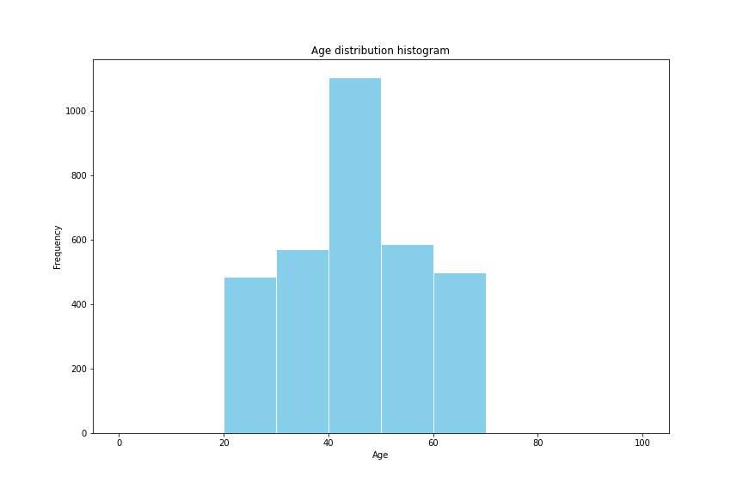
Note: The data and information in this document is reflective of a hypothetical situation and client. This document is to be used for KPMG Virtual Internship purposes only.
Data Exploration - Customer Age Distribution
The highest frequency is in the age range of 41-50 years.
The second-highest frequency is in the age range of 51-60 years.
Customers under the age group 20 - 30 are the least.
The Median age is estimated to be around 43 - 45.
Overall, this distribution shows a skewed right distribution, with a larger proportion of the population falling in the higher age ranges (41-70 years) than in the lower age ranges (0-30 years).

Slide 5
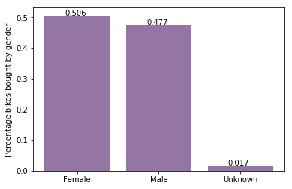
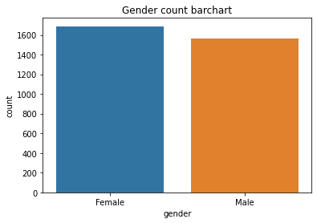
Note: The data and information in this document is reflective of a hypothetical situation and client. This document is to be used for KPMG Virtual Internship purposes only.
Data Exploration - Bike purchases within the last 3 years
It is evident that the majority of our new customers, accounting for 50.6% of the purchases, are female and have bought a total of 25,212 bikes.
Male customers make up 47.7% of the purchases, with a total of 23,765 bikes.

Slide 6
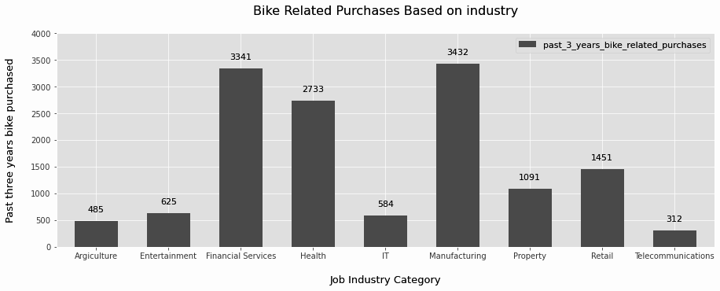
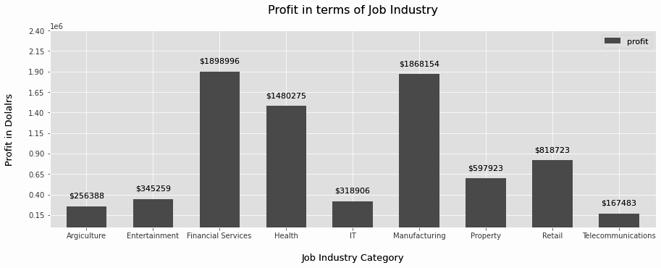
Note: The data and information in this document is reflective of a hypothetical situation and client. This document is to be used for KPMG Virtual Internship purposes only.
Data Exploration - Job Industry
Financial Services, Manufacturing, and Health are the top three profit-generating industries, followed by retail and property.
As indicated in the second chart, the Financial Services, Manufacturing, and Health industries also exhibit the highest profits.

Slide 7
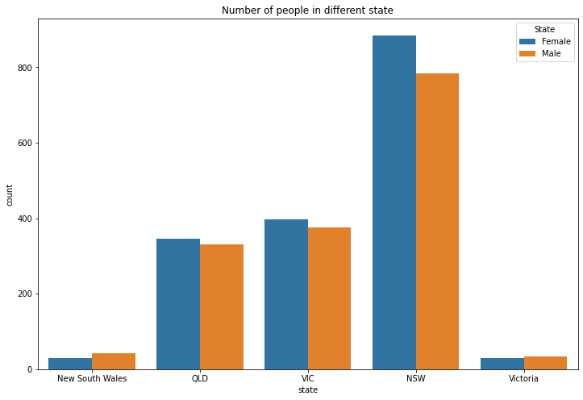
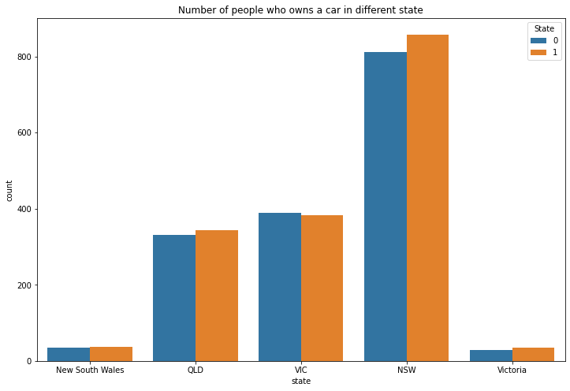
Note: The data and information in this document is reflective of a hypothetical situation and client. This document is to be used for KPMG Virtual Internship purposes only.
Data Exploration : Number of cars owned by each states
NSW has the highest number of car owners as well as population, and a relatively higher proportion of customers who do own cars.
VIC has the second-highest number of car owners, with a relatively equal proportion of customers who do not own cars.
On the other hand, QLD has the lowest number of car owners, which presents an opportunity to target this state.

Slide 8
Note: The data and information in this document is reflective of a hypothetical situation and client. This document is to be used for KPMG Virtual Internship purposes only.
Interpretation
After conducting initial analyses, we have identified the following high-value clients to target from the new list:
Aged between 40 – 50.
Most of the high value customers are female compared to male
Customers employed in the financial services, manufacturing, and health sectors show high potential
Customers who currently reside in New South Wales and Victoria exhibit high potential.

Slide 9
Note: The data and information in this document is reflective of a hypothetical situation and client. This document is to be used for KPMG Virtual Internship purposes only.
Appendix

Slide 10
Note: The data and information in this document is reflective of a hypothetical situation and client. This document is to be used for KPMG Virtual Internship purposes only.
Appendix
Our proposed approach to the customer segmentation analysis for Sprocket Central Pty Ltd involves three phases - Data Exploration, Model Development, and Interpretation. We believe this approach will provide valuable insights into customer behavior and preferences, which will help the client to develop targeted marketing strategies and drive the most value for the organization.

