Slide 1

Aspect-Based Sentiment Analysis on Hotel Reviews
ML Mini Project
PRESENTED BY
Chinmayee C M — SRN: PES2UG24CS133
Harshit Chandak — SRN: PES2UG24CS185
PES University
Illustration
Notes:
Introduce the project: aspect-based sentiment analysis on hotel reviews, built with classical machine learning. ML Mini Project, PES University.

Slide 2







Why one overall rating is not enough
Illustrative review example — not from the dataset
“The staff were very helpful, but the room was dirty and the location was convenient.”
Staff / service
Room cleanliness
Location
A single 3-star average would hide both the praise and the complaint.
Positive
Negative
Positive
Keep what works
Fix what hurts
Prioritise action
Praise for staff and location is preserved.
The cleanliness complaint is pinpointed.
Each concern can go to the right team.
Notes:
A single score hides what guests liked and what went wrong. The sentence on this slide is an illustrative example, not a dataset record.

Slide 3




What is Aspect-Based Sentiment Analysis?
1
2
3
4
Hotel review
Aspect identification
Aspect-specific rating
Sentiment classification
Raw text from a guest
Which feature is discussed?
Predict 1–5 stars
Negative · neutral · positive
Illustrative example
Polarity classification: ratings to sentiment
The staff were very helpful, but the room was dirty and the location was convenient.
1–2 ★
3 ★
4–5 ★
Negative
Neutral
Positive
Service
positive
Cleanliness
negative
Location
positive
Every aspect rating is mapped the same way.
Aspect identification determines which hotel feature is discussed.
Star-rating prediction estimates the rating for that aspect.
Polarity classification maps 1–2 to negative, 3 to neutral, 4–5 to positive.
Notes:
ABSA reads a review and answers: which feature is being discussed, how many stars does that feature deserve, and is the opinion negative, neutral or positive.

Slide 4






Project objectives
01
02
03
04
Predict overall ratings
Predict aspect ratings
Classify sentiment
Compare classical ML
Estimate the 1–5 star rating of a whole review.
Rate service, rooms, location, value, cleanliness and business service.
Map ratings to negative, neutral or positive.
Naive Bayes, Linear SVM and Logistic Regression.
05
06
07
Compare text processing
Show textual evidence
Handle uncertainty
Full review versus aspect-specific clauses.
Display the text the model actually used for each aspect.
Abstain when confidence falls below a validation-derived threshold.
Notes:
Seven objectives: predict overall and aspect ratings, classify sentiment, compare classical ML models and text-processing strategies, show textual evidence and handle uncertainty.

Slide 5
Dataset and experimental setup
Real data
Hotel-disjoint
Labels vary by aspect
Synthetic ≠ real
ArguAna TripAdvisor annotated v2 · 2,100 reviews · 122 hotels
No hotel appears in more than one of train, validation and test
Overall 2,100 · Service 1,608 · Rooms 1,647 · Location 1,238 · Value 1,631 · Cleanliness 1,651 · Business 772. Sleep Quality: no usable real labels
320 synthetic reviews are demo-only; never combined with real-test results
Notes:
Real data: ArguAna TripAdvisor annotated v2, 2,100 reviews from 122 hotels, split by hotel into 1,342 / 388 / 370. The 320-review synthetic set is a demonstration only and is never mixed with the real evaluation.

Slide 6






System architecture
1
2
3
4
5
Review input
Text segmentation
Aspect mention detection
Text routing
Count / TF-IDF
Raw hotel review text
Split into sentences and clauses
Rules find aspect words and keep the evidence clause
Full review, or the aspect clause only (fallback if unclear)
Turn words and 2-word phrases into numbers
6
7
8
9
10
ML classifier
Star rating
Polarity
Confidence and abstention
Results dashboard
Naive Bayes, Linear SVM or Logistic Regression, chosen per target
Predict 1–5 stars
1–2 negative · 3 neutral · 4–5 positive
Below the threshold → “uncertain”
Aspect, evidence, rating, polarity, confidence, status
Overall always uses the full review. Location and Cleanliness use aspect-specific text; the other targets use the full review (chosen on validation data).
Notes:
Left to right, then second row: review → segmentation → aspect mention detection and evidence → routing → vectorisation → classifier → stars → polarity → confidence threshold → results dashboard.

Slide 7


Machine-learning models and selection
Multinomial Naive Bayes
Linear Support Vector Machine
Logistic Regression
TF-IDF · 1–2-word phrases · α = 0.5
Count vectors · C = 0.1 · balanced classes
TF-IDF · C = 4 · balanced classes
Probabilistic and fast; learns how likely each word is in each rating class.
Finds the widest margin between classes; probabilities via sigmoid calibration.
Learns a weight for each word or phrase to estimate class probabilities.
Count vectors vs TF-IDF
Selected configuration per target (real data)
Review: “great room, dirty room”
Target | Model | Text | Val. F1
Overall | Naive Bayes (TF-IDF) | Full review | 0.666
Service | Logistic Regression (TF-IDF) | Full review | 0.635
Rooms | Logistic Regression (TF-IDF) | Full review | 0.588
Location | Logistic Regression (TF-IDF) | Aspect clause | 0.413
Value | Naive Bayes (TF-IDF) | Full review | 0.600
Cleanliness | Logistic Regression (TF-IDF) | Aspect clause | 0.567
Business Service | Logistic Regression (TF-IDF) | Full review | 0.548
Word | Count | TF-IDF idea
room | 2 | Common in hotel reviews → down-weighted
dirty | 1 | Rarer and informative → up-weighted
great | 1 | Moderate weight
Count vectors record how often a word appears. TF-IDF also scales each word by how rare it is across all reviews.
Chosen on validation polarity macro-F1 (ties → star accuracy, full review, model name). Linear SVM competed on every target but won none on real data.
Notes:
Three model families are candidates for every target. The selected model and text strategy differ by target, chosen on validation polarity macro-F1 with deterministic tie-breaking. Linear SVM was a candidate but was not selected for any real-data target.

Slide 8
Full-review vs aspect-specific processing
Full-review processing
Aspect-specific processing
The staff were friendly and helpful. The room was dirty, but the location was close to the station.
The staff were friendly and helpful. The room was dirty, but the location was close to the station.
vs
Every clause reaches the model, whatever aspect is being rated.
Location → “the location was close to the station.”
Risk: praise for staff or a complaint about the room can bleed into the Location prediction.
Cleanliness → “The room was dirty”
Evidence shown as extracted by the app for this demo review.
Who uses which?
Not always better
Aspect clause: Location, Cleanliness
Full review: Overall, Service, Rooms, Value, Business Service
Fallback: ambiguous routing or no explicit mention → whole review (e.g. 243 of 794 labelled Location training reviews).
Cleanliness macro-F1 rose (0.539 → 0.566) but Location fell (0.423 → 0.383). Hotel-level bootstrap intervals for both changes include zero, so no improvement is claimed.
Notes:
Full-review models see every clause, so opinions about one aspect can leak into another. Aspect-specific processing feeds the model only the clause about that aspect. It is used for Location and Cleanliness, falls back to the full review when routing is ambiguous, and does not always improve results.

Slide 9
How we measure performance
POLARITY METRICS · 3 classes: negative / neutral / positive
Accuracy
Precision
Recall
Macro-F1
Share of reviews whose polarity is predicted correctly.
Of reviews predicted as a class, how many truly belong to it.
Of reviews truly in a class, how many were found.
Per-class F1 (balance of precision and recall), averaged equally.
(136 + 40 + 100) / 370 = 74.6%
Negative: 136 of 164 predicted = 82.9%
Negative: 136 of 170 true = 80.0%
Mean of 3 class F1 scores = 0.709
STAR METRICS · 5 classes: 1★ to 5★
Polarity and star metrics are separate measurements — never interchangeable.
Exact-star accuracy
Within-one-star accuracy
Mean Absolute Error
Confusion matrix
Share of reviews where the predicted star equals the true star.
Share of predictions at most one star away from the truth.
Average gap between predicted and true stars (lower is better).
Table of true class (rows) versus predicted class (columns); the diagonal is correct.
189 of 370 exactly right = 51.1%
341 of 370 within ±1 star = 92.2%
Average gap = 0.608 stars
See slide 12 for the real matrix
Notes:
Polarity metrics use three classes; star metrics use five. They are different measurements. Examples use the real Overall test results: 370 reviews.

Slide 10
Overall results on the real test set
POLARITY · negative / neutral / positive
74.6%
0.709
Polarity accuracy
Polarity macro-F1
Correct negative / neutral / positive calls
Classes weighted equally
EXACT STARS · 1★ to 5★
51.1%
92.2%
0.608
Exact-star accuracy
Within-one-star
Star MAE (stars)
Predicted star = true star
At most 1★ away
Average star error
370 test reviews
Hotel-disjoint; test rows never used for fitting.
95% Wilson interval for polarity accuracy: 69.9–78.8% (ignores hotel clustering).
The model predicts polarity more accurately than the exact star rating, while most star predictions are within one star of the true rating.
Notes:
All values are read from outputs/real/metrics.csv. The model predicts polarity more accurately than exact stars; most star predictions are within one star. Both exceed the majority-class baselines.

Slide 11
Aspect-wise performance comparison
Overall polarity macro-F1
0.709
Location
72.2% accuracy · macro-F1 0.383
Business Service
55.4% polarity accuracy
Performance differs across aspects
Accuracy alone can hide weak classes when class distributions are uneven: 176 of 223 Location test reviews are positive. No significance tests or external benchmarks are claimed.
Notes:
Seven targets from the real held-out test set. Polarity accuracy, polarity macro-F1 and exact-star accuracy are different measurements. Location shows why accuracy alone can mislead when classes are uneven. No significance tests or external benchmarks are claimed.

Slide 12
Confusion matrix and error analysis
Overall rating — actual vs predicted stars (test, n = 370)
What the matrix shows
PREDICTED RATING →
189 of 370 predictions sit on the diagonal (51.1%).
1★ is found best: 69 of 85 (81%).
2★ is hardest: only 17 of 85 correct; 39 went to 1★ and 27 to 3★.
27 of 65 true 5★ reviews were predicted as 4★. Most errors are neighbouring stars (92.2% within one star).
ACTUAL ↓ | 1★ | 2★ | 3★ | 4★ | 5★
1★ (n=85) | 69 | 11 | 2 | 1 | 2
2★ (n=85) | 39 | 17 | 27 | 1 | 1
3★ (n=80) | 8 | 13 | 40 | 15 | 4
4★ (n=55) | 0 | 2 | 10 | 33 | 10
5★ (n=65) | 4 | 1 | 3 | 27 | 30
Overall · actual 2★, predicted 1★ (confidence 0.600)
“…Room looked nothing like the expedia picture, no coverlet and bed linen was not changed in the 3 days we stayed there.”
Location · actual 1★, predicted 5★ (confidence 0.796)
“…The location, la rambla, is awful.” — a clear negative opinion predicted positive; only 20 of 223 Location test reviews are negative.
Share of the true class (row)
0%
100%
Notes:
Real Overall confusion matrix on 370 test reviews (counts). Darker cells hold a larger share of the true class. Errors are mostly adjacent stars. The two examples are real rows from error_examples.csv.

Slide 13
Confidence-aware prediction
1
Prediction
2
Confidence assessment
3
Validation-derived threshold
≥ threshold → Predicted
Rating and class probabilities from the model
Probability of the predicted polarity
Maximises balanced accuracy of spotting correct vs wrong validation predictions; frozen before refit
< threshold → Uncertain
Predicted
Uncertain
Confidence at or above the threshold: rating and polarity are shown.
Below the threshold: no rating or polarity shown; a tentative candidate stays in the details.
Not mentioned
Unavailable
The aspect is not explicitly mentioned in the review.
Sleep Quality: no usable real labels, so no real model exists.
Confidence scores are model outputs, not guaranteed probabilities of correctness. Accepted accuracy covers only 36–67% of reviews, so it never replaces the all-review metrics.
Notes:
Each prediction gets a confidence value. A threshold chosen on validation data decides whether the system commits to a rating or says uncertain. Confidence is not a guarantee of correctness.

Slide 14
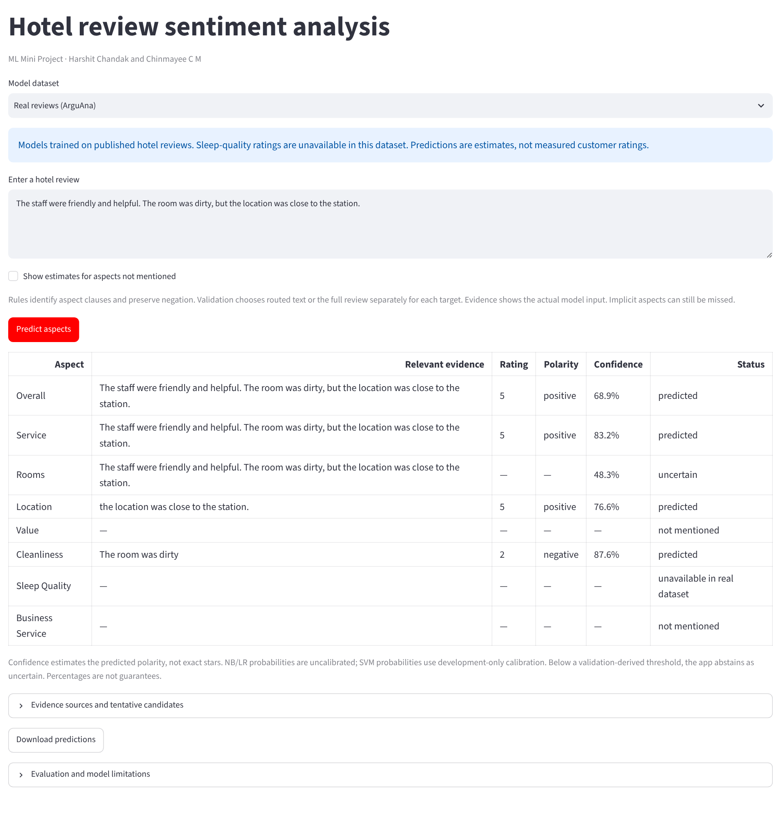


Application demonstration
Real screenshot of the Streamlit app
1
Review input — Paste or type any hotel review.
2
Aspect-wise predictions — One row per aspect, including Overall.
1
3
Relevant evidence — The text the model used for that aspect.
2
3
4
5
4
Star rating and polarity — 1–5 stars mapped to negative / neutral / positive.
5
Confidence and status — Predicted · uncertain · not mentioned · unavailable.
How hotel managers could use it
Rooms
Cleanliness
Service
Location
Value
Read the evidence behind each aspect to see which guest concerns recur, then route them to the right team.
Notes:
Real screenshot of the Streamlit app using the real-review models on its default demo review. Rooms is uncertain, Value and Business Service are not mentioned, and Sleep Quality is unavailable.

Slide 15


Findings, limitations and future work
Key findings
Limitations
74.6%
overall polarity accuracy
Location macro-F1 (0.383) is low despite 72.2% polarity accuracy; positive reviews dominate.
Aspect labels are not available for every review.
Aspect routing can be imperfect.
Cross-aspect information can still affect predictions.
Data are historical, English-language reviews.
Sleep Quality has no usable real labels.
Results do not establish performance on all hotels or future reviews.
Held-out results are descriptive, not an independent external benchmark. Not production-ready.
0.709
overall polarity macro-F1
51.1%
exact-star accuracy
92.2%
within-one-star accuracy
Varies
performance differs by aspect (macro-F1 0.383–0.709)
Future work
Improve aspect extraction and routing
Use broader, more diverse hotel-review datasets
Improve handling of ambiguous reviews
Improve confidence calibration
Evaluate on independently collected reviews
Notes:
Be honest: results are descriptive on a reused held-out split, performance varies by aspect, and the system is not production-ready.

Slide 16

Conclusion
Aspect-Based Sentiment Analysis turns unstructured hotel reviews into aspect-specific sentiment insights.
Contribution: an end-to-end classical-ML pipeline with aspect routing, star and polarity prediction, textual evidence and abstention.
Main findings: 74.6% polarity accuracy and 0.709 macro-F1 overall; performance varies by aspect.
Scope: descriptive held-out results; not production-ready.
References and dataset attribution
Wachsmuth, H. et al. (2014). A Review Corpus for Argumentation Analysis. CICLing. ArguAna TripAdvisor annotated v2, zenodo.org/records/3973241 (scientific use only).
Yu, Y. (2016). Aspect-based Sentiment Analysis on Hotel Reviews. Stanford CS229.
scikit-learn: Probability calibration, scikit-learn.org/stable/modules/calibration.html
Thank You
Questions?
Chinmayee C M — SRN: PES2UG24CS133
Harshit Chandak — SRN: PES2UG24CS185
Notes:
Wrap up: ABSA turns unstructured reviews into aspect-specific insight; main findings; honest scope. Then thank the audience and invite questions.

