Slide 1
Q1
Steps involved:
Checked for duplicate values, if any found removed.
Handled missing or null values by replacing them with mean or medium.
Formulas used:
=if(isblank(x),average(column),x)
=counta(column)

Slide 2
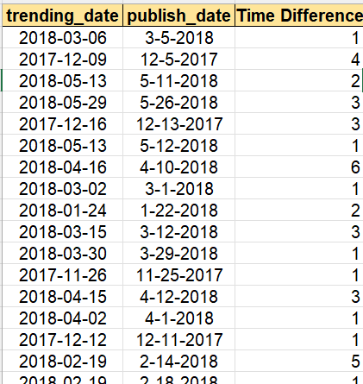
Q2
Insights:
On an Average it takes 2 days for a video to go trend.
formula used:
Time difference = trending date – publish date
=Round(days,0)

Slide 3
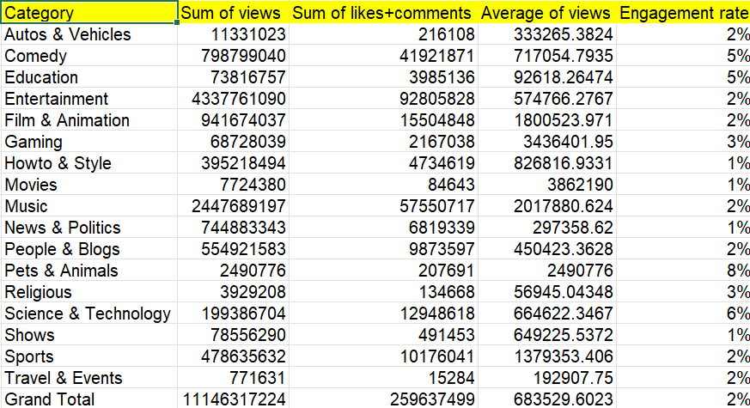
Q3
Formulas used:
Engagement rate = (likes + comments)/views *100
Calculated average views for each category

Slide 4
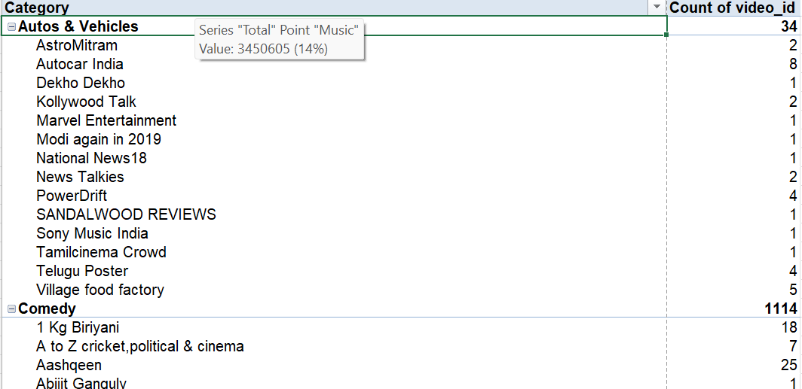
Q4
Formulas used:
Filter( Column array, Column = Creiteria)
=Xlookup(lookup value, lookup array, return array)

Slide 5
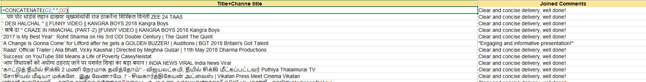
Q5
Formulas used:
concatenate(title,channeltitle)
=textjoin(“,”,1,comment cell)

Slide 6
Q6
Insights:
Obviously, There are no comments under the videos which disabled the comment section.
Comment enabled videos have comment count which shown in the bar chart.

Slide 7
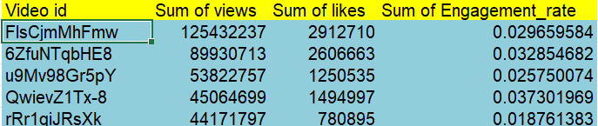
Q8
Insights:
1. Below are the top 5 videos based on views, likes and engagement rates

Slide 8
Q9
Insights:
12-6-2017 on this day, most videos are published and views also more.

Slide 9
Q10
Insights:
Compared to 2017 2018 has more views and likes.
We can say that views has a significant increase along with the likes.

Slide 10
Q13
Insights:
Entertainment category has the most views, likes and engagement rates over other categories.
Music takes the second place with most views, likes and comments.

Slide 11
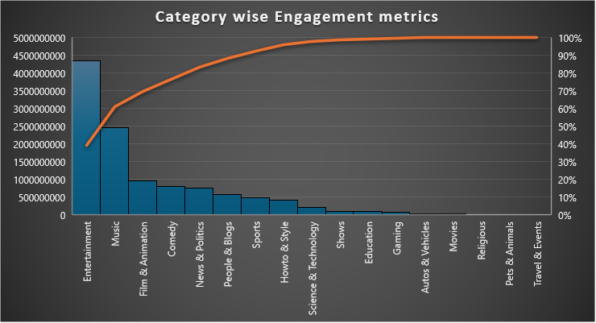
Q14
Insights:
Entertainment stood the first in terms of engagement metrics over other categories.
Music is next category to have that much engagemetrics .

Slide 12
Q15
Insights:
Correlation Between likes and dislikes 0.50921
Correlation between views and comment count 0.665026

