Slide 1

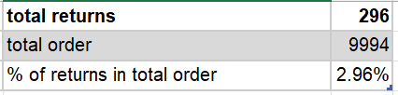
Q1
Inference :
We can say that, There are 3 people out of 100 are returning products
Because of that we are having loss out of sales.
Insights :
Used pivot table to analyse the sum of sales
Categorize the orders into two groups which are returned and not returned
Calculated the sales for the returned orders and deducted it from the overall sales

Slide 2
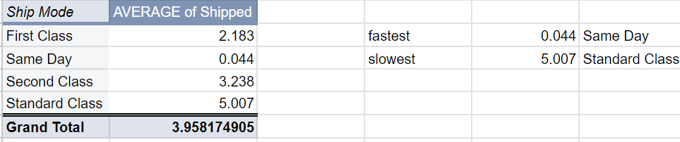
Q2
Inference :
The days taken to ship the same day mode orders are 0, which is great thing.
The people which are preferring standard class are getting order by 5 days averagely.
Insights :
Added a column of number of days taken to ship by deducting order date from ship date
Then calculated the average of ship days by ship mode using pivot table

Slide 3
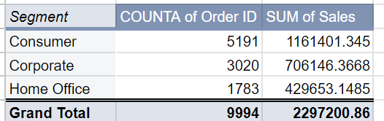
Q3
Insights :
calculated segment wise orders count, so we can find which segment has more number of orders.
Calculated total sales by each segment , to find which segment generating more sales amount.
Inference :
We can see that , consumer segment generating more sales amount, so we can expand our network to more consumers.
The segment with less sales amount and less number of orders , we can change our strategy to increase sales.

Slide 4
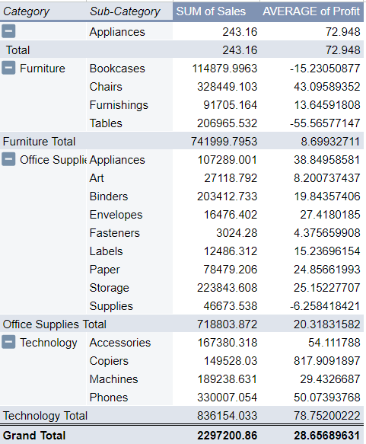
Q4
Insights :
Used pivot table to calculate the category wise and sub category wise total sale.
Calculated average profit we are getting by each sub category there by category.
Inference :
In each category , we can see that sub categories with high sales and sub category with low sales, which means we can increase the production of those sub categories.
We can stop production of sub categories in each category which are giving low profit.

Slide 5
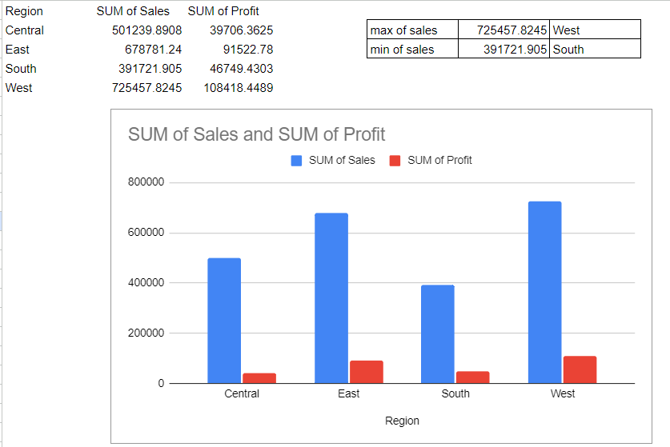
Q5
Insights :
Calculated region wise total sales and total profit.
There by calculated the maximum sales of region and region with less sales.
Inference :
The west region has more orders, which means we can increase our production.
The south region has less number of sales and profit, which means we can make changes in our production and have to increase our marketing strategy.

Slide 6
Q6
Inference :
When the discount is high, the quantity is likely to increase. Which means two are strongly correlated.
When discounts are given to customers, our profits are likely to go on loss, so give discounts based on value of the customer.
Insights :
Drew a correlation between discount and profit.
Calculated the correlation matrix between discount and quantity.

Slide 7
Insights :
Q7
Inference :

Slide 8
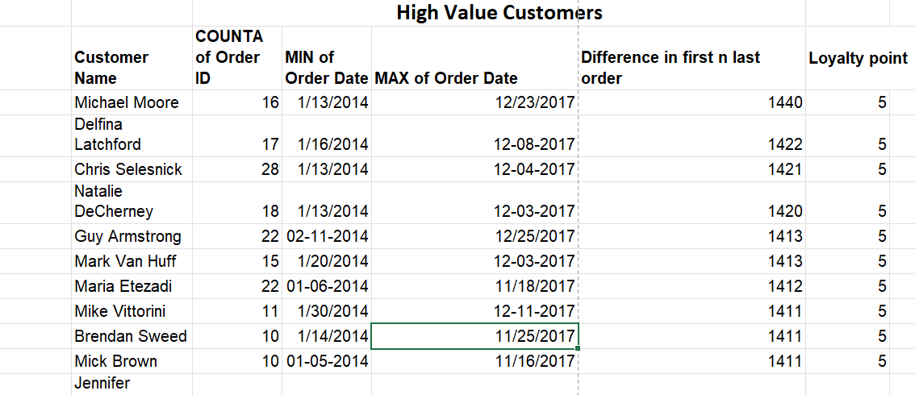
Q8
Inference :
The customers with high loyalty points are more valuable customers , so we can give them discounts and coupons.
We have to encourage the customers with high loyalty points by giving them offers.
Insights :
Used new metric such as loyalty points to segment the customers based on certain metrics
The metrics taken such as number of orders, retention rate, total purchase.

Slide 9
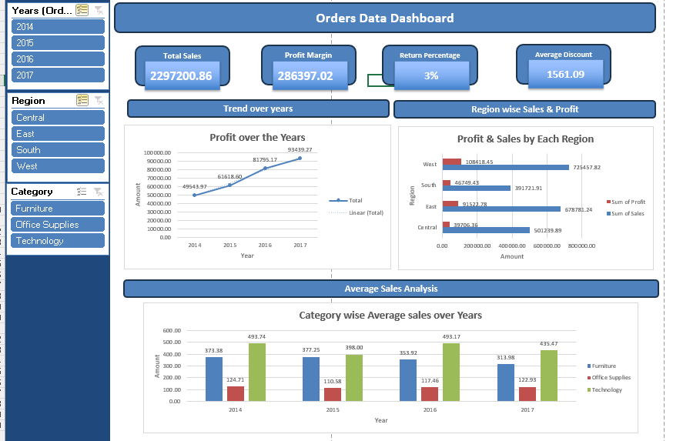
Q9

