Slide 1
Agentic Commute Planner
Plans your commute tonight. Fixes it at sunrise.
Home
9 PM plan
Morning check
Alert
Work
Chandan Das
Notes:
Agentic Commute Planner: an AI agent that plans a Bay Area commute the night before and re-plans it in the morning from live data. Live at agentic-commute-planner.cdas2020kapu.workers.dev.

Slide 2






Tonight’s best commute can be wrong by morning
The problem
The goal
Traffic shifts by the hour
One stalled car on US-101 can add 20+ minutes
One plan the night before
Four ways to go
One live check in the morning
Drive, BART, Caltrain or ACE: a different one wins each day
Too many apps, too late
One alert, only if it changes
Checking five apps at 7 AM leaves no time to change plans
Why it mattered to me: it is built around my own Mountain House → Santa Clara commute.
Notes:
Why: Bay Area commutes swing with traffic, and the best mode (drive, BART, Caltrain, ACE) changes day to day. Goal: plan the night before, re-check live in the morning, and alert only when the plan meaningfully shifts. The 20+ minute example is illustrative. Personal line based on the default commute in the repo (Mountain House Pkwy → Great America Pkwy, arrive ~9:00); edit if needed.

Slide 3



What commuters get
Know when to leave
The best of four modes
Alerts that matter
Learns your habits
Leave time, arrival, chance of being late and cost
Drive, BART, Caltrain and ACE compared side by side
“Leave 15 min early”, sent only when the plan shifts
“I took this” tunes every later recommendation
Plus: every data source shows LIVE, MOCK or ERROR, so you know when not to trust a plan.
Notes:
Benefits from the README and user guide: best way to go with leave time, arrival, late risk and cost; alternatives; alerts via ntfy/Slack when the plan shifts by the chosen threshold (default 10 min); feedback ("I took this") shifts a learned mode bias.

Slide 4

Built for Bay Area commuters who have choices
Long-distance commuters
Mixed-mode commuters
Flexible-hours workers
Central Valley to Silicon Valley, e.g. Tracy or Mountain House to Santa Clara
Can drive, or drive to a BART, Caltrain or ACE station
Can leave later and “wait it out” when traffic eases
Notes:
Target users are inferred from what the app supports (Bay Area data sources; drive, BART, Caltrain and ACE; flexible arrival and a "wait it out" option). Today it is tuned for one commuter; multi-user needs higher 511 rate limits.

Slide 5





End-to-end architecture
Live data
511 traffic
Web app
Set up and view plans
Cloudflare Worker
BART departures
Planner
scores every option
NVIDIA NIM
Language model
Caltrain departures
PeMS freeway speeds
AI agent
checks data, picks one option
Supabase
Users, plans, alerts
Weather
Timer: every 10 min
Phone alert
ntfy or Slack
Mapbox drive ETA
Keys stay inside the Worker; the browser never sees them.
Notes:
Static UI and API both run in one Cloudflare Worker, with a cron trigger every 10 minutes. Data adapters (src/sources) are fetched in parallel, cached in KV, and each fails independently. NVIDIA NIM is called with OpenAI-compatible tool calling. Supabase stores profiles, plans, alerts and feedback, with magic-link sign-in. Alerts go to an ntfy or Slack webhook.

Slide 6


How a plan is made
1 Trigger
2 Gather
3 Score
4 Choose
5 Alert
9 PM plan, every 10 min in the morning, or a button
6 live sources at once; each can fail on its own
Every mode × departure, in 5-minute steps
AI agent reviews the data and picks one option
Compare with last night; save and notify
Steps 2 to 4 run in seconds: about 11 s per plan with the AI agent.
Notes:
gatherSnapshot() → buildOptions() (deterministic: traffic profile × live anomaly, incidents, rain, next train, miss-the-train risk → late risk, cost, score) → runAgent() (NVIDIA model calls get_traffic_incidents, get_transit_departures, get_weather, evaluate_options and must pick one scored option id) → computeAlert() → save to Supabase and webhook. ~10–12 s per plan with 2 model calls, measured on the live site (docs/STATUS.md).

Slide 7
The AI chooses; it never invents times
Planner computes
AI agent decides
Departure and arrival times
Chance of being late
Cost and overall score
Checks traffic, trains, weather
Picks one of the scored options
Explains the choice in plain words
No key, error, over 30 s, or an unknown pick
Use the planner’s top pick, and say so in the trace
Notes:
Guardrail from the README: the LLM explains the plan and chooses among options the planner has computed. If the key is missing, the API fails or times out (30 s budget, NVIDIA_BUDGET_MS), or the model returns an unknown option, the app falls back to the deterministic recommendation and shows this in the trace.

Slide 8

Night plan, morning check, alert only on a real change
9 PM
6:30 AM
7:05 AM
7:25 AM
Night plan
Re-plan every 10 min
Plan shifted: alert
Leave
“US-101 N is backing up. Leave 15 minutes early (7:25 AM), or take Caltrain at 7:32 AM.”
Alert types: switch mode · leave early · leave later · tight commute. Default trigger: a 10-minute shift. Times shown are an example.
Notes:
Cron runs every 10 minutes: a night-before plan at ~9 PM and morning re-plans in the departure window. computeAlert() compares morning vs night plan with hysteresis and sends urgent (switch mode, leave N min early), info (leave later) or warn (tight commute) alerts. The alert text is the example from the README; timeline times are illustrative.

Slide 9
Models: fast first, bigger as backup, rules last
1
Nemotron 3.5 Lightning 30B, 3B active
Tried, not used
Primary. Reliable tool calling and fast: about 11 s per plan. Thinking off, temperature 0.2.
Nemotron 3.5 Super VL 120B
unreliable JSON answers
Llama 3.3 70B
not enabled on the account
2
Nemotron 3 Ultra 550B, 55B active
Backup if the first model errors or times out. Also calls tools, but slower.
All served through NVIDIA NIM’s OpenAI-compatible API.
3
Rules-based planner no AI
Last resort. Always returns the top-scored option.
Notes:
From wrangler.toml and docs/STATUS.md: NVIDIA_MODEL = nvidia/nemotron-3.5-lightning-30b-a3b, NVIDIA_FALLBACK_MODEL = nvidia/nemotron-3-ultra-550b-a55b (used on 404, 5xx, 429 or timeout). Thinking switched off (enable_thinking=false), temperature 0.2, max 900 tokens, 30 s budget, then the planner's pick. ~10–12 s per plan with 2 model calls on the live site. Tested: nemotron-3.5-super-vl-120b-a12b (unreliable JSON); meta/llama-3.3-70b-instruct returned 404 (not enabled).

Slide 10

Supabase: four tables, each row owned by one user
Users (sign-in)
profiles
plans
alerts
feedback
Settings and learned habits
Each night and morning plan
What was sent and why
What you actually took
id
prefs jsonb
updated_at
user_id
kind night | morning
target_date
plan jsonb
user_id · plan_id
severity
title · message
read_at
user_id · plan_id
chosen_mode
actual_depart / arrive
rating 1–5
Row-level security: each user can read only their own rows.
Notes:
supabase/schema.sql: profiles(id → auth.users, prefs jsonb, updated_at); plans(id, user_id, kind night|morning, target_date, plan jsonb, created_at); alerts(id, user_id, plan_id → plans, severity info|warn|urgent, title, message, fingerprint unique per user, read_at, created_at); feedback(id, user_id, plan_id, chosen_mode drive|bart|caltrain|ace, actual_depart, actual_arrive, rating 1–5, note, created_at). The Worker writes with the service-role key; browsers read only their own rows. Feedback drives the learned modeBias.

Slide 11
Two sample rows (illustrative)
alerts
feedback
user_id | 7c1e…
plan_id | 1042
severity | urgent
title | Leave 15 min early
message | US-101 N is backing up. Leave 15 minutes early (7:25 AM), or take Caltrain at 7:32 AM.
created_at | 2026-11-11 07:05
user_id | 7c1e…
plan_id | 1042
chosen_mode | caltrain
actual_depart | 07:30
actual_arrive | 08:52
rating | 4
note | Train on time
Notes:
Both rows are invented for illustration, shaped to match supabase/schema.sql. The alert message text is the example alert from the README. For real rows: select * from alerts order by created_at desc limit 1; and the same for feedback.

Slide 12
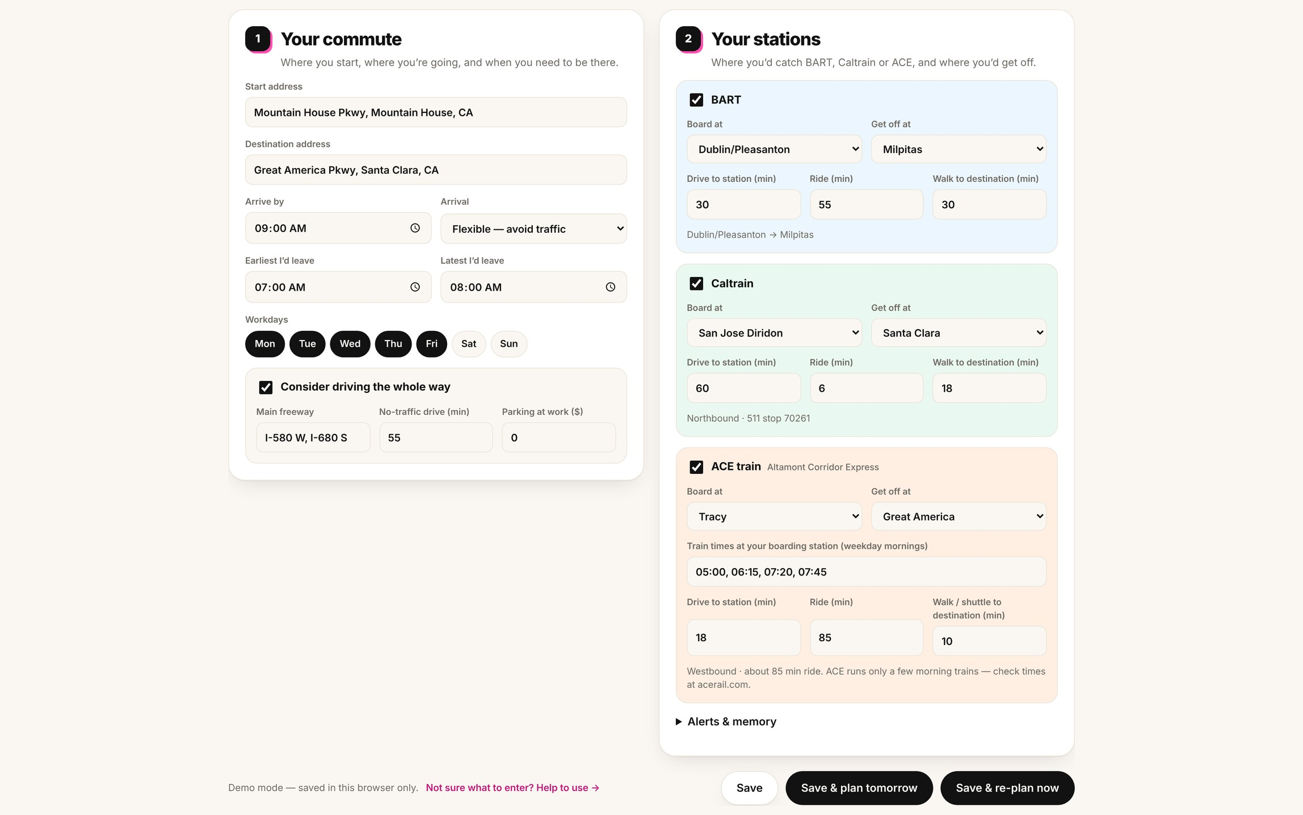
Demo: set it up once
1
Enter start, destination and arrive-by time
2
Pick your BART, Caltrain or ACE stations
3
Press “Save & plan tomorrow”
agentic-commute-planner.cdas2020kapu.workers.dev
Notes:
Live: https://agentic-commute-planner.cdas2020kapu.workers.dev. Sign-in is optional (magic link); without it settings are saved in the browser. Screenshot from the live site with the Mountain House → Great America Pkwy commute, including the ACE card.

Slide 13
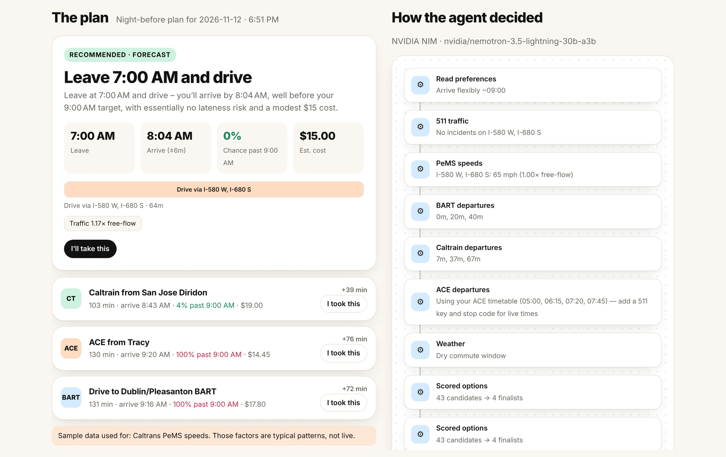

Demo: the plan, and why the agent chose it
Best option
Leave time, arrival, late risk, cost
Alternatives
How much later each one arrives
Agent trace
Every data check behind the pick
Live site, live data, decided by the NVIDIA agent. Live demo: “Save & re-plan now”.
Notes:
Demo script: 1) open the live site, 2) show the saved commute, 3) press Save & re-plan now and wait ~11 s, 4) walk through the recommended option, alternatives and the agent trace, 5) press "I took this" to show learning. Screenshot is from the live site: 511 traffic, BART, Caltrain and weather LIVE; only PeMS uses sample data; decided by nvidia/nemotron-3.5-lightning-30b-a3b.

Slide 14

Questions?
Thank you
Chandan Das
agentic-commute-planner.cdas2020kapu.workers.dev · github.com/Chandan-Kapu/Agentic-Commute-Planner
Notes:
Open the floor for questions. Links: live site and GitHub repo.

