Slide 1
PETROL PRICE FORECASTING

Slide 2
PROJECT DETAIL
PROJECT TITLE : PETROL PRICE FORECASTING
TECHNOLOGY : MACHINE LEARNING
DOMAIN : OIL AND ENERGY
PROGRAMMING LANGUAGE USED : PYTHON
TOOLS USED : FLASK, HTML, CSS, PYCHARM, JUPYTER NOTEBOOK, DOCKERHUB, CIRCLECI, GIT AND GITHUB, HEROKU.

Slide 3
PROBLEM STATEMENT
The client organisation is dedicated to the exploration and production of oil and natural gas. Price information is supplied on a weekly basis from 9th June 2003 to 31st December 2018. It seeks to forecast petrol prices for the following 16 months.

Slide 4
BUSINESS CONTEXT
The main goal is to forecast petrol prices for the following 16 months, from January 1, 2019 to April 1, 2020. The petrol price forecasting is a machine learning based model which will help us to forecast the petrol price in USD. Different Regression algorithms have been tested and compared to predict the better outcome of the model. Also, MLOps on the cloud gives the leverage of carrying the automation of ML projects on a various cloud platforms.

Slide 5
CHALLENGES FACED
Outliers
Missing values
Statistical time series models did not provide good results.
Multicollinearity

Slide 6
THINGS LEARNED
Not only ARIMA and SARIMA models is used for Forecasting time series data, other machine learning algorithms can also be used to forecast and get better results.
Doing proper EDA and preprocessing of the data can improve the performance of the model significantly.
Creating new features can improve the performance.

Slide 7
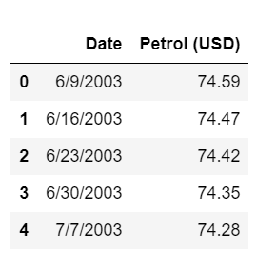
DATASET INFORMATION
The dataset consists of 813 rows and 2 columns.
Date – The date on which petrol price is recorded, given on a weekly basis from 9th June 2003 to 31st December 2018.
Petrol(USD) – Petrol price in USD.

Slide 8
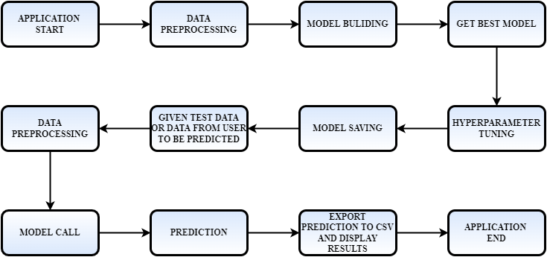
ARCHITECTURE

Slide 9
EDA AND PREPROCESSING
CHECKING THE DATA TYPE OF THE COLUMNS
Date – Object
Petrol (USD) – Float64
HANDLING MISSING VALUES
The dataset contains missing values in the Petrol(USD) column.
Using forward fill to fill the missing values.

Slide 10
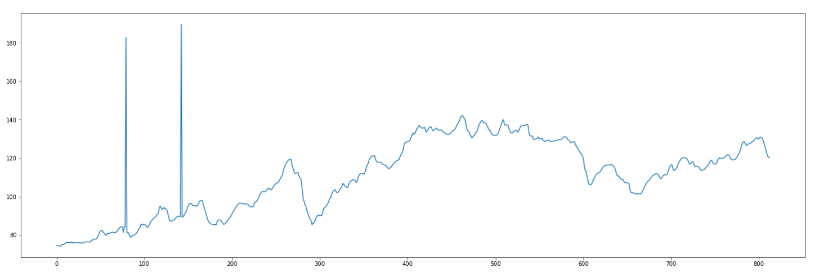
EDA AND PREPROCESSING
VISUALIZING TARGET FEATURE – PETROL(USD)
From the below diagram we can see that, there are outliers in the dataset.

Slide 11
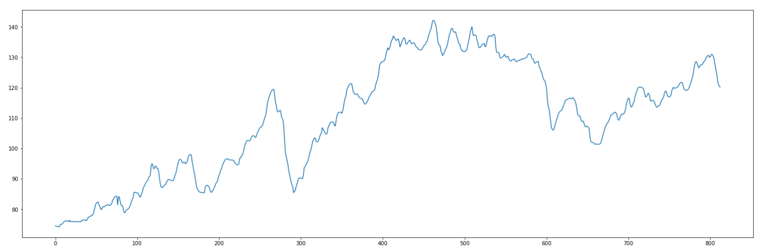
EDA AND PREPROCESSING
HANDLING OUTLIERS
Detecting outliers in the dataset using Inter Quantile Range (IQR)
Replacing outliers with the mean of top and bottom row of the outlier data.

Slide 12
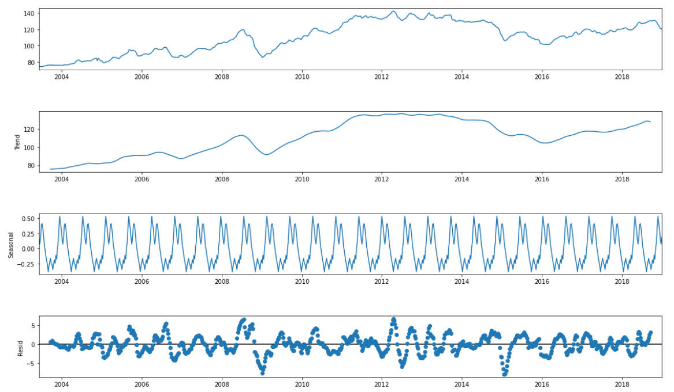
EDA AND PREPROCESSING
SEASONAL DECOMPOSITION

Slide 13
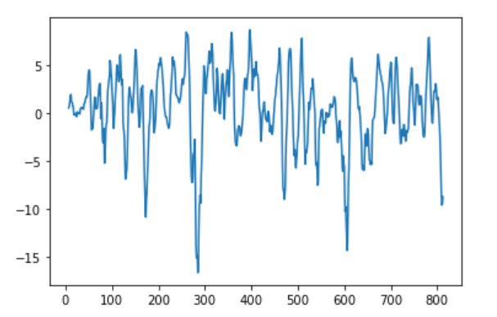
EDA AND PREPROCESSING
TO CHECK IF THE DATA IS STATIONARY OR NOT
From using Augmented Dicky-Fuller test, it shows that the dataset is Non – stationary
Differencing the data in the petrol column to make the non stationary data to stationary data.

Slide 14
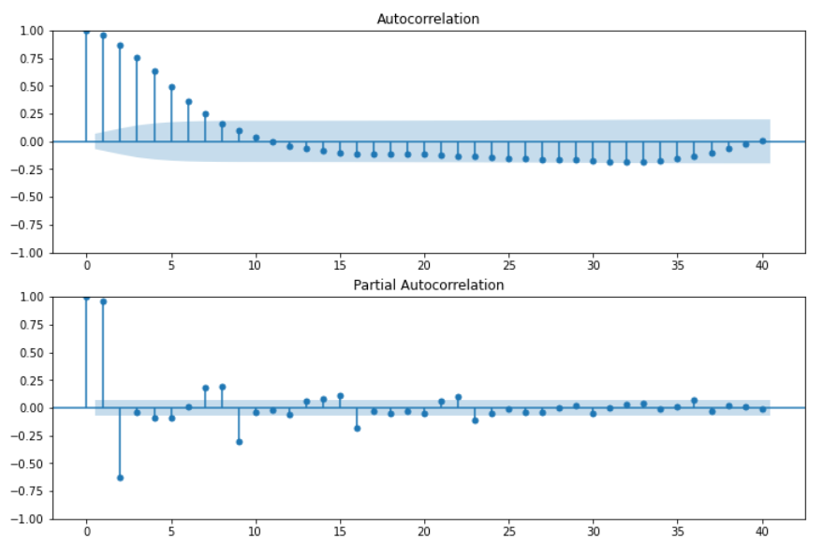
EDA AND PREPROCESSING
VISUALIZING THE AUTOCORRELATION AND PARTIAL AUTOCORRELATION PLOTS

Slide 15
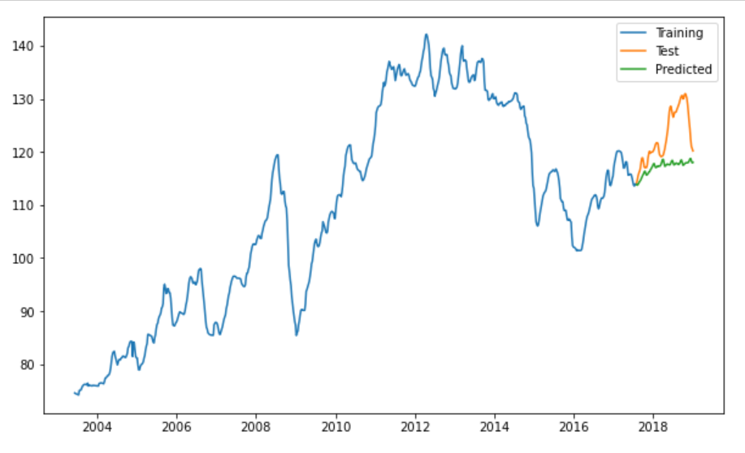
EDA AND PREPROCESSING
Using auto ARIMA, which is using AIC score to find the best model.
The best auto ARIMA model gives very high MAPE score (Mean absolute percentage error), hence evaluating using other machine learning models.

Slide 16
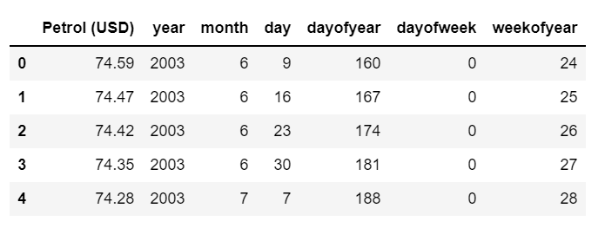
EDA AND PREPROCESSING
CREATING NEW FEATURES
Converting Date column to a Datetime
Extracting Year, Month, Day, Dayofyear, Dayofweek, Weekofyear from the datetime column(Date).
Dropping the date column.

Slide 17
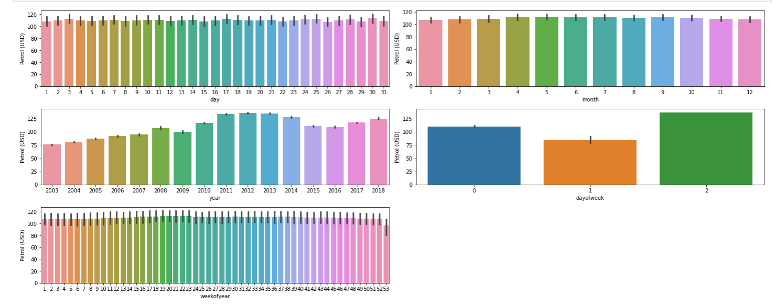
EDA AND PREPROCESSING
VISUALIZING THE INDEPENDENT FEATURE WITH THE DEPENDENT FEATURE

Slide 18
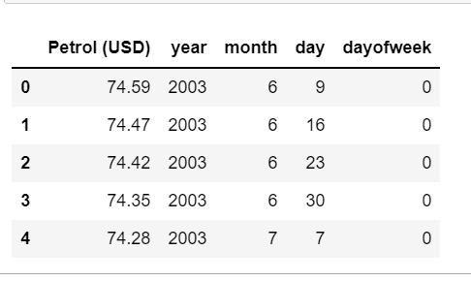
EDA AND PREPROCESSING
HANDLING CORRELATED FEATURES
Detecting and removing correlated features using heatmap and VIF score respectively.
Thus dropping the columns Dayofyear and Weekofyear.

Slide 19
MODEL TRAINING AND VALIDATION
Training the dataset with regression algorithms like Linear Regression, Linear Regression(Ridge), Linear Regression(Lasso), Support vector Regression, Random Forest Regressor, XGBoost Regressor, Light Gradient boosting.
Random Forest Regressor gives the least MAPE score compared to all the other models.
Hyperparameter tuning was performed.

Slide 20



DEPLOYMENT
The final model is deployed on Heroku by dockerizing using dockerhub, and using the tool Circleci.
Deployment link: https://petrol-price-forecast.herokuapp.com/

Slide 21
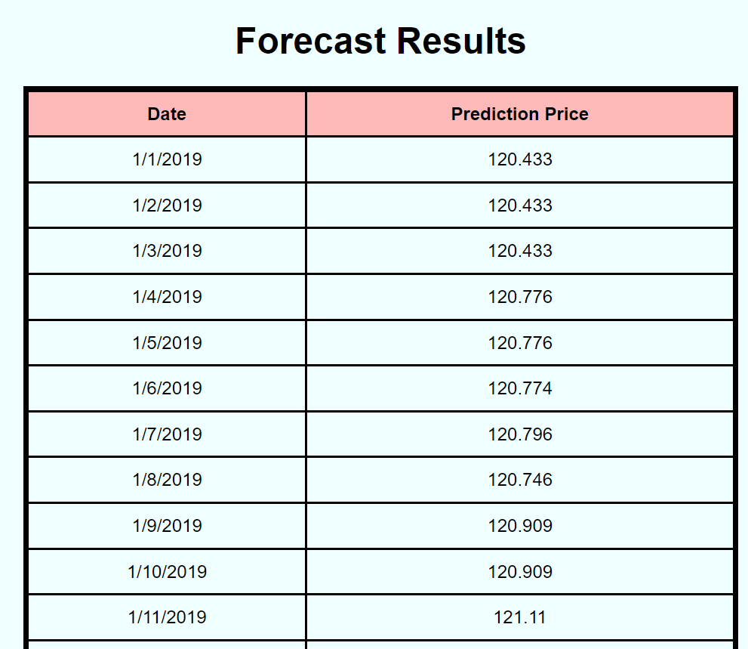
OUTPUT

Slide 22









TOOLS USED

Slide 23
BUSINESS BENEFITS
Oil prices are determined by global supply and demand, rather than any country's domestic production level. There have been a number of structural drivers of global oil prices historically, including oil supply, demand, and storage shocks, and shocks to global economic growth affecting oil prices. Forecasting of the prices of petrol is important for Business decisions like airlines, auto manufacturers, utilities, Predicting carbon emissions and climate change, Designing regulatory policies such as fuel standards and petrol taxes.

Slide 24
FAQ
Q1. What was the type of data?
It was a time series data
Q2. How did you manage the null values in the dataset?
Using forward fill to handle the missing values
Q3. What was the complete flow you followed in this project?
Please refer to the slide 5 for better understanding

Slide 25
FAQ
Q4. What were the techniques used for data pre-processing?
Using forward fill to handle missing values
Visualizing target features
Replacing outliers
Creating new features
visualizing the relationship between independent variables and dependent variable
Removing correlated features.

Slide 26


