Slide 1
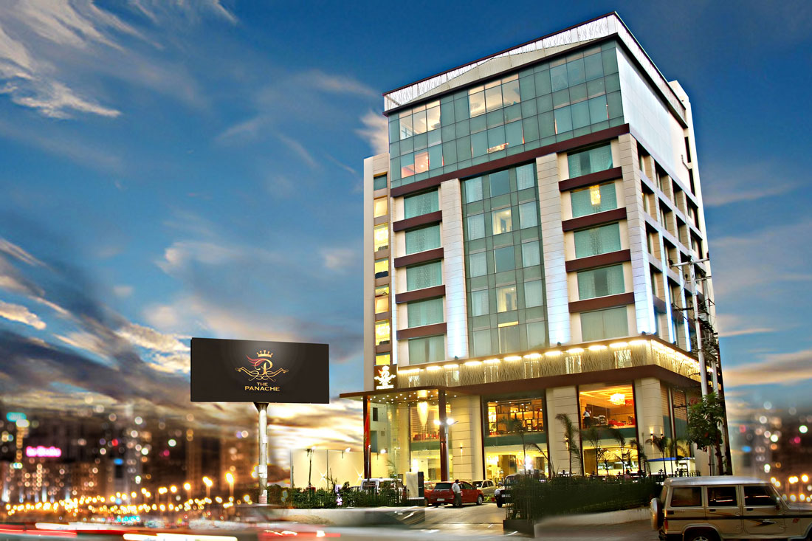
AtliQ Grands Hospitality Analysis

Slide 2
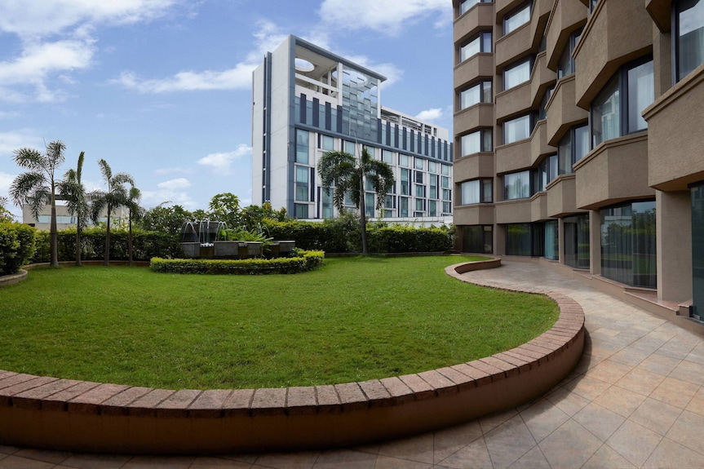
Overview :
AtliQ Grands owns multiple five-star hotels across India. They have been in the hospitality industry for the past 20 years. Due to strategic moves from other competitors and ineffective decision-making in management, AtliQ Grands are losing its market share and revenue in the luxury/business hotels category. As a strategic move, the managing director of AtliQ Grands wanted to incorporate “Business and Data Intelligence” to regain their market share and revenue.

Slide 3
Task :
Calculate Overall Revenue .
Generates KPI(Key Performance Indicators) according to datasets and requirements.
Generate City wise trends on revenue , booking index and no of guests.
Create the metrics according to the metric list.
Create a dashboard according to the mock-up provided by stakeholders.
Create relevant insights that are not provided in the metric list/mock-up dashboard.

Slide 4

Project Goal :
To enhance AtliQ Grands market share in the luxury and business hotel segment by implementing data driven strategies and business intelligence .The goal is to identify opportunities for improving guest experiences, maximizing revenue generation, and enhancing operational effectiveness. Ultimately, the aim is to empower stakeholders with data-driven insights that enable informed strategic decisions and maintain a competitive edge in the dynamic hospitality market."

Slide 5
KPIs :
DSRN(Daily Sellable Room Nights) - Average how many rooms are ready to sell for a day considering a time period.
DURN(Daily Utilized Room Nights) - Average how many rooms are successfully utilized by customers for a day considering a time period.
ADR(Average Daily rate) - It is the ratio of revenue to the total rooms booked/sold.
Realisation(%)- It is nothing but the successful "checked out" percentage over all bookings happened.
Occupancy(%) - Total successful bookings happened to the total rooms available(capacity) .
RevPAR(Revenue Per Available Room) - Revenue generated per available room, whether or not they are occupied.

Slide 6
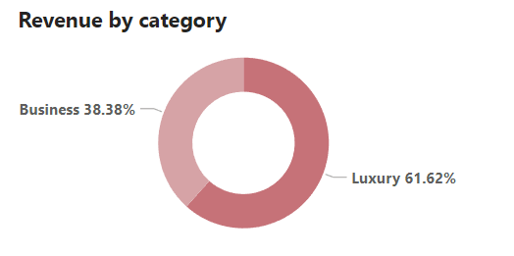
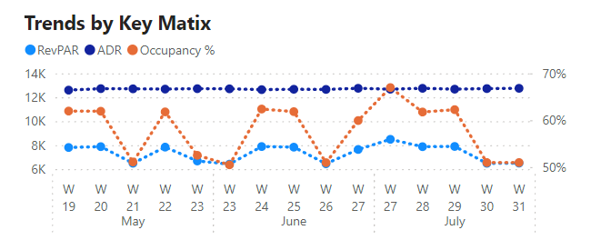
Visualization :

Slide 7
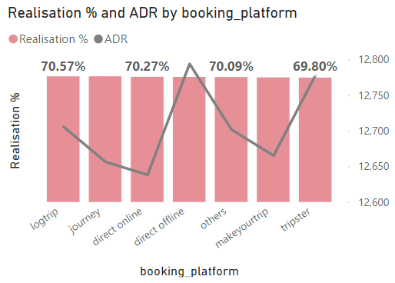
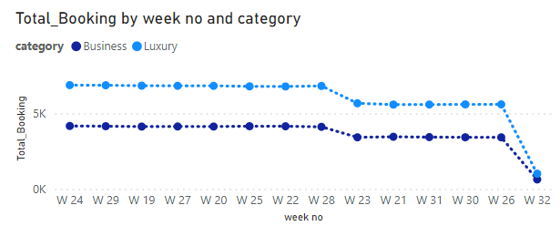

Slide 8
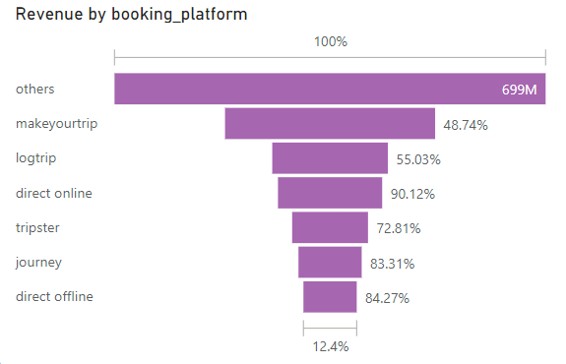
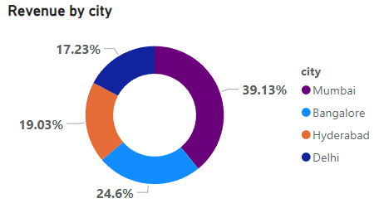

Slide 9
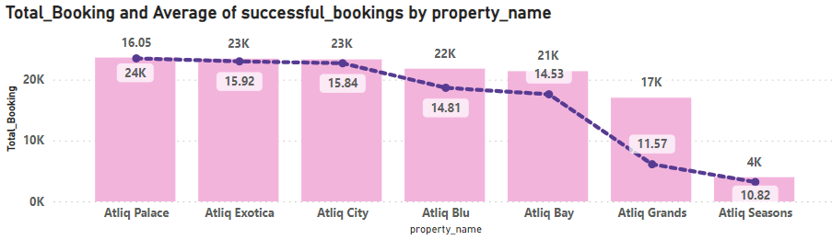
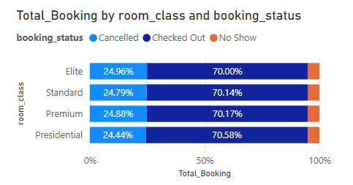

Slide 10
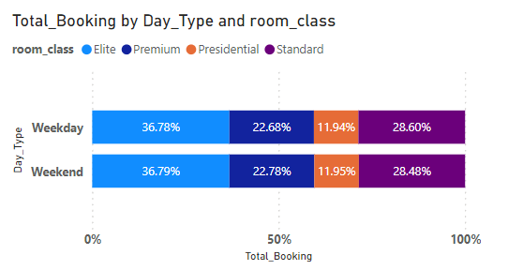
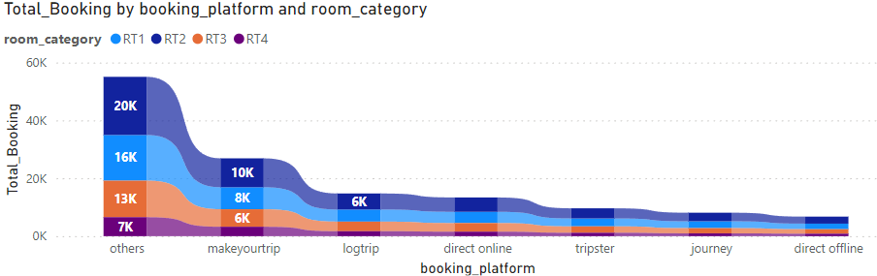

Slide 11
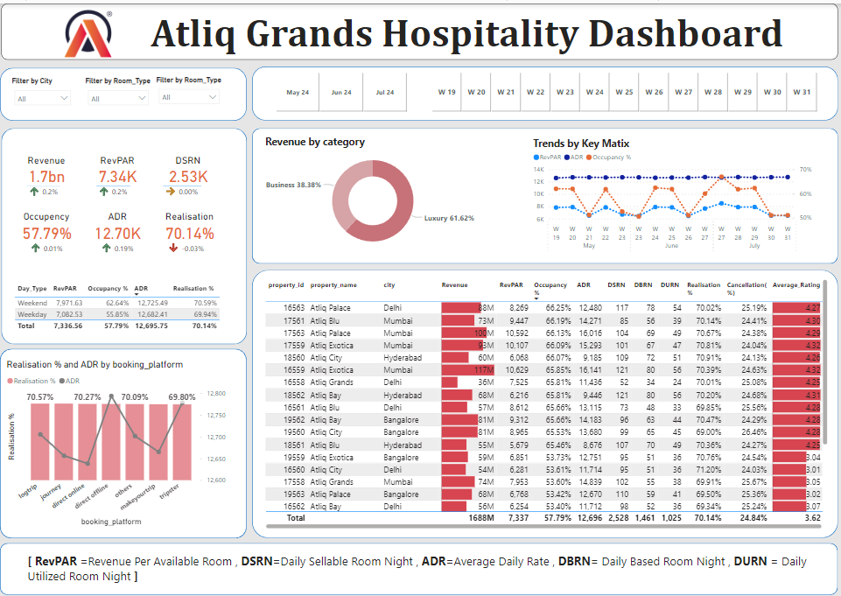
Dashboard :
Dashboard-1

Slide 12
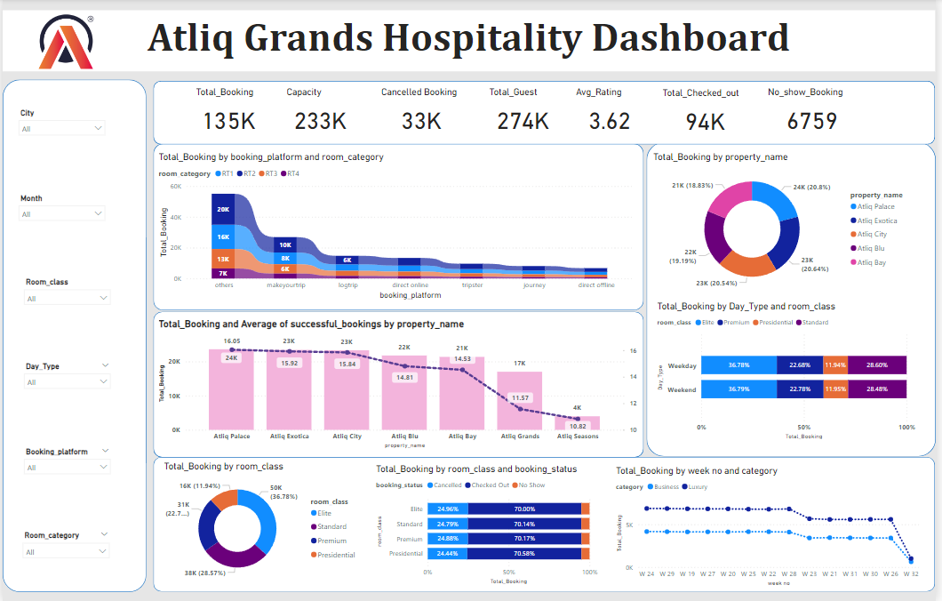
Dashboard-2

Slide 13
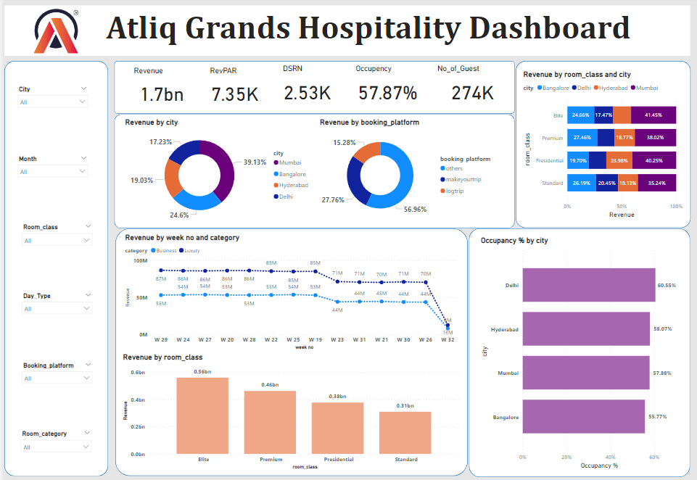
Dashboard-3

Slide 14
Key Insights :
Total revenue is 1.7bn.
Average Rating is 3.78.
Revenue per available night (RevPAR) is 77.43K
Category wise Business occupies 38.38% and Luxury occupies 61.62% of total revenue.
Mumbai City generates maximum of 39.13%(669M) of total revenue ,RevPAR(Revenue per available Room) is 8.79K ,Occupancy is 57.88%,Total_guest is 89K,Elite type room class generates 0.23bn revenue and the maximum revenue generates in the month of July(78M),total_booking is 30K and total_guest is 62K.
Delhi City generates minimum of 17.23%(295M) of total revenue ,RevPAR(Revenue per available Room) is 7.36K ,Occupancy is 60.55%,Total_guest is 48K,Elite type room class generates 98M revenue and the maximum revenue generates in the month of May(100M) ),total_booking is 17K and total_guest is 33K.
Maximum occupancy is occupied by Delhi(58.62%) in weekend.
Daily Available Rate is 12.70K.
Total Booking is 135K.

Slide 15
Dashboard Link :
https://app.powerbi.com/view?r=eyJrIjoiNjMxOTE2YzEtOTQzMi00YzFiLWE4MDItY2U1ZWUxOGZmZDQ1IiwidCI6ImRmODY3OWNkLWE4MGUtNDVkOC05OWFjLWM4M2VkN2ZmOTVhMCJ9

Slide 16
Thank You

