Slide 1
Spring Boot
An Introduction to Spring-Boot.

Slide 2
Agenda
Prerequisites
What is Spring Boot
Features of Spring Boot
Project Structure
Demo

Slide 3
Disclaimer !!
You will Get to know about few Features of Spring boot.
You wont be learning all about Spring boot.

Slide 4
Prerequisite
Java
Maven/Gradle
Spring Framework

Slide 5
What is Spring-Boot ?
Spring Boot is designed to get you up and running as quickly as possible, with minimal upfront configuration of Spring.

Slide 6
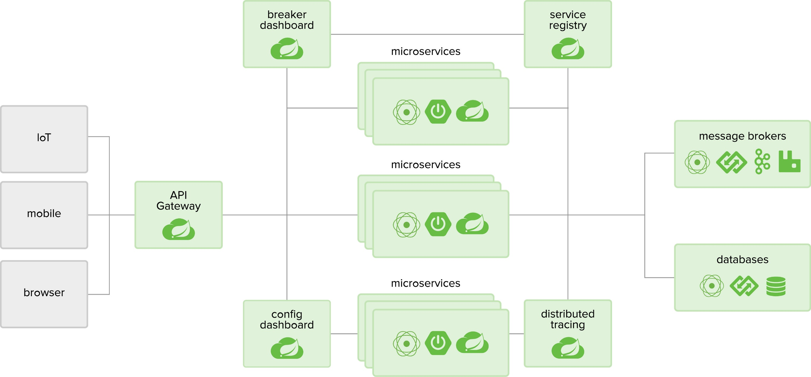
What we want to Build ?

Slide 7
Lets Create…
start.spring.io

Slide 8
SpringBootApplication
@SpringBootApplication
//@SpringBootConfiguration
//@EnableAutoConfiguration
//@ComponentScan
public class DemoApplication {
public static void main(String[] args) {
SpringApplication.run(DemoApplication.class, args);
}
}

Slide 9
Features
Devtools
Externalized Configuration
Auto Configuration
Service Registry
Distributed tracing
Hystrix

Slide 10
Devtools
<dependency>
<groupId>org.springframework.boot</groupId>
<artifactId>spring-boot-devtools</artifactId>
<scope>runtime</scope>
<optional>true</optional>
</dependency>

Slide 11
Actuator
A number of additional features to help you monitor and manage your application when you push it to production.
You can choose to manage and monitor your application by using HTTP endpoints or with JMX. Auditing, health, and metrics gathering can also be automatically applied to your application.
health: Shows application health information.
info: Displays arbitrary application info.
env: Exposes properties.
Ref : https://docs.spring.io/spring-boot/docs/current/reference/html/production-ready-endpoints.html

Slide 12
Service registration & Discovery
Application A
@EnableDiscoveryClient
Application B
@EnableDiscoveryClient
Eureka Server
@EnableEurekaServer
@EnableEurekaServer

Slide 13
Externalized Configuration/Centralized Configuration
App A
Git Repo
a.properties
Config Server
Configure Git repo location
spring-cloud-starter-config

Slide 14
Distributed tracing
( spring-cloud-sleuth & spring-cloud-zipkin )
App A
App B
App D
App E
App C
App F
Trace ID : trace1
Span ID : span2
Trace ID : trace1
Span ID : span4
trace1
trace1
trace1
Trace ID : trace1
Span ID : span5
trace1
Trace ID : trace1
Span ID : span1
trace1
Trace ID : trace1
Span ID : span6
Trace ID : trace1
Span ID : span3

Slide 15
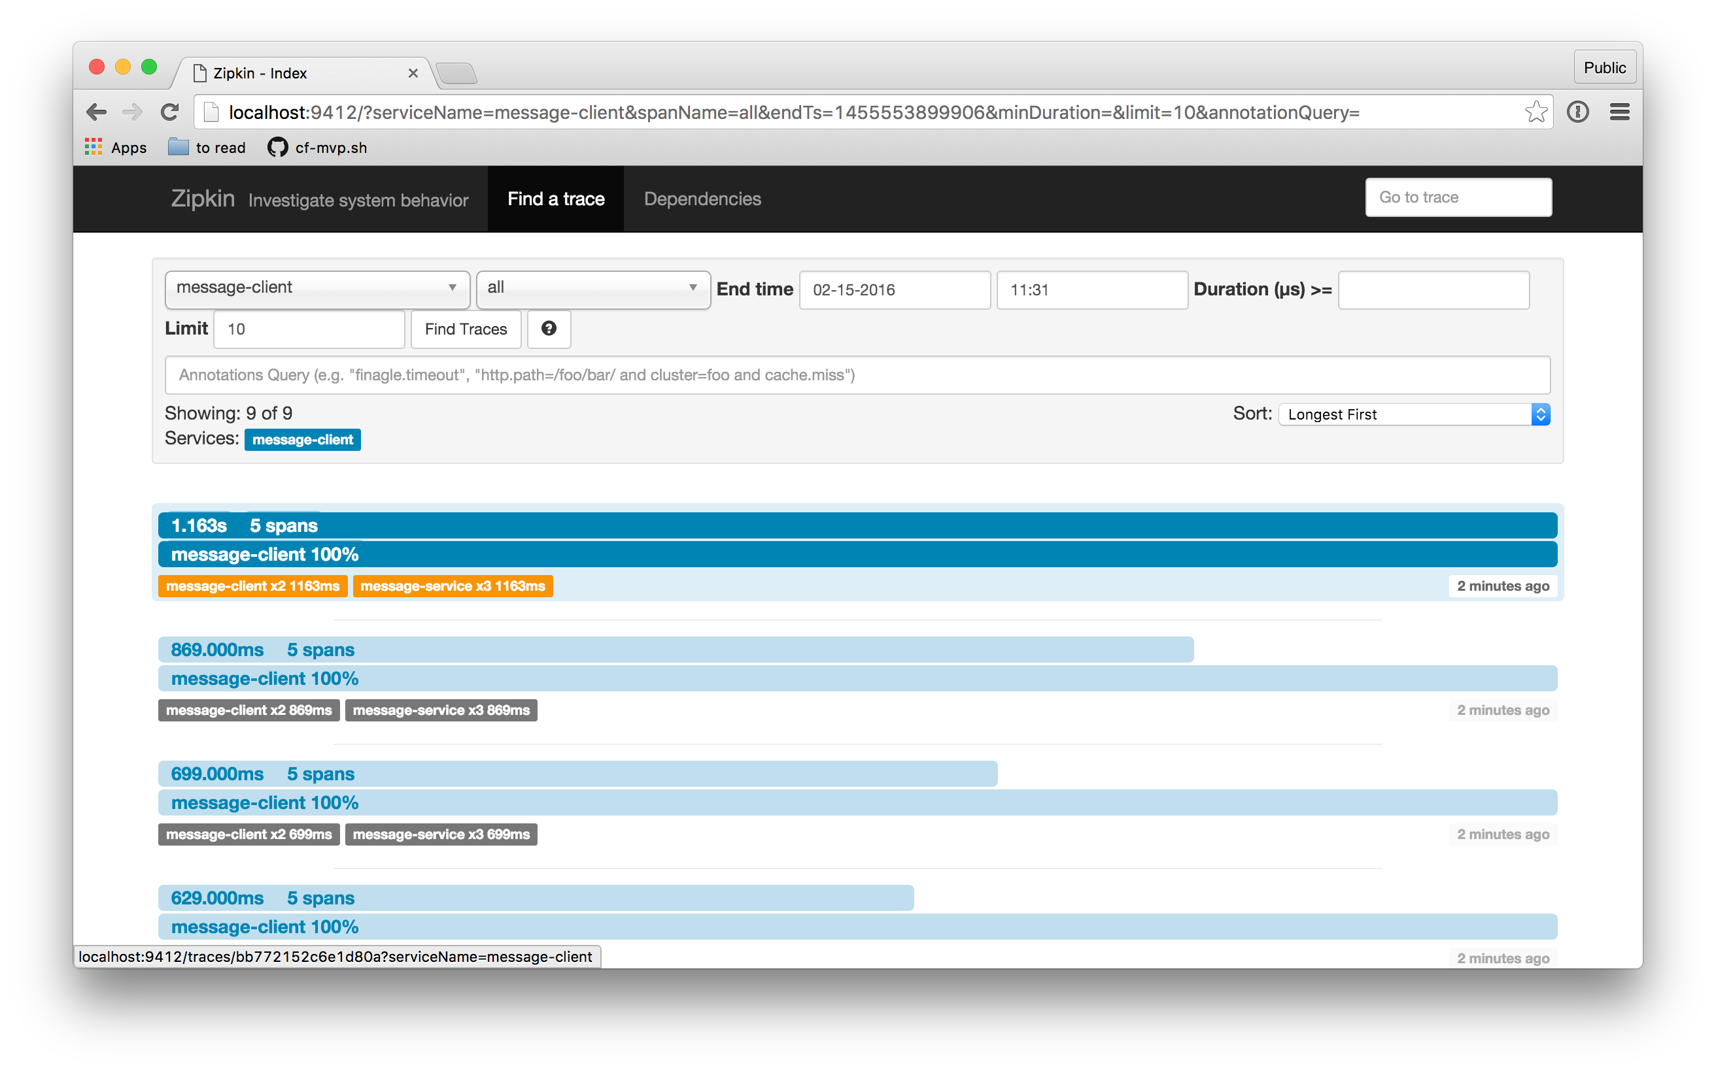
Distributed tracing
( spring-cloud-sleuth & spring-cloud-zipkin )
Ref: https://spring.io/blog/2016/02/15/distributed-tracing-with-spring-cloud-sleuth-and-spring-cloud-zipkin

Slide 16
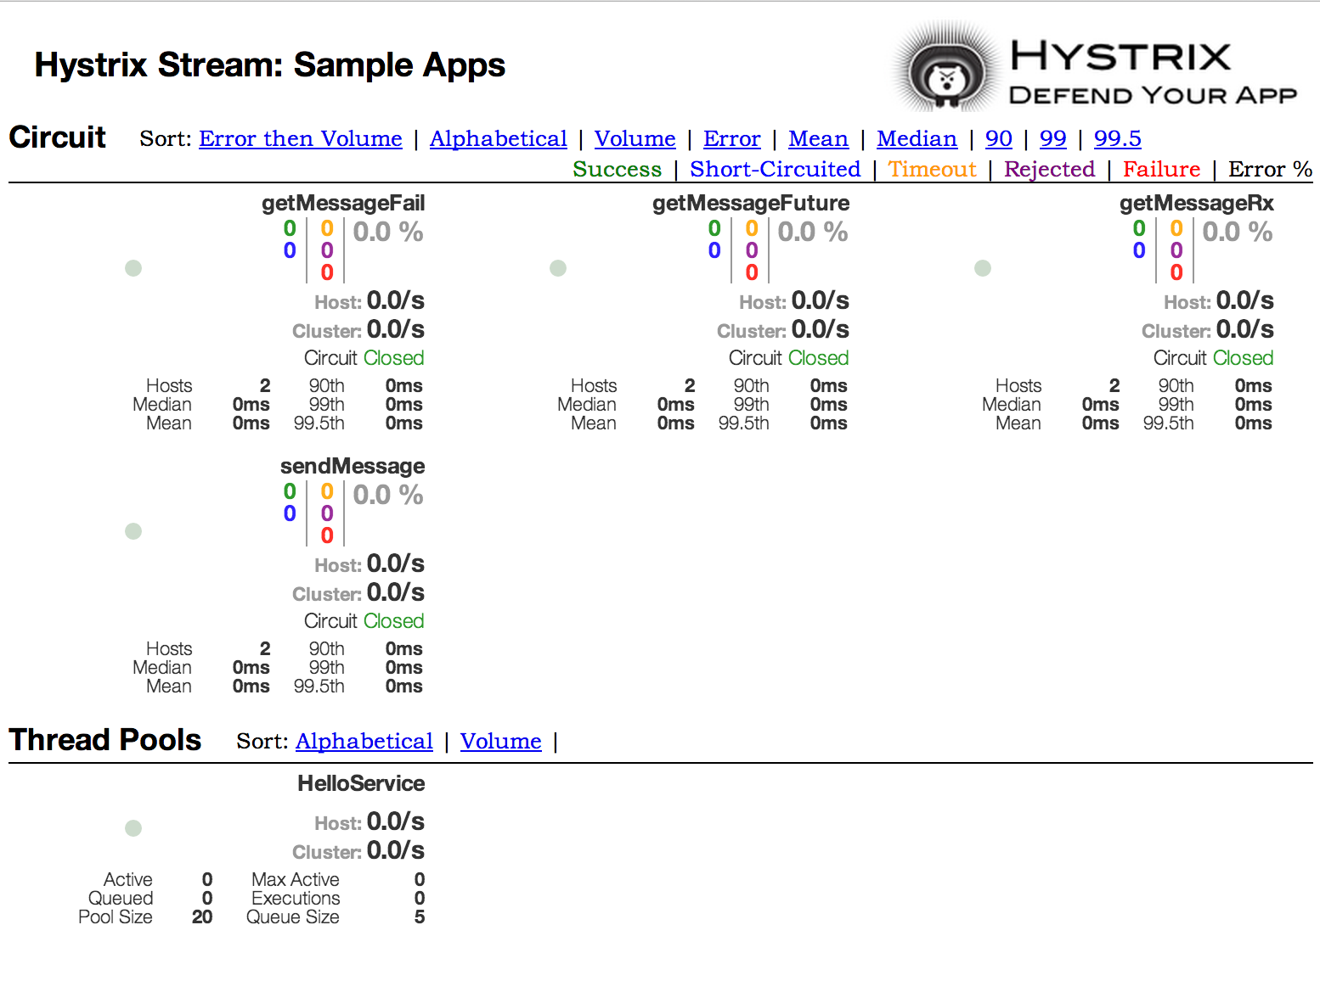
Hystrix
@EnableCircuitBreaker : Client Microservice Application

Slide 17
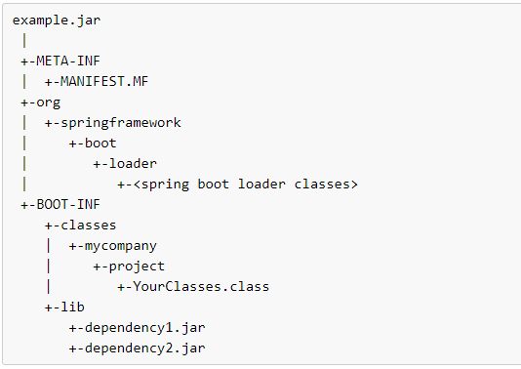
Spring-Boot Jar file
Ref: https://docs.spring.io/spring-boot/docs/2.1.8.RELEASE/reference/html/executable-jar.html

Slide 18
Thank You

