Slide 1

SMART INDIA HACKATHON 2026
TITLE PAGE
Problem Statement ID – SIH26120
Problem Statement Title – Digital Twin for Well-to-Surface Optimization of CSS and SRP Operations
Theme – Smart Automation
PS Category – Software
Team Name – CosmicRift

Slide 2
Smart India Hackathon 2026
PROPOSED SOLUTION
PROBLEM STATEMENT & CHALLENGES
PROPOSED SOLUTION (VARUNA-AI)
• Blind Subsurface Operations:
Zero real-time visibility into deepwater wellhead dynamics, downhole PDC drill torque, and multi-phase flow lines.
• Costly Unscheduled Downtime:
Reactive maintenance leads to catastrophic pump failures, stuck pipe incidents, and ₹25L+ losses per event.
• Undetected Water/Gas Breakthroughs:
Emulsion surges and hydrate plugs choke subsea flowlines without early warning or ASTM D1250 net oil purification.
• Fragmented Industrial Data:
Telemetry is siloed across SCADA systems with no 3D spatial twin or automated midnight settlement compliance.
• 50.0 Hz Physics-Informed Cyber-Twin:
Real-time subsea-to-topside 3D visualization in WebGL/Three.js with 20ms ultra-fast sensor ingestion.
• Edge 1D Kalman Denoising:
Filters raw pressure, temperature, and Coriolis vibration noise for crystal-clear anomaly detection.
• Automated ASTM D1250 Net Oil Reconciliation:
Continuously calculates Gross Extracted vs Net Dry Purified Oil, BS&W water-cut %, and associated gas.
• 180-Day Database & Midnight Settlement:
Local high-speed database with sub-millisecond binary search and automated 12:00 Midnight DGH regulatory audits.
2 @SIH Idea submission-Template
[Enter Your Team Name]

Slide 3
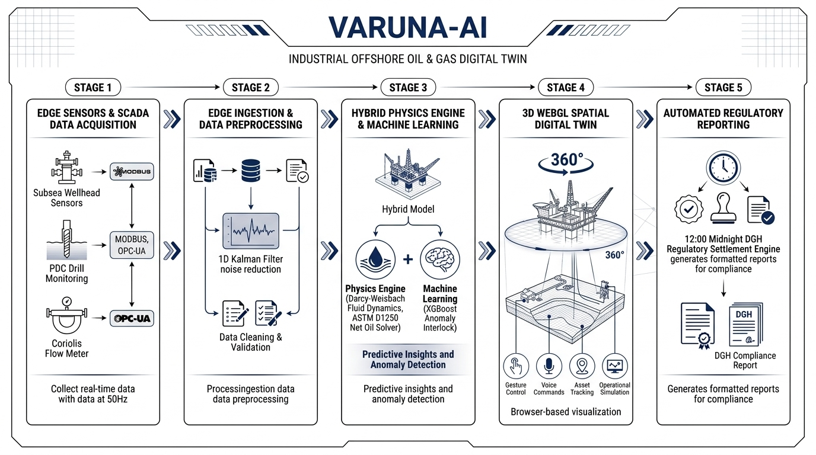
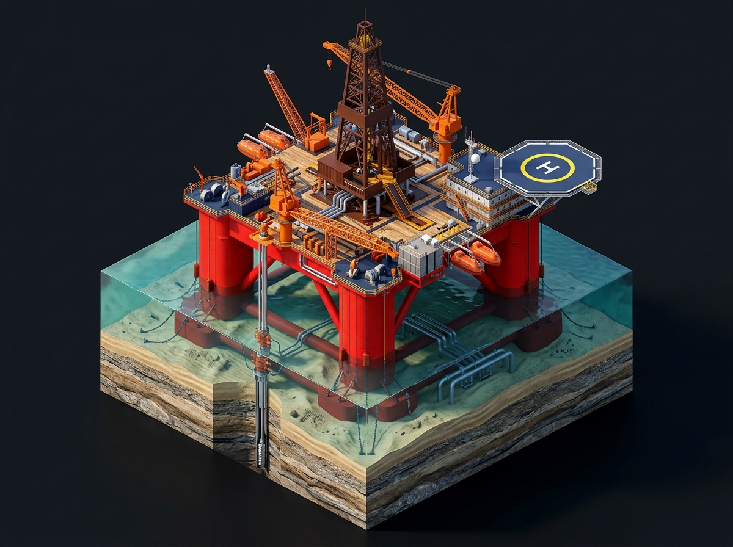
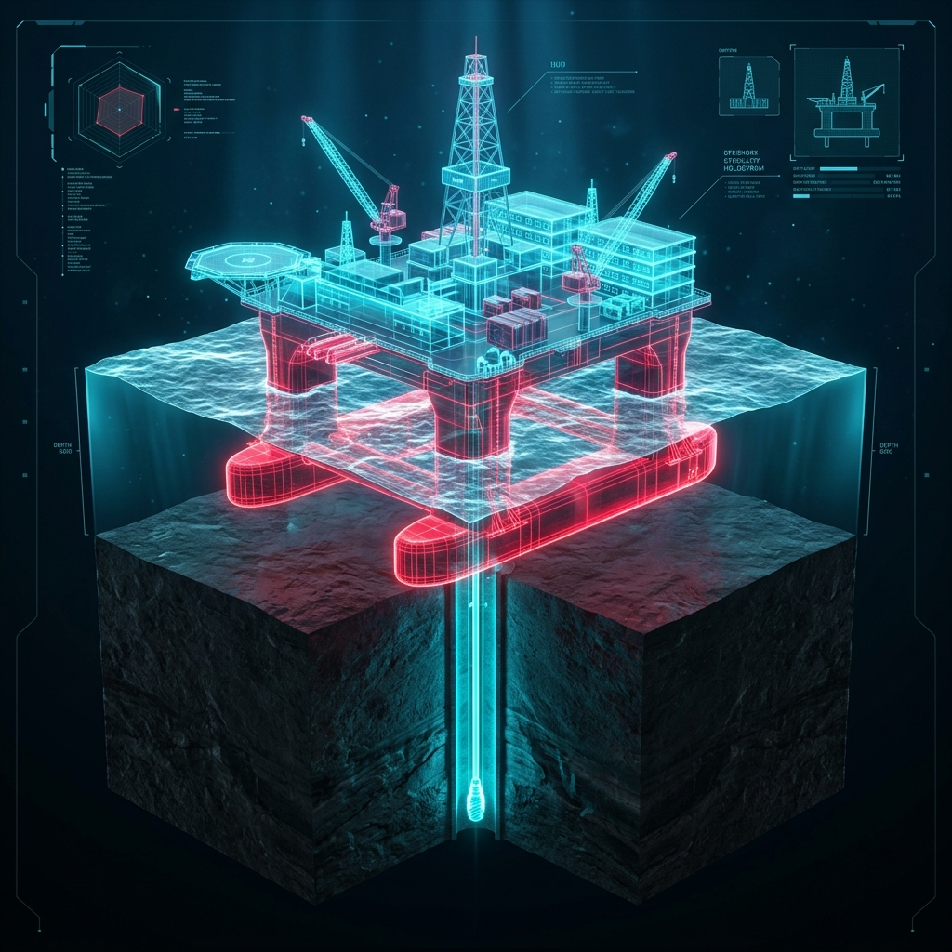
Smart India Hackathon 2026
TECHNICAL APPROACH: SYSTEM WORKFLOW & ARCHITECTURE
CORE TECHNOLOGY STACK & COMMUNICATION PROTOCOLS
• Stage 1 (Edge SCADA): Modbus RTU/TCP, OPC-UA, WITSML, Serial USB WebGateway (50Hz / 20ms).
• Stage 2 (Denoising): Discrete 1D Kalman recursive state estimator + 180-day local buffer ledger (<0.1ms query).
• Stage 3 (Physics & AI): Darcy-Weisbach multiphase hydraulics, ASTM D1250 / API MPMS 11.1 net oil solver, XGBoost AI.
• Stage 4 & 5 (Twin & Audit): Three.js WebGL 3D spatial twin with gestures/voice + automated 12:00 Midnight DGH audit ledger.
3 @SIH Idea submission-Template
[Enter Your Team Name]

Slide 4
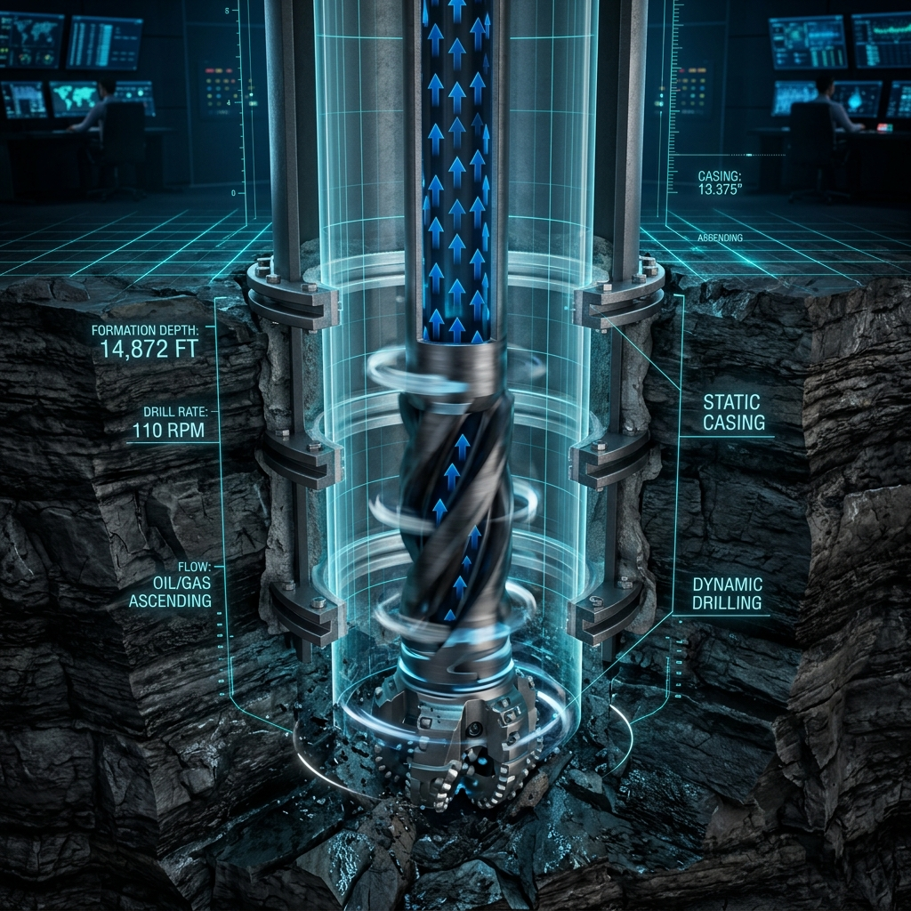
Smart India Hackathon 2026
FEASIBILITY AND VIABILITY
• Analysis of the feasibility of the idea:
- Proven Industrial Standards: Works directly with standard Modbus RTU, OPC-UA, and AVEVA PI historians.
- Low Latency Execution: Sub-millisecond binary search (<0.1ms) enables seamless real-time analytics without cloud latency.
- Zero Server Overhead: Self-contained WebGL client runs in any modern browser with local laptop database fallback.
• Potential challenges and risks:
- Severe deepwater sensor noise and intermittent connectivity at -2,040m seabed.
- High computational burden of coupled thermodynamic reservoir simulations.
• Strategies for overcoming these challenges:
- 1D Kalman Edge Filter: Suppresses transient bubble glitches and pressure noise locally.
- Surrogate Edge AI: XGBoost classifiers act as fast surrogates while heavy physics calibrates asynchronously.
4 @SIH Idea submission-Template
[Enter Your Team Name]

Slide 5
Smart India Hackathon 2026
IMPACT AND BENEFITS
Potential impact on the target audience (OIL & ONGC):
Benefits of the solution (Economic & Operational):
• Deepwater Subsea Optimization:
Unlocks actionable visibility into deepwater manifolds, enabling higher extraction rates from ultra-deep offshore blocks.
• Predictive Health & Asset Life:
Maximizes lifespan of drill strings, subsea risers, and topside separators by preventing fatigue and over-torque.
• Shift to Autonomous Supervision:
Transforms control room operations from reactive fire-fighting to autonomous AI-driven supervisory guidance.
• Environmental Safety (Zero Spills):
Early pipe blockage and rupture detection prevents catastrophic environmental contamination.
• Cost Recovery: ₹25+ Lakhs saved per incident through proactive anomaly detection and automated pump speed throttling.
• 35% Downtime Reduction: Automated 12:00 Midnight reconciliation and instant incident dispatch reduce mean time to resolution.
• 40% Lifting Cost Reduction: Optimized multiphase fluid balance and ASTM D1250 purification minimize energy and demulsifier waste.
• 100% Regulatory Compliance: Certified DGH / ISO 14001 daily ledger with cryptographic audit hash verification.
5 @SIH Idea submission-Template
[Enter Your Team Name]

Slide 6
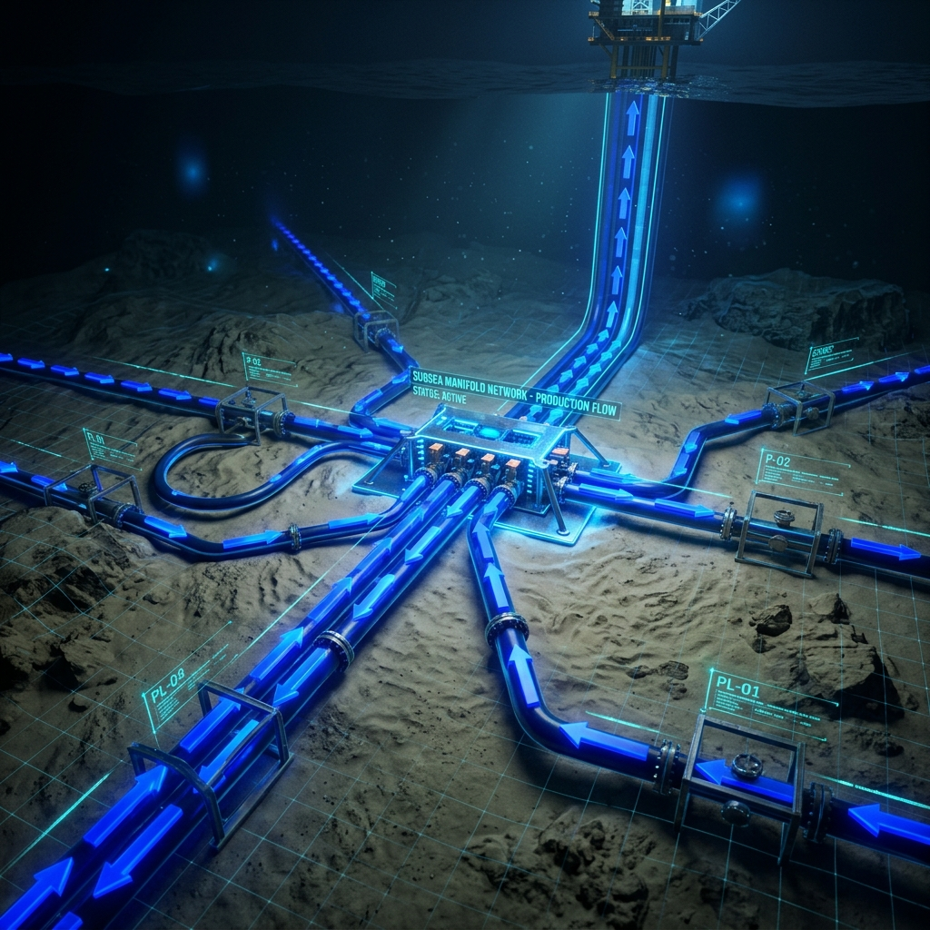
Smart India Hackathon 2026
RESEARCH AND REFERENCES
Details / Links of the reference and research work:
• ASTM D1250 & API MPMS Chapter 11.1 Standards:
Standardized equations for temperature & pressure volume correction factors (CTL/CPL) for crude oils.
• Coriolis Resonance & Darcy-Weisbach Multiphase Mechanics:
Mathematical formulation for tube frequency inversion and subsea pipeline friction factor calculations.
• 1D Kalman Filtering for Industrial SCADA Denoising:
Discrete recursive Bayesian state estimation for high-frequency telemetry streams.
• WebGL & Three.js for 3D Cyber-Physical Spatial Computing:
High-performance GPU-accelerated rendering of complex offshore assemblies with real-time gesture interaction.
• DGH (Directorate General of Hydrocarbons) Offshore Reporting Guidelines:
Indian statutory standards for certified daily hydrocarbon reconciliation and environmental auditing.
6 @SIH Idea submission-Template
[Enter Your Team Name]

