Slide 1
CHINOOK MUSIC STORE
"Enhancing Chinook Music Store Performance through Data-Driven Analysis"
SQL Project By Chandan Kumar
Tools Used – MySQL Workbench, MS-Excel
Batch – Professional certificate course in data science - December 2024
Platform – Newton School
Date – 31 March 2025

Slide 2
Agenda
INTRODUCTION
DATABASE SCHEMA
INSIGHTS
CONCLUSION

Slide 3
Introduction
The main objective of this project is to explore and analyse the chinook database using SQL to uncover valuable business insights.
This involves querying the database to gain a deeper understanding of customer behaviour, sales, trend, and the management of the music library
In the modern business environment, data analysis plays a vital role decision-making.
By leveraging SQL, businesses can extract meaningful patterns and trends from their data, enabling them to make informed decisions, optimize strategies, and improve overall performance.

Slide 4
“Did you know? Analyzing customer purchase patterns at Chinook can help identify top-selling genres and boost revenue with smarter recommendations!.”

Slide 5
Problem Statement
Identify and address missing values and duplicates to ensure data integrity.
Determine top-selling tracks, artists, and genres, both in the USA and globally.
Analyze customer demographics and purchasing behavior, including churn rate and frequency.
Calculate total revenue and top customers by region, with a focus on geographical differences.
Recommend albums for promotion based on genre sales performance and customer preferences.
Segment customers based on purchase history to predict lifetime value and identify high-risk groups.

Slide 6
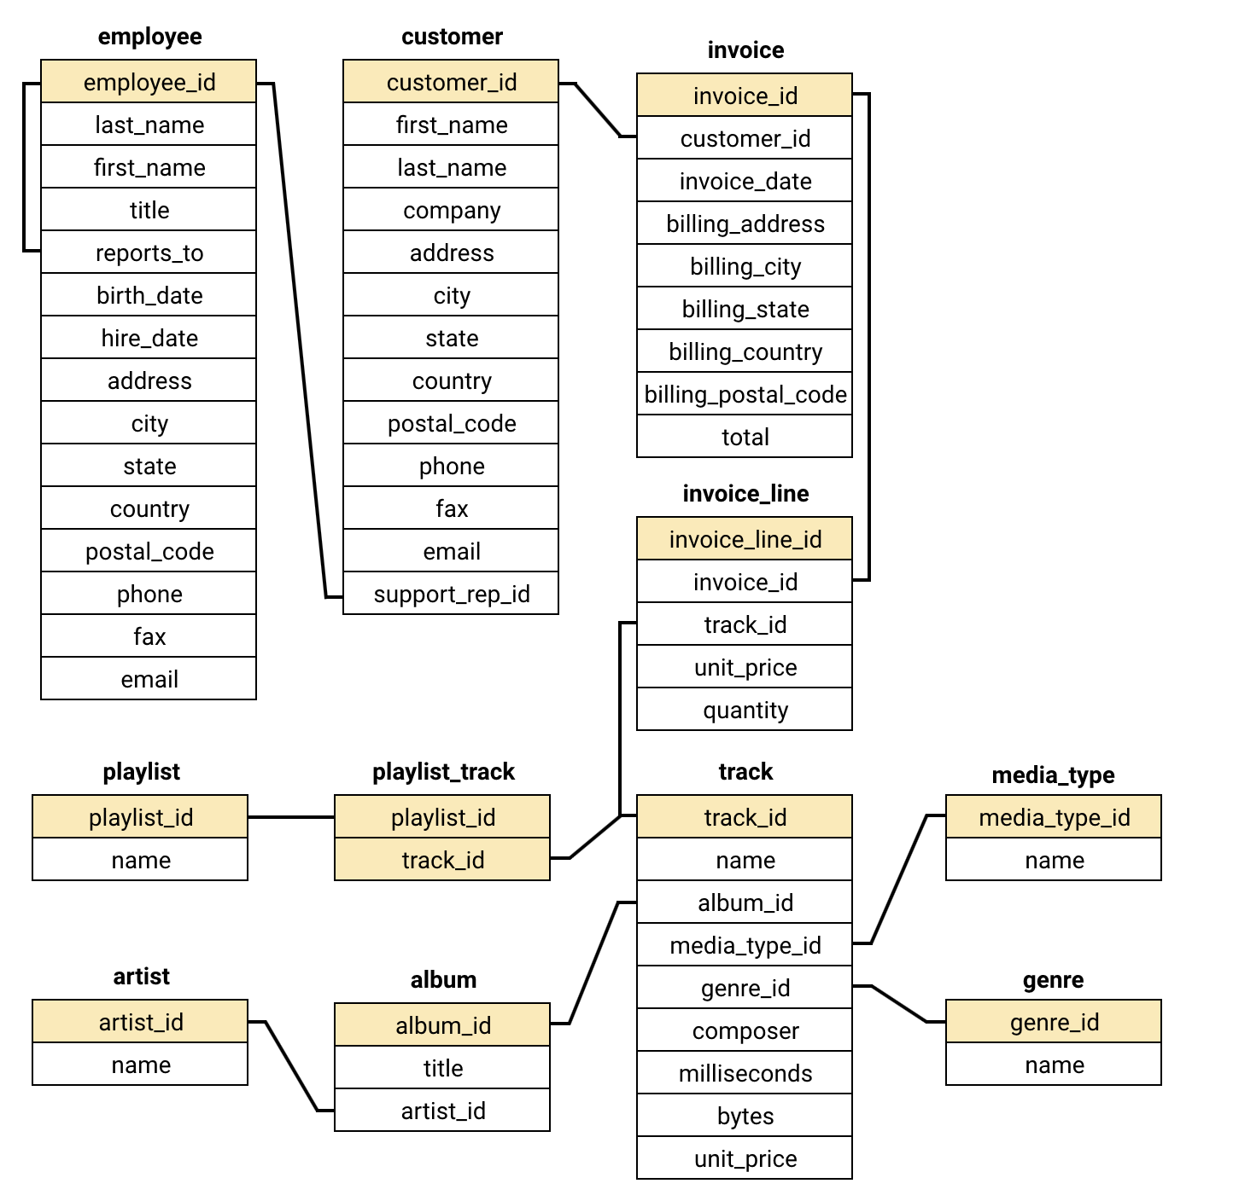
Database Schema:

Slide 7
Data Description:
Customer Table:
customer_id: Unique identifier assigned to each customer.
first_name: The given name or first name of a customer.
last_name: The surname or family name of a customer.
company: The name of the company associated with a customer.
address: The street address of a customer's location.
city: The city where a customer is located.
state: The state or province where a customer is located.
country: The country where a customer is located.
postal_code: The postal or zip code of a customer's address.
phone: The phone number of a customer.
fax: The fax number associated with a customer.
email: The email address of a customer.
support_rep_id: The employee ID of the support representative assigned to a customer.
Invoice Table:
invoice_id: Unique identifier assigned to each invoice.
customer_id: The customer ID associated with the invoice.
invoice_date: The date when the invoice was generated or issued.
billing_address: The street address used for billing purposes.
billing_city: The city used for billing purposes.
billing_state: The state or province used for billing purposes.
billing_country: The country used for billing purposes.
billing_postal_code: The postal or zip code used for billing purposes.
total: The total amount due on the invoice.

Slide 8
Data Description (Continued….):
invoice_line Table:
invoice_line_id: Unique identifier assigned to each line item on an invoice.
invoice_id: The invoice ID to which the line item belongs.
track_id: The ID of the track or product included in the line item.
unit_price: The price per unit for the line item.
quantity: The quantity of units for the line item.
Playlist Table:
playlist_id: Unique identifier assigned to each playlist.
name: The name or title of the playlist
Playlist_track Table:
playlist_id: The ID of the playlist to which the track belongs.
track_id: The ID of the track included in the playlist.
Track Table:
track_id: Unique identifier assigned to each track or song.
name: The title or name of the track.
album_id: The ID of the album to which the track belongs.
media_type_id: The ID of the media type associated with the track.
genre_id: The ID of the genre associated with the track.
composer: The name of the composer or artist who composed the track.
milliseconds: The duration of the track in milliseconds.
bytes: The file size of the track in bytes.
unit_price: The price per unit for the track.

Slide 9
Insights:
Total revenue and number of invoices for each country, state, and city?
Top 5 customers by total revenue in each country
Customers who have purchased tracks from at least 3 different genres
Average order value for each customer
Total revenue generated by each customer
Three albums -- prioritized for advertising and promotion in the USA based on genre sales analysis
Genres, artists, or albums frequently purchased together by customers
Customer purchasing behaviors by region
Number of customers and the average number of tracks purchased per customer

Slide 10
1. Total revenue and number of invoices for each country and city
The customer base is geographically diverse, with customers spread across multiple countries, including Argentina, Australia, Brazil, Canada, and the USA.
In the USA, Mountain View, California, and London in the United Kingdom have the highest number of customers, with two customers each.
The data indicates that many cities have only one customer, suggesting a wide but shallow customer distribution.
Major cities like Paris, Berlin, São Paulo, and Prague also have a slightly higher concentration of customers compared to other locations.
There is a notable presence of customers in Canada, with representation in multiple provinces such as Ontario, British Columbia, Alberta, and Quebec.

Slide 11
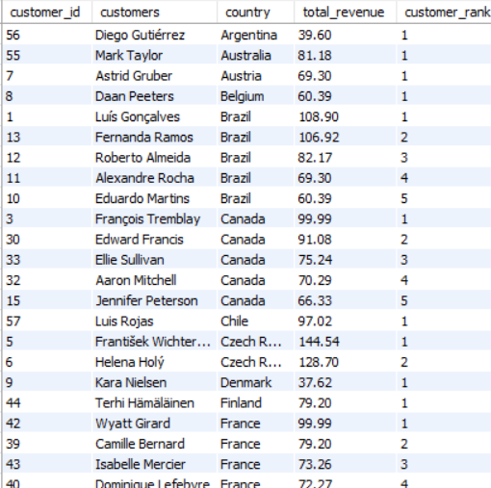
2. Top 5 customers by total revenue in each country
The highest revenue-generating customer is František Wichterlová from the Czech Republic, with a total revenue of 144.54.
Customers are spread across various countries, with notable contributions from Brazil, the USA, Canada, and the Czech Republic.
Brazil has a significant number of top customers, with multiple entries in the top revenue rankings.
Many countries have customers with similar revenue figures, indicating a broad and relatively even distribution of high-value customers.
The USA has several high-revenue customers, with Jack Smith leading the list at 98.01 in revenue.

Slide 12
3. Customers who have purchased tracks from at least 3 different genres
Leonie Köhler is the customer with the highest genre diversity, having purchased tracks across 14 different genres.
Several customers, including František Wichterlová, Terhi Hämäläinen, Madalena Sampaio, and others, have purchased from 13 different genres, indicating a broad music taste.
Many customers fall within the 10 to 12 genre count range, showing a wide but moderate variety in their music preferences.
A few customers, like Robert Brown, Kara Nielsen, and Victor Stevens, have engaged with only 5 to 6 genres, suggesting a more focused or niche musical interest.
Overall, the data indicates that most customers are exploring a diverse range of genres, with many engaging with more than 10 different genres.

Slide 13
4. Average order value for each customer
François Tremblay has the highest average order value at 11.11, indicating that this customer spends more per order compared to others.
Customers like Helena Holý and Robert Brown also have high average order values above 10, showing they are likely to be high-value customers.
A significant number of customers have average order values ranging between 7 and 9, suggesting a moderate spending pattern across the customer base.
Customers like Kara Nielsen and Mark Philips have significantly lower average order values, with Mark Philips having the lowest at 2.97, indicating more frequent but smaller purchases.
The data shows a wide range of average order values, reflecting diverse spending behaviors among the customers.

Slide 14
5. Total revenue generated by each customer
František Wichterlová is the highest revenue-generating customer, contributing 144.54 in total revenue.
Customers like Helena Holý, Hugh O'Reilly, and Manoj Pareek also have high total revenues, each exceeding 100, indicating they are key contributors to the business.
The revenue distribution spans a wide range, with the top customers generating significantly more revenue than those at the lower end of the spectrum, such as Mark Philips, who has the lowest total revenue at 29.7.
A large number of customers contribute between 70 and 100 in total revenue, showing a strong middle-tier customer base.
few customers, such as Kara Nielsen and Robert Brown, contribute relatively lower revenue, suggesting they may be infrequent purchasers or focus on lower-priced items.

Slide 15
6. Three albums -- prioritized for advertising and promotion in the USA based on genre sales analysis
genre_id | genre_name | album_id | new_record_label | total_genre_sales
1 | Rock | 163 | From The Muddy Banks Of The Wishkah [live] | 27.72
1 | Rock | 120 | Are You Experienced? | 27.72
1 | Rock | 214 | The Doors | 26.73
Genre Popularity: Rock is the dominant genre with the highest total sales figures. The top three albums all belong to this genre, indicating a strong market preference for Rock music in the USA.
Sales Figures: The selected albums have the highest total genre sales, making them strong candidates for promotion.
Given the strong sales performance of these albums in the Rock genre, they should be prioritized for advertising and promotion in the USA to capitalize on their popularity.

Slide 16
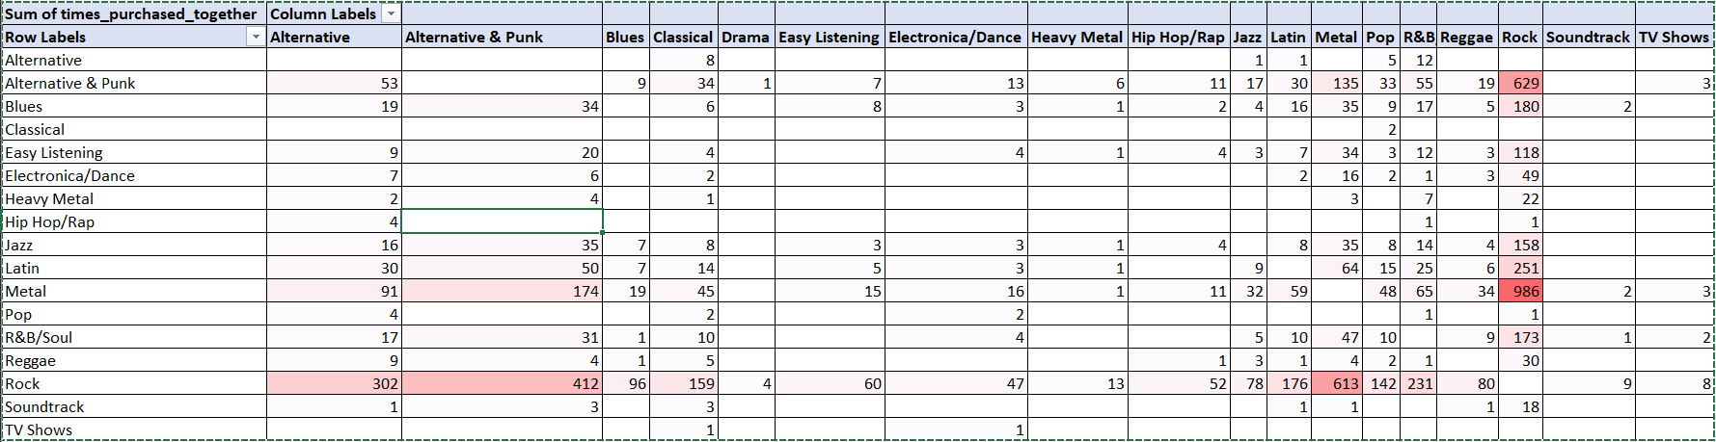
7A. Genres frequently purchased together by customers (Genre Affinity Analysis)
Metal and Rock, along with Alternative & Punk and Rock, are often purchased together, indicating shared fan bases.
Latin and R&B/Soul also pair with Rock, suggesting potential for cross-genre promotions.

Slide 17
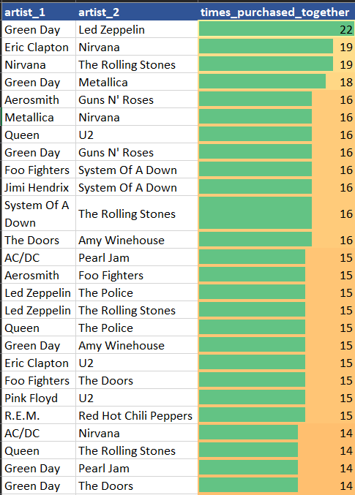
7B. Artists frequently purchased together by customers (Artist Affinity Analysis)
Green Day and Led Zeppelin, as well as Nirvana and The Rolling Stones, are often bought together, showing cross-genre appeal.
Co-purchases of artists like System Of A Down with Foo Fighters and Queen with The Police highlight popular listener combinations.

Slide 18
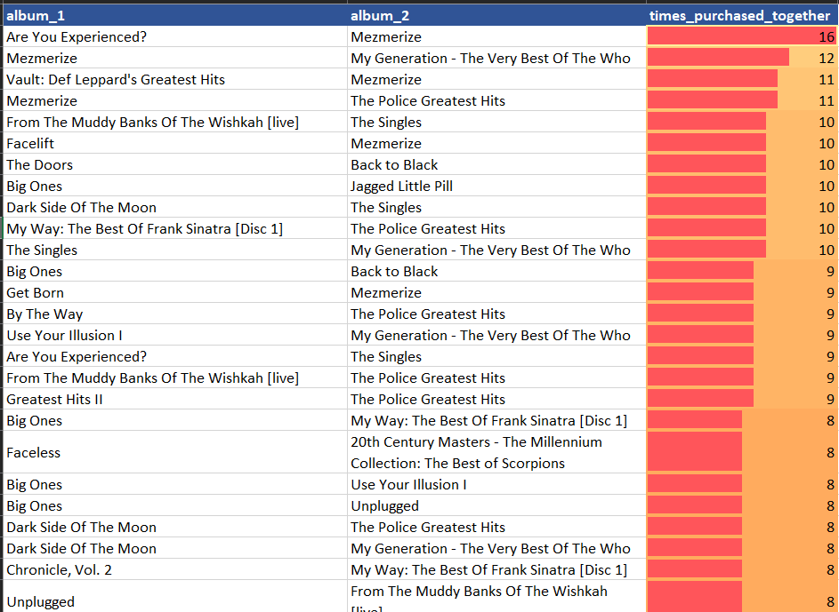
7C. Albums frequently purchased together by customers (Album Affinity Analysis)
"Mezmerize" is often paired with classic rock albums like "Are You Experienced?" and "The Police Greatest Hits," showing broad appeal.
Frequent co-purchases of "The Police Greatest Hits" with "My Generation" and "Big Ones" with "Back to Black" indicate strong cross-genre interests.

Slide 19
8. Customer Purchasing Behaviors by Region
High order value and frequency in Prague, Mountain View, and London: Ideal for premium products.
Moderate in São Paulo and Berlin: Focus on retention and repeat purchases.
Low in Edmonton and Copenhagen: Use promotions to boost sales.

Slide 20
9. Number of customers and the average number of tracks purchased per customer
Czech Republic has the highest average spend per customer at $136.62, showing strong customer value.
USA has the largest customer base, but a lower average spend of $80.04, indicating broad reach but less engagement.
Countries like India, Portugal, and Brazil have moderate spends, while Argentina and Denmark have low average spends around $40.

Slide 21
Conclusion
Data Integrity: Null values and duplicates were addressed to ensure data accuracy across the Chinook database.
Top Performers: Rock is the most popular genre, particularly in the USA. Focusing on Rock music can enhance market engagement.
Customer Behavior: Long-term customers show higher spending, indicating strong loyalty. New customers have growth potential through personalized promotions.
Market Analysis: Rock music dominates globally, except in regions like Brazil, which favor Alternative & Punk and Metal.
Product Affinity: Identified popular genres and artists can guide cross-selling and bundling strategies.
Risk Management: High-value customers need tailored engagement to prevent churn. Predictive models can identify at-risk customers.
Recommendations: Focus on high-performing genres, implement loyalty programs, and use data-driven insights for targeted marketing.

Slide 22
Thank You

