Slide 1
IT Ticket Analysis Report
“Enhancing IT Support Efficiency through Data-Driven Insights”
Spreadsheet Project – by Chandan
25 Jan 2025

Slide 2
Agenda
Problem Statement
Data Description
Objective Key Metrics and Visualizations
Insights and Recommendations

Slide 3
“Did you know? According to industry benchmarks, companies lose an average of $5600 per minute due to IT downtime.”

Slide 4
Problem Statement
The objective is to analyze the IT support ticket management system to understand the performance of IT agents, the efficiency of ticket resolution, and the satisfaction levels of employees. The analysis aims to identify high and low performers among IT agents, assess the overall effectiveness of the team, and pinpoint areas for improvement in the ticket resolution process. The ultimate goal is to make informed staffing decisions, including hiring, firing, and training, to enhance overall service quality and team performance.
Goal:
Informed staffing decisions
Improved training
And software efficiency.

Slide 5
Data Overview
Total Ticket: 97498
Tickets Sheet : Contains information about IT support tickets. Tickets Sheet: Contains information about IT support tickets.
ID: Unique identifier for the ticket.
Ticket Fecha: Date of the ticket.
Employee ID: ID of the employee who raised the ticket.
Agent ID: ID of the agent assigned to the ticket.
Request Category: Category of the request (e.g., Login Access, System, Software).
Issue Type: Type of issue (e.g., IT Error, IT Request).
Severity: Severity of the issue.
Priority: Priority level of the issue.
Resolution Time (Days): Time taken to resolve the ticket.
Satisfaction Rate: Satisfaction rate provided by the employee (1-5 scale).
IT Agents Sheet : Contains information about IT agents.
Agent ID: Unique identifier for the agent.
Full Name: Full name of the agent.
Email: Email address of the agent.
Year of Birth: Year the agent was born.
Month of Birth: Month the agent was born.
Day of Birth: Day the agent was born.

Slide 6
Metric 1: “Ticket Count by Time (Year)”
This tracks the total number of tickets created each year.
It helps in understanding year-over-year trends and analyzing ticket volumes over long periods.
Analysis:
This chart shows a consistent year-over-year increase in the total number of tickets created from 2016 to 2020.
The ticket volume has grown steadily, with significant growth observed between 2019 (21,490) and 2020 (29,088), indicating an accelerating trend in ticket creation.
This growth could reflect expanding operations, increased demand, or enhanced reporting mechanisms.

Slide 7
Metric 2: “Tickets by Request Category”
Tickets are grouped into predefined categories such as Hardware, Login Access, Software, and System, and the count is determined for each.
This shows which category generates the highest or lowest number of requests, allowing for better resource allocation.
Analysis:
This chart indicates that System-related tickets constitute the largest share at 40%, followed by Login Access (30%) and Software (20%), with Hardware having the lowest proportion at 10%.
The dominance of System tickets suggests it requires the most resources, while Hardware issues may need less focus.
This breakdown can guide targeted resource allocation.

Slide 8
Metric 3: “Ticket Count by Severity Rate”
This groups tickets based on their severity (e.g., 0, 1, 2, 3, 4) and provides the total count for each category.
It highlights the proportion of tickets with varying levels of urgency.
Analysis:
This chart shows the distribution of tickets by severity levels, with severity 2 having the highest count (88,656), indicating it is the most common urgency level.
Severities 3 (4,836) and 1 (2,258) follow, while severities 0 (356) and 4 (1,392) are comparatively rare, suggesting that most tickets fall into mid-level urgency.

Slide 9
Metric 4: “Tickets by Priority”
This categorizes tickets based on their assigned priority levels (e.g., 0, 1, 2, 3) and tracks the total count in each category.
It identifies the tickets requiring immediate attention.
Analysis:
This chart depicts the distribution of tickets by priority level. Priority 3 has the highest count (35,549), indicating the largest number of tickets requiring immediate attention.
Priorities 0 (29,410) and 1 (16,694) follow, while priority 2 (15,845) has the smallest share.

Slide 10
Metric 5: “Distribution of tickets based on satisfaction”
This metric looks at how tickets are distributed across different customer satisfaction rates.
For example, tickets may be grouped by satisfaction scores (e.g., 1–5), showing the proportion of satisfied vs. dissatisfied customers.
Analysis:
Satisfaction score 5 has the highest number of tickets (50,770), followed by score 4 (27,562), indicating a significant majority of positive feedback.
Lower scores, especially 2 (1,977) and 3 (7,282), represent smaller proportions, suggesting relatively fewer dissatisfied customers.

Slide 11
Metric 6: “Average Resolution Time by Request Category Quarterly”
The chart shows the average resolution time for different request categories (Hardware, Login Access, Software, and System) across four quarters.
It provides a periodic view of resolution efficiency.
Analysis:
Hardware consistently takes the longest to resolve (~7.5–7.7 hours), while Login Access is the quickest (~0.3 hours).
Resolution times for Software and System remain steady across quarters at ~5.2–5.3 and ~6.6 hours, respectively, indicating consistent performance in these areas.

Slide 12
Metric 7: “Satisfaction Rate By Time (Year)”
This measures customer satisfaction rates (e.g., 1-5) and tracks how they change over the years.
It’s useful for identifying long-term trends in customer experience.
Analysis:
The chart shows a gradual improvement in customer satisfaction rates over the years, starting at 4.0 in 2016 and reaching 4.2 in 2020.
While the increase is modest, it indicates a steady positive trend in customer experience. Maintaining or accelerating this trend could further enhance customer satisfaction.

Slide 13
Metric 8: “Satisfaction Rate By Age-groups”
This analyzes satisfaction rates across different agent age groups (e.g., 28–31, 32–35, etc.).
It identifies how satisfaction levels differ based on demographic factors.
Analysis:
The 52–55 age group shows the highest satisfaction rate at 4.4, while the 40–43 age group has the lowest at 3.9.
Younger and middle-aged groups (28–31 and 36–39) also report relatively higher satisfaction rates, indicating that older and younger demographics may have different expectations or experiences.

Slide 14
Metric 9: “Distribution Of Tickets Based On Resolution Time”
This shows how efficiently tickets are resolved and highlights areas for process improvement.
Analysis:
The chart indicates that a majority of tickets (over 25,000) are resolved on the same day (0 days), showcasing strong efficiency in immediate resolution.
However, a significant number of tickets take longer, with noticeable peaks around 1, 5, and 6 days, suggesting possible bottlenecks or complex cases requiring more time.
Process improvements could focus on reducing resolution times beyond the first day to enhance overall efficiency.

Slide 15
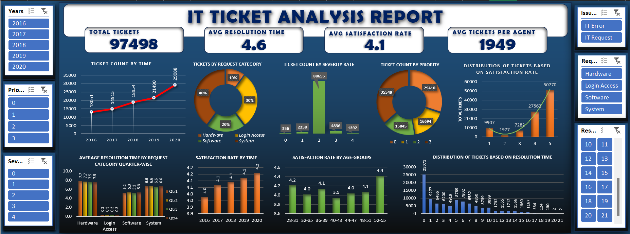
Dashboard
15

Slide 16
Conclusion
The KPIs indicate steady growth in ticket volume, with System-related issues requiring the most resources.
Most tickets fall into mid-level severity and priority, emphasizing the need for efficient resolution processes.
Customer satisfaction is improving, but variations across age groups suggest opportunities for tailored support.
While same-day resolutions are strong, addressing longer resolution times can enhance efficiency.
Prioritizing resource allocation, process improvements, and scalability will ensure continued service excellence.

Slide 17
Recommendations
To improve service efficiency, focus on optimizing resolution times for complex cases and scaling resources for System-related issues.
Enhancing mid-level severity and priority ticket handling will improve response times.
Tailoring support strategies for different age groups can further boost customer satisfaction.
Additionally, planning for continued ticket volume growth will ensure sustained service excellence.
17

Slide 18
Thank You

