Slide 1
OUT OF SYLLABUS
Production-Grade Edition

Slide 2
A NOTE to Juniors
You Don’t have to be an ‘Expert’ in one thing.
Expand your knowledge in as many areas as possible and understand how things work. Adaptability is the key.
Don’t by-heart commands / programs.
You are an Engineer, you just have to know how to put things together to make them work for a bigger purpose.

Slide 3
A BASIC DIFFRENCE between COLLEGE life and corporate life
In College, you think that your job is to know the output of a code snippet.
In company, you will realize that it is the job of the compiler.

Slide 4
Demystifying : Containerization
By Chandan Shastri

Slide 5



Let’s Start from your MINI Projects

Slide 6

Virtual machines

Slide 7
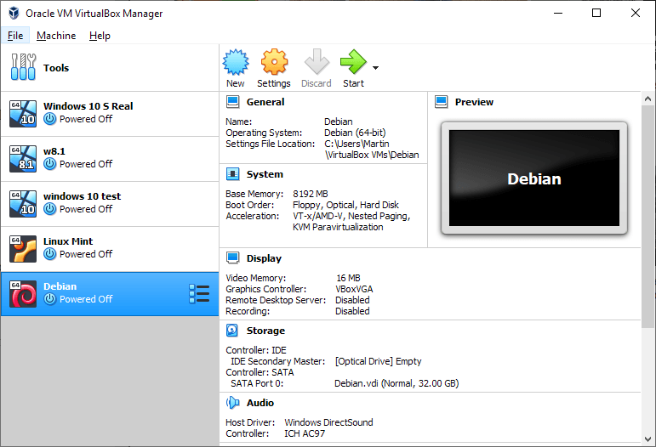

Slide 8
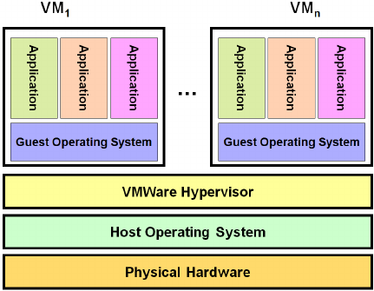

Slide 9


Slide 10
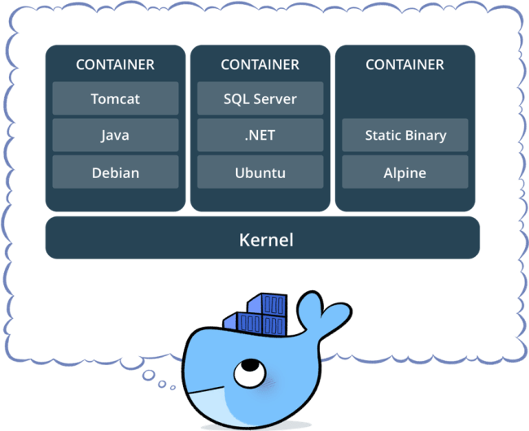

Slide 11
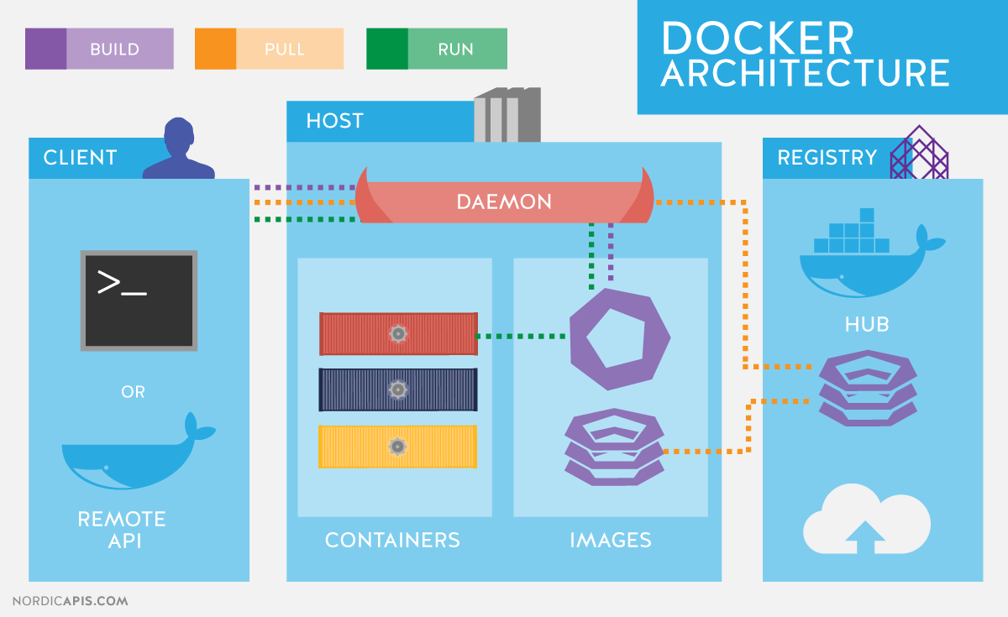

Slide 12
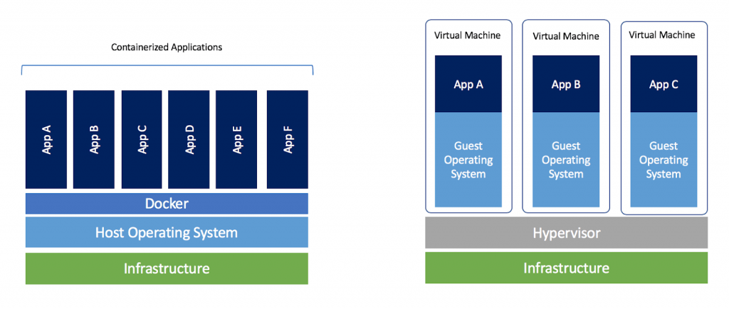

Slide 13
Docker PRACTICLES
Docker Hub
Docker Pull / Push / Run / Start / Stop
Exposing Ports
VS Code Integration

Slide 14
WHY Docker ?

Slide 15
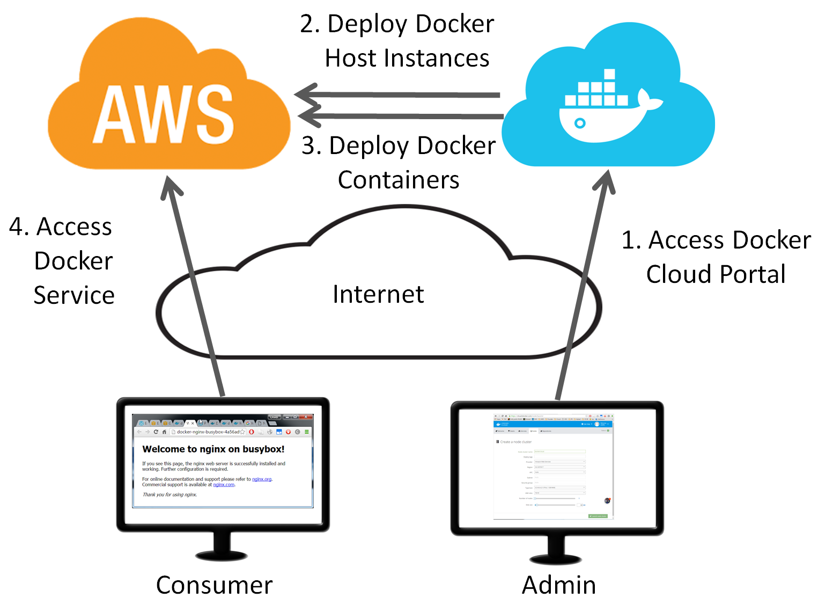

Slide 16
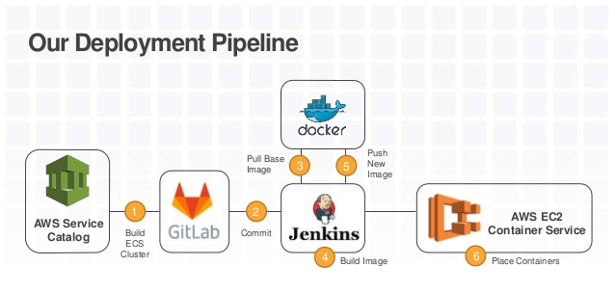

Slide 17
Demystifying : Data Engineering
By Chandan Shastri

Slide 18



ROLES IN BIG DATA PROJECTS
Data Analyst
Data Engineer
Data Scientist
( Extremely
Advanced Tools)

Slide 19
BIG DATA is OF course big.
But how it gets so Big ?

Slide 20


Slide 21
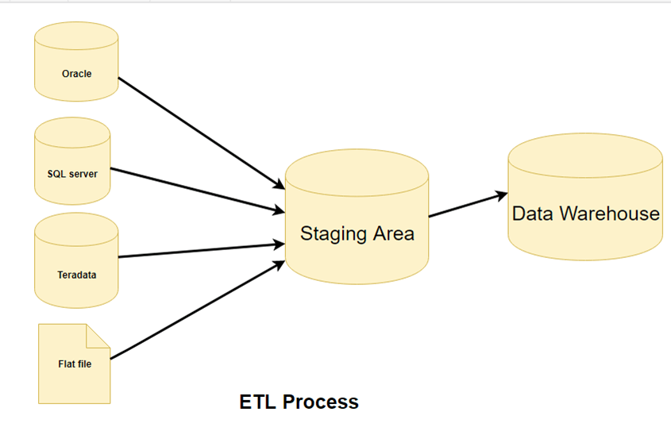

Slide 22
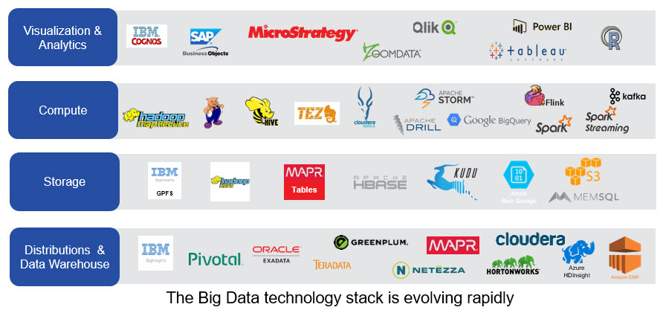

Slide 23
Let’s See only three of them for now

Slide 24



The trending stack

