Slide 1
Ch 7: Normalization-Part 2
Much of the material presented in these slides was developed by Dr. Ramon Lawrence at the University of Iowa

Slide 2
Normal Forms
A relation is in a particular normal form if it satisfies certain normalization properties.
There are several normal forms defined:
  1NF - First Normal Form
  2NF - Second Normal Form
  3NF - Third Normal Form
  BCNF - Boyce-Codd Normal Form
  4NF - Fourth Normal Form
  5NF - Fifth Normal Form
Each of these normal forms are stricter than the next.
  For example, 3NF is better than 2NF because it removes more redundancy/anomalies from the schema than 2NF.

Slide 3
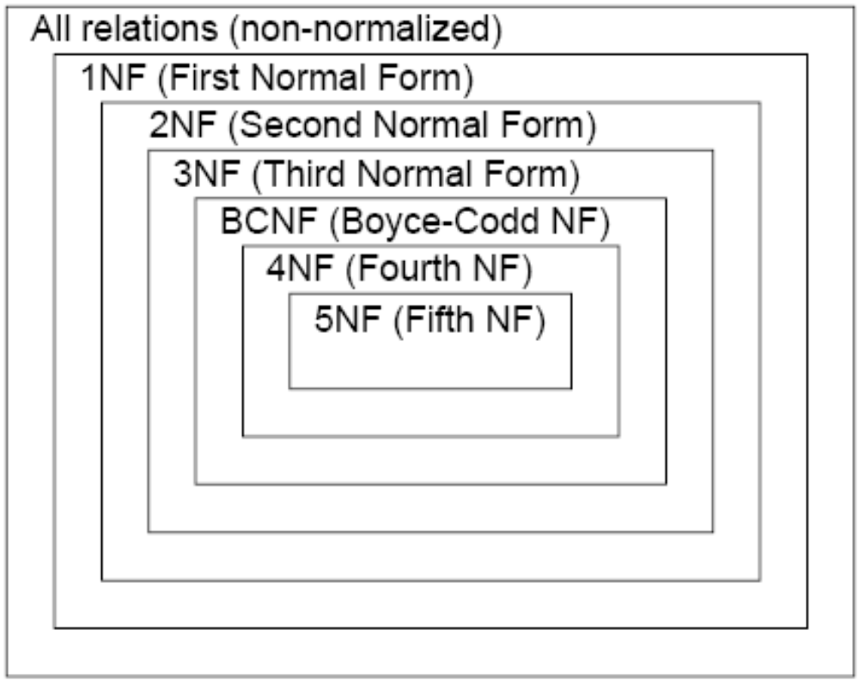
Normal Forms

Slide 4
First Normal Form (1NF)
A relation is in first normal form (1NF) if all its attribute values are atomic.
That is, a 1NF relation cannot have an attribute value that is:
  a set of values (multi-valued attribute)
  a set of tuples (nested relation)
1NF is a standard assumption in relational DBMSs.
  However, object-oriented DBMSs and nested relational DBMSs relax this constraint.
A relation that is not in 1NF is an unnormalized relation.

Slide 5
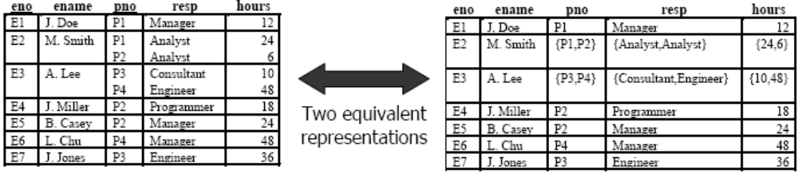
A non-1NF Relation
Two ways to convert a non-1NF relation to a 1NF relation:
1) Splitting Method - Divide the existing relation into two relations: non-repeating attributes and repeating attributes.
  􀃖Make a relation consisting of the primary key of the original relation and the repeating attributes. Determine a primary key for this new relation.
  􀃖Remove the repeating attributes from the original relation.
2) Flattening Method - Create new tuples for the repeating data combined with the data that does not repeat.
  􀃖Introduces redundancy that will be later removed by normalization.
  􀃖Determine primary key for this flattened relation.

Slide 6
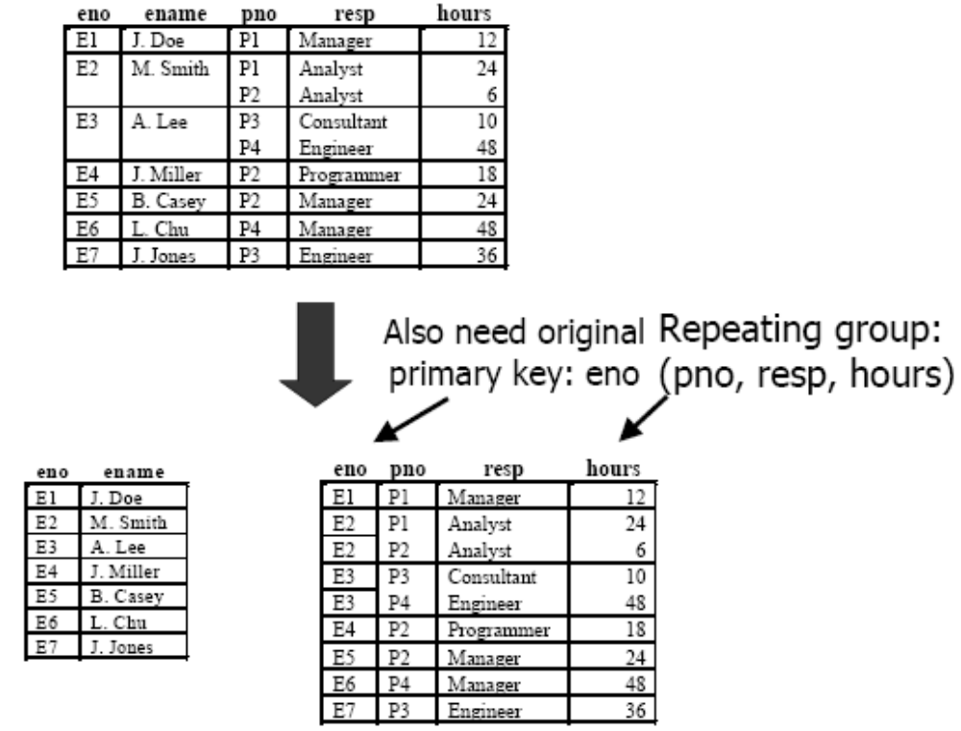
Converting a non-1NF Relation to 1NF Using Splitting

Slide 7
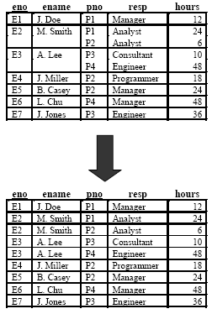
Converting a non-1NF Relation to 1NF Using Flattening

Slide 8
Second Normal Form (2NF)
A relation is in second normal form (2NF) if it is in 1NF and every non-primary key (non-prime) attribute is fully functionally dependent on the primary key.
  Alternative definition from your text: every nonkey column depends on all candidate keys, not a subset of any candidate key
Violations:
  Part of key -> nonkey
  Violations only for combined keys
Note: By definition, any relation with a single primary key attribute is always in 2NF.
If a relation is not in 2NF, we will divide it into separate relations each in 2NF by insuring that the primary key of each new relation functionally determines all the attributes in the relation.

Slide 9
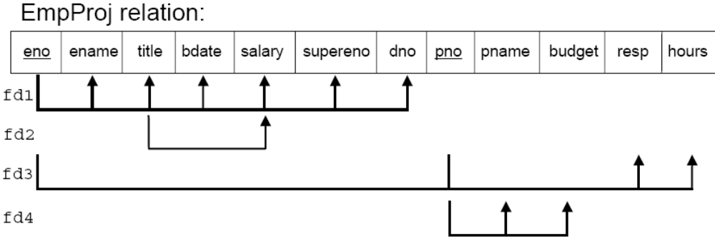
Second Normal Form (2NF) Example
fd1 and fd4 are partial functional dependencies. Normalize to:
  Emp (eno, ename, title, bdate, salary, supereno, dno)
  WorksOn (eno, pno, resp, hours)
  Proj (pno, pname, budget)

Slide 10
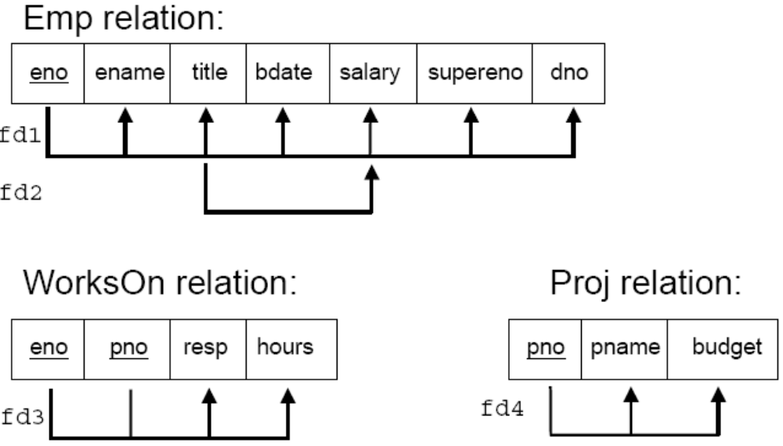
Second Normal Form (2NF) Example

Slide 11
Third Normal Form (3NF)
Third normal form (3NF) is based on the notion of transitive dependency. A transitive dependency A → C is a FD that can be inferred from existing FDs A → B and B → C.
  Note that a transitive dependency may involve more than 2 FDs.
A relation is in third normal form (3NF) if it is in 2NF and there is no non-primary key (non-prime) attribute that is transitively dependent on the primary key.
  Alternate definition from your text: A table is in 3NF if it is in 2NF and each nonkey column depends only on candidate keys, not on other nonkey columns
Violations: Nonkey → Nonkey
Converting a relation to 3NF from 2NF involves the removal of transitive dependencies. If a transitive dependency exists, we remove the transitively dependent attributes from the relation and put them in a new relation along with a copy of the determinant (LHS of FD).

Slide 12
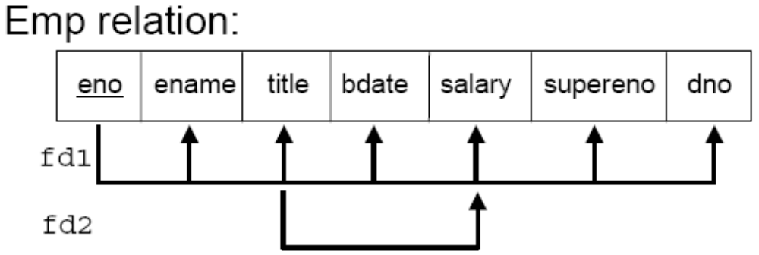
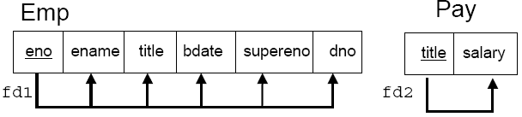
Third Normal Form (3NF) Example
fd2 results in a transitive dependency eno → salary. Remove it.

Slide 13
Third Normal Form (3NF) Formal Definition
A relation schema R is in 3NF if for all functional dependencies that hold on R of the form X →Y, at least one of the following holds:
  Y is a prime attribute of R
  X is a superkey of R
The last condition deals with transitive dependencies. Since X is a superkey of R, we cannot have a non-prime attribute (alone) for X and hence we cannot have transitive dependencies.

Slide 14
General Definitions of 2NF and 3NF
We have defined 2NF and 3NF in terms of primary keys. However, a more general definition considers all candidate keys (just not the primary key we have chosen).
General definition of 2NF:
  A relation is in 2NF if it is in 1NF and every non-prime attribute is fully functionally dependent on any candidate key.
General definition of 3NF:
  A relation is in 3NF if it is in 2NF and there is no non-prime attribute that is transitively dependent on any candidate key.
Note that a prime attribute is an attribute that is in any key (candidate or primary).

Slide 15
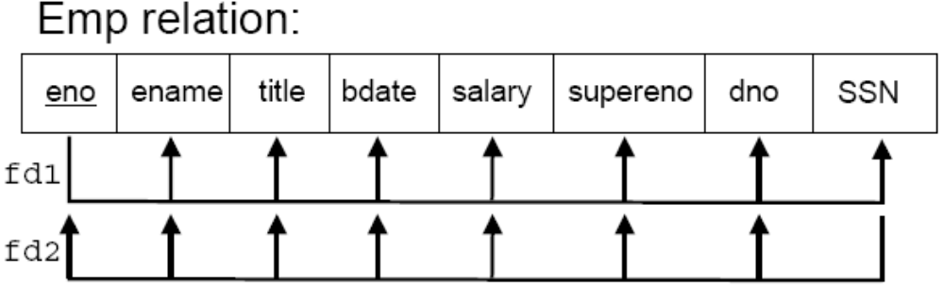
General Definition of 3NF Example
The relation is not in 3NF according to the basic definition because SSN is not a primary key attribute.
  However, there is nothing wrong with this schema (no anomalies) because the SSN is a candidate key and any attributes fully functionally dependent on the primary key will also be fully functionally dependent on the candidate key.
Thus, the general definition of 2NF and 3NF includes all candidate keys instead of just the primary key.

Slide 16
Normalization Question
Consider the universal relation R(A,B,C,D,E,F,G,H,I,J) and the set of functional dependencies:
  F= { A,B → C ; A → D,E ; B → F ; F → G,H ; D → I,J }
List the keys for R.
Decompose R into 2NF and then 3NF relations.

Slide 17
Boyce-Codd Normal Form (BCNF)
A relation is in Boyce-Codd normal form (BCNF) if and only if every determinant is a candidate key.
To test if a relation is in BCNF, we take the determinant of each FD in the relation and determine if it is a candidate key.
  Special cases not covered by 3NF
    Part of key → Part of key
    Nonkey → Part of key
    Special cases are not common
The difference between 3NF and BCNF is that 3NF allows a FD X → Y to remain in the relation if X is a superkey or Y is a prime attribute. BCNF only allows this FD if X is a superkey.
  Thus, BCNF is more restrictive than 3NF. However, in practice most relations in 3NF are also in BCNF.

Slide 18
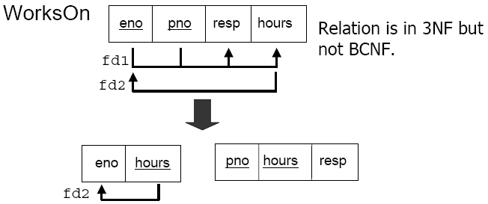
Boyce-Codd Normal Form (BCNF)
Consider the WorksOn relation where we have the added constraint that given the hours worked, we know exactly the employee who performed the work. (i.e. each employee is FD from the hours that they work on projects). Then:
Note that we lose the FD eno,pno → resp, hours.

Slide 19
BCNF versus 3NF
We can decompose to BCNF but sometimes we do not want to if we lose a FD.
The decision to use 3NF or BCNF depends on the amount of redundancy we are willing to accept and the willingness to lose a functional dependency.
Note that we can always preserve the lossless-join property (recovery) with a BCNF decomposition, but we do no always get dependency preservation.
In contrast, we get both recovery and dependency preservation with a 3NF decomposition.

Slide 20
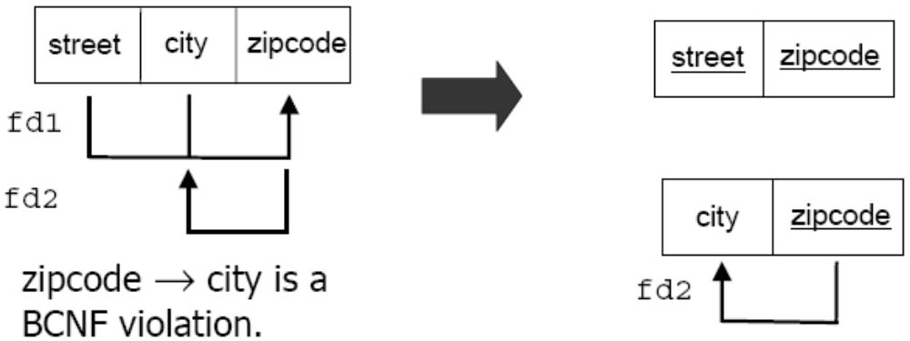
BCNF versus 3NF Example
An example of not having dependency preservation with BCNF:
  street,city → zipcode and zipcode → city
  Two keys: {street,city} and {street, zipcode}

Slide 21
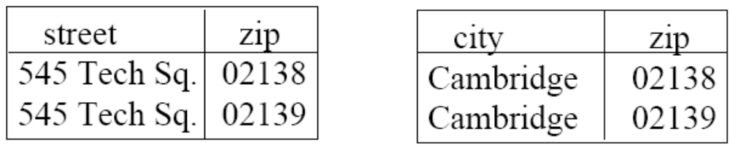
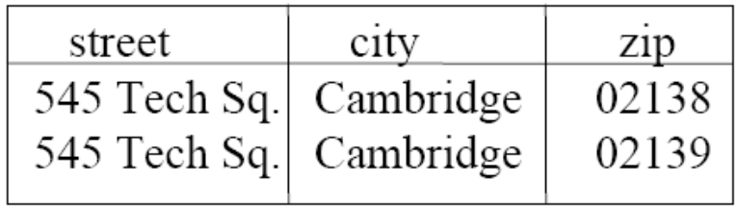
BCNF versus 3NF Example
Consider an example instance:
Join tuples with equal zipcodes:
Note that the decomposition did not allow us to enforce the constraint that street,city → zipcode even though no FDs were violated in the decomposed relations.

Slide 22
Conversion to BCNF
There is a direct algorithm for converting to BCNF without going through 2NF and 3NF given relation R with FDs F:
  Eliminate extraneous columns from the LHSs
  Remove derived FDs
  Arrange the FDs into groups with each group having the same determinant.
  For each FD group, make a table with the determinant as the primary key.
  Merge tables in which one table contains all columns of the other table.

Slide 23
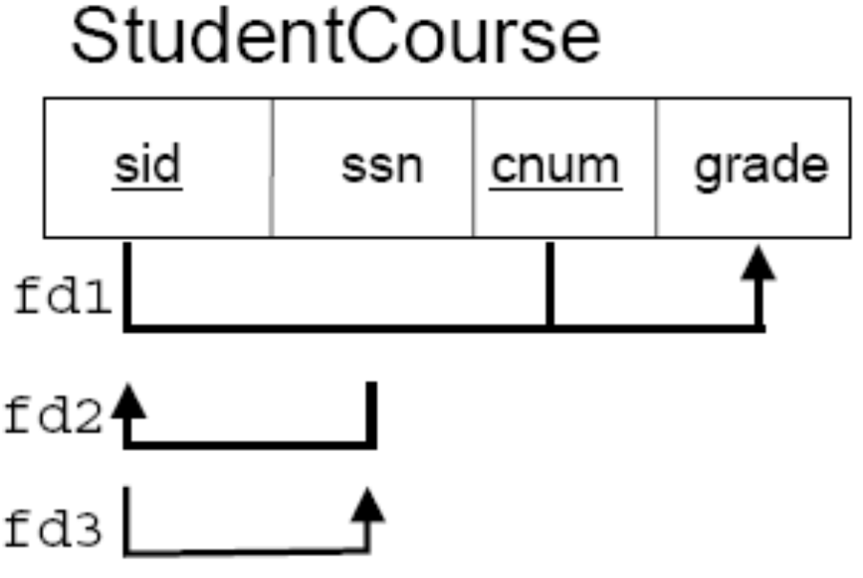
Normalization to BCNF Question
Given this schema normalize into BCNF directly.

Slide 24
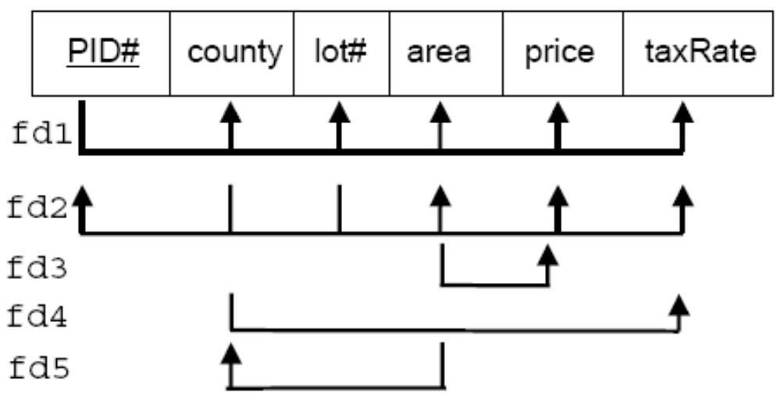
Normalization Question 2
Given this database schema normalize into BCNF.
New FD5 says that the size of the parcel of land determines what county it is in.

Slide 25
Normalization to BCNF Question
Given this schema normalize into BCNF:
  R (courseNum, secNum, offeringDept, creditHours, courseLevel, instructorSSN, semester, year, daysHours, roomNum, numStudents)
  courseNum → offeringDept,creditHours, courseLevel
  courseNum, secNum, semester, year → daysHours, roomNum, numStudents, instructorSSN
  roomNum, daysHours, semester, year → instructorSSN, courseNum, secNum

Slide 26
Multi-Valued Dependencies
A multi-valued dependency (MVD) occurs when two independent, multi-valued attributes are present in the schema.
  A MVD occurs when two independent 1:N relationships are in the relational schema.
When these multi-valued attributes are flattened into a 1NF relation, we must have a tuple for every combination of the values in the two attributes.
  It may seem strange why we would want to do this as it obviously increases the number of tuples and redundancy.
  The reason is that since the two attributes are independent it does not make sense to store some combinations and not the others because all combinations are equally valid. By leaving out some combination, we are unintentionally favoring one combination over the other which should not be the case.

Slide 27
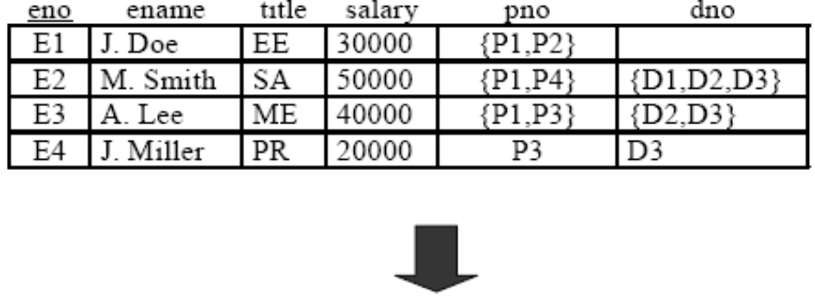
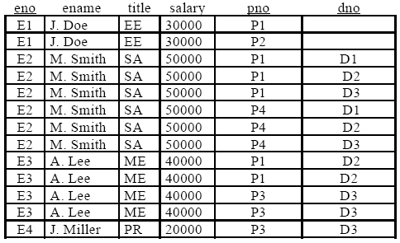
Multi-Valued Dependencies Example
Employee may:
- work on many projects
- be in many departments

Slide 28

Multi-Valued Dependencies (MVDs)
A multi-valued dependency (MVD) is a dependency between attributes A, B, C in a relation such that for each value of A there is a set of values B and a set of values C where the set of values B and C are independent of each other.
A MVD is denoted as A → → B and A → → C or abbreviated as A → → B | C.
A trivial MVD A → → B occurs when either:
  B is a subset of A or
  A B = R

Slide 29
Multi-Valued Dependencies Rules
1) Every FD is a MVD.
  If X →Y, then swapping Y ’s between two tuples that agree on X doesn’t change the tuples.
  Therefore, the “new” tuples are surely in the relation, and we know X → → Y.
2) Complementation: If X → → Y, and Z is all the other attributes, then X → → Z.
Note that the splitting rule for FDs does not apply to MVDs.

Slide 30
Fourth Normal Form (4NF)
Fourth normal form (4NF) is based on the idea of multi-valued dependencies.
A relation is in fourth normal form (4NF) if it is in BCNF and contains no non-trivial multi-valued dependencies.
Formal definition: A relation schema R is in 4NF with respect to a set of dependencies F if, for every nontrivial multi-valued dependency X → → Y, X is a superkey of R.
If X → → Y is a 4NF violation for relation R, we can decompose R using the same technique as for BCNF:
  XY is one of the decomposed relations.
  All but Y – X is the other.

Slide 31
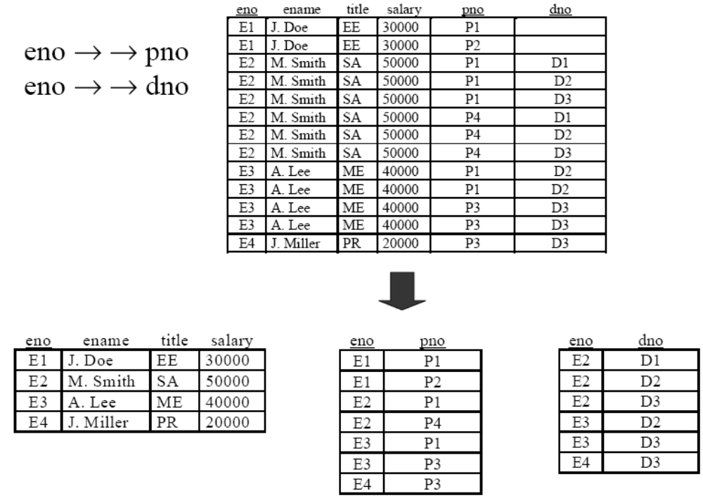
Fourth Normal Form (4NF) Example

Slide 32
Lossless-join Dependency
The lossless-join property refers to the fact that whenever we decompose relations using normalization we can rejoin the relations to produce the original relation.
A lossless-join dependency is a property of decomposition which ensures that no spurious tuples are generated when relations are natural joined.
There are cases where it is necessary to decompose a relation into more than two relations to guarantee a lossless-join.

Slide 33
Fifth Normal Form (5NF)
Fifth normal form (5NF) is based on join dependencies.
A relation is in fifth normal form (5NF) if nad only if every nontrivial join dependency is implied by the superkeys of R.
A join dependency (JD) denoted by JD(R1, R2, …, Rn) on relational schema R specifies a constraint on the states r of R. The constraint states that every legal state r of R is equal to the join of its projections on R1, R2, …, Rn. That is for every such r we have:
  ΠR1(r) ∗ ΠR2(r) ∗ … ∗ ΠRn(r) = r

Slide 34
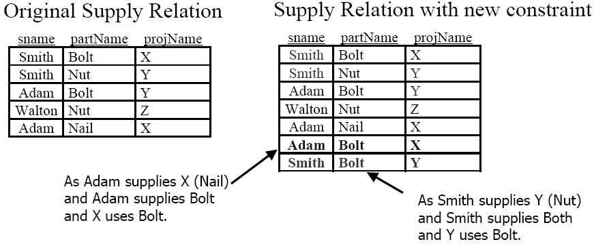
Fifth Normal Form (5NF) Example
Consider a relation Supply (sname, partName, projName). Add the additional constraint that:
If project j requires part p
and supplier s supplies part p
and supplier s supplies at least one item to project j Then
supplier s also supplies part p to project j

Slide 35
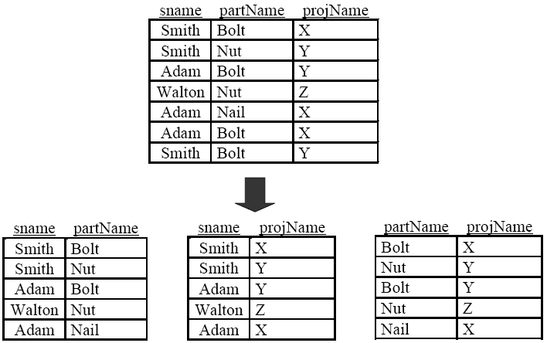
Fifth Normal Form (5NF) Example
Let R be in BCNF and let R have no composite keys. Then R is in 5NF
Note: That only joining all three relations together will get you back to the original
relation. Joining any two will create spurious tuples!

Slide 36
4NF and 5NF in Practice
In practice, 4NF and especially 5NF are rare.
  4NF relations are easy to detect because of the many redundant tuples.
  5NF are so rare than no one really cares about them in practice.
Further, it is hard to detect join dependencies in large-scale designs, so even if they do exist, they often go unnoticed.
  The redundancy in 5NF is often tolerable.
The redundancy in 4NF is not acceptable, but good designs starting from conceptual models (such as ER modeling) will rarely produce a non-4NF schema.

Slide 37
Normal Forms in Practice
Normal forms are used to prevent anomalies and redundancy. However, just because successive normal forms are better in reducing redundancy that does not mean they always have to be used.
For example, query execution time may increase because of normalization as more joins become necessary to answer queries.

Slide 38
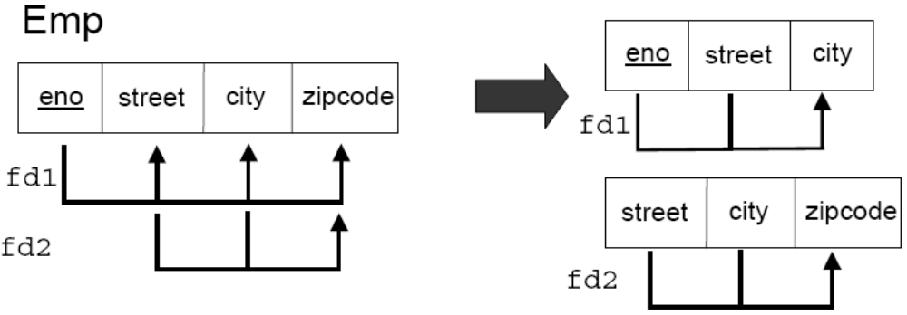
Normal Forms in Practice Example
For example, street and city uniquely determine a zipcode.
In this case, reducing redundancy is not as important as the fact that a join is necessary every time the zipcode is needed.
When a zipcode does change, it is easy to scan the entire Emp relation and update it accordingly.

Slide 39
Normal Forms and ER Modeling
Normalization and ER modeling are two independent concepts.
You can use ER modeling to produce an initial relational schema and then use normalization to remove any remaining redundancies.
  If you are a good ER modeler, it is rare that much normalization will be required.
In theory, you can use normalization by itself. This would involve identifying all attributes, giving them unique names, discovering all FDs and MVDs, then applying the normalization algorithms.
  Since this is a lot harder than ER modeling, most people do not do it.

