Slide 1
Generative AI for Weather Forecasting and Crop Yield Simulation
PIP4004 Capstone Project
Final Review
Batch Number: PSCS_401
20211CSE0723 | SIBBALA CHANDANA
20211CSE0812 | GABBURI NEHA
20211CSE0824 | PATHAKAMURI HARSHITHA
20211CSE0827 | CIVINI MEGHANA
Under the Supervision of,
Mr. PRAVEEN PAWASKAR
Assistant Professor
School of Computer Science and Engineering
Presidency University
Roll Number | Student Name
Name of the Program: Computer Science and Engineering(CSE)
Name of the HoD : Dr. Asif Mohammed H B
Name of the Program Project Coordinator: Mr. Jerrin Joe Francis
Name of the School Project Coordinators: Dr. Sampath A K / Dr. Abdul Khadar A / Mr. Md Ziaur Rahman

Slide 2
Introduction
Weather forecasting is the prediction of atmospheric conditions at a specific location using scientific methods and weather observations. It is a challenging task due to the dynamic and complex nature of the atmosphere. In recent times, data mining and machine learning techniques have been applied to enhance weather prediction. This study proposes a model that predicts weather types based on historical data, including precipitation, temperature, wind speed, and direction from various weather stations. Classification algorithms were used, and the model was trained and tested on separate datasets. The results showed over 90% accuracy, indicating strong potential for accurate weather forecasting and crop suggestions. This approach provides valuable insights for industries like agriculture, transportation, and aviation that depend on precise weather forecasts.

Slide 3
Introduction
The model can be improved by incorporating more weather variables, such as precipitation, cloud cover, and solar radiation, and by applying more sophisticated machine learning techniques, such as ensemble methods.
Keywords: CNN, Logistic Regression, Navie Bayes, MLP, ML & DL techniques, evaluation, Gemini AI and Crops Suggestion.

Slide 4
Review of Literature
Sl. No | Title of Paper & Year | Authors | Methodology Used | Advantages | Disadvantages
1 | Deep Learning for Weather Forecasting: A Comparative Study | J. Smith, A. Lee | CNN, LSTMs, and Transformers for weather prediction | High accuracy in capturing temporal patterns | Requires large training datasets
2 | Generative Models for Climate Data Simulation | M. Brown, T. Kumar | GANs for synthetic climate data generation | Helps in data augmentation for improved forecasting | Computationally intensive training
3 | AI-Based Crop Yield Prediction Using Remote Sensing Data | S. Gupta, L. Wang | Machine learning models (Random Forest, XGBoost) for yield estimation | Improves accuracy by integrating multiple environmental factors | Limited generalization across different regions
4 | Transformers for Time-Series Forecasting in Agriculture | P. Taylor, R. Mehta | Transformer-based models for long-term agricultural forecasting | Captures long-range dependencies in data effectively | High computational cost
5 | Multi-Source Data Fusion for AI-Driven Weather and Crop Prediction | K. Sharma, D. Patel | Integration of satellite, sensor, and historical data for predictive modeling | Enhances precision in both weather and yield forecasting | Requires extensive preprocessing and data cleaning

Slide 5
Sl. No | Title of Paper & Year | Authors | Methodology Used | Advantages | Disadvantages
6 | Impact of Climate Change on Crop Yield: AI-Based Insights | R. Das, N. Verma | AI models integrating climate variables for yield prediction | Provides early warnings for crop failures | Requires high-quality climate datasets
7 | Spatio-Temporal Deep Learning for Agricultural Forecasting | L. Chen, A. Bose | LSTMs and CNNs for spatial and temporal analysis | Captures both location and time-based patterns effectively | High computational cost for large-scale implementation
8 | GANs for Synthetic Weather Data Generation | M. Patel, J. Singh | Generative Adversarial Networks for climate data synthesis | Enhances dataset diversity for training predictive models | Sensitive to hyperparameter tuning
9 | AI-Based Pest and Disease Prediction in Crops | T. Roy, P. Nair | AI models combining weather and crop health data | Helps in precision agriculture by reducing losses | Requires integration of multiple real-time data sources
10 | Federated Learning for Distributed Agricultural Data Analysis | B. Wilson, K. Rao | Federated learning models for decentralized crop prediction | Ensures privacy while leveraging large-scale data | Complexity in model training and deployment

Slide 6
Research Gaps Identified
Existing models (GFS, ECMWF) lack accuracy for hyper-local weather predictions.
High computational requirements limit real-time application in low-resource settings.
Limited ability to incorporate dynamic variables like solar radiation or real-time crop data.
Not optimized for agricultural decision-making, such as crop suggestions.
Minimal integration of AI/ML techniques for adaptive and faster forecasting.

Slide 7
Proposed Methodology
We propose a comprehensive weather forecasting model leveraging deep learning techniques, including Convolutional Neural Networks (CNN), Logistic Regression, Naive Bayes, and Multi-Layer Perceptron (MLP). Utilizing historical weather data comprising precipitation, temperature, wind speed, and direction, our system predicts weather types and Crops Suggestions with high accuracy rates. This system provides valuable insights for various industries reliant on precise weather predictions, with potential enhancements through the incorporation of additional weather variables and advanced ensemble methods.

Slide 8
Objectives
The objective of this project is to develop a robust weather forecasting model using deep learning techniques. Leveraging historical weather data and Crops Suggestion and machine learning algorithms, including logistic regression, naive Bayes, CNNs, and MLPs, the aim is to accurately predict weather types. The project seeks to achieve high prediction accuracy, demonstrating the potential of data mining methods for enhancing weather forecasting capabilities and crop suggestions.

Slide 9
System Design And Implementation
CNN (Convolutional Neural Networks): Extracts complex features from high-dimensional data using convolution, pooling, and fully connected layers.
MLP (Multilayer Perceptron): Learns non-linear relationships for classification through layers with ReLU activations and backpropagation.
Logistic Regression: Performs binary classification using a linear model and sigmoid function for probability prediction.
Naive Bayes: Applies Bayes’ Theorem with feature independence to calculate class probabilities for probabilistic decisions.
Random Forest: Combines multiple decision trees to boost accuracy and prevent overfitting; optimized via Grid/Randomized Search.
Decision Tree: Creates interpretable rules by splitting data on features; uses pruning and depth control to avoid overfitting.

Slide 10
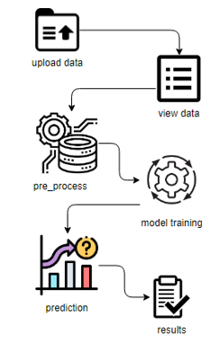
Architecture

Slide 11
Hardware/software components
SOFTWARE REQUIREMENTS
Operating System: Windows 7/8/10
Server-side Script: HTML, CSS, Bootstrap & JS
Programming Language: Python
Libraries: Flask, Pandas, mysql.connector, Os, Numpy
IDE/Workbench: PyCharm, VS-Code
Technology: Python 3.6+
Server Deployment: Xampp Server
Database: MySQL

Slide 12
Hardware/software components
HARDWARE REQUIREMENTS
Processor - I3/Intel Processor
RAM - 4GB (min)
Hard Disk - 128 GB
Keyboard - Standard Windows Keyboard
Mouse - Two or Three Button Mouse
Monitor - Any

Slide 13
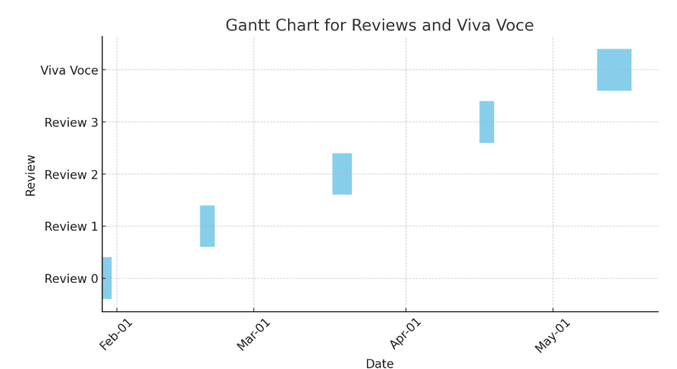
Timeline of the Project (Gantt Chart)

Slide 14
Expected Outcomes
User-Friendly Interface
Accurate Weather Classification
Efficient Data Processing
Dynamic ML Model Building
AI-Powered Crop Recommendation System

Slide 15
Conclusion
In conclusion, our study underscores the efficacy of leveraging data mining techniques and machine learning algorithms for weather forecasting. Through the development of a predictive model based on historical weather data, we achieved high accuracy rates exceeding 90%. This model, employing logistic regression, naive Bayes, CNNs, and MLPs, demonstrates its potential as a valuable tool for accurately predicting weather types. Our findings suggest significant implications across industries such as agriculture, transportation, and aviation, where precise weather forecasts are indispensable. Moving forward, further enhancements incorporating additional weather variables and advanced machine learning techniques promise to refine and augment the predictive capabilities of our model.

Slide 16
Pseudocode
START
IMPORT necessary libraries (Django, ML, Pandas, etc.)
DEFINE views:
1. index()
RENDER 'index.html'
2. about()
RENDER 'about.html'
3. login(request)
IF request is POST:
GET email and password
CHECK if user exists in database
REDIRECT to 'userhome'
ELSE:
RENDER 'login.html'

Slide 17
Pseudocode
4. registration(request)
IF request is POST:
GET name, email, password, confirm password
IF password == confirm:
SAVE user to database
RENDER 'login.html'
ELSE:
SHOW error
RENDER 'registration.html'
5. userhome()
RENDER 'userhome.html'
6. load(request)
IF request is POST:
READ uploaded CSV into dataframe `df`
DISPLAY success message
RENDER 'load.html'
7. view(request)
DISPLAY first 100 rows of `df` in 'view.html'

Slide 18
Pseudocode
8. preprocessing(request)
IF request is POST:
DROP 'date' column
ENCODE 'weather' labels using LabelEncoder
OVERSAMPLE data using SMOTE
SPLIT into x_train, x_test, y_train, y_test
DISPLAY success message
RENDER 'preprocessing.html'
9. model1(request)
IF request is POST:
GET selected algorithm:
IF "1": Train Logistic Regression
IF "2": Load CNN from pickle and predict
IF "3": Train MLP
IF "4": Train Random Forest
IF "5": Train Decision Tree
CALCULATE accuracy
DISPLAY result in 'model1.html'
RENDER 'model1.html'

Slide 19
Pseudocode
10. prediction(request)
IF request is POST:
GET input features: precipitation, temp_max, temp_min, wind
PREDICT weather using Random Forest
MAP predicted label to weather type
PROMPT Gemini API with weather type for crop suggestions
DISPLAY weather + crop recommendations in 'result.html'
ELSE:
RENDER 'prediction.html'
11. result()
RENDER 'result.html'
END

Slide 20
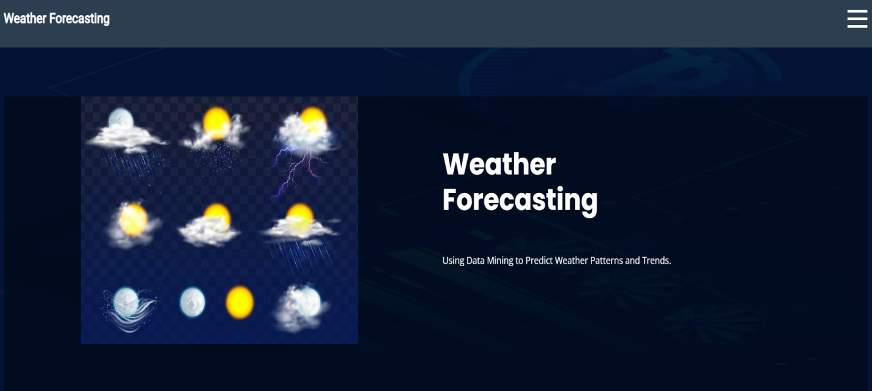
Screenshots
Home: This is the home Page for Weather Forcasting.

Slide 21
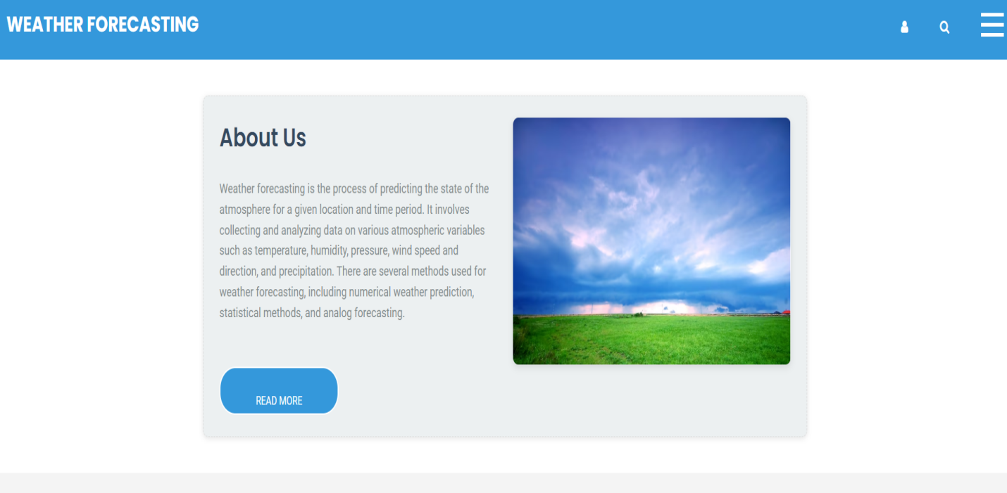
Screenshots
About: We can see the related information of the project.

Slide 22
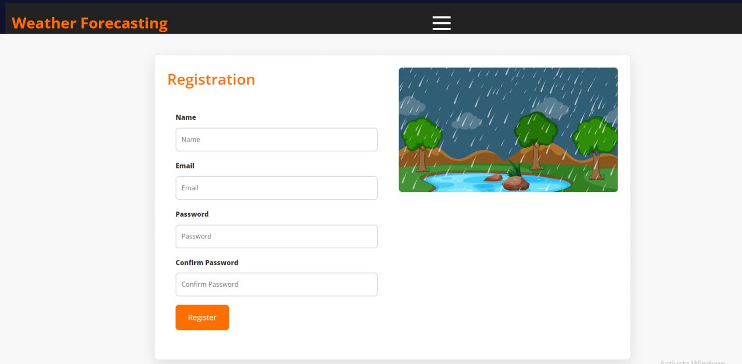
Screenshots
Registration: Here user have to pass the all credential to register.

Slide 23
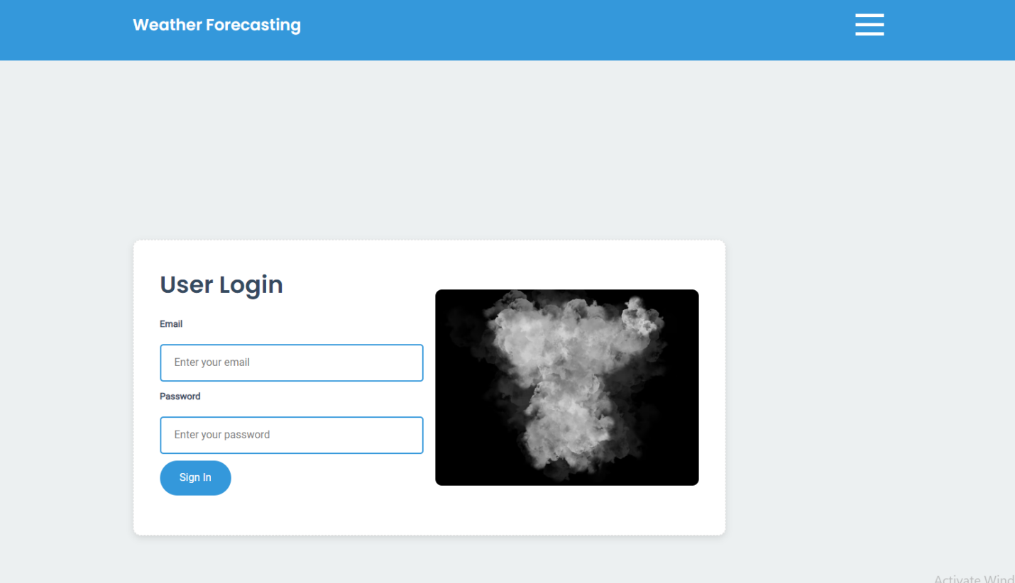
Screenshots
Login: Here user have to provide the register Email-ID and Passwords.

Slide 24
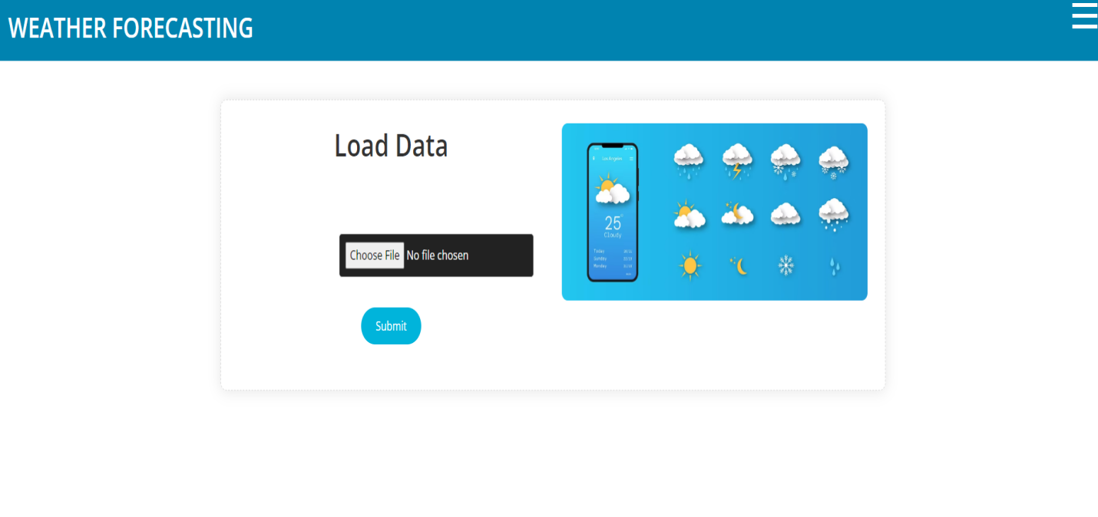
Screenshots
Load: Here user have to select the csv file and load the data.

Slide 25
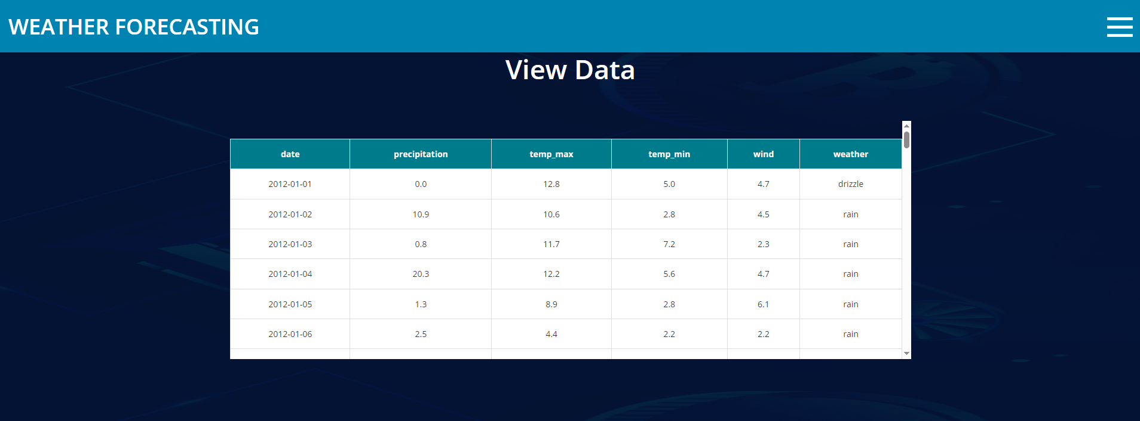
Screenshots
View: Hear user can see the load data columns and there values.

Slide 26
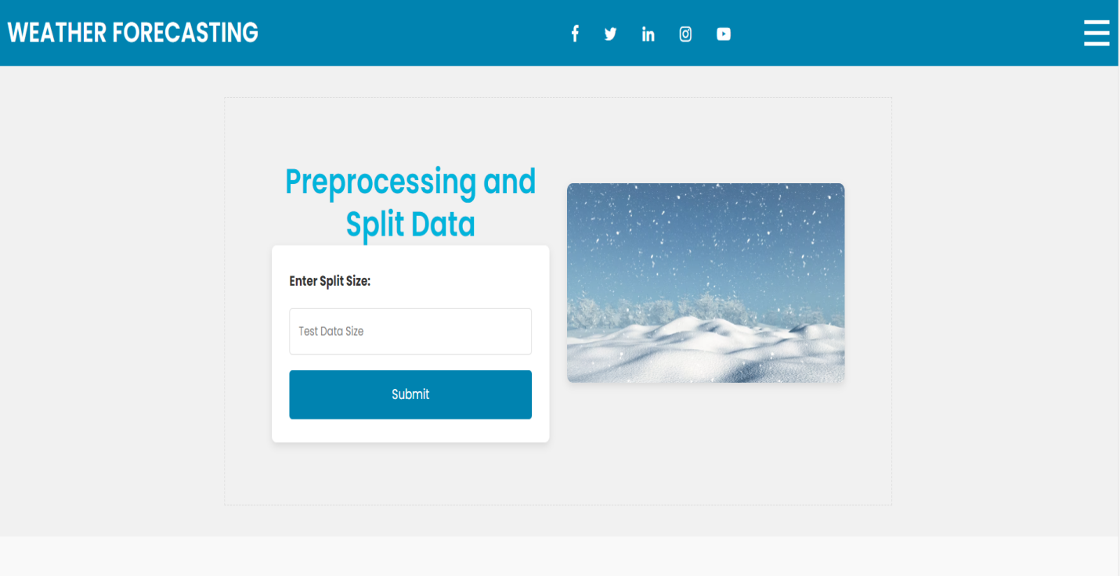
Screenshots
Preprocess: User can provide the test size for splitting the data into training and testing.

Slide 27
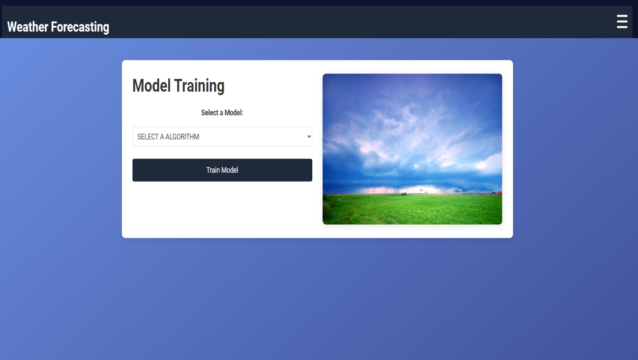
Screenshots
Model: Here you can select the model and check the accuracy of each model.

Slide 28
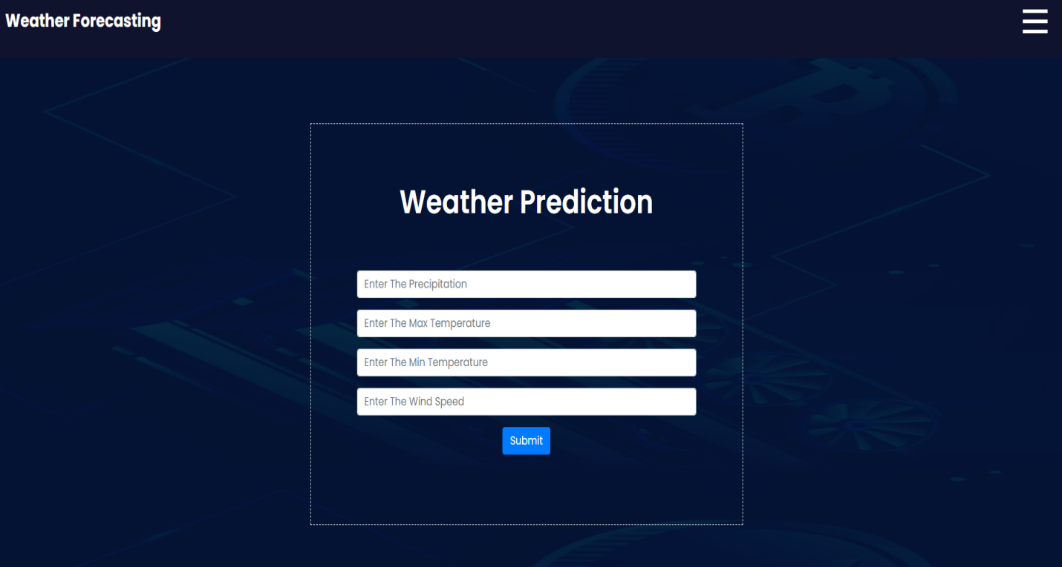
Screenshots
Prediction: Hear user have to pass the values and predict the weather.

Slide 29
Github Link
Github Link:
https://github.com/Chandana-sibb/AI-Based-Crop-Recommendation-with-Weather-Prediction-using-Data-Mining

Slide 30
References (IEEE Paper format)
[1] S. Patel, M. Gupta, "Deep Learning-Based Weather Forecasting Using Time Series Data," IEEE Transactions on Neural Networks and Learning Systems, 2022. [2] R. Verma, T. Singh, "Generative Adversarial Networks for Synthetic Weather Data Generation," International Conference on Artificial Intelligence in Environmental Sciences, 2023. [3] K. Sharma, L. Zhang, "Transformer-Based Models for Time-Series Weather Prediction," IEEE Transactions on Artificial Intelligence, 2021. [4 P. Das, R. Nair, "Climate Impact on Crop Yield: A Machine Learning Perspective," IEEE International Conference on Big Data and Smart Computing, 2020.
[5] J. Lee, S. Brown, "Neural Networks for Climate and Crop Yield Predictions," IEEE Transactions on Computational Agriculture, 2023 [6] A. Kumar, N. Reddy, "Application of AI and IoT in Smart Agriculture for Crop Yield Optimization," IEEE International Symposium on Precision Agriculture Technologies, 2022. [7] M. Ali, F. Chen, "GANs for Agricultural Data Augmentation and Crop Yield Forecasting," IEEE Transactions on Machine Learning in Agriculture, 2021. [8] V. Kaur, P. Mehta, "A Hybrid Approach to Weather Forecasting Using LSTM and GANs," IEEE International Conference on Data Science and Engineering, 2022. [9] H. Lin, R. Wilson, "Deep Learning-Based Weather and Climate Predictions for Sustainable Farming," IEEE Transactions on Environmental Data Science, 2023. [10] B. Singh, G. Thomas, "AI-Driven Crop Yield Estimation Using Remote Sensing and Meteorological Data," IEEE International Conference on Smart Agriculture and Environment, 2021.

Slide 31
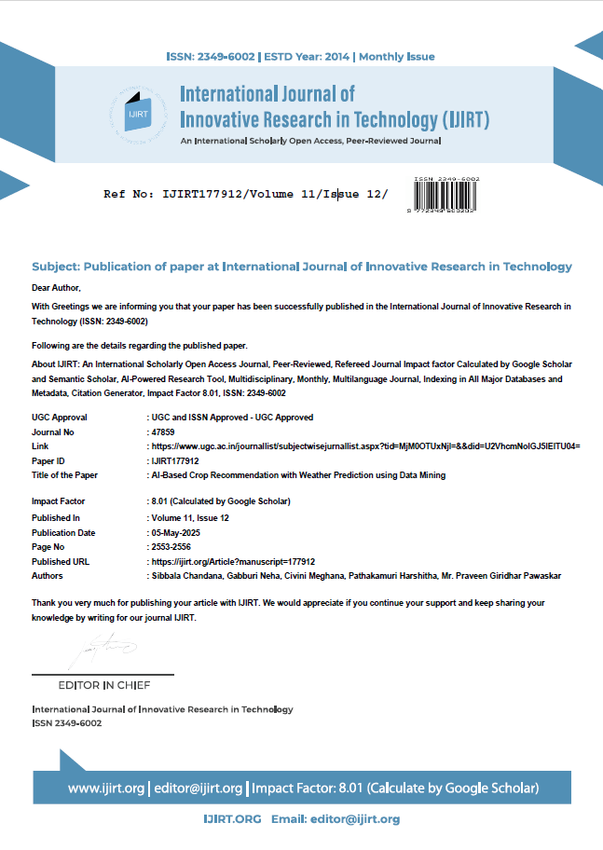
Publication Details
Letter of Confirmation for Publication
Paper Publication Link:
https://ijirt.org/publishedpaper/IJIRT177912_PAPER.pdf

Slide 32
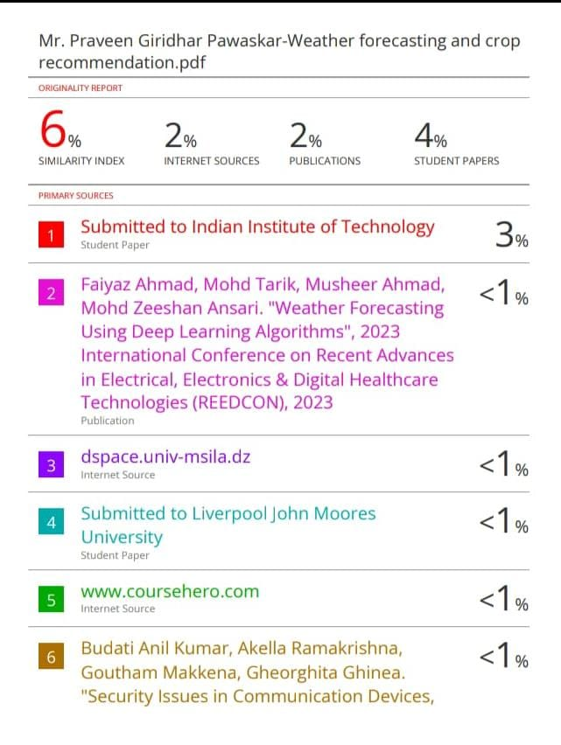
Similarity Index
Plagiarism Report

Slide 33

Project work mapping with SDG
1. SDG 13: Climate Action
The weather prediction component enables farmers to prepare
for climate variability, mitigate risks, and adapt their practices.
This proactive approach supports climate-resilient agriculture
and reduces the environmental impact of farming.
2. SDG 12: Responsible Consumption and Production
This system helps optimize resource use (e.g., water, fertilizer) by
recommending crops that are best suited to current weather conditions.
This reduces waste, enhances efficiency, and supports environmentally
sustainable farming practices.

Slide 34


