Slide 1
Smart Ticket-An Intelligent Public Transport System with Fraud Detection and Loyalty Program
PIP2001 Capstone Project
Final Review
Batch Number: PSCS103
ROLL NO | NAME
20211CSE0723 | SIBBALA CHANDANA
20211CSE0480 | KOTHA GREESHMA REDDY
20211CSE0812 | GABBURI NEHA
20211CSE0827 | CIVINI MEGHANA
20211CSE0824 | PATHAKAMURI HARSHITHA
Under the Supervision of,
Dr. SENTHIL KUMAR S
Professor
School of Computer Science and Engineering
Presidency University
Name of the Program: Computer Science And Engineering
Name of the HOD: Dr. Asif Mohammed
Name of the Program Project Coordinator: Mr. Amarnath J L
Name of the School Project Coordinators: Dr. Abdul Khadar A

Slide 2
Introduction
Our Smart Ticket system integrates cutting-edge technologies like face recognition for secure ticketing, personalized QR codes for identification, and real-time fare calculation, making the boarding and ticketing process more efficient and user-friendly. We aim to eliminate the need for conductors and automate ticket validation, enhancing the overall travel experience for passengers while ensuring security and accuracy.
Our project leverages Flask’s lightweight framework, which allows us to rapidly develop and implement features like user registration, face recognition setup, and fare management. By utilizing MongoDB for data storage, we ensure scalability and maintain well-structured, accessible data. This system simplifies the user experience, improves operational efficiency, and addresses real-world issues such as long queues and manual ticketing in public transport.

Slide 3
Literature Review
SL NO | Title of the paper and year | Authors | Methodology used | Advantages | Disadvantages
1 | RFID-based Smart Public Transit System. Year:2023 | Venkata Subba Reddy Bakka, Sai Sri Nidhin Tankala, Aarthi Bodumallu Gardannagari, Chandana Reddy Bakka, Dr. N. Sangeetha | The project utilizes RFID technology combined with IoT to create an intelligent public transportation system. It allows users to track the real-time location of buses using GPS, book seats, and make payments using an RFID card. | Automates fare collection and reduces the need for physical tickets. Offers a user-friendly interface for passengers and drivers via Android applications​ | Potential delay in the synchronization of data from some sensors to the cloud.Limited access for passengers who do not have smartphones or RFID cards.
2 | Cloud Controlled Transport Fare Management System Based on Traveller's Information in Private Web Server​ Year:2023 | V. Vedanarayanan, Ramakrishnan Raman, Sagar Ramesh Pujar, T. Sivakumar | The system uses Internet of Things (IoT) and RFID to automate fare collection in public transportation. Passengers place their finger on a fingerprint sensor to log their entry and exit, with the distance traveled and fare calculated based on this data. | Reduces the need for manual ticketing. Uses biometric and RFID technology for precise fare calculation. Real-time updates improve route and resource management. | Implementing IoT and RFID-based infrastructure may have high upfront costs. - System failures or sensor malfunctions could disrupt service.
3 | An Approach of Enhancing the Quality of Public Transportation Service in Sri Lanka using IoT Year:2023 | Weligamage H.D, Wijesekara S.M.,Chathwara M.D.S, Isuru Kavinda H.G, Nelum Amarasena,Narmada Gamage | The paper proposes a non-interactive automated ticketing system using RFID smart cards, IoT-based real-time tracking, and image processing for face recognition and seat identification. | Non-interactive ticketing reduces the need for manual ticketing. - Face recognition and smart card verification prevent unauthorized access. | The accuracy of image-based seat detection and passenger counting can be affected by lighting conditions. High reliance on multiple technologies (RFID, IoT, image processing) increases maintenance complexity.
4 | The Future of Travel in public Bus Service: How a Mobile Bus Ticketing System is Revolutionizing the Public Travel Year:2023 | T. Kavitha , G. Senbagavalli | The paper proposes the development of an online mobile bus ticketing system using technologies like Optical Character Recognition (OCR) for mobile ticketing, supported by a Firebase database and Android development using Java. | Improved customer insights for bus operators through data analytics.Reduction in staffing costs at ticket counters. | Risk of security breaches, such as hacking or fraud in online transactions.Resistance from less tech-savvy users, especially older passengers.
5 | Integrated Bus System Using QR code Year: 2023 | Kajal Hargunani, Pranita Kengar, Prof. Meghana Lokhande,Rishal Gawade, Sunil Kumar More | The paper proposes an Integrated Bus System using QR codes for e-ticketing and bus tracking. Passengers can scan QR codes placed at bus stops to view bus schedules and estimated arrival times. | QR codes and smartphones provide a low-cost solution for e-ticketing and tracking. | Dependence on smartphone availability and network connectivity for real-time updates​

Slide 4
Literature Review
SL NO | Title of the paper and year | Authors | Methodology used | Advantages | Disadvantages
6 | Mobile Enabled Bus Tracking and Ticketing System | Suresh Sankarananrayanan Paul Hamilton | The project utilizes RFID technology combined with IoT to create an intelligent public transportation system. It allows users to track the real-time location of buses using GPS, book seats, and make payments using an RFID card. | RFID tags which is passive one affixed to bus are detected by RFID Reader installed at bus stop. | The scheduling and tracking of buses will rely heavily on the capabilities of ICT in order to reflect in real time.
7 | Proposing a Real-Time Ticket Monitoring System for Public Transport in NSW, Australia | Rawdah and Syed Shafin Ali | The methodology involves the integration of hardware (ultrasonic sensors, Raspberry Pi module) and software (RFID for ticket validation, real-time data transmission via Google Firebase). | Helps reduce fare evasion by tracking.Provides real-time data to transportation authorities. | May involve high implementation costs due to sensor installation.
8 | Automatic Bus Ticketing System Bangladesh Year:2021 | Md Junayed Bin Alam, Fatema Zahra, Mohammad Monirujjaman Khan | RFID-based smart cards and rotary encoder technology combined with Arduino to automatically calculate bus fares based on distance traveled, using RFID readers at bus entrances and exits. | Simplifies fare collection, preventing fare disputes.Reduces the risk of cheating in fare payments. | Potential dependency on technology, which may fail or require maintenance.No mention of handling potential system failures during fare calculation.
9 | A Smart Paperless Electronic Ticketing System using RFID and Bluetooth Technologies Year:2022 | P. Manikandan, S. Sunil Kumar, G. Ramesh, P. Vara Siddartha, V. Muneeswaran, A. K. Koushik | The system utilizes RFID and Bluetooth technologies for automated ticketing. RFID readers interface with microcontrollers to read tags, verify passenger information, calculate fares based on destination, and manage payments via a mobile app integrated with the banking system. | Integrates with mobile banking for seamless transactions. | Initial setup costs may be high due to hardware requirements.
10 | Smart E-Ticketing System for Public Transport Bus | Sanam Kazi, Murtuza Bagasrawala, Farheen Shaikh, Anamta Sayyed | The system uses a mobile application for e-ticketing and automatic seat allocation for public buses. It includes a GPS-enabled device for real-time tracking of buses, a novel seat allocation algorithm based on booking time, and digital wallets for cashless payments. | Reduces the use of paper tickets by generating e-tickets.Promotes a cashless economy by integrating digital payments. | Requires upfront infrastructure development, including GPS devices and bus stop installations.

Slide 5
Research Gaps Identified
Face Recognition Accuracy in Real-World Environments
Data Privacy and Security
Scalability of QR Code Systems
User Adoption and Accessibility
Notes:
Encryption mechanisms in the system minimize the risk of data breaches, enhancing data privacy for users.

Slide 6
Proposed Methodology
Implemented a robust facial recognition system using HOG (Histogram of Oriented Gradients) for efficient real-time face detection and enhance model training with diverse datasets for better accuracy in real-world conditions (e.g., varying lighting, angles).
Stores sensitive data (such as photos and Aadhar numbers) securely in the database by using encryption techniques and implement proper access control measures to safeguard users' personal information from unauthorized access.
Designed a scalable QR code system by implementing efficient generation and storage of QR codes in the database (using Base64 encoding for QR code images) and optimizing the code for handling a large number of user requests simultaneously.
Enhanced the user experience by creating a simple, intuitive interface for registration and QR code generation, while ensuring accessibility features for diverse user groups, and easy navigation for users.

Slide 7
Objectives
Face Recognition: Implement real-time face recognition to identify users and match recognized faces with registered data in the database.
QR Code Scanning: Enable users to scan QR codes for identification or ticket validation.
Home and Navigation: Provide a user-friendly home page with navigation options for registration, QR code generation, face recognition, and scanning.

Slide 8
System Design And Implementation
User Registration:
Users register by capturing their face and providing Aadhar details, which are stored securely.
QR Code Generation:
A unique QR code linked to the user's profile and facial recognition data is generated and displayed.
Public Transport Entry:
Users scan their QR code at the station, which is validated for authentication.
Real-Time Face Recognition:
A live face image is captured, compared with stored data, and validated for entry.
Fare Calculation and Boarding:
The system calculates the fare based on the user's source and destination and issues a digital ticket.

Slide 9
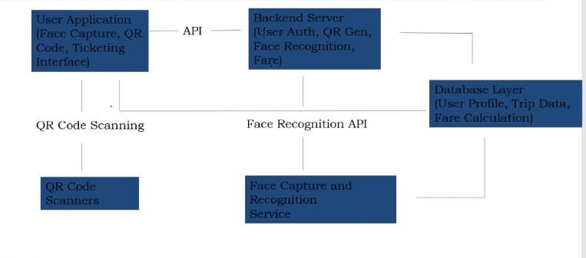
Architecture

Slide 10
Hardware/software components
Code Editor: VS Code VS Code is a versatile and powerful text editor, offering extensive features like IntelliSense, Git integration, and a rich extension ecosystem for seamless development.
Libraries Used: NumPy, Flask, PyMongo, QRCode, OpenCV NumPy for data handling, Flask for web development, PyMongo for MongoDB integration, and QRCode for QR code generation. OpenCV for computer vision tasks, such as image processing, object detection, and video capture.
Technology: Python 3.6+ Python 3.6 or higher is used for development, providing modern syntax and library support

Slide 11
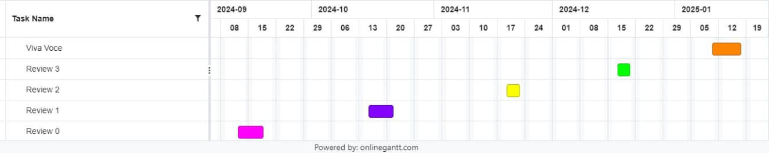
Timeline of Project

Slide 12
Expected Outcomes
Seamless Card Generation: Enables users to easily create and manage digital travel cards with stored travel info and rewards.
Accurate Fare Calculation: Provides fare estimates based on source and destination for pricing transparency.
Efficient QR Code Scanning: Facilitates quick and reliable QR code validation to minimize boarding delays.
Facial Recognition for Boarding: Adds security and convenience by verifying users through facial recognition during boarding.
Loyalty Rewards Management: Tracks trips and allows users to earn and redeem loyalty points for discounts or rewards.

Slide 13
Conclusion
In conclusion, this Smart Ticket System demonstrates the development of a highly efficient and secure Flask-based application that seamlessly integrates user registration, QR code generation, and facial recognition for enhanced identification and verification. By utilizing MongoDB for scalable data storage and leveraging advanced face recognition algorithms, the system ensures reliability and robust performance. The successful integration of these features highlights the potential for such applications in various domains, including public transport, security, and user management. This research contributes to the advancement of user-centric, scalable, and secure systems, setting a foundation for future innovations in similar fields.

Slide 14
Pseudocode
QR Code Scanning and Validation
# Function to validate the QR code scanned by the user
function validate_qr(qr_code):
# Check if QR code is empty
if qr_code is null:
print ("Invalid QR Code. Please scan again.")
return false
# Decode QR code to retrieve user data
user_data = decode_qr_code(qr_code)
# Verify if user data is valid
if user_data is not valid:
print ("User not registered. Please generate a card.")
return false
print ("QR Code validated successfully.")
return user_data
Route Selection
# Function to choose the source and destination for the trip
function select_route (source, destination):
# Validate source and destination
if source is null or destination is null:
print ("Source or Destination cannot be empty.")
return false

Slide 15
Pseudocode
if source == destination:
print ("Source and Destination cannot be the same.")
return false
# Calculate route information such as distance
route_details = calculate_route_details (source, destination)
return route_details
Fare Calculation
# Function to calculate fare based on route and user category
function calculate_fare (route_details, user_category):
distance = route_details["distance"] # Distance of the route
base_fare = route_details["base_fare"] # Base fare per kilometer
# Apply discount based on user category
if user_category == "student" or user_category == "senior_citizen":
discount = apply_discount(base_fare)
else:
discount = 0
# Calculate total fare
total_fare = (base_fare * distance) - discount
return total_fare
Ticket Generation
# Function to generate ticket after validation and fare calculation

Slide 16
Pseudocode
function generate_ticket (user_data, route_details, total_fare):
# Create a ticket dictionary with all required details
ticket = {
"User_id": user_data["id"],
"source": route_details["source"],
"destination": route_details["destination"],
"fare": total_fare,
"timestamp": get_current_timestamp (),
"Ticket_id": generate_unique_ticket_id ()
}return ticket
Loyalty Rewards
# Function to update loyalty points for frequent travelers
function update_loyalty_points (user_data, trips_completed):
# Add points based on the number of completed trips
if trips_completed > 0:
user_data["loyalty_points"] += trips_completed * points_per_trip
# Check if points exceed the reward threshold
if user_data["loyalty_points"] >= reward_threshold:
redeem_rewards(user_data)
return user_data["loyalty_points"]

Slide 17
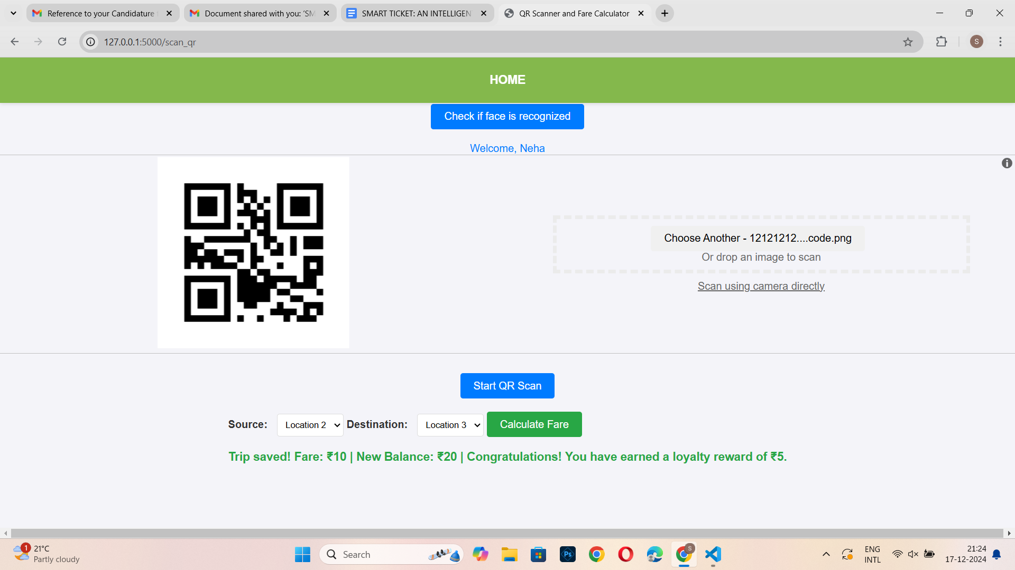
Screenshots

Slide 18
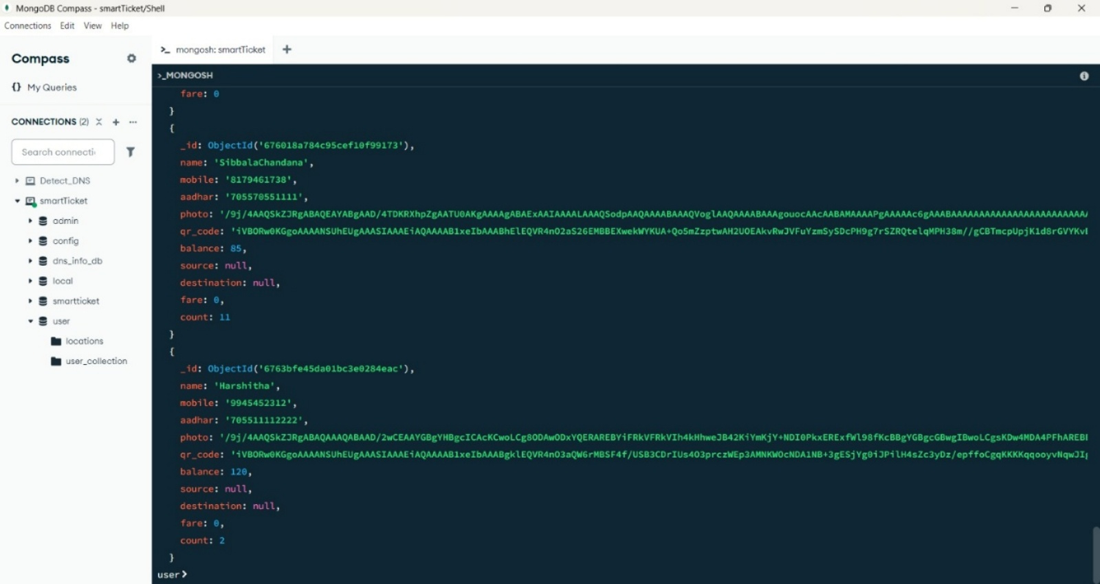
Screenshots

Slide 19
Github Link
GitHub Link
https://github.com/Chandana-sibbala

Slide 20
References
[1] V. S. R. Bakka, S. S. N. Tankala, A. B. Gardannagari, C. R. Bakka, and Dr. N. Sangeetha, "RFID-based Smart Public Transit System," 2023.
[2] V. Vedanarayanan, R. Raman, S. R. Pujar, and T. Sivakumar, "Cloud Controlled Transport Fare Management System Based on Traveller's Information in Private Web Server," 2023.
[3] Weligamage H. D., Wijesekara S. M., Chathwara M. D. S., Isuru Kavinda H. G., Nelum Amarasena, and Narmada Gamage, "An Approach of Enhancing the Quality of Public Transportation Service in Sri Lanka using IoT," 2023.
[4] T. Kavitha and G. Senbagavalli, "Integrated Bus System Using QR Code," 2023.
[5] Kajal Hargunani, Pranita Kengar, Prof. Meghana Lokhande, Rishal Gawade, and Sunil Kumar More, "Integrated Bus System Using QR Code," 2023.
[6] Suresh Sankarananrayanan and Paul Hamilton, "Mobile Enabled Bus Tracking and Ticketing System," 2023.
[7] Rawdah and Syed Shafin Ali, "Proposing a Real-Time Ticket Monitoring System for Public Transport in NSW, Australia," 2023.
[8] Md Junayed Bin Alam, Fatema Zahra, and Mohammad Monirujjaman Khan, "Automatic Bus Ticketing System Bangladesh," 2021.
[9] P. Manikandan, S. Sunil Kumar, G. Ramesh, P. Vara Siddartha, V. Muneeswaran, and A. K. Koushik, "A Smart Paperless Electronic Ticketing System using RFID and Bluetooth Technologies," 2022.
[10] Sanam Kazi, Murtuza Bagasrawala, Farheen Shaikh, and Anamta Sayyed, "Smart ETicketing System for Public Transport Bus," 2023.

Slide 21
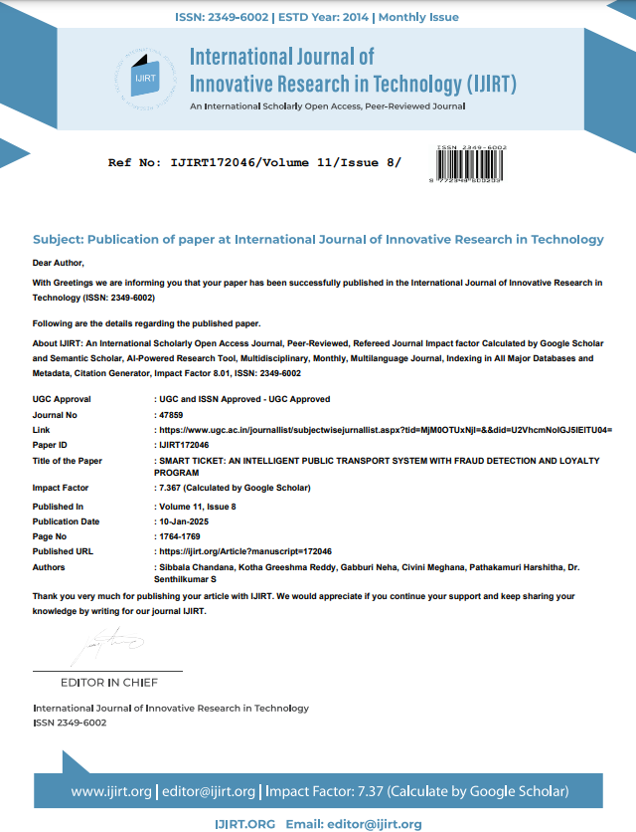
Publication Details
Letter of Confirmation for Publication
2. Paper Publication Link:
https://ijirt.org/Article?manuscript=172046

Slide 22
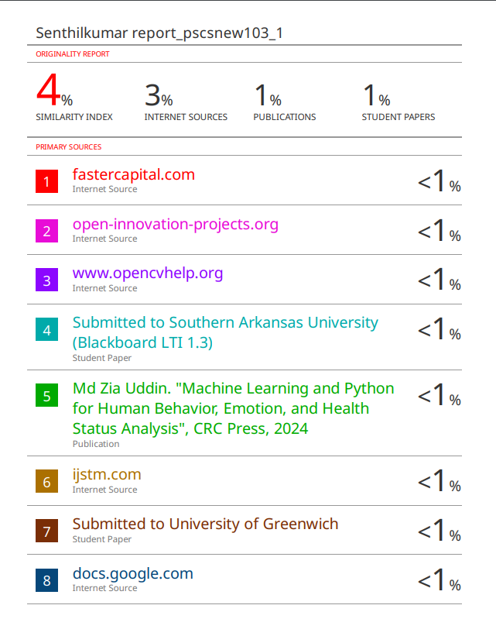
Similarity Index
Plagiarism Report

Slide 23

Project work mapping with SDG
Goal 8: Decent Work and Economic Growth Boosts public transport revenue and fosters employment in tech-driven solutions, supporting economic growth and innovation.
Goal 9: Industry, Innovation, and Infrastructure Integrates modern technologies like QR codes and scalable backend systems to enhance public transport infrastructure and promote smart cities.

Slide 24
Thank You

