Slide 1
Reason KG
Knowledge-Graph-Grounded RAG
with Logical Consistency Checking
Applied to Financial Document Analysis
CSE 579 — Knowledge Representation & Reasoning
Chandana Vinay Kumar
Raaghul Nataraj Kannan
Narahari Kommi
Madhurika Kandukoori
Raja Shree Reddy Pailla
May 2026
1/10

Slide 2


Background & Motivation
The Core Problem
LLMs hallucinate numerical facts in financial QA - fabricating revenue figures, net income values, and EPS that are factually incorrect and undetectable by standard RAG.
What Vanilla RAG Cannot Do
Verify specific numbers
Track entity relationships
Detect hallucinated claims
Cross-check against ground truth
Why Financial Documents?
Public & verifiable - SEC 10-K filings (EDGAR) Rich numerical ground truth (revenue, EPS,
profit)
High-stakes domain: errors carry real
consequences
Direct benchmark available: FinanceBench
Our Answer: ReasonKG
Knowledge Graph
+
Hybrid
Retrieval + Consistency Checker
2/10

Slide 3
Progress from Initial Presentation
Component
Data Coverage
Knowledge Graph
Final Presentation
4 companies, 10 years (2015–2025)
218 verified metrics in Neo4j via SEC XBRL
Hybrid:
FAISS
Fully built, 10/10 edge case tests pass
Initial Presentation
1 company (AAPL), 1 year Schema defined, basic NER
Retrieval
PageIndex planned
PageIndex + KG-guided
Consistency Checker Evaluation
LLM
Designed, not implemented Expected outcomes only GPT-4o-mini (planned)
20 queries
× 3 systems, real results
GPT-4o via OpenAI API free trial credits
3/10

Slide 4
ReasonKG - System Architecture
SEC EDGAR
Consistency Checker
Claim Extract KG Verify Correct
Neo4j KG
218 verified financial metrics
Hybrid
Retrieval PageIndex + KG-FAISS
GPT-4o
Answer Generation
26 filings AAPL/MSFT/ AMZN/NVDA
ground truth
Verified
Answer + Report
KG: SEC XBRL API
→ Neo4j; 2015–2025; 5
Novel contribution:
metric-first claim extractor
→
metrics per company per year
KG verifier (
±5% tolerance) → auto-correction
4/10

Slide 5
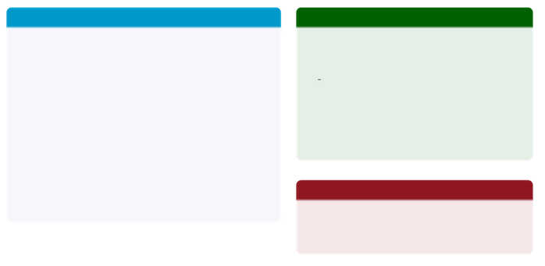
Consistency Checker - Our Novel Contribution
Three-Stage Pipeline
Stage 1 - Claim Extraction
Metric-first regex + spaCy sentence parser Handles billions, millions, EPS, multi-claim sentences 10/10 edge case tests passing
Stage 2 - KG Verification
Queries Neo4j for ground truth value
Verdict: VERIFIED • HALLUCINATED • UNVERIFIABLE
Example - Apple Net Income FY2024
LLM raw answer:
“Apple’s net income was $ 96.2 billion”
Claim extracted:
net_income | AAPL | 2024 | $96.2B
KG query result:
Neo4j: $93.7B
Verdict: HALLUCINATED (error: 2.7%)
Corrected answer:
“Apple’s net income was$93.74 billion”
±
Tolerance: 5%forroundingdifferences
Stage 3 – Auto Correction
Hallucinated sentences rewritten by LLM with verified KG value substituted in it.
Key Property
Consistency Checker operates after retrieval and generation - it catches errors that even good retrieval misses, as demonstrated by the Amazon gross profit case.
5/10

Slide 6
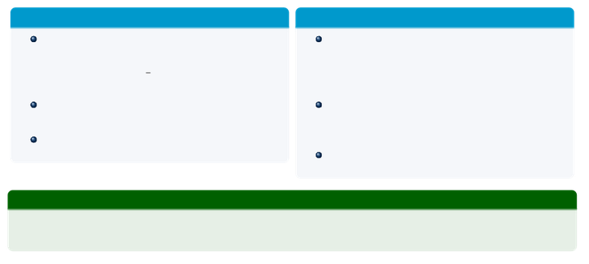
Design Choices & KRR Concepts
Knowledge Representation
Reasoning & Consistency
Neo4j encodes financial entities as typed nodes:
((Company)-[:HAS METRIC] ->
(FinancialMetric{value, year})
Hybrid retrieval:
PageIndex uses LLM to reason over document tree structure; KG-FAISS anchors retrieval to verified
entities
Consistency checking:
logical cross-validation - if claim = KG value 5%
verdict = HALLUCINATED
Auto-correction:
hallucinated sentences rewritten with verified KG value
Ground truth sourced from SEC XBRL API - same data companies file with regulators
218 verified records across 4 tickers,
2015–2025
±
KRR Connection
Representation (Neo4j KG) + Retrieval Reasoning (PageIndex tree) + Consistency (cross-validation) = complete KRR pipeline applied to financial QA
6/10

Slide 7
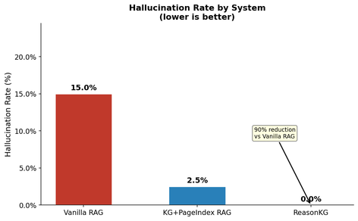

Results - Hallucination Rate (20 Queries, 4 Companies)
System
Vanilla RAG KG+PageIndex RAG
ReasonKG
Hall. Rate 15.0%
2.5%
0.0%
Key Finding
100% reduction in hallucination rate from Vanilla RAG to ReasonKG across 4 companies and 4 fiscal years.
On medium difficulty queries: Vanilla RAG
21.4% vs ReasonKG 0%.
7/10

Slide 8
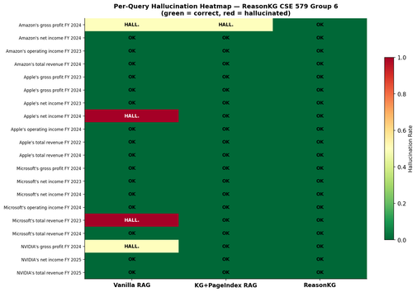

Results - Per-Query Breakdown
Where Vanilla RAG failed:
Apple net income FY2024 Microsoft revenue FY2023 NVIDIA gross profit FY2024 Amazon gross profit FY2024
KG+PageIndex caught: 3of4
ReasonKG caught: all 4
Consistency checker in action
The Amazon gross profit case was missed by KG+PageIndex retrieval but caught by the consistency checker - demonstrating that verification is independent of retrieval quality.
8/10

Slide 9
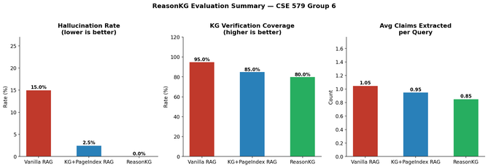

Key Takeaways & Contribution
Novel Contributions
System Stack
Consistency Checker - first rule-based claim verifier grounded in a live financial KG
Hybrid retrieval - PageIndex tree reasoning + KG-entity-guided FAISS
XBRL-powered KG - 218 verified metrics, 10 years, 4 companies
100% hallucination reduction vs Vanilla RAG on 20-query
benchmark
KG & Storage:
Neo4j, SEC EDGAR XBRL
Retrieval:
PageIndex, FAISS, BAAI/bge-large
NLP: LLM:
spaCy, regex claim extractor GPT-4o via OpenAI API
Language:
Python, Google Colab
9/10

Slide 10
Thank You
Reason KG - KG-Grounded RAG with Consistency Checking
Group6
Chandana Vinay Kumar Raaghul Nataraj Kannan Narahari Kommi Madhurika Kandukoori Raja Shree Reddy Pailla
1237227955 1234197122 1237228397 1237766818 1237967252

