Slide 1


VISVESVARAYA TECHNOLOGICAL UNIVERSITY
“Jnana Sangama”, Belagavi, Karnataka-590018
K R Pete Krishna Government Engineering College,
K R Pete-571426, 2024-2025
Department of Computer Science and Engineering
PROJECT PHASE-2 PRESENTATION ON
SUBJECT CODE : BCS786
“AI-Powered Legal Documentation Assistant”
UNDER THE GUIDANCE OF
DR . HAREESH. K
PROFESSOR
DEPARTMENT OF COMPUTER SCIENCE
& ENGINEERING
PRESENTING TEAM(B6)
CHANDANA S 4GK22CS010
BHAGYALAKSHMI D 4GK22CS005
K S PAVANA 4GK22CS021
T M NIKHITHA 4GK22CS049

Slide 2
ABSTRACT
The legalquest app is an ai-powered legal document assistant utilising OCR and the Open AI for text extraction and summarization. Built in flutter, it provides concise legal document summaries and connects users with legal professionals, aiming for more accessible, efficient, and affordable legal processing. Broader AI and ML applications are poised to radically alter India's legal system, addressing case backlogs and inefficiency through tools for legal research, document analysis, and contract review, boosting efficiency and reducing costs.

Slide 3
SL.NO | TABLE OF CONTENT | SLIDE.NO
 | ABSTRACT | 3
1 | INTRODUCTION | 4
2 | OVERVIEW | 5-6
3 | APPLICATIONS & BENCHMARK DATASETS | 7
4 | TECHNOLOGY USED | 8
5 | EXISTING SYSTEMS & THEIR LIMITATIONS | 9
6 | PROBLEM STATEMENT | 10
7 | OBJECTIVES | 11
8 | LITERATURE REVIEW | 12-13

Slide 4
SL/NO | TABLE OF CONTENT | PAGE NO
9 | EXISTING WORK 1 | 15
11 | METHODOLOGY USED | 17-18
15 | CONCLUSION | 25
17 | REFERENCES | 28

Slide 5
INTRODUCTION
The inherent challenges of traditional legal document processing.
Systemic issues within legal systems and the specific context of India.
The transformative potential of AI, ML, and OCR technologies.
Specific AI/ML applications and enabling technologies in legal practice.
The legalquest app as a concrete AI application.

Slide 6
Overview
DEFINITION:
An ai-powered legal assistant is a digital platform that uses artificial intelligence (AI), natural language processing (NLP), and optical character recognition (OCR) to analyze, summarize, and manage legal documents, while also connecting users to legal professionals for consultation.
PRINCIPLES:
Accuracy & transparency – deliver clear and reliable summaries of legal content.
Accessibility – make legal services available to everyone, regardless of background.
Efficiency – reduce time, cost, and human errors in legal document handling.
Confidentiality – ensure secure handling of sensitive legal data.
User-centric design – simplify complex legal procedures through intuitive interfaces.

Slide 7
slogans
🧠 "Smarter Law, Simpler Life."
⚖ "Your Legal Guide in a Click."
📄 "Understand Legal Documents—Fast, Clear, Smart."
🤝 "Justice for All, Powered by AI."

Slide 8
Applications & Benchmark Datasets
Applications
Legal document summarization
Quickly condense lengthy contracts, agreements, and judgments into readable summaries.
Advocate matching & scheduling
Match users with qualified legal professionals based on expertise, location, and availability.
Irregularity detection in contracts
Identify ambiguous clauses, missing elements, and potential legal risks using NLP and NER.
Benchmark Datasets
JEC-QA dataset (china)
CUAD (contract understanding atticus dataset)
Legal case reports (indian kanoon / SCC online)

Slide 9
Technology used
Manual legal processes are inefficient
Traditional legal document handling involves extensive manual reading, clause identification, and summarization, which is time-consuming and error-prone.
Complex legal language requires advanced nlp
Legal documents use dense, domain-specific jargon that demands deep natural language processing (NLP) and contextual understanding to interpret accurately.
Unstructured data needs structured intelligence
Legal information often exists in pdfs, scans, handwritten notes, and emails—requiring OCR, text normalization, and entity recognition to process meaningfully.

Slide 10
Existing Systems & Their Limitations
EXISTING SYSTEM | KEY FEATURES | LIMITATIONS
Kira systems | Contract clause extraction, due diligence | No real-time OCR or Indian legal support
Evisort | Contract lifecycle management, AI insights | Expensive and enterprise-focused
Legalsifter | Risk identification in contracts | No multilingual support, limited customization
ROSS intelligence | AI legal research using NLP | Research-focused only; no document summarization or consultation integration
Lex machina | Litigation outcome prediction, analytics | Lacks direct user interaction or summarization features

Slide 11
PROBLEM STATEMENT
Legal professionals and businesses need an AI-powered document assistant to automate contract drafting, review, and customization—reducing time, cost, and errors while ensuring compliance."

Slide 12
Objectives
Data collection
Gather various types of legal documents (pdfs, images, handwritten notes, contracts, etc.)
Text extraction using ocr
Use optical character recognition (OCR) to extract text from scanned or handwritten documents.
Preprocessing & cleaning
Clean and normalize the extracted text for consistent formatting and accurate analysis.
Ai-based summarization
Apply NLP models (e.g., Gemini API or chatgpt) to generate concise summaries of the legal content.
Irregularity & clause detection
Use named entity recognition (NER) and sentiment analysis to detect missing, ambiguous, or risky clauses.

Slide 13
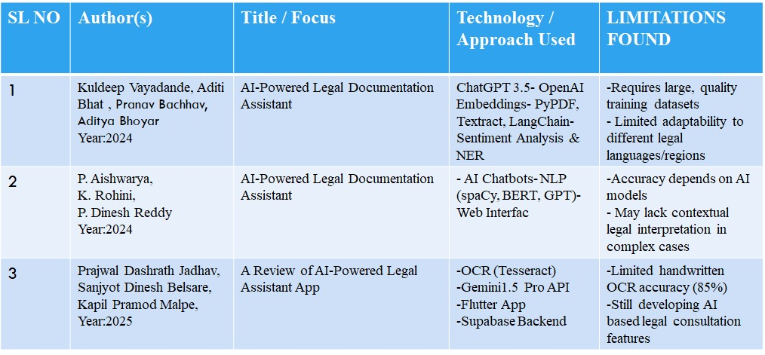
Literature Review
SL NO | AUTHOR(S) | TITLE / FOCUS | TECHNOLOGY / APPROACH USED | LIMITATIONS FOUND
1 | Kumar et al. (2023) | LegalDoc Scan / Mobile-Based OCR for Contracts | Mobile-based OCR system, mobile optimization, legal-specific NLP. | Faces challenges with handwritten text. Highlights needs for better non-standard document handling.
2 | ETH Zurich (2022) | OCR Error Analysis in Legal Docs4 / analysis of OCR errors in legal documents | OCR engines, proposed correction techniques | Particularly notes challenges with legal jargon and non-standard formats.
3 | NUS LawTech (2021) | User Feedback on Legal AI Tools4 / surveys user experiences with legal AI tools | Legal AI tools | User trust remained limited due to explain ability concerns.

Slide 14
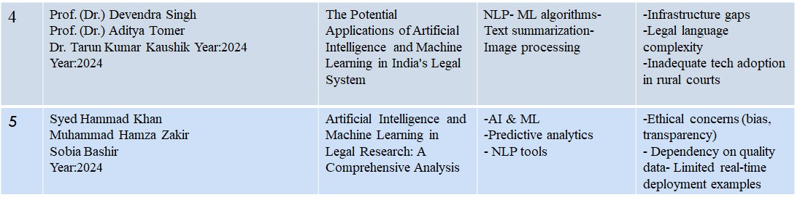
4 | Prof. (Dr.) Devendra Singh Prof. (Dr.) Aditya Tomer Dr. Tarun Kumar Kaushik Year:2024 Year:2024 | The Potential Applications of Artificial Intelligence and Machine Learning in India's Legal System | NLP- ML algorithms- Text summarization- Image processing | -Infrastructure gaps -Legal language complexity -Inadequate tech adoption in rural courts
5 | Syed Hammad Khan Muhammad Hamza Zakir Sobia Bashir Year:2024 | Artificial Intelligence and Machine Learning in Legal Research: A Comprehensive Analysis | -AI & ML -Predictive analytics - NLP tools | -Ethical concerns (bias, transparency) - Dependency on quality data- Limited real-time deployment examples

Slide 15
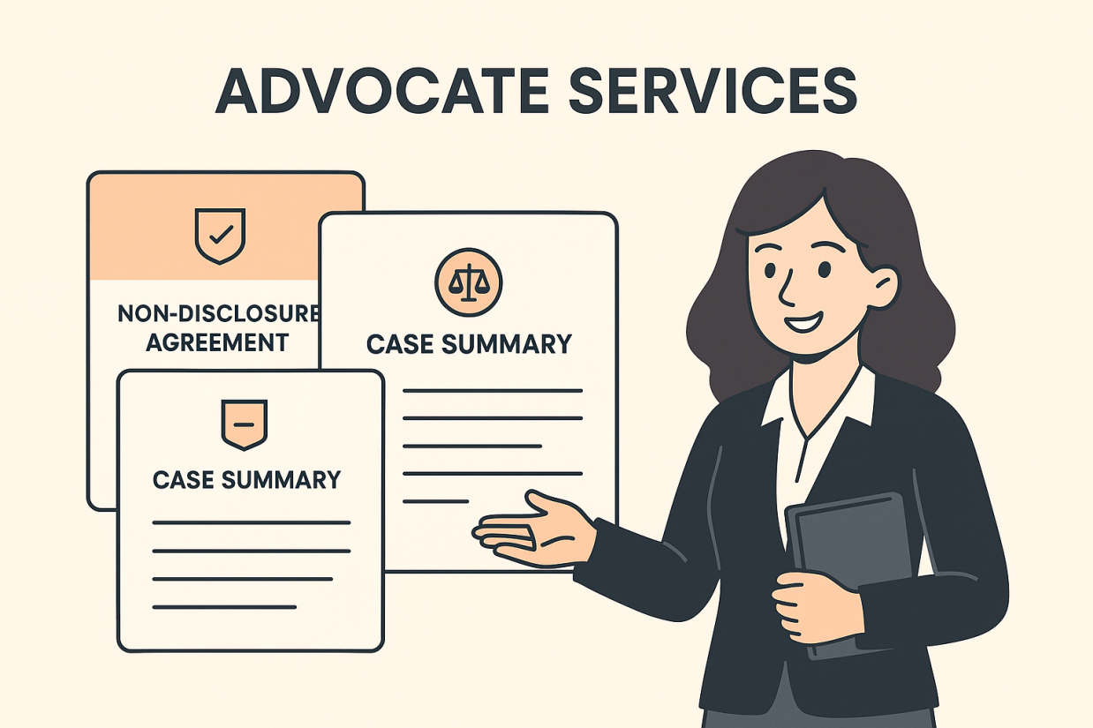
Visual Representation
of Legal Services.
Professional Advocate
Integration.
Organized Document
Management.

Slide 16
Existing work 1
RECENT RESEARCH WORK (2023 ONWARDS)
TITLE: SAILER: structure-aware pre-trained language model for legal case retrieval
AUTHORS: haitao li, qingyao ai, jia chen, qian dong, yueyue wu, yiqun liu, chong chen, qi tian PUBLISHED: april 2023 SOURCE: arxiv preprint LINK: SAILER paperarxiv+2arxiv+2arxiv+2
OVERVIEW: SAILER is a specialized pre-trained language model designed to enhance legal case retrieval by incorporating the structural nuances of legal documents.
KEY FEATURES:
Structure-aware modeling
Asymmetric encoder-decoder architecture

Slide 17
Methodology USED
DOCUMENT INPUT AND PREPROCESSING
Accepts legal documents in PDF, DOCX, or TXT formats.
DOCUMENT CLASSIFICATION
Goal: categorize legal documents into domains such as criminal, civil, corporate, etc.
Model: legalbert fine-tuned on labeled legal datasets.
Output: classification label + confidence score.
CLAUSE DETECTION
Detects and extracts clauses like: Jurisdiction, force majeure, arbitration, termination, indemnity.
Method: rule-based patterns (regex + legal templates). Custom ner (spacy) trained on annotated clause data.

Slide 18
SUMMARIZATION
Reduces large legal documents into concise summaries.
Models: Pegasus, longt5, or BART fine-tuned on legal corpora.
Techniques: Abstractive summarization (generates new sentences).
May combine with extractive methods for better factual retention.
LEGAL CASE RETRIEVAL
Goal: retrieve semantically similar past judgments or statutes.
Models: Embeddings via sentence- bert or SAILER (structure-aware).
QUESTION ANSWERING (QA)
Allows user to ask natural language questions based on uploaded document.
Model: Legalbert or roberta fine-tuned on squad or legal QA datasets.
USER INTERFACE AND DISPLAY
Frontend built with react.Js and tailwind CSS.
Displays: Document summary, Extracted clauses,Classification label,Retrieved similar cases

Slide 19
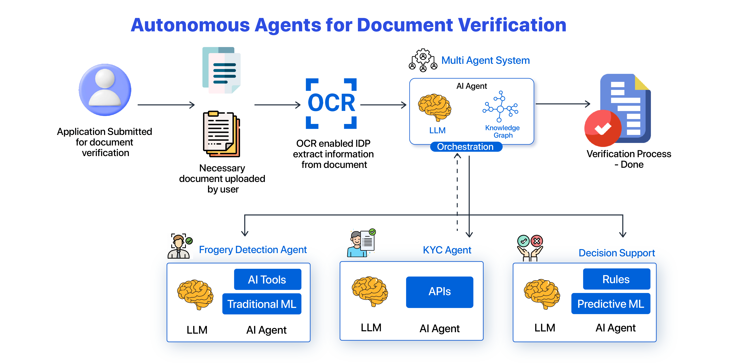
System Architecture

Slide 20
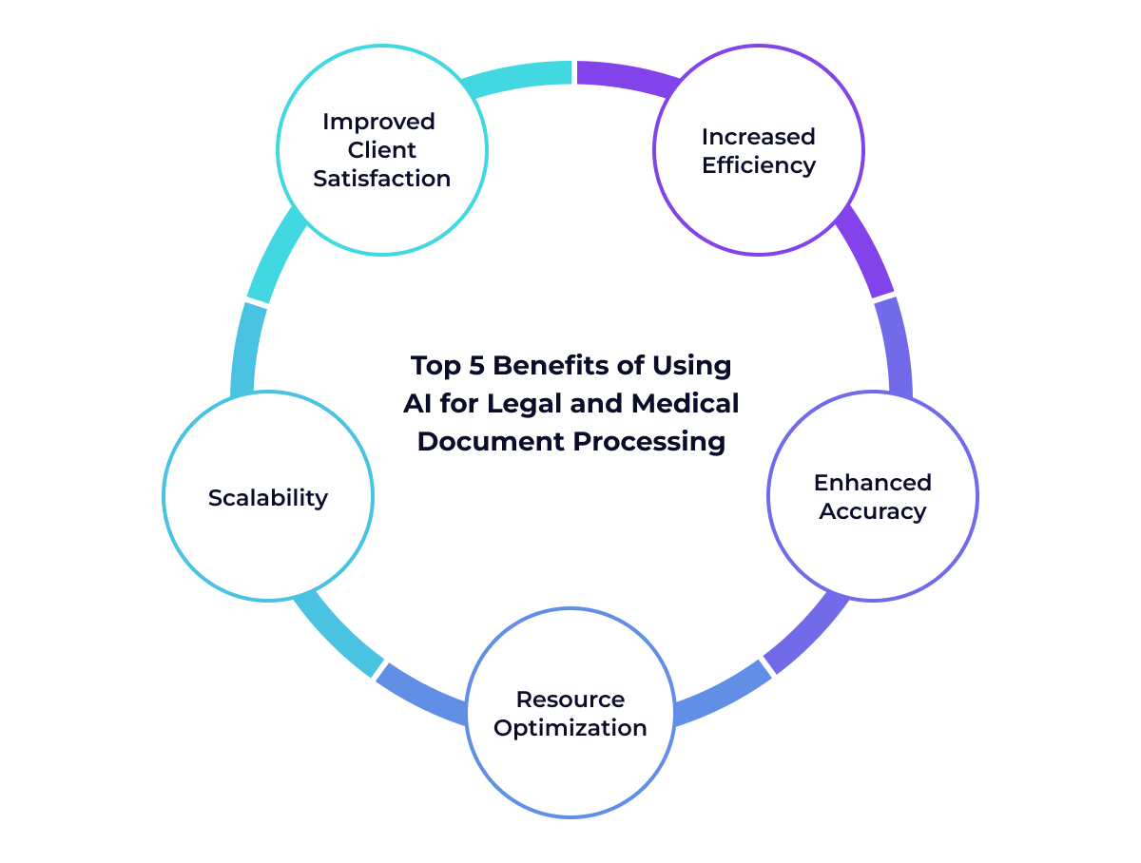
ADVANTAGES

Slide 21
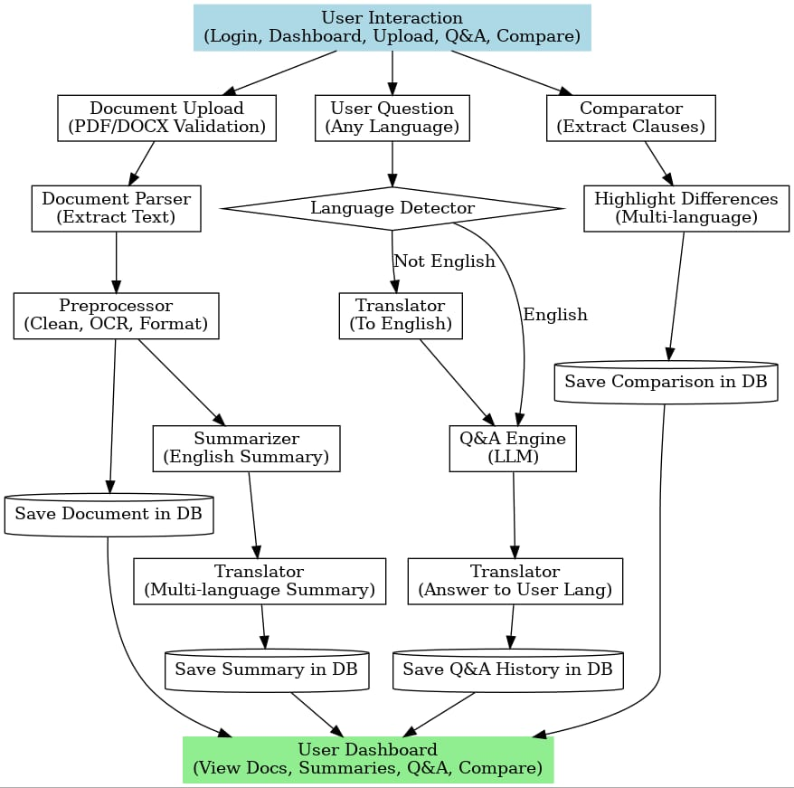
flow chart

Slide 22
Legal Document Assistant — Core Algorithm
Input: PDF/DOCX legal document, user query (optional)
Output: extracted parties, dates, clauses, key terms, multilingual summary, answers to legal queries
Steps:
1. User Upload:
Receive file from user (PDF/DOCX).
Validate file type and size.
Store file in object storage (s3) and metadata in db.
2. Queue Job:
Create processing job with document ID.
Push job to task queue (redis/celery/rabbitmq).
3. Document Conversion:
If DOCX → convert to text.
If pdf → extract text; if scanned pdf → perform ocr.

Slide 23
Preprocessing:
Clean text (remove special characters, normalize spaces).
Detect language.
Split document into chunks (paragraphs or clauses).
Information Extraction:
Apply NER / rule-based extraction to identify:
Parties
Dates
Clauses
Key legal terms
Store structured data in DB (JSON format).
Embedding Generation:
Convert text chunks into embeddings.
Store embeddings in Vector Database for semantic search & comparison.
Summarization:
Generate summary using LLM.
Translate summary to multiple languages (English, Hindi, Kannada, etc.).
Store summaries in DB.

Slide 24
Q&A Handling (Optional):
Receive user query.
Embed query and retrieve top-k relevant chunks from vector db.
Pass retrieved context + query to llm to generate answer.
Translate answer into requested languages.
Document Comparison (Optional):
Select two documents.
Generate clause-level embeddings.
Compute similarity scores and align clauses.
Present differences and similarities.
Dashboard Update:
Update user dashboard with processed document, summaries, Q&A results, and comparison reports.
Return Results:
Notify frontend via websocket/SSE.
Provide structured extraction, multilingual summaries, q&a responses, and comparison results.
End of Algorithm

Slide 25
CONCLUSION
The AI-Powered Legal Document Assistant is a smart system designed to simplify and speed up the process of reading and understanding legal documents. By using parametric models like BERT, GPT, and T5, the system can:
Summarize lengthy legal judgmentsClassify legal clauses from agreements (like lease contracts)Answer user queries accurately through a chatbotAssist lawyers, clients, and legal staff in understanding complex documents easily
It improves legal efficiency, reduces manual work, and makes legal services more accessible.
b

Slide 26
REFERENCES
P. D. Jadhav, S. D. Belsare, K. P. Malpe, A. A. Bodakhe, L. R. Jadhav, and dr. L. K. Gautam, "legalquest: A review of ai-powered legal assistant app," international journal of research publication and reviews, vol. 6, no. 4, pp. 289–294, apr. 2025.(IEEE)
K. Vayadande, A. Bhat, P. Bachhav, A. Bhoyar, Z. Charoliya, and A. Chavan, "ai-powered legal documentation assistant," in proc. 2024 4th int. Conf. On pervasive computing and social networking (ICPCSN), 2024.
D. Singh, A. Tomer, T. K. Kaushik, R. Singh, and S. Kumar, "the potential applications of artificial intelligence and machine learning in India's legal system," in proc. 2024 int. Conf.
H. Li, Q. Ai, J. Chen, Q. Dong, Y. Wu, Y. Liu, C. Chen, and Q. Tian, “SAILER: structure-aware pre-trained language model for legal case retrieval,” arxiv preprint, arxiv:2304.11370, apr. 2023. [Online]. Available: https://arxiv.Org/abs/2304.11370
J. Cui, M. Ning, Z. Li, B. Chen, Y. Yan, H. Li, B. Ling, Y. Tian, and L. Yuan, “chatlaw: A multi-agent collaborative legal assistant with knowledge graph enhanced mixture-of-experts large language model,” arxiv preprint, arxiv:2306.16092, June 2023. [Online]. Available: https://arxiv.Org/abs/2306.16092

Slide 27
THANK YOU

