Slide 1
DATA ANALYTICS • EXCEL
EXCEL SALES
ANALYTICS
From raw sales data to clear business insights
Presented by: Chandana
30-minute project presentation
PROJECT 2026
Notes:
Opening (1 min): Introduce the project as an Excel-based sales analytics workflow. Replace the presenter name if needed.

Slide 2
Project overview
01 • CONTEXT
Business focus: understand sales performance across products, regions, employees and channels.
Excel is used to clean, calculate, summarise and visualise the sales data.
The final output combines analysis, an interactive dashboard and business insights.
Decision-ready
OUTCOME
A clearer view of performance
EXCEL SALES ANALYTICS • PROJECT PRESENTATION
02
Notes:
Explain the business purpose and why sales reporting needs clear summaries.

Slide 3
Objectives & key questions
01 • CONTEXT
01
Measure
02
Compare
How much are we selling?
Which regions and products perform best?
03
Explain
04
Explore
What patterns appear over time?
How do results change with filters or assumptions?
EXCEL SALES ANALYTICS • PROJECT PRESENTATION
03
Notes:
Describe the questions the analysis is designed to answer.

Slide 4
End-to-end workflow
02 • METHOD
01
02
03
04
05
Prepare
›
Calculate
›
Summarise
›
Visualise
›
Interpret
Inspect data and fix issues
Apply formulas and checks
Build PivotTables and KPIs
Create charts and slicers
Translate patterns into insights
Principle: reliable analysis starts with clean, consistently structured data.
EXCEL SALES ANALYTICS • PROJECT PRESENTATION
04
Notes:
Walk through the workflow from data preparation to insights.

Slide 5
Data preparation & quality
02 • METHOD
Reviewed column names, data types and the structure of the sales table.
QUALITY CHECKS
Checked missing values, duplicate records and inconsistent date formats.
Completeness
Missing values
Used Excel tables and consistent formatting to make the dataset easier to maintain.
Uniqueness
Duplicate records
Kept a cleaning log so changes and checks can be explained.
Consistency
Dates & categories
Usability
Table structure
EXCEL SALES ANALYTICS • PROJECT PRESENTATION
05
Notes:
Explain the main quality checks. Mention only cleaning steps actually completed in your workbook.

Slide 6
Formula toolkit
03 • ANALYSIS
SUM / AVERAGE
MIN / MAX / COUNT
IF / AND / OR
SUMIF(S) / COUNTIF(S)
XLOOKUP / INDEX-MATCH
IFERROR / IFNA
EXCEL SALES ANALYTICS • PROJECT PRESENTATION
06
Notes:
Describe the formula groups and demonstrate one or two real formulas in Excel.

Slide 7
Data handling skills
03 • ANALYSIS
Text functions help standardise names and categories.
Date functions support month, year and time-based reporting.
Absolute and mixed references keep formulas stable when copied.
Sorting, filtering and structured tables make large datasets easier to work with.
Example: =SUMIFS(Sales, Region, "East", Product, "Laptop")
EXCEL SALES ANALYTICS • PROJECT PRESENTATION
07
Notes:
Explain how text/date functions, references and tables support consistent analysis.

Slide 8
Power Query: repeatable preparation
04 • AUTOMATION
Power Query can import data and apply repeatable transformation steps.
SOURCE
Typical steps include changing data types, renaming columns and removing unwanted rows.
Sales file
↓
Refresh can rerun the saved steps when new data arrives.
TRANSFORM
Clean & shape
↓
This reduces repetitive manual work and supports consistent reporting.
LOAD
Excel table
EXCEL SALES ANALYTICS • PROJECT PRESENTATION
08
Notes:
Describe Power Query as the repeatable preparation stage. Be clear about what you implemented.

Slide 9
PivotTables: summarise quickly
05 • REPORTING
Group sales by region, product, employee, month or channel.
ILLUSTRATIVE SUMMARY
Compare totals, counts and averages without writing a separate formula for every group.
East
₹8.44M
Use filters to focus on the segment that matters.
West
₹5.2M
PivotTables provide the summary layer behind the charts and dashboard.
South
₹4.1M
Example values for visual explanation
EXCEL SALES ANALYTICS • PROJECT PRESENTATION
09
Notes:
Explain how PivotTables group data and make summaries flexible.

Slide 10
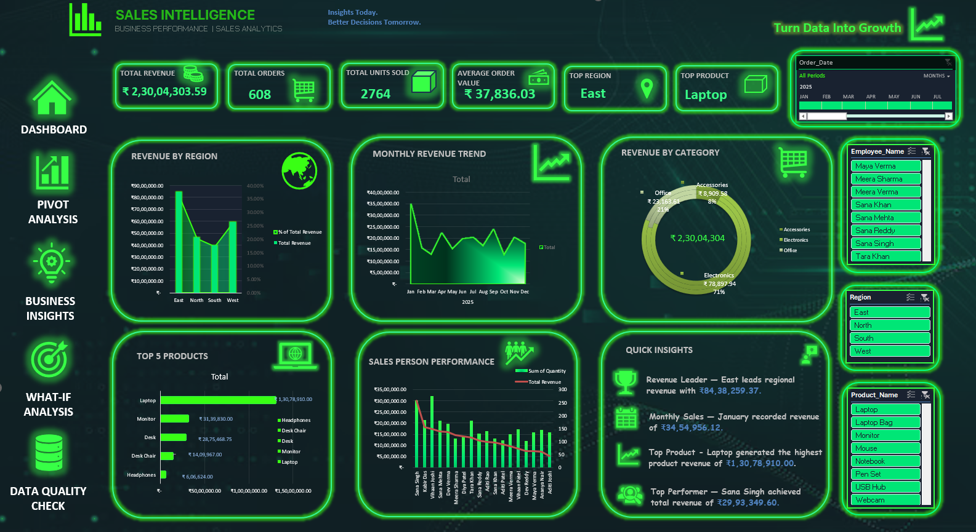
DASHBOARD
Notes:
Use this as a design concept. If possible, switch to the real workbook dashboard for a short live demonstration.

Slide 11
KPIs & performance measures
06 • DECISION SUPPORT
Total Revenue
Total Orders
Total Units Sold
Average Order Value
Top Region
Top Product
EXCEL SALES ANALYTICS • PROJECT PRESENTATION
11
Notes:
Explain each KPI in plain language and confirm its definition in the workbook.

Slide 12
What-If analysis: test scenarios
06 • DECISION SUPPORT
Create alternative assumptions such as conservative, base and growth scenarios.
SCENARIO MODEL
Use formulas to project results when assumptions change.
Conservative
−5%
Goal Seek can estimate the input needed to reach a target result.
Base
0%
Growth
+10%
Scenarios support planning; they are estimates, not guaranteed outcomes.
Aggressive
+20%
EXCEL SALES ANALYTICS • PROJECT PRESENTATION
12
Notes:
Explain that scenarios change assumptions and do not predict guaranteed outcomes.

Slide 13
Business insights: what the data can reveal
07 • FINDINGS
Regional contribution identifies where sales are concentrated.
Monthly trends reveal stronger and weaker periods.
Product comparisons help prioritise high-performing and underperforming items.
Employee and channel views help compare sales activity.
Validate findings against the final refreshed workbook before presenting.
Use insights to ask better business questions—not just report numbers.
EXCEL SALES ANALYTICS • PROJECT PRESENTATION
13
Notes:
Present only findings verified in your final workbook. Regional values on visual mockups are illustrative.

Slide 14
Value delivered & considerations
07 • FINDINGS
VALUE
KEEP IN MIND
Faster recurring summaries
Results depend on data quality
Consistent calculations
Check formulas and refresh outputs
Interactive exploration
Confirm KPI definitions and targets
Clearer communication of results
Treat projections as scenarios
EXCEL SALES ANALYTICS • PROJECT PRESENTATION
14
Notes:
Discuss benefits while acknowledging the need for validation and refresh checks.

Slide 15
Conclusion & key takeaways
08 • WRAP-UP
01
02
03
Prepare
Analyse
Communicate
Quality data is the foundation.
Formulas and PivotTables reveal patterns.
Dashboards make findings easier to use.
The project connects Excel skills to a practical sales reporting workflow.
EXCEL SALES ANALYTICS • PROJECT PRESENTATION
15
Notes:
Summarise the three takeaways and transition to the live workbook or questions.

Slide 16
EXCEL SALES ANALYTICS
Thank you.
From data to decisions.
END
Notes:
Close confidently and invite questions.

