Slide 1
From Data to Safety: Predicting Crime Hotspots and Trends
TEAM E :
Chandana Anugu
Sai Sindhu Beeravolu
Viquarath Ali Khaja
GitHub Page: https://github.com/ChandanaAnugu/Capstone.git

Slide 2
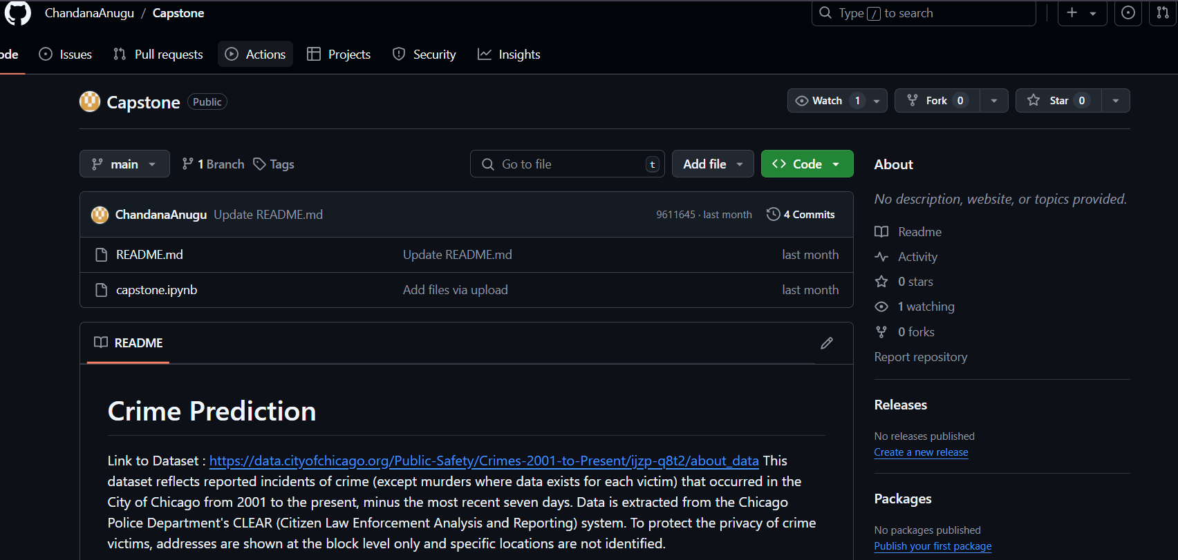
Snapshot of GitHub Page

Slide 3

INTRODUCTION
This project focuses on using machine learning and data analytics to predict crime occurrences, leveraging historical crime data to identify patterns and trends. By analyzing the data, we aim to forecast where and when crimes are likely to occur, providing valuable insights to help law enforcement agencies allocate resources more effectively. Using techniques like prediction, and trend analysis, the project seeks to enhance decision-making and contribute to safer communities through data-driven strategies for crime prevention and management.

Slide 4
Dataset
Link to Dataset: https://data.cityofchicago.org/Public-Safety/Crimes-2001-to-Present/ijzp-q8t2/about_data
Source: Chicago Data Portal
Size: Over 6 million rows, dating back to 2001.
Key Attributes:
Date of crime occurrence
Primary Type (e.g., theft, assault, burglary)
Location Description
Arrest (Yes/No)
Community Area
Extracted Features:
Hour of Crime
Day of Week, Month, Season

Slide 5
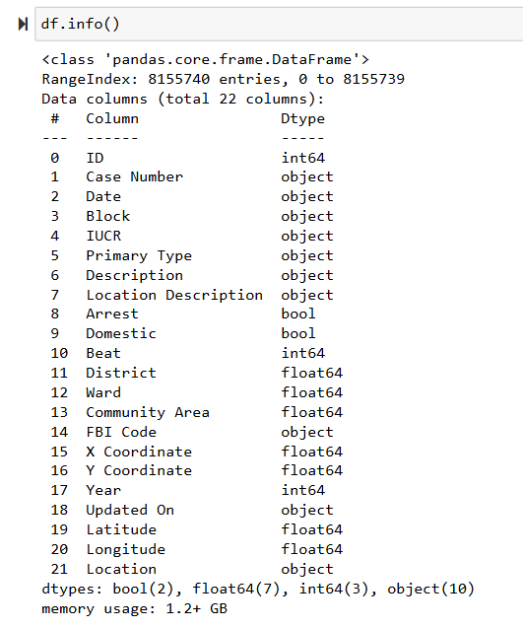
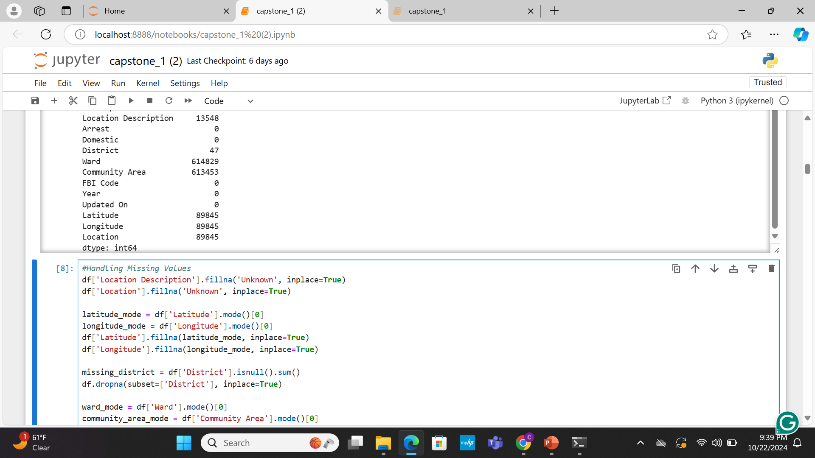
Exploratory Data Analysis

Slide 6
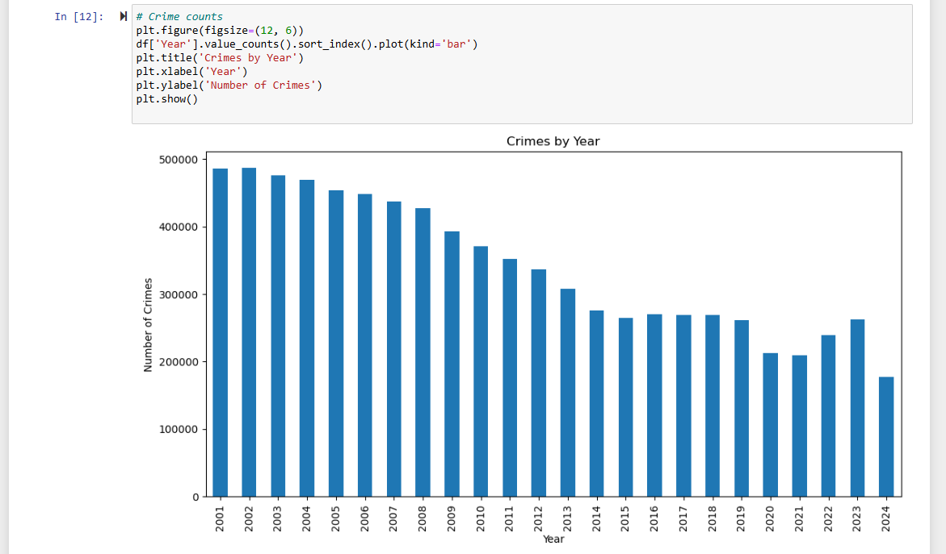
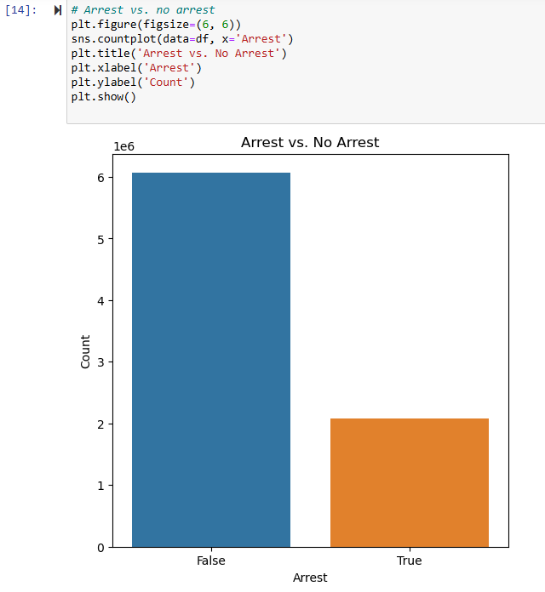

Slide 7
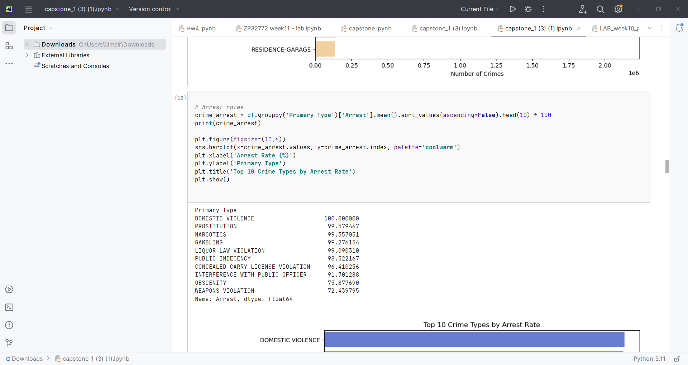
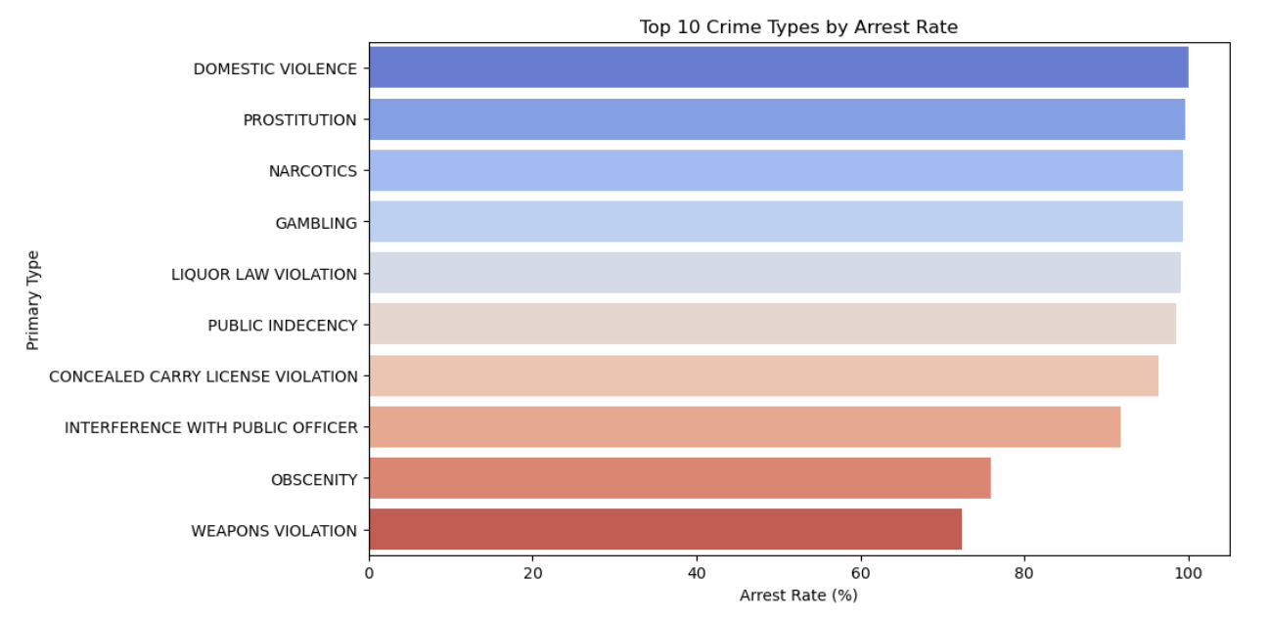

Slide 8
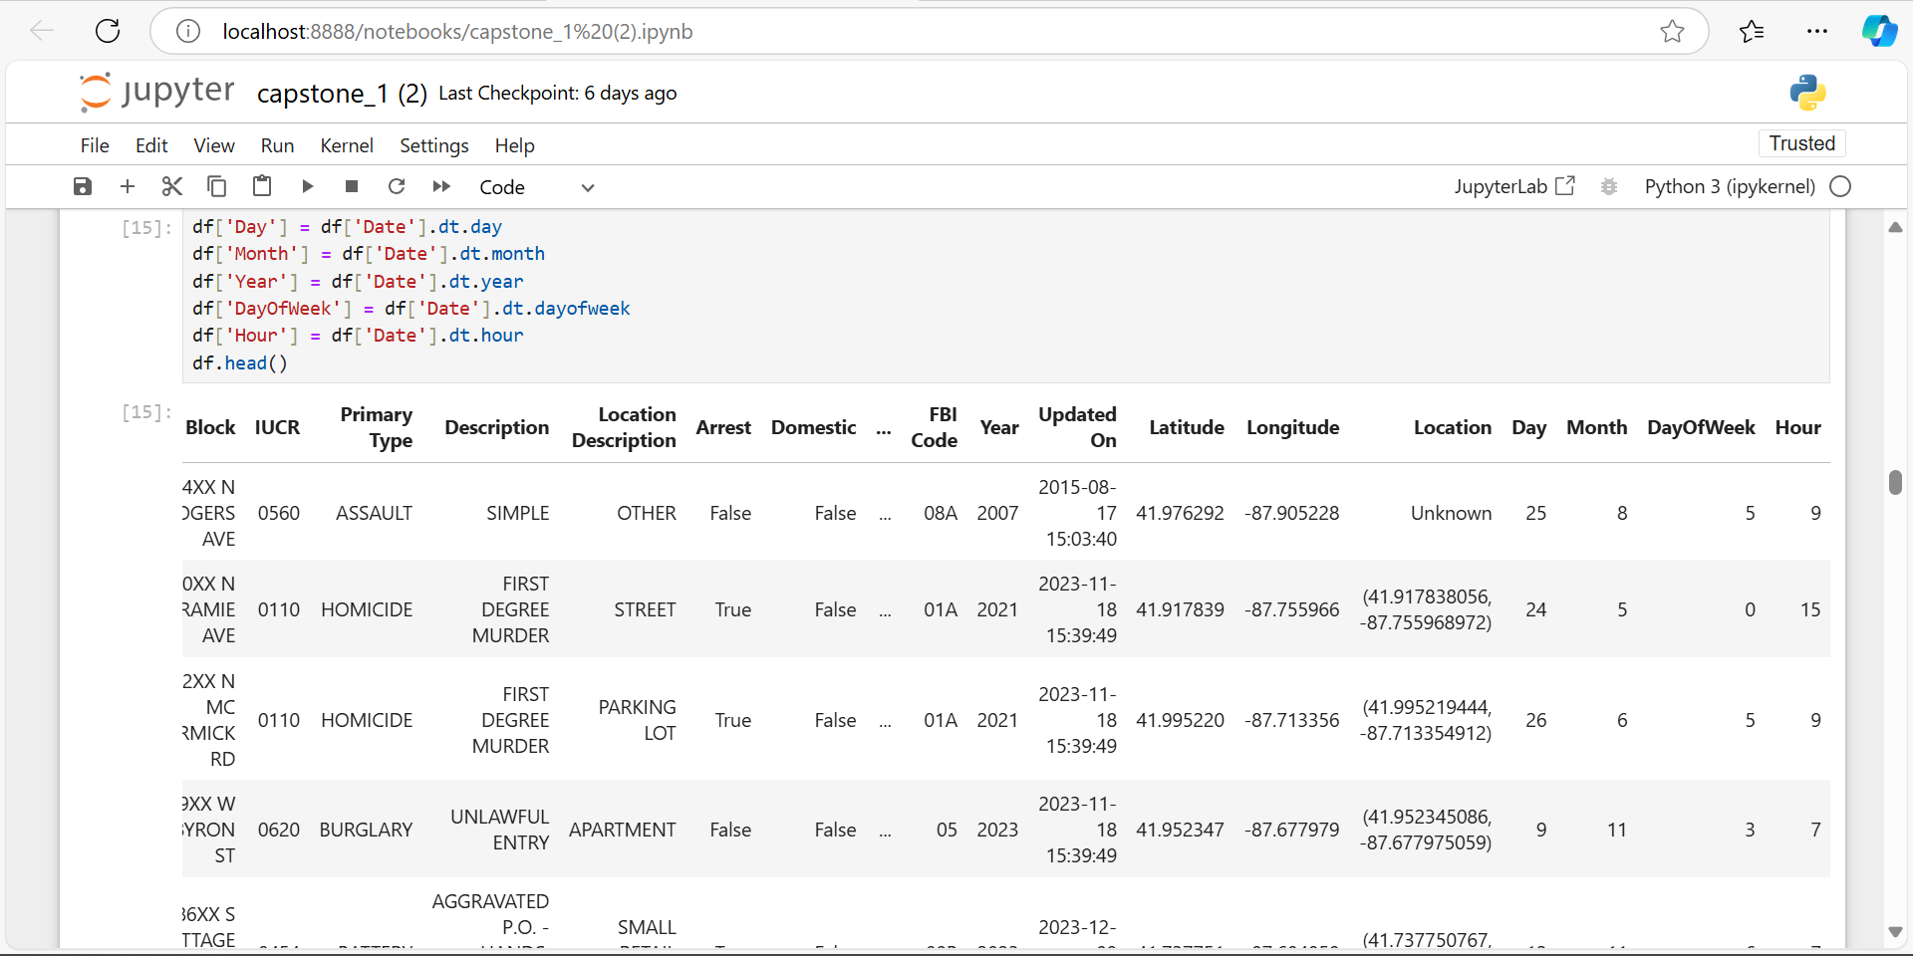

Slide 9
Overview of Similar Approaches
Our project builds on existing research by employing advanced machine-learning techniques and new methods for data analysis. While previous work primarily relied on traditional approaches for categorization and estimation, our approach aims to achieve more precise and localized predictions by utilizing cutting-edge models and a comprehensive set of data features. This enhanced methodology will enable us to better identify and understand crime hotspots and trends, ultimately contributing to more effective public safety strategies.
We integrate both spatial and temporal data to improve prediction accuracy, distinguishing our approach from conventional methods. Additionally, by incorporating attributes such as community areas and law enforcement units, we provide a richer analysis that enhances our understanding of crime dynamics and informs targeted interventions.

Slide 10
Crime Classification:
Violent Crimes: Assault, homicide, battery
Property Crimes: Burglary, robbery, motor vehicle theft
Drug-Related Crimes: Drug possession, distribution, trafficking
Public Order Crimes: Disorderly conduct, public intoxication
Other Crimes: Miscellaneous categories

Slide 11

Proposed Methodology: 1. Crime Spatial Analysis
Objective:
Utilize historical crime data and factors like community areas to predict areas with high crime rates. This analysis can help assess risk, allowing individuals and organizations to evaluate safety in particular locations. The findings can guide decisions about personal safety and community interventions..
Models:
Random Forest: An ensemble learning method to improve predictive accuracy and control over-fitting. Handles high-dimensional data well, is robust to noise, and provides feature importance.
Gradient Boosting: A boosting method that combines weak learners to create a strong predictive model by focusing on correcting errors made by previous models. Often achieves high predictive accuracy and handles various types of data effectively.

Slide 12
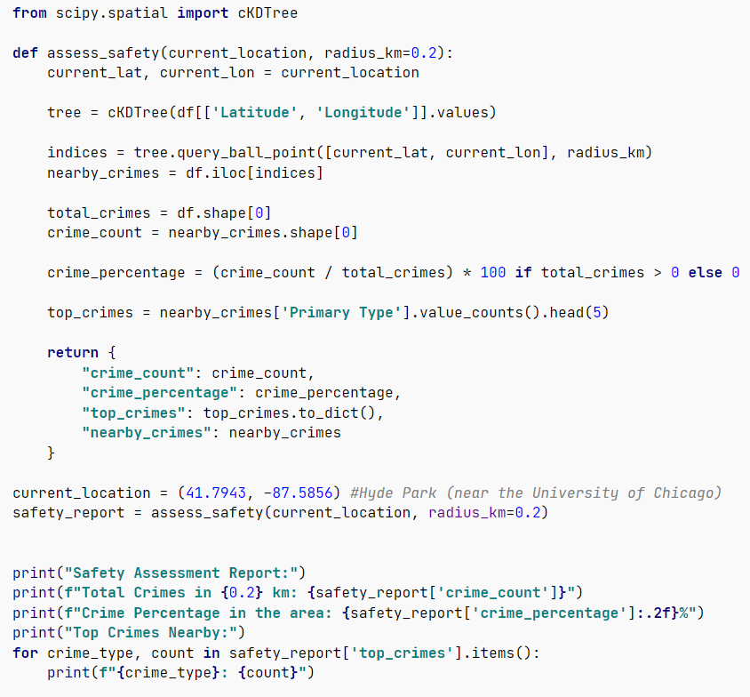
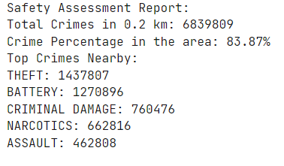

Slide 13
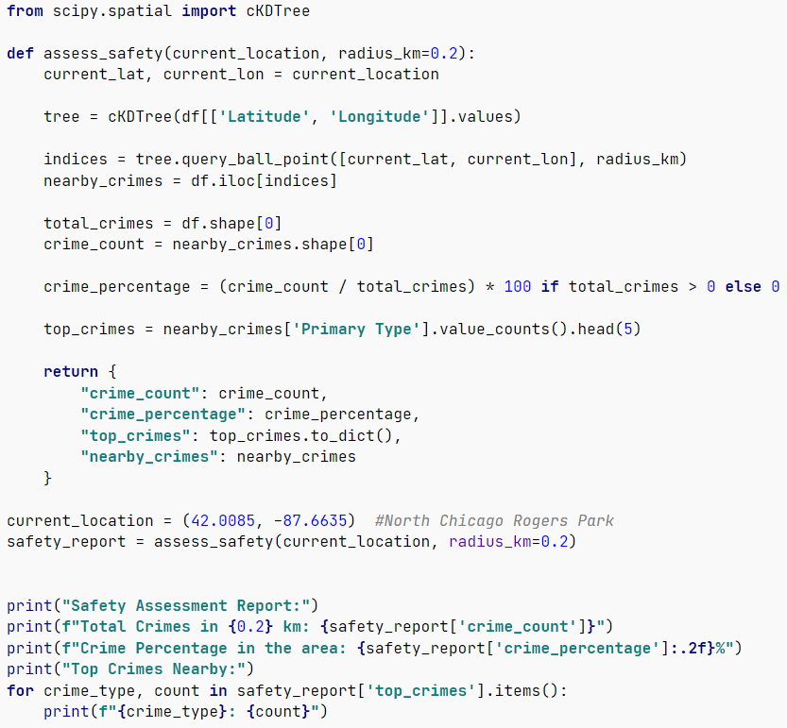
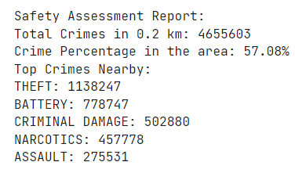

Slide 14
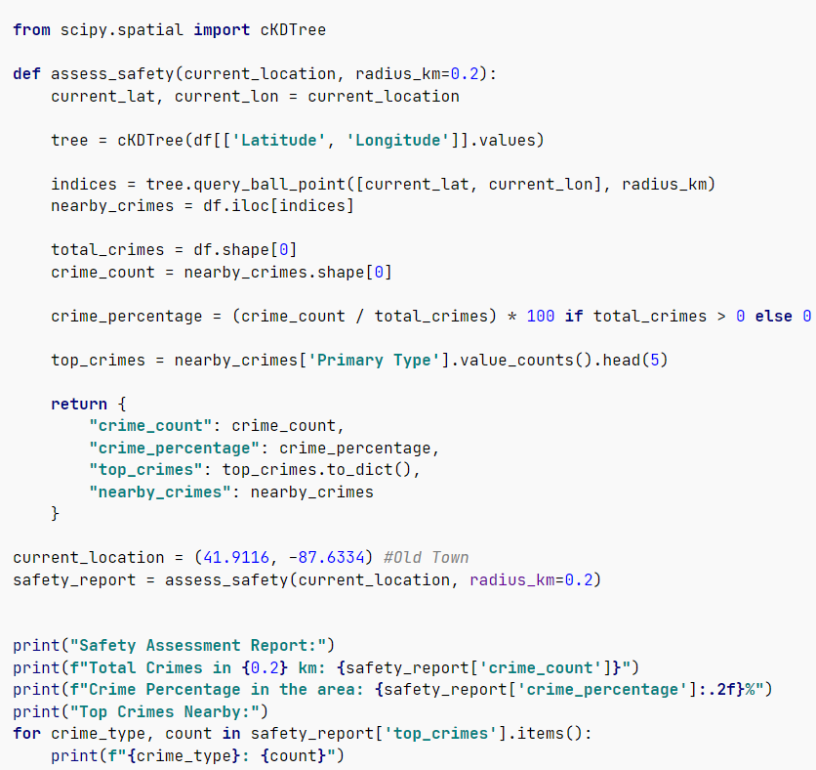
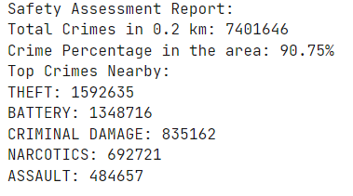

Slide 15

2. Crime Trend Analysis
Objective:
Historical data will be analyzed to detect seasonal variations and long-term patterns in crime rates. This will help identify peak crime periods, such as weekends, holidays, and summer months.
Techniques:
ARIMA (AutoRegressive Integrated Moving Average): A popular time-series forecasting method that combines autoregression, differencing, and moving averages. Effective for capturing trends and seasonal patterns.

Slide 16
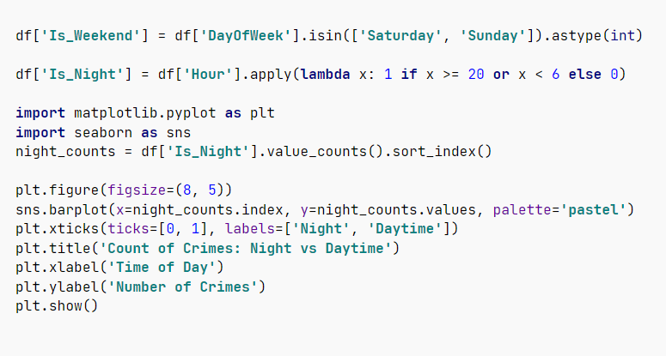
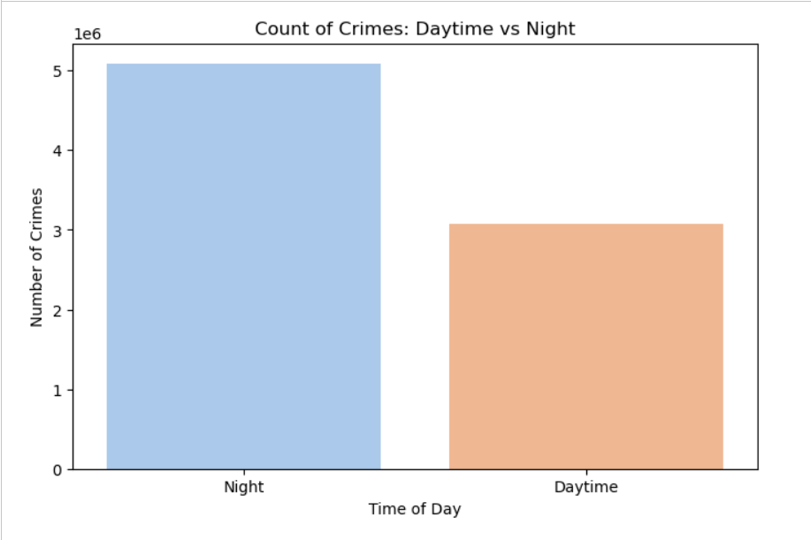

Slide 17
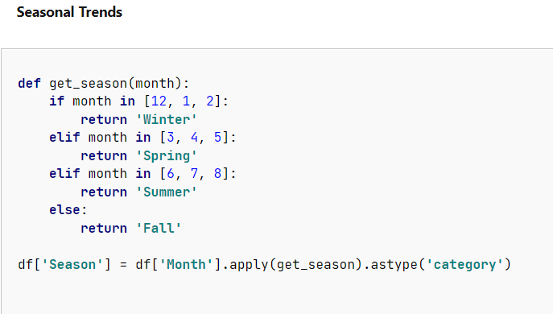
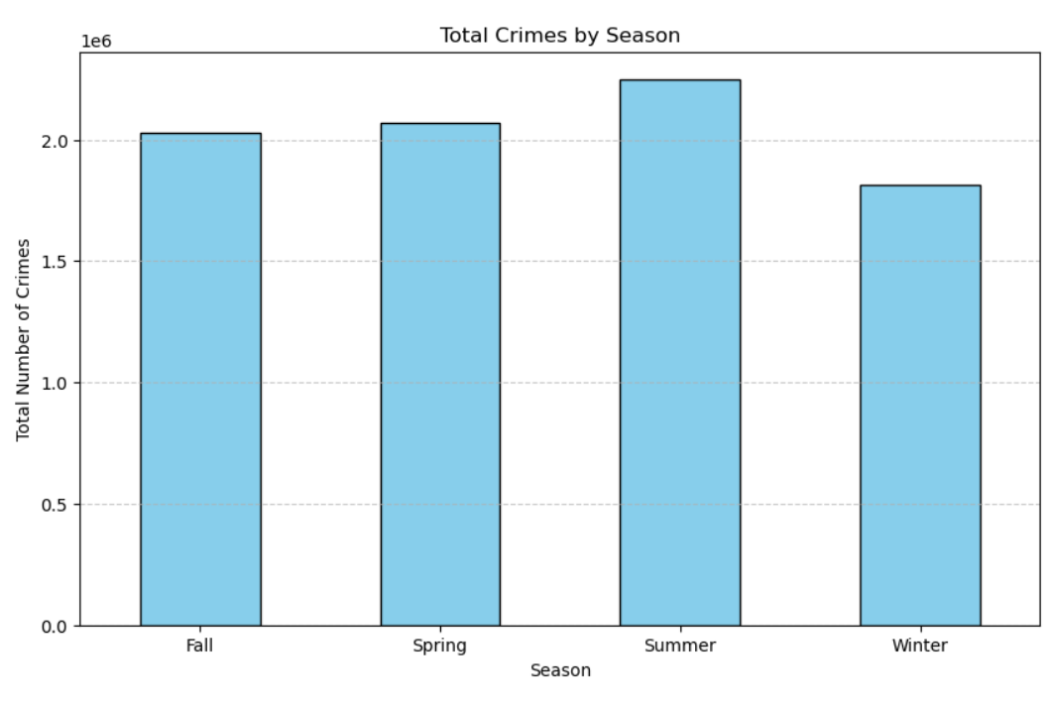
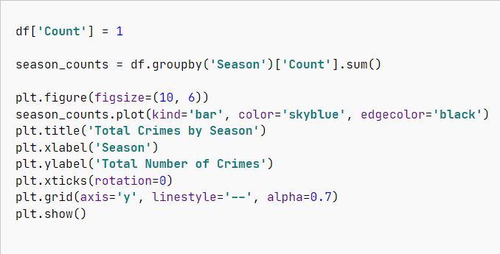

Slide 18
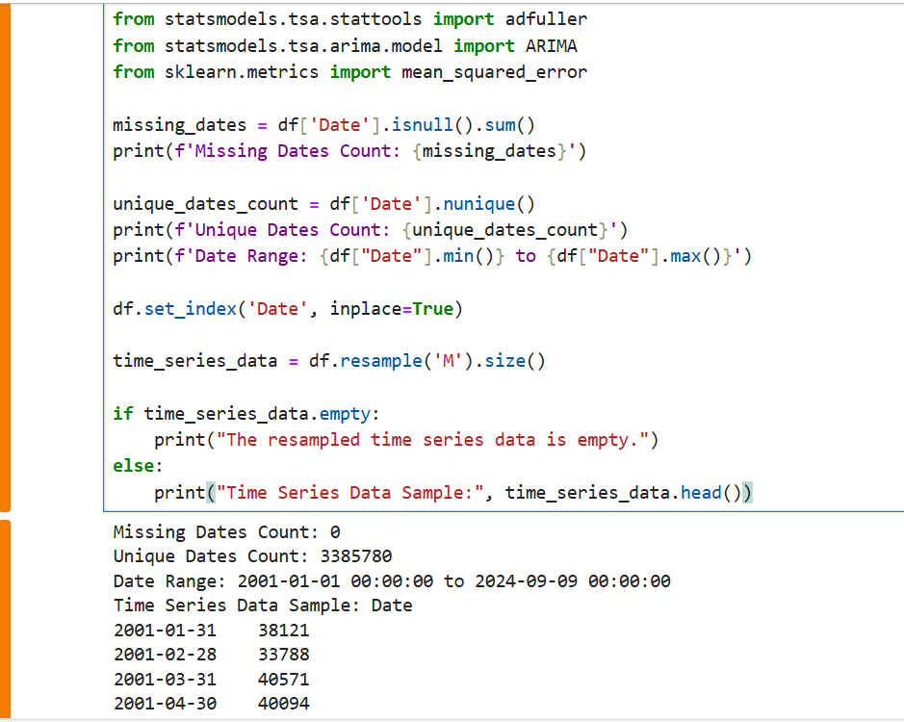
ARIMA Model

Slide 19
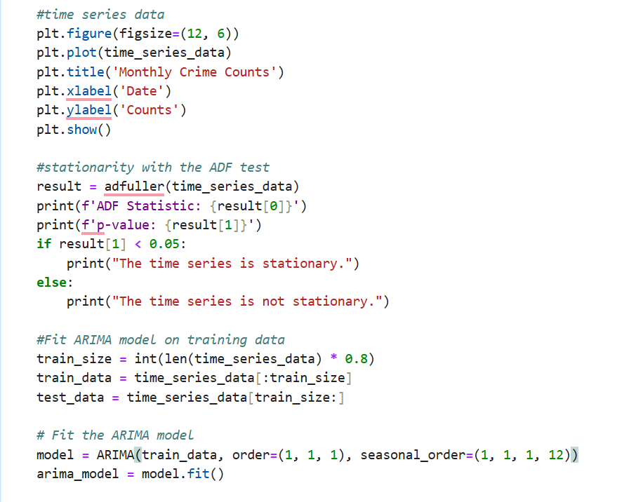
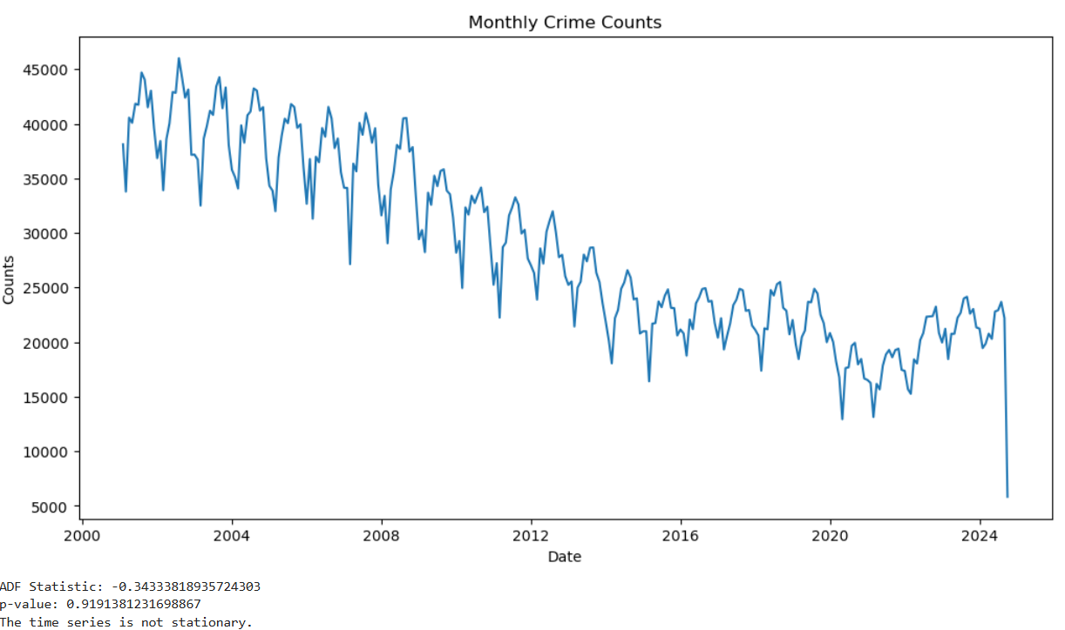

Slide 20
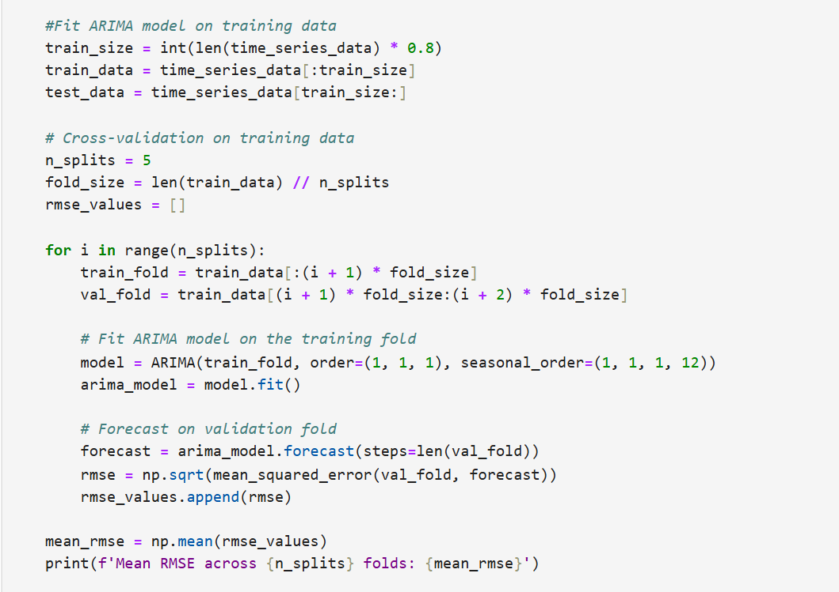
ADF Statistic:
-0.34333818935724303
p-value: 0.9191381231698867
The time series is not stationary.
Mean RMSE across 5 folds: 3104.7319643832425

Slide 21
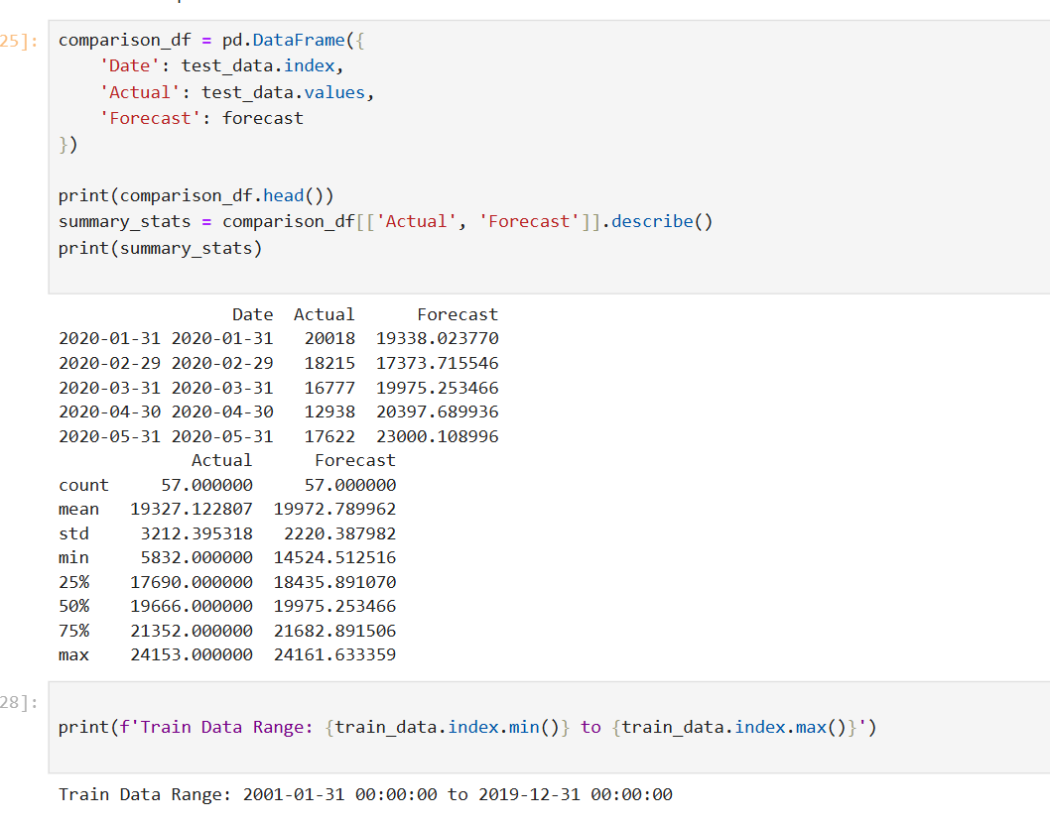
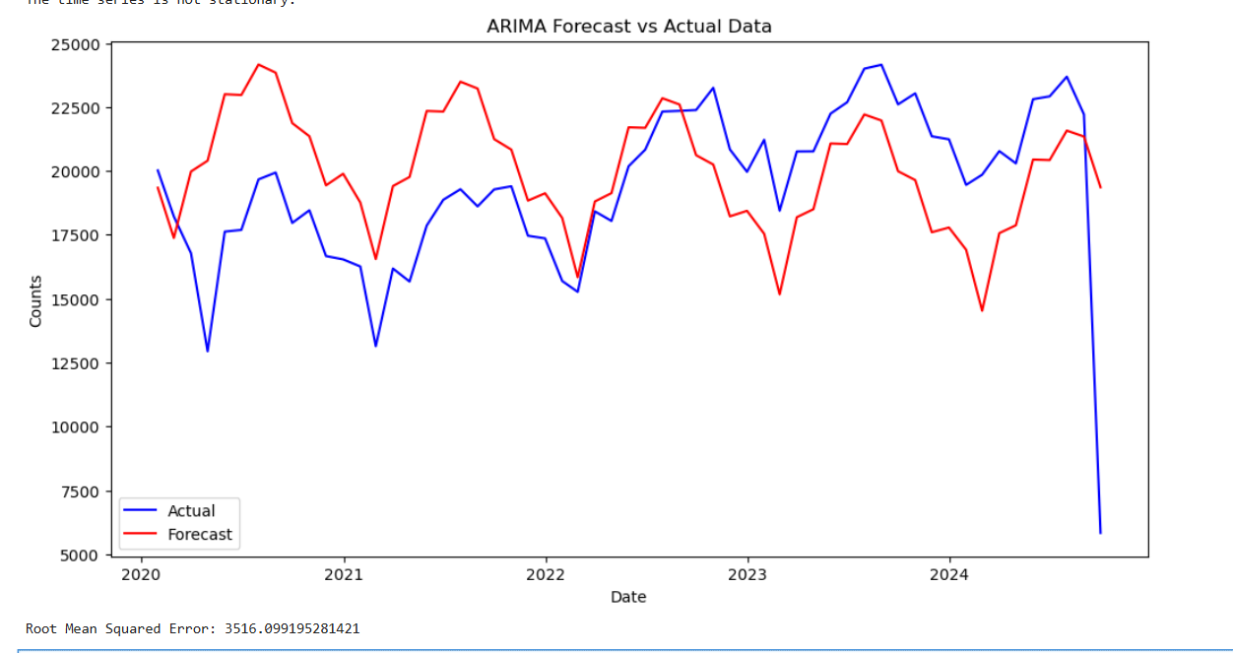
In time series forecasting with ARIMA, the model predicts future values based on past values. The last date in the training set is December 2019, so the first forecast is January 2020.

Slide 22
Challenges and Improvements
Since the ADF test indicated non-stationarity, we will consider differencing the data further to achieve stationarity.
Use techniques like grid search or automated tools (like pmdarima) to find the best parameters.

