Slide 1


Project Title: AI Powered Personalized Tutoring System
Presented By:
Yellenki Bhavya Sri Roll No:23951A6633
Dommeti Chandana Roll No: 23951A6637
Dase Chinmayee Roll No: 23951A6641

Slide 2

Introduction
Objective: Build an AI-powered tutoring system for personalized learning.
Use of Machine Learning to predict student performance.
Recommendation of personalized study materials.
Adaptability to different student learning styles.
Integration of AI with traditional teaching methods.
Potential impact on academic outcomes.

Slide 3
Problem Statement
Students have different learning paces and abilities.
Generic learning materials do not cater to individual needs.
Lack of early intervention for struggling students.
Difficulty in identifying strengths and weaknesses.
Teachers need better tools to support personalized learning.
Need for a data-driven approach to improve student outcomes.
Traditional systems lack predictive analytics.

Slide 4
Solution Overview
AI-based system to track student progress.
Predicts future scores based on multiple factors.
Personalized learning material recommendations.
Identifies struggling students for early intervention.
Provides insights to teachers for better guidance.
Encourages self-paced learning.
Improves overall student engagement and success.

Slide 5
Data Presentation
Features used in student performance prediction.
Student Information: Grade level, IQ, attendance.
Study Habits: Study hours per week.
Performance Metrics: Past scores.
Target Variable: Future assessment score prediction.
Data cleaning and preprocessing.
Handling missing or inconsistent data.

Slide 6
Exploratory Data Analysis (EDA)
Understanding data distribution.
Correlation between study hours and scores.
Identifying trends in student improvement.
Visualizing attendance vs. performance.
Outlier detection and handling.
Clustering students based on learning patterns.
Extracting insights for feature engineering.

Slide 7
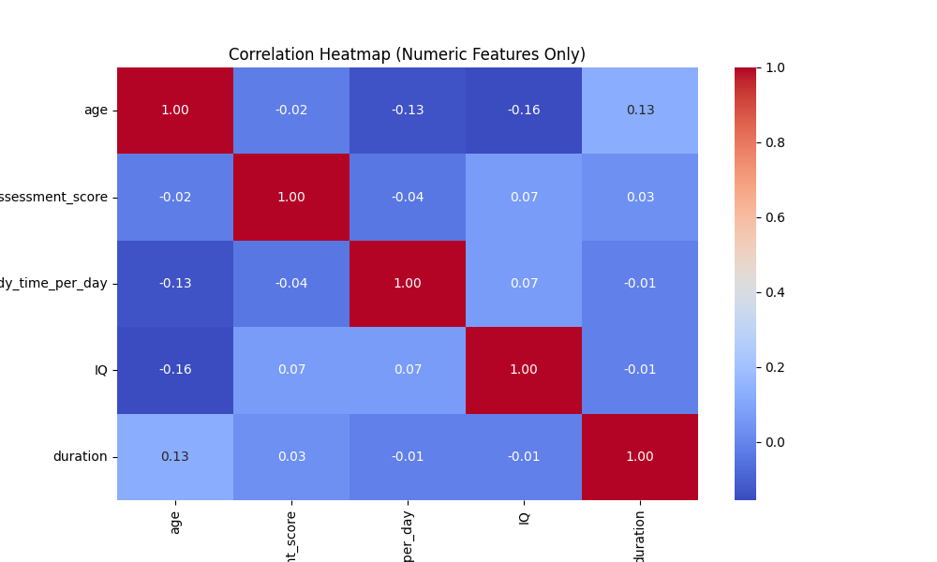
Exploratory Data Analysis (EDA)

Slide 8
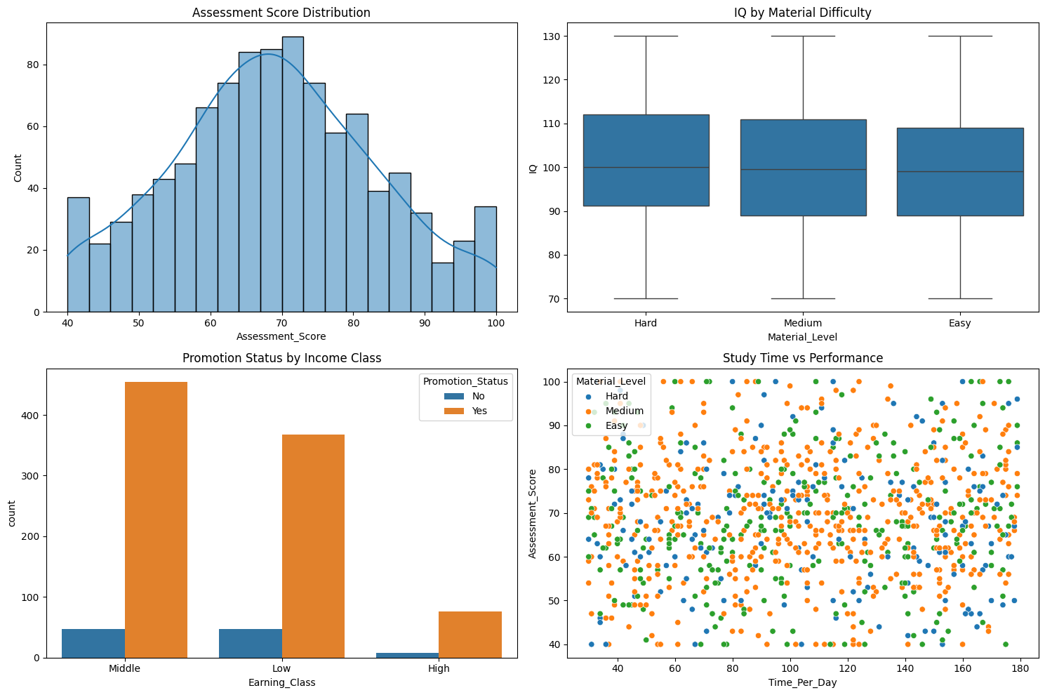
Exploratory Data Analysis (EDA)

Slide 9
Machine Learning Models
Random Forest Regressor for predicting future scores.
Classification Model to determine student promotion.
Feature selection to improve model accuracy.
Hyperparameter tuning for model optimization.
Support Vector Machines (SVM) for classification tasks.
Artificial Neural Networks (ANNs) for deep learning insights.
K-Nearest Neighbor (KNN) for pattern recognition
Naïve Bayes Classifier for probability-based predictions.

Slide 10
Evaluation Metrics:
Mean Absolute Error (MAE).
Mean Squared Error (MSE).
R-squared score.
Comparison with other models (Linear Regression, XGBoost).
XGBoost Regressor for better accuracy and performance.

Slide 11
Student Promotion Prediction
Classification model to determine promotion eligibility.
Pass Threshold: Score of 50+ required for promotion.
Binary classification (Promoted/Not Promoted).
Feature importance analysis.
Training on historical student data.
Accuracy and performance evaluation.
Future improvements for better predictions.

Slide 12
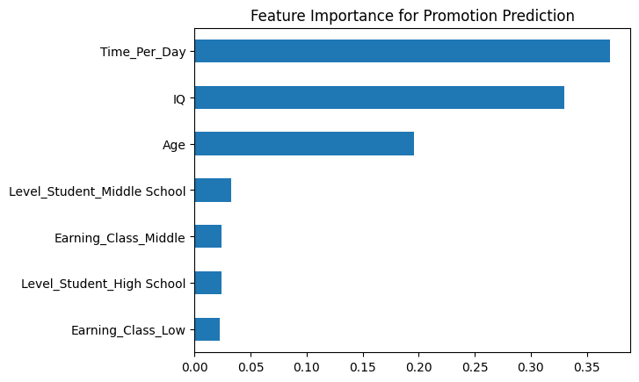
Student Promotion Prediction

Slide 13
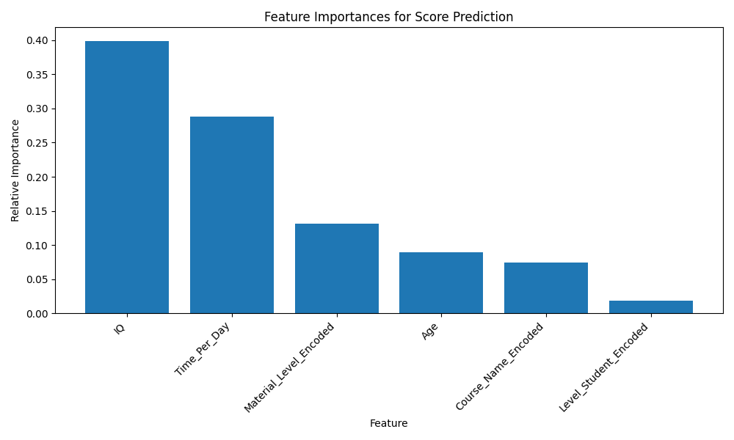
Student Score Prediction

Slide 14
System Architecture
Data Collection: Student data stored in a database.
ML Model Processing: Prediction & classification.
Recommendation System: Personalized study material suggestions.
Web App: User interface for students and teachers.
Database Integration: Efficient data retrieval and storage.
Real-time analytics dashboard.
Scalability and cloud deployment options.

Slide 15
Database Integration
SQL/NoSQL databases for storing student data.
Efficient indexing for fast retrieval.
Data pipeline automation.
Integration with machine learning models.
Cloud-based storage solutions.
API for seamless data communication.
Security and data privacy considerationion.

Slide 16
Future Scope & Enhancements
Implement NLP for AI-based tutoring.
Expansion to include real-time feedback.
Gamification elements to improve engagement.
Mobile app version for easier accessibility.
Integration with external learning platforms.
Adaptive assessments for better learning evaluations.
AI-driven teacher assistance for grading and feedback.

Slide 17
Conclusion:
AI-powered tutoring system provides personalized learning.
Predicts student scores and helps in early interventions.
Improves student engagement and success rates.
Empowers teachers with data-driven insights.
Enhances traditional education systems.
Future potential to scale across multiple curricula.
Continuous improvement using AI advancements.

