Slide 1
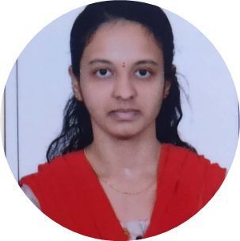



Chandana G K
Analyst/Software Engineer
Bachelor of Engineering, Computer Science : 2017- 2021
Skills
Banglore
Dot Net | C#, MVC , Oop’s ,Generics, Collections,
Data base | SQL
UI Tech | HTML5 ,CSS3 ,JavaScript
Add on skills | Peer learning
chandana.g-k@capgemini.com
+91 8861296306
A4
DOTNET DEVELOPER
Hands on experience in creating microservices with AspDotNet MVC , Entityframe work.
Proficient in creating Single page Web Application in Visual studio with Authentication with routing.
Hands on experience in developing web pages using HTML5,CSS3,MVC,Object Oriented language , SQL.
Online Hotel Management System
Case study of Online Hotel Management System along with AspDotNet MVC and payment , Email notification , responsive UI with HTML5, CSS, Bootstrap used as User Interface.
Check out my work on GitHub & Video Profile

