Slide 1
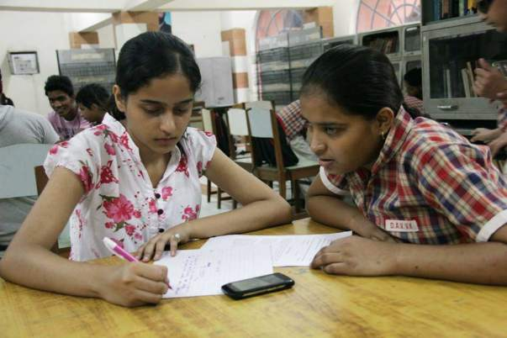
Scribble for those who need it the most

Slide 2
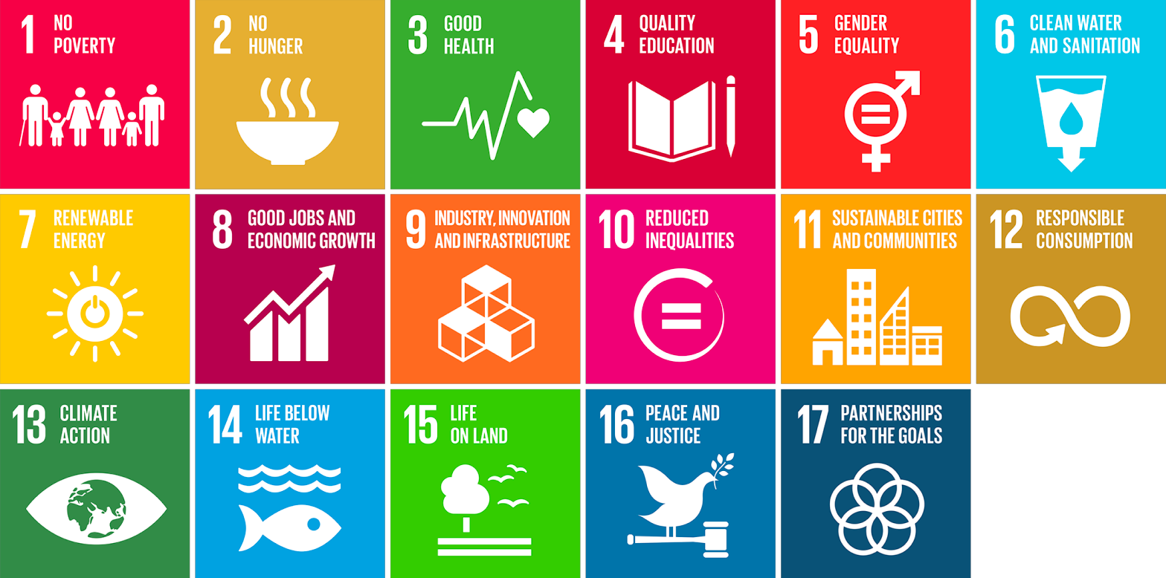
Achieving UN Goals
Quality Education
Reduced Inequalities

Slide 3
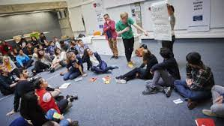
SDG INDICATOR 4.3.1: Equal access to further education
ensure equal access for all women and men to affordable and quality technical, vocational and tertiary education.
SCRIBBLER creates communities for scribes that would give them tips and tricks to help visually impaired students better and also would address the scopes and job opportunities of being a scribe.

Slide 4
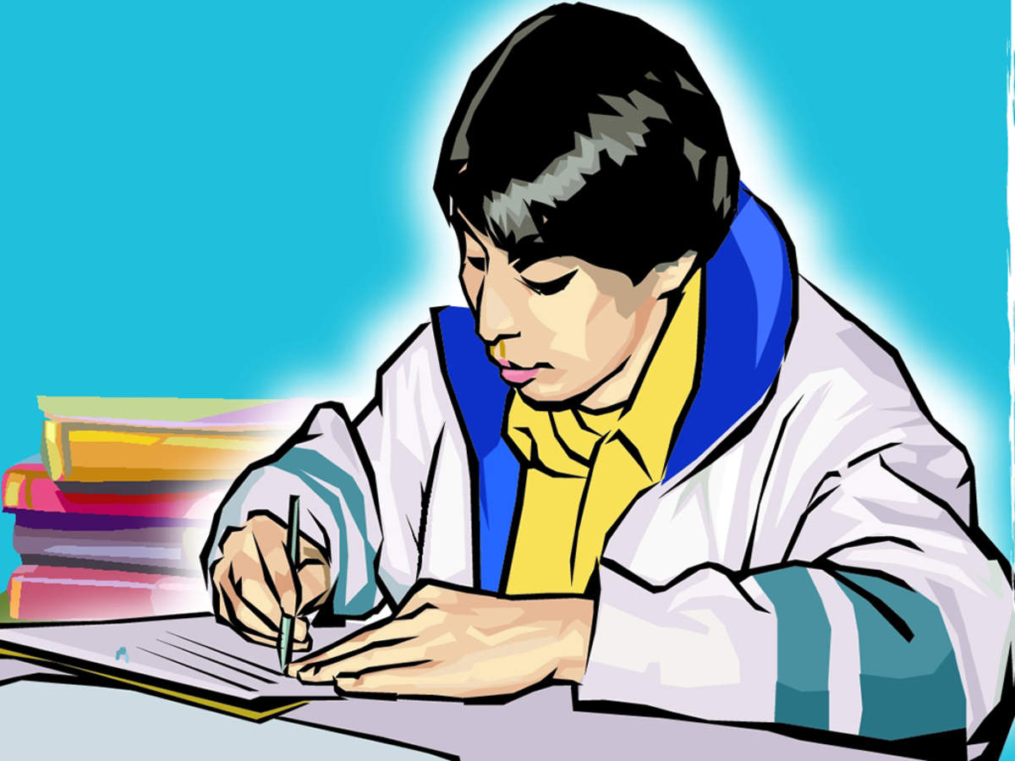
SDG INDICATOR 4.5.1: Disparities in educational access
eliminate gender disparities in education and ensure equal access to all levels of education and vocational training
SCRIBBLER helps visually impaired students have volunteered and verified scribes so that they can complete their education thus providing equal access.

Slide 5
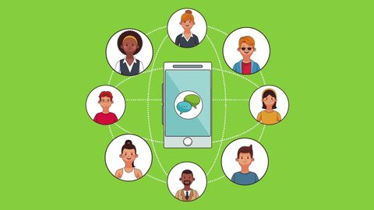
SDG INDICATOR 4.A.1: Inclusive and Safe schools
The proportion of schools with access to adapted infrastructure and materials for students with disabilities
SCRIBBLER allots scribes for the blind students who reside in a nearby location and provide better infrastructure for them to take up the exam.

Slide 6

SDG INDICATOR 10.2.1 : People living below 50 percent of median income
empower and promote the social inclusion of all, irrespective of age, sex, disability, race, ethnicity, origin, religion or economic, or another status.
SCRIBBLER includes students in volunteer activities and building communities to engage with all students either blind or a scribe. A student irrespective of her/his academic performance can be a scribe and possibly be a professional one.

