Slide 1
IMAGE ANALYSIS 18-02-2018
CHANDANA KOTTA
Prof. Neelam Sinha
Notes:
Why do we do second order derivatives?

Slide 2
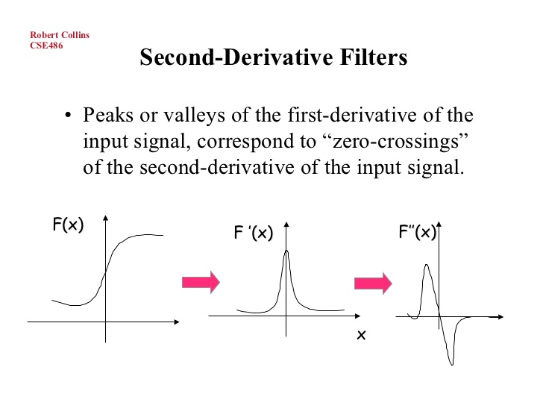
BASELINE: Find out edges, or areas of intensity change.
First derivative peaks: sharp edges or stark intensity changes
Second derivative: Zero crossings, since its much more easier to locate zero crossings when compared to peaks.
IS THIS FOOLPROOF?
--------------------------------------------
1. Robert CollinsCSE486 Lecture 11: LoG and DoG Filters

Slide 3
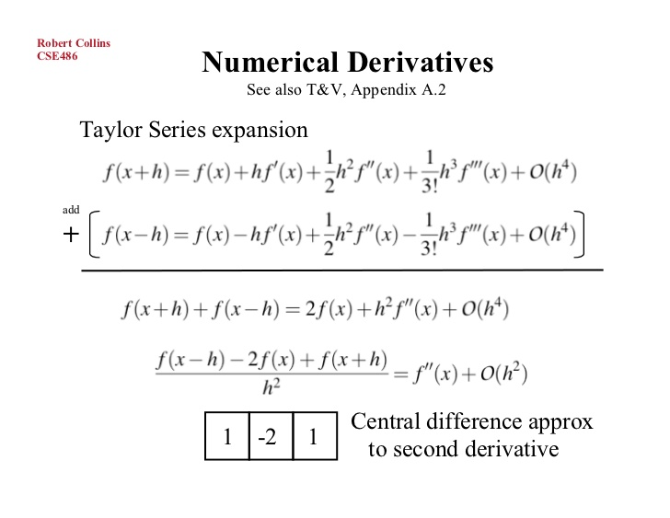

Slide 4
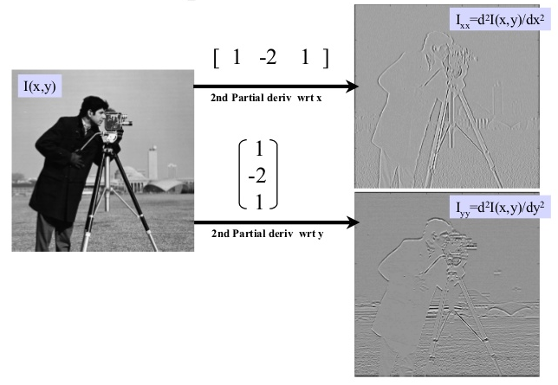

Slide 5
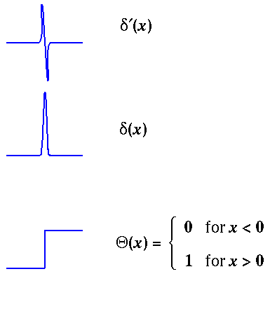
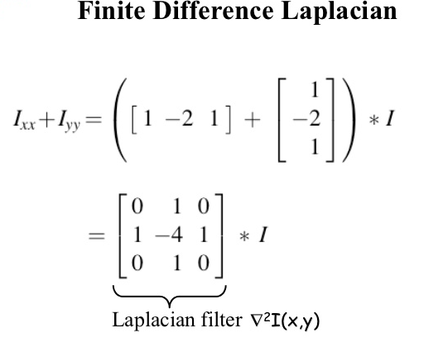
Problem: when first derivative is zero, so is second. I.e. the filter [1 -2 1] also produces zero when convolved with regions of constant intensity.
FIX FOR THIS?
So, in 1D, convolve with [1 -2 1] and look for pixels where response is nearly zero AND magnitude of first derivative is “large enough”.
Ix > threshold
WHERE ARE ALL THE ZERO CROSSINGS IN THE STEP DERIVATIVES ?
Notes:
Is this foolproof? Consider the step function and its derivatives.

Slide 6
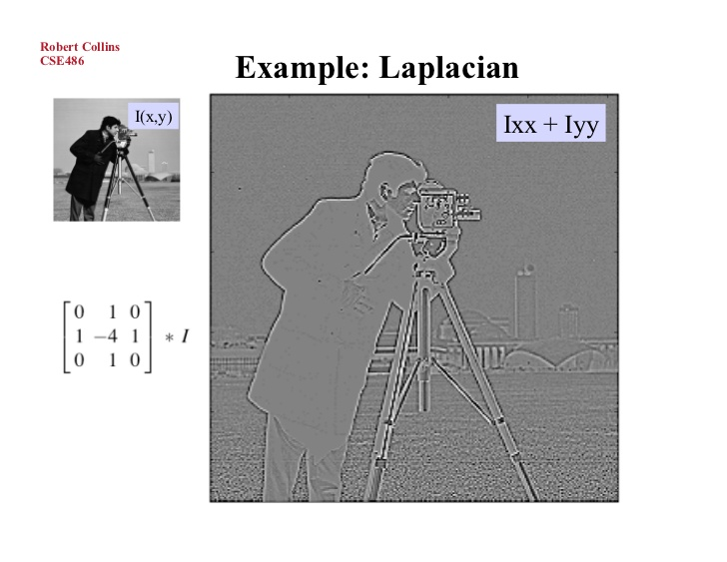

Slide 7
Histogram Equalization
Slides from Trinity College, Dublin

Slide 8


Adaptive histogram equalization
Images may not have similar colours or textures throughout.
Images may have areas darker than others, or having a huge variation with other areas.
The motivation is that most images may be composed of objects, and all objects may have different appearances, so doing a global level histogram equalization would mean manipulating the local neighbourhood.

Slide 9
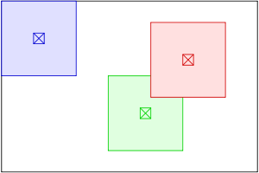
In its simplest form, each pixel is transformed based on the histogram of a square surrounding the pixel.
The size of the neighbourhood region is a parameter of the method. It constitutes a characteristic length scale: contrast at smaller scales is enhanced, while contrast at larger scales is reduced.
When the image region containing a pixel's neighbourhood is fairly homogeneous regarding to intensities, its histogram will be strongly peaked, and the transformation function will map a narrow range of pixel values to the whole range of the result image. This causes AHE to overamplify small amounts of noise in largely homogeneous regions of the image
( IMAGINE SALT AND PEPPER NOISE! )

Slide 10
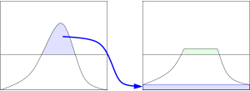
Contrast Limited Adaptive Histogram Equalization
CLAHE was developed^{[3]} to prevent the overamplification of noise that AHE could cause.
Idea is to limit the contrast enhancement of AHE. CLAHE limits the amplification by clipping the histogram at a predefined value before computing the CDF. This limits the slope of the CDF and therefore of the transformation function. The value at which the histogram is clipped, is the clip limit.
Redistribute excess part equally among all histogram bins.
Source: Wikipedia

Slide 11
Bilateral Filtering
Edge-preserving filtering.
Bilateral filtering is a non-linear edge preserving smoothing technique. It’s biggest advantage is that it takes care of the local neighbourhood in the window. Essentially it localizes areas. It keeps track of intensity changes in addition to smoothing.
It smoothens homogenous areas while preserving areas of stark intensity changes. The weights given to pixels in the window neighbourhood may follow the Gaussian distribution, which is a common form of Bilateral filtering.
Crucially, the weights depend not only on Euclidean distance of pixels, but also on the radiometric differences (e.g. range differences, such as colour intensity, depth distance, etc.) [1].

Slide 12
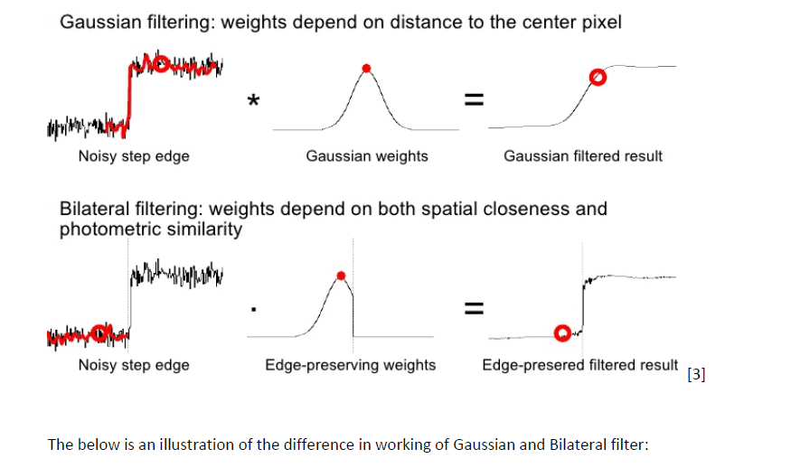

Slide 13
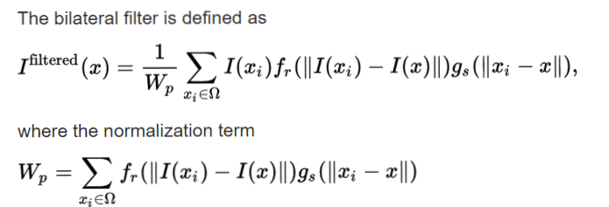
Bilateral filter has an additional weight term for intensity, (f_{r)} called the range weight which is a function of the intensity difference, the greater the intensity difference, the lower will be the range weight. The range weight is multiplied with the Intensity at the central pixel, and the whole equation is normalized using the weight.
In case a Gaussian is used as the weight function for the bilateral filter, the filter can average across features that span less than twice the variance of the Gaussian as it can detect them.

Slide 15
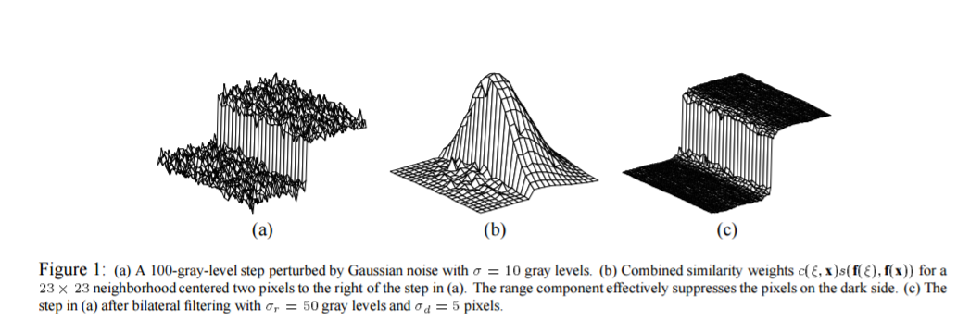
^{[2]} Image extracted from the “Proceedings of the 1998 IEEE International Conference on Computer Vision, Bombay, India”

Slide 16
Thank you!

