Slide 1
Tutorial Session

Slide 2
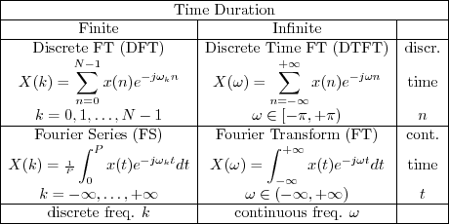
DFT for images

Slide 3
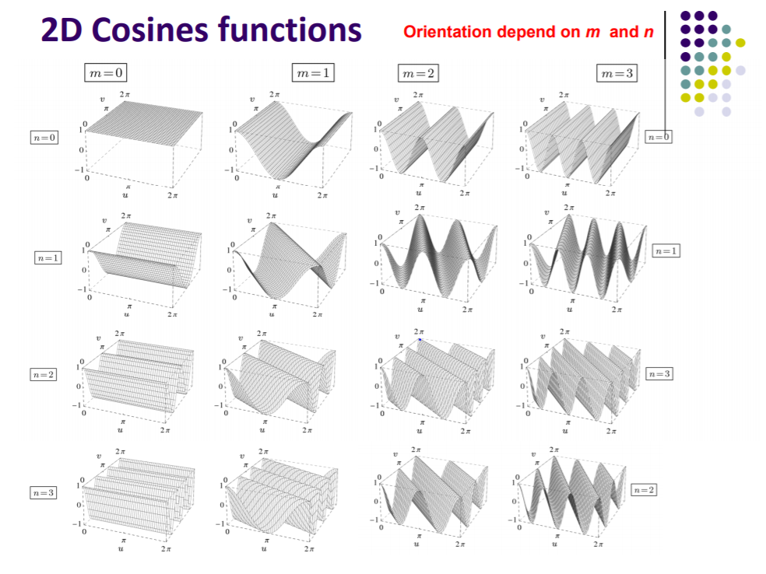

Slide 4
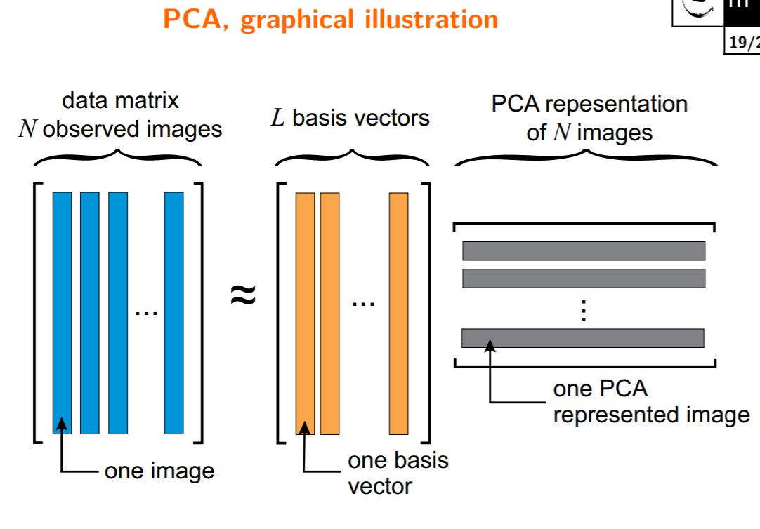
PCA for images
https://jakevdp.github.io/PythonDataScienceHandbook/05.09-principal-component-analysis.html

Slide 5
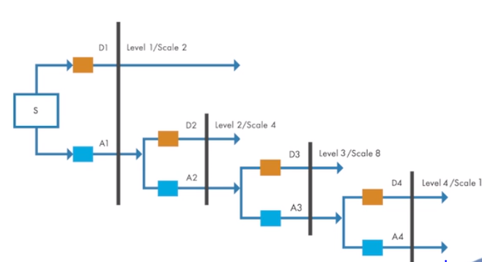
DWT
LOW PASS AND HIGHT PASS FILTERING
Approximation and detail bands
Can specify level of filtering in lib implementations

