Slide 1

Distributed Computing
By:
Chandana mn
20030141cse060
Assigned by:
DR.A.Ezil Sam LeNI

Slide 2
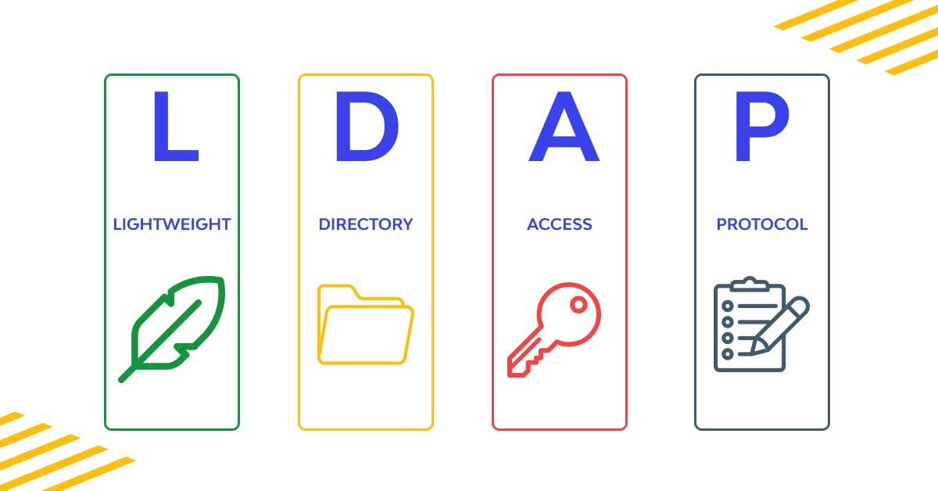
LDAP

Slide 3
Introduction
Lightweight directory access protocol (LDAP) is a protocol, that helps users find data about organizations, persons, and more.
LDAP has two main goals: to store data in the LDAP directory and authenticate users to access the directory.
It also provides the communication language that applications require to send and receive information from directory services.
A directory service provides access to where information on organizations, individuals, and other data is located within a network.

Slide 4
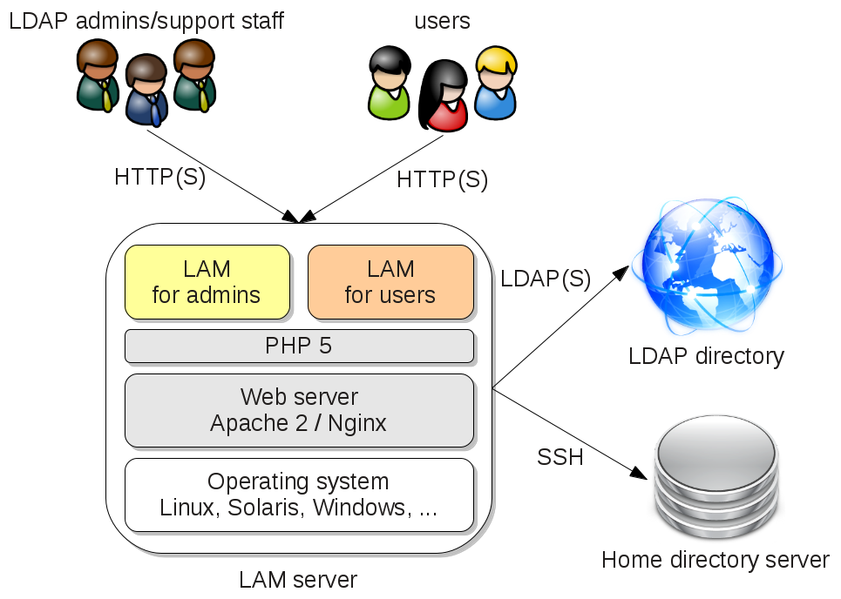
LDAP Architecture
LDAP's architecture is designed around a client-server model.
It defines the communication protocol and content of the messages exchanged between an LDAP client and an LDAP directory server.
The messages specify the operations requested by the client, the responses from the server, and the format of the data carried in the messages.
An LDAP client can request operations such as search, add, modify, and delete.

Slide 5
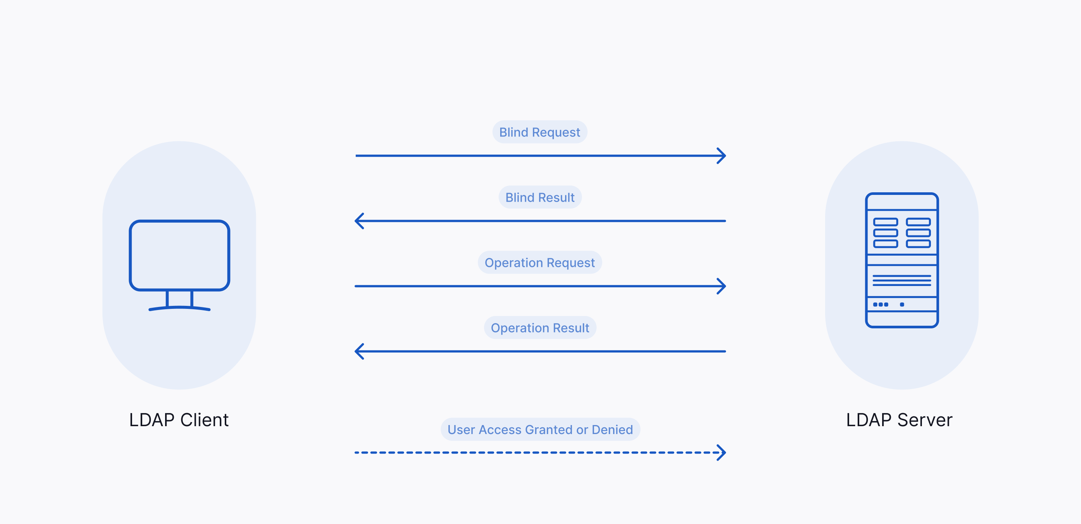
Cont
LDAP uses the following process to interact between an LDAP client and an LDAP directory server:
The client establishes a session or binding with the LDAP directory server.
The client specifies the host name or IP address and the port number to which the LDAP directory server is listening.
The client can either enter a username and password for authentication with the server or establish an anonymous session with default access rights. The client can also use one-way or two-way secure communication.
The client performs operations on the directory data. LDAP has both read and write capabilities. You can manage and query the directory information.
LDAP also searches the directory for data to satisfy the specified criteria. Specify the part of the directory to search and the information to return. A search filter that uses Boolean conditions displays data, based on the condition.
After completing the client requests, the client closes the session or unbinds with the server.

Slide 6
LDAP Models
LDAP can be explained by using four models upon which it based:
Information Model: This model describes structure of information stored in an LDAP Directory.
Naming Model: This model describes how information in an LDAP Directory is organized and identified.
Functional Model: LDAP defines operations for accessing and modifying directory entries .
Security Model: This model describes how information in LDAP directory can be protected from unauthorized access. It is based on BIND operation.

Slide 7
LDAP Information Model
The LDAP Information Model defines the structure and organization of data within an LDAP directory.
Data in LDAP is organized into entries, with each entry representing an object.
Entries are further classified based on object classes, which define the set of attributes an entry can have.
LDAP attributes are name-value pairs used to store specific information within an entry.
The Information Model is the foundation for LDAP's data organization and retrieval, allowing structured and efficient data access.

Slide 8
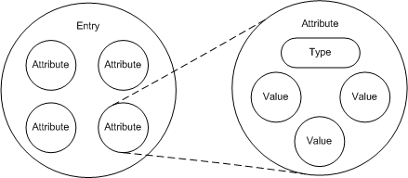
Cont
The LDAP information model is based on the entry that contains information about an object.
The following entities represent the LDAP information model:
Entries: An entry is a basic unit of information stored in a directory and consists of a collection of attributes.
Attribute: Each attribute has a type and is associated with one or more values.

Slide 9
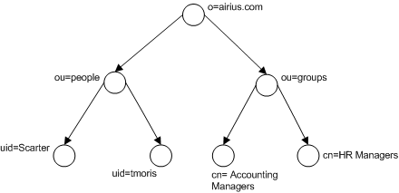
Cont
The LDAP information model is a hierarchical data model that represents the information stored in an LDAP directory.
Directory Information Tree (DIT)
LDAP directories are organized in a tree-like structure called the Directory Information Tree (DIT). The DIT is a hierarchy of entries, with each entry having a unique Distinguished Name (DN). The DN uniquely identifies the entry within the DIT.
The root of the DIT is the most general entry in the directory. It typically represents the organization. Below the root are entries for departments, groups, and users.
LDAP object classes:
LDAP object classes define the types of entries that can be stored in the directory. They also define the attributes that are required and optional for each type of entry.
Object classes can be organized in a hierarchy, with child object classes inheriting the attributes of their parent object classes. This allows administrators to define new object classes without having to redefine all the attributes.

Slide 10
Cont
LDAP Attributes
LDAP attributes are properties of entries.
They contain information about the entry, such as the user's name, the group's members, or the computer's operating system.
Each attribute has a type and one or more values.
The type of the attribute specifies the format of the data.
Attributes can be single-valued or multi-valued.

Slide 11
LDAP Naming Model
The Naming Model is a fundamental part of LDAP. It defines how entries in an LDAP directory are named and identified.
A structured naming system is crucial for efficient and precise location of directory entries.
It ensures that each entry has a unique and hierarchical name.
This standardized approach simplifies navigation and reduces access time.
Without it, finding and accessing directory entries would be time-consuming and error-prone.

Slide 12
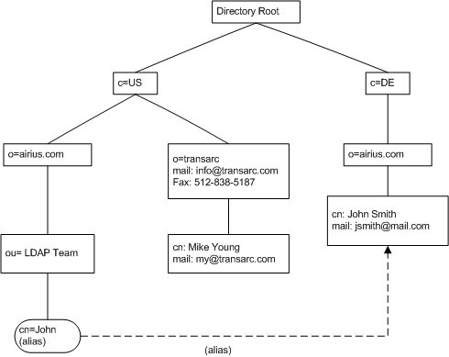
Cont
The LDAP naming model consists of the following components:
Distinguished Name (DN): The DN is a unique name that identifies an entry within the LDAP Directory Information Tree (DIT).
Relative Distinguished Name (RDN): The RDN is a component of the DN that uniquely identifies an entry among its siblings.
Attribute Value Pair (AVP): An AVP is a combination of an attribute name and an attribute value. It is the basic building block of an RDN.

Slide 13
Cont
The LDAP directory entries contains the following naming conventions:
A DN is a unique name that identifies a single entry.
An RDN consists of a sequence of relative distinguished names.
Each RDN is derived from the attributes of the directory entry.
An RDN has the form <attribute name> = <value> .
For example, the following DN identifies the entry for the user "jdoe" in the ACME Corporation directory:
cn=jdoe, ou=People, o=ACME Corporation, c=US
This DN consists of three RDNs:
cn=jdoe: This RDN identifies the entry for the user "jdoe".
ou=People: This RDN identifies the organizational unit (OU) that contains the user entry.
o=ACME Corporation: This RDN identifies the organization that contains the OU.

Slide 14
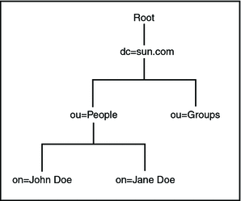
Cont
Advantages of LDAP Naming Service
LDAP gives you the ability to consolidate information by replacing application-specific databases; reduces the number of distinct databases to be managed
LDAP allows for more frequent data synchronization between masters and replicas
LDAP is multi-platform and multi-vendor compatible
Disadvantages of LDAP Naming Service
There is no support for pre-Solaris 8 clients
An LDAP server cannot be its own client
Setting up and managing an LDAP naming service is more complex and requires careful planning

Slide 15
LDAP Functional Model
The LDAP Functional Model is a crucial component of LDAP's architecture. As it defines the set of operations that can be performed on LDAP directory entries.
It outlines the various actions that can be taken to interact with and manage directory data efficiently.
The operations defined in the Functional Model enable users to perform tasks like searching for information, adding new entries, updating existing data, and removing entries, which are essential for maintaining directory data.
LDAP operations can be divided into following categories:
Query
Update
Authentication

Slide 16

Cont
The LDAP functional model includes the following categories of operations that are performed against the LDAP directory server:
Authentication. Bind, unbind, and abandon operations used to connect to and disconnect from an LDAP directory server, establish access rights, and protect information.
Query or Interrogation. Search and compare entries satisfying the user-specified criteria.
Update. Add, delete, or modify an entry, and modify the DN or RDN of an entry.
Use the following options to perform the search operation:
Base DN: The starting point within the DIT.
Scope: Specifies the search level in the query that limits the scope of the search performed on the directory data.
Search Filter: Specifies the filter for querying the LDAP entries.
Returning Attributes: Attributes to retrieve from entries that match the search criteria.

Slide 17
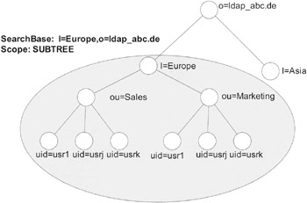
Cont
LDAP Operations
Search: This operation is used to retrieve information from the LDAP directory. It allows users to query the directory for specific data, making it an indispensable feature for various applications like user authentication and directory lookups.
Add: The "Add" operation is used to create new directory entries. It's vital for populating the LDAP directory with new data, such as adding new user profiles, devices, or resources.
Modify: LDAP's "Modify" operation enables users to update existing directory entries. This operation is crucial for keeping directory data up to date, whether it's changing user details or modifying device configurations.
Delete: The "Delete" operation is used to remove directory entries. It plays a pivotal role in managing the directory by allowing the removal of outdated or unnecessary data.
Bind: LDAP's "Bind" operation is a versatile function that serves two main purposes. Firstly, it's used for client authentication, where a user or application logs in and proves their identity to access the directory. Secondly, it's used to establish a connection to the directory server, setting the stage for subsequent operations.

Slide 18
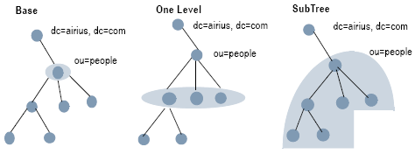
Cont
LDAP uses the following search levels to limit the scope of the search performed on the directory data:
Base or Object: Specifies that the search is carried out on the base DN.
One Level: Specifies that the search is carried out on the entries that are directly below the base DN.
Subtree: Specifies that the search is carried out on the entire Subtree rooted at the base DN.

Slide 19
LDAP Security Model
The LDAP Security Model is a pivotal aspect of LDAP that addresses critical security concerns associated with LDAP communication.
LDAP is commonly used in various contexts, including corporate user databases and network configurations, where the security and integrity of data are paramount.
The Security Model provides the framework for implementing robust security measures, securing data in transit, and controlling access to the directory.
Highlight that it plays a fundamental role in ensuring that sensitive information remains confidential and protected from unauthorized access.

Slide 20
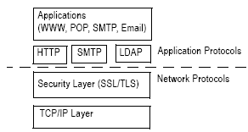
Cont
The LDAP security model protects the directory from any unauthorized access. The LDAP security model uses Secure Socket Layer (SSL) and Transport Layer Security (TLS) that encrypt the data exchanged between a client and a server. LDAP offers a standard method for clients to encrypt data with SSL and TLS.

Slide 21
Cont
Primary security aspects covered by the LDAP Security Model:
Authentication: Explain that LDAP provides various authentication mechanisms for client verification. Mention "Simple Bind" and "SASL" as common methods.
Encryption: Discuss the use of SSL/TLS to encrypt LDAP traffic. Emphasize that encryption ensures data confidentiality during transmission.
Access Control: Highlight the role of access control mechanisms in LDAP. These mechanisms define who can access and modify directory data, ensuring data integrity and privacy.
Security Policies: Mention that LDAP can enforce security policies, such as password policies, to enhance the overall security of the directory.
Authentication mechanisms used in LDAP:
Simple Bind: Explain that Simple Bind is a basic authentication method that involves sending a username and password to the LDAP server. It is straightforward but may not be the most secure method.
SASL (Simple Authentication and Security Layer): Discuss SASL as a more advanced and extensible authentication framework. Explain that SASL supports various authentication mechanisms like GSSAPI, DIGEST-MD5, and more.

Slide 22
Merits & Demerits
Advantages of LDAP:
Data present in LDAP is available to many clients and libraries.
LDAP support many types of application.
LDAP is very general and has basic security.
Disadvantages in LDAP:
It does not handle well relational database.
While LDAP is simple, its query language can be complex, making advanced queries and searches challenging for beginners.

Slide 23
Analysis
LDAP's lightweight, standardized, and secure nature makes it a strong choice for modern directory services, but it may require careful planning and management, particularly in larger environments. The choice between LDAP and traditional systems should be based on specific organizational requirements and use cases.
Some challenges
Complex Query Language: LDAP's query language can be intricate, making advanced queries more challenging, especially for administrators who are new to the protocol.
Maintenance Overhead: As LDAP directories grow, managing them can become more complex, potentially requiring additional resources and expertise.
Replication Challenges: Setting up and maintaining replication in LDAP may involve more complexity, particularly in larger-scale deployments.
Performance Tuning: While LDAP is scalable, achieving high performance in very large directories may require meticulous design and tuning.

Slide 24


