Slide 1


Design Thinking Module 002
Group number- C5
Group members:
Chandana MN - CSE060
AISHWARYA RAJESH – CSE006
PREM KUMAR S – LCSE107
RAUT ADESH DNYANDEO – AE006
PRAVEENA

Slide 2
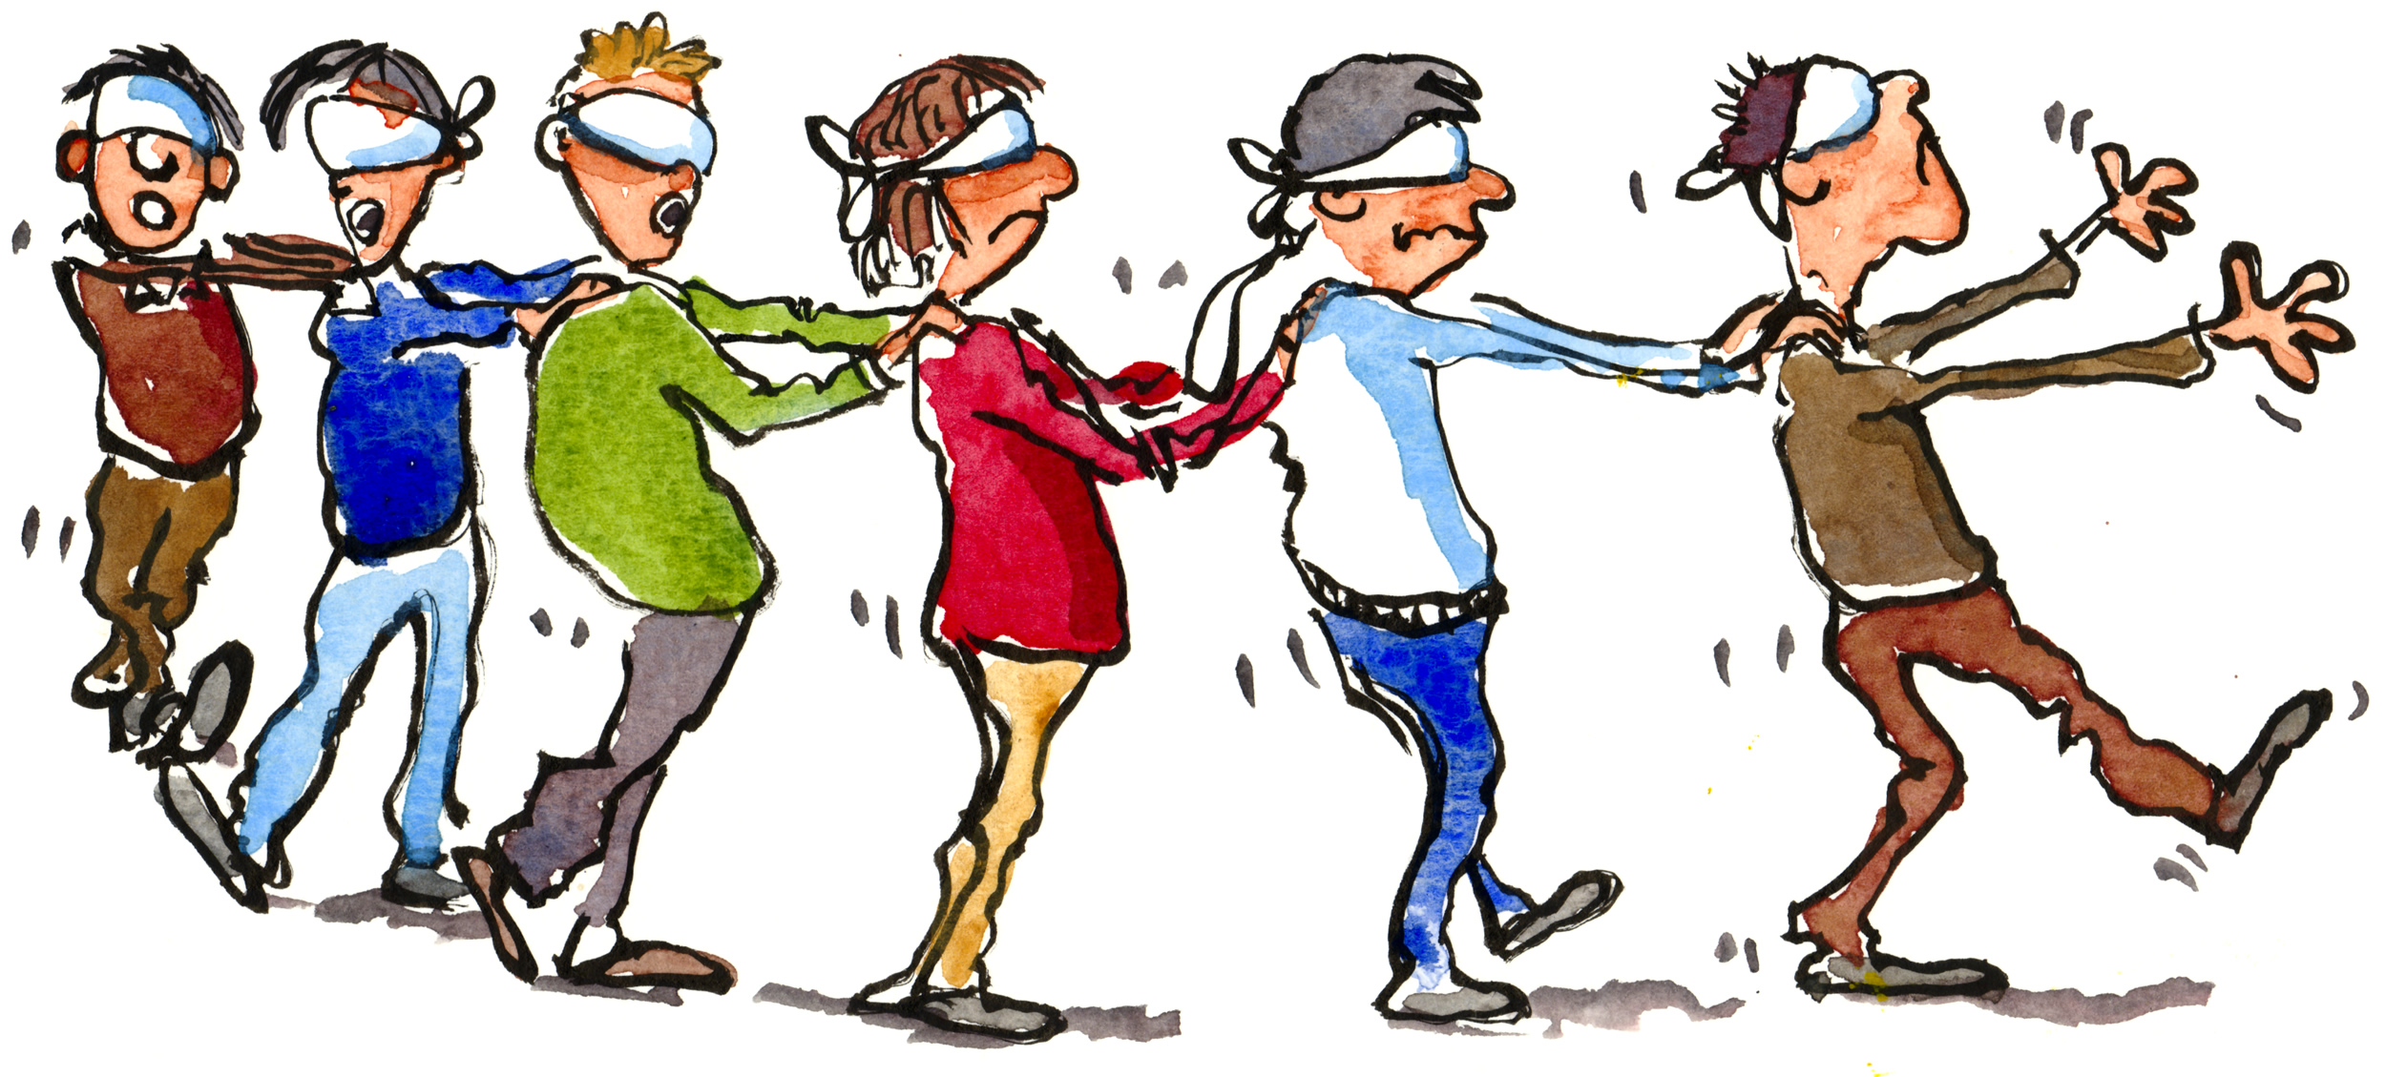
THE PROBLEM STATEMENT:
HELP VISION IMPAIRED INDIVIDUALS NAVIGATE UNFAMILIAR ENVIRONMENTS

Slide 3

OBJECTIVES
INCREASE THE INDEPENDENCE OF THE USER
HELP THE CARETAKER WITH ALL INFORMATION
NAVIGATE THROUGH UNFAMILIAR ENVIRONMENTS

Slide 4

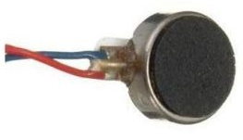
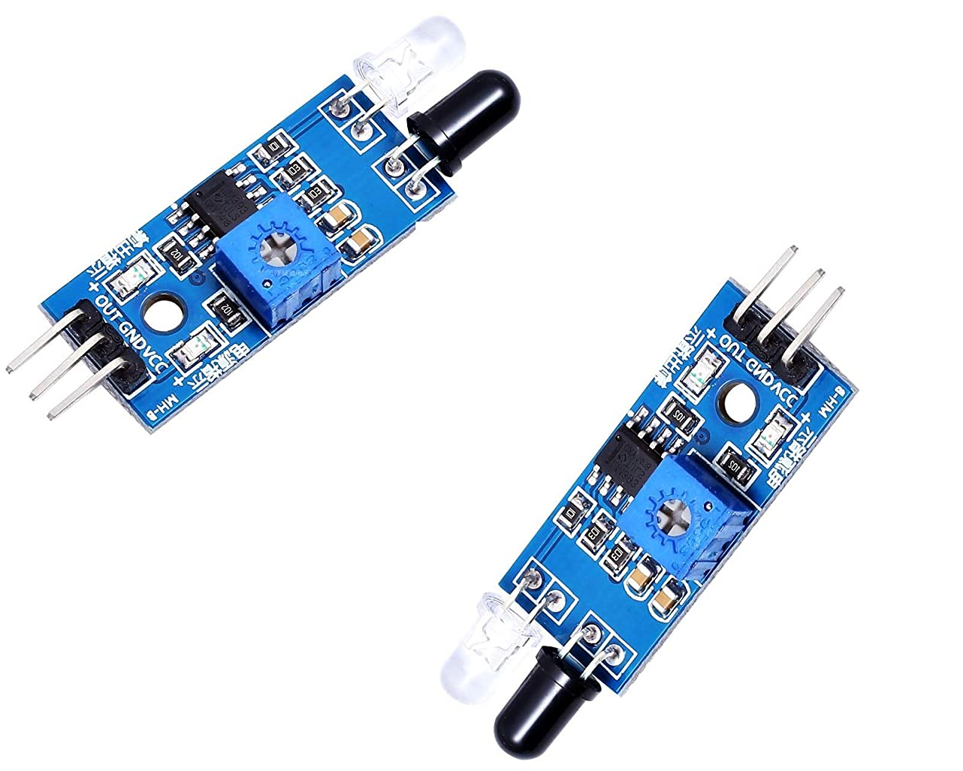
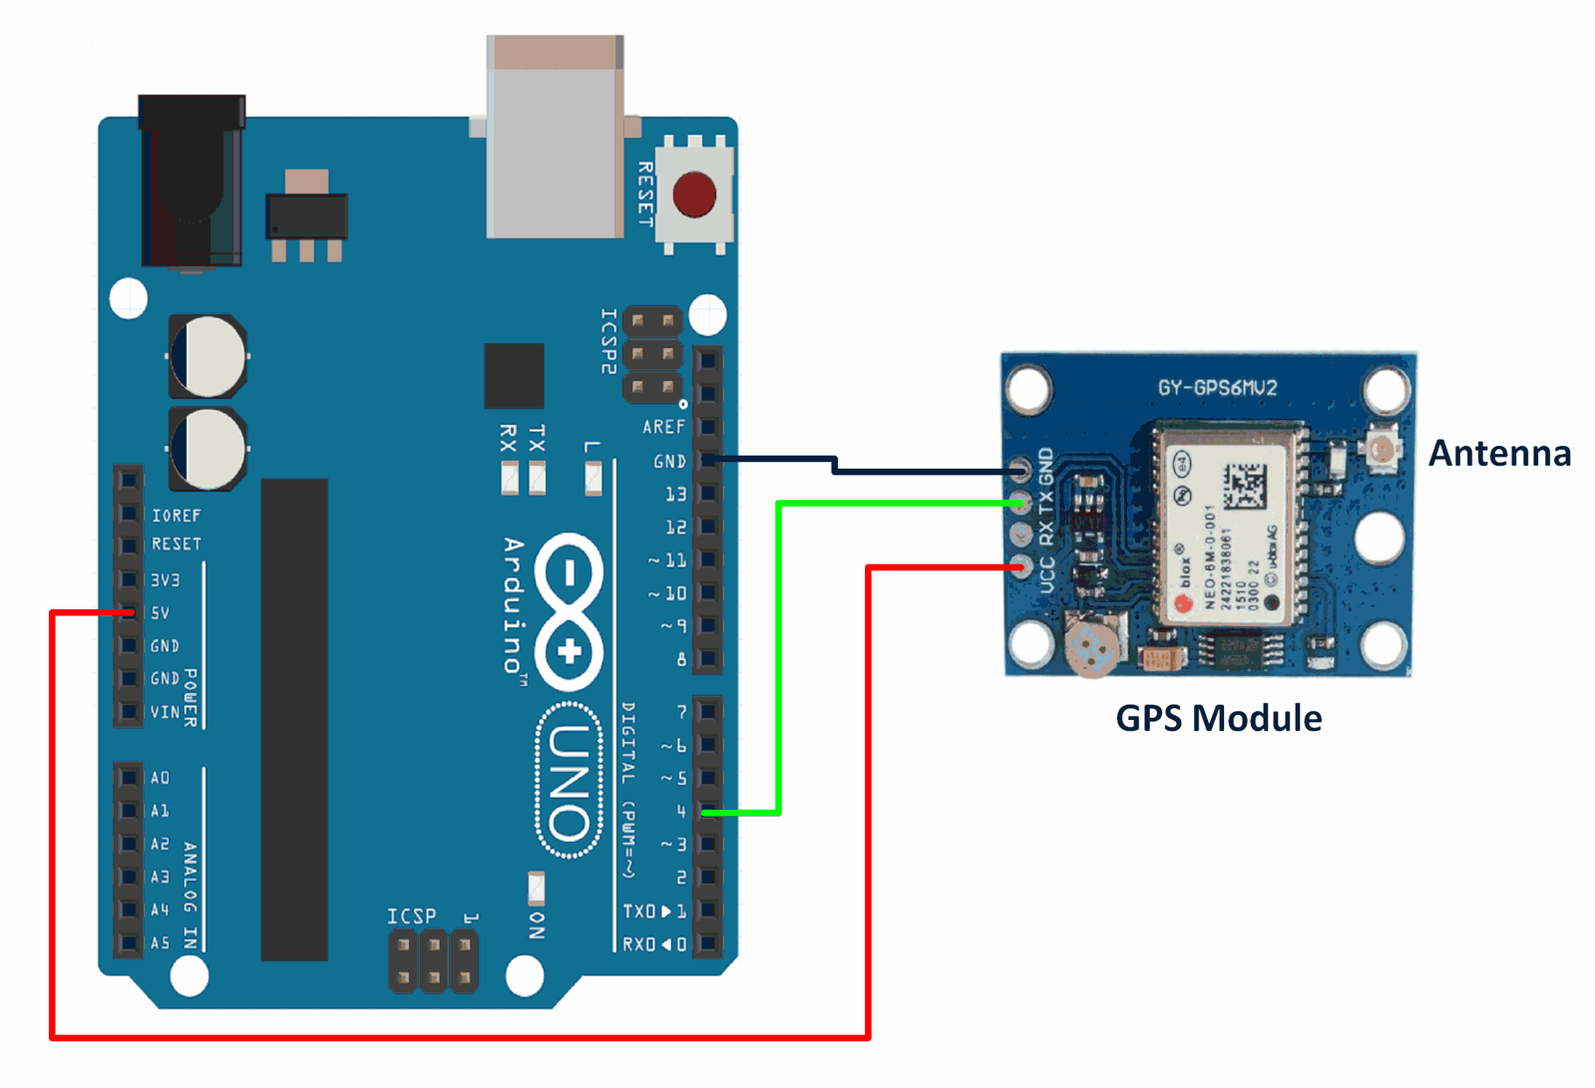
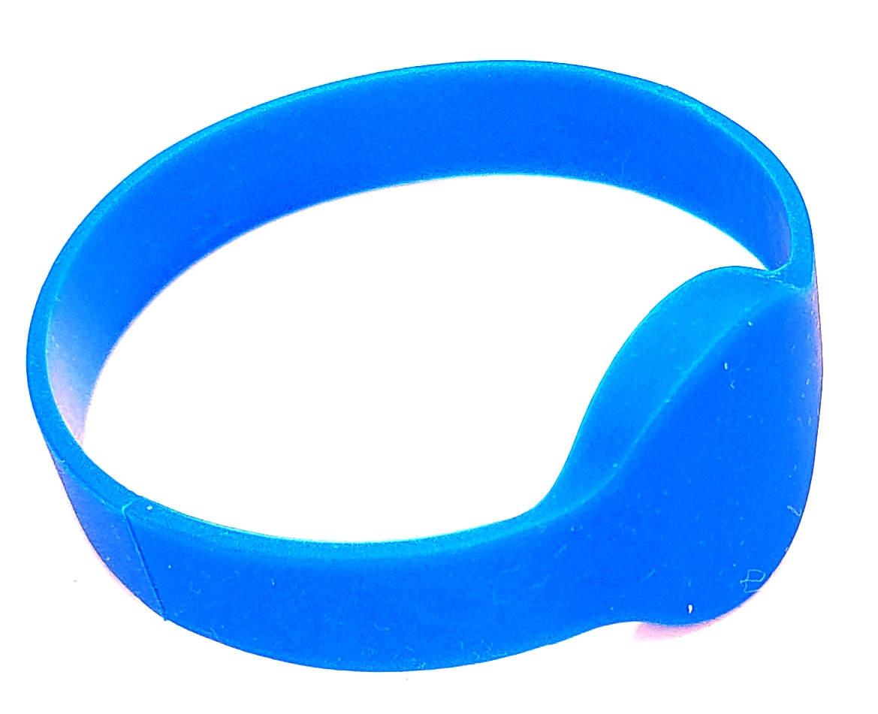
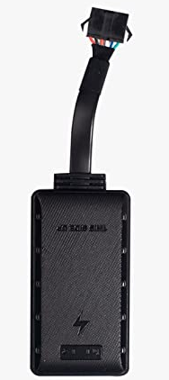
Components:

Slide 5
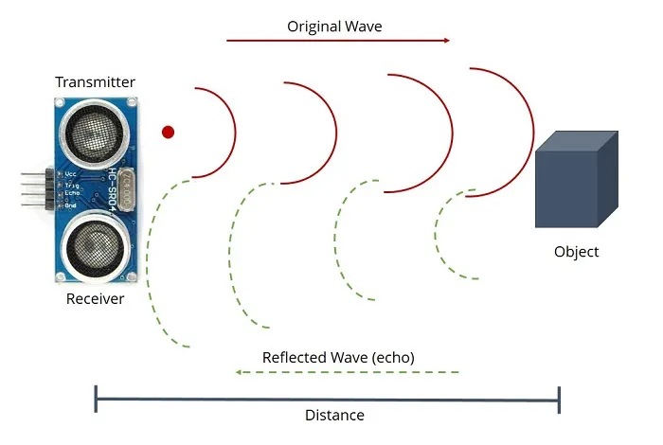
Working Principle :

Slide 6
Work progress:
Working on app – Chandana and Pream
Working on collecting components - Praveena
Working on circuit - Aishwarya and Adesh

Slide 7


