Slide 1

Image Processing
Presented by: CHANDANA MN
VINAY R
SANDEEP JN
MRIDUL PAL
HARSHA A
GALI LAKSHMI VENKATA MAHESH
Assigned by: Shiv Kumar Verma sir

Slide 2
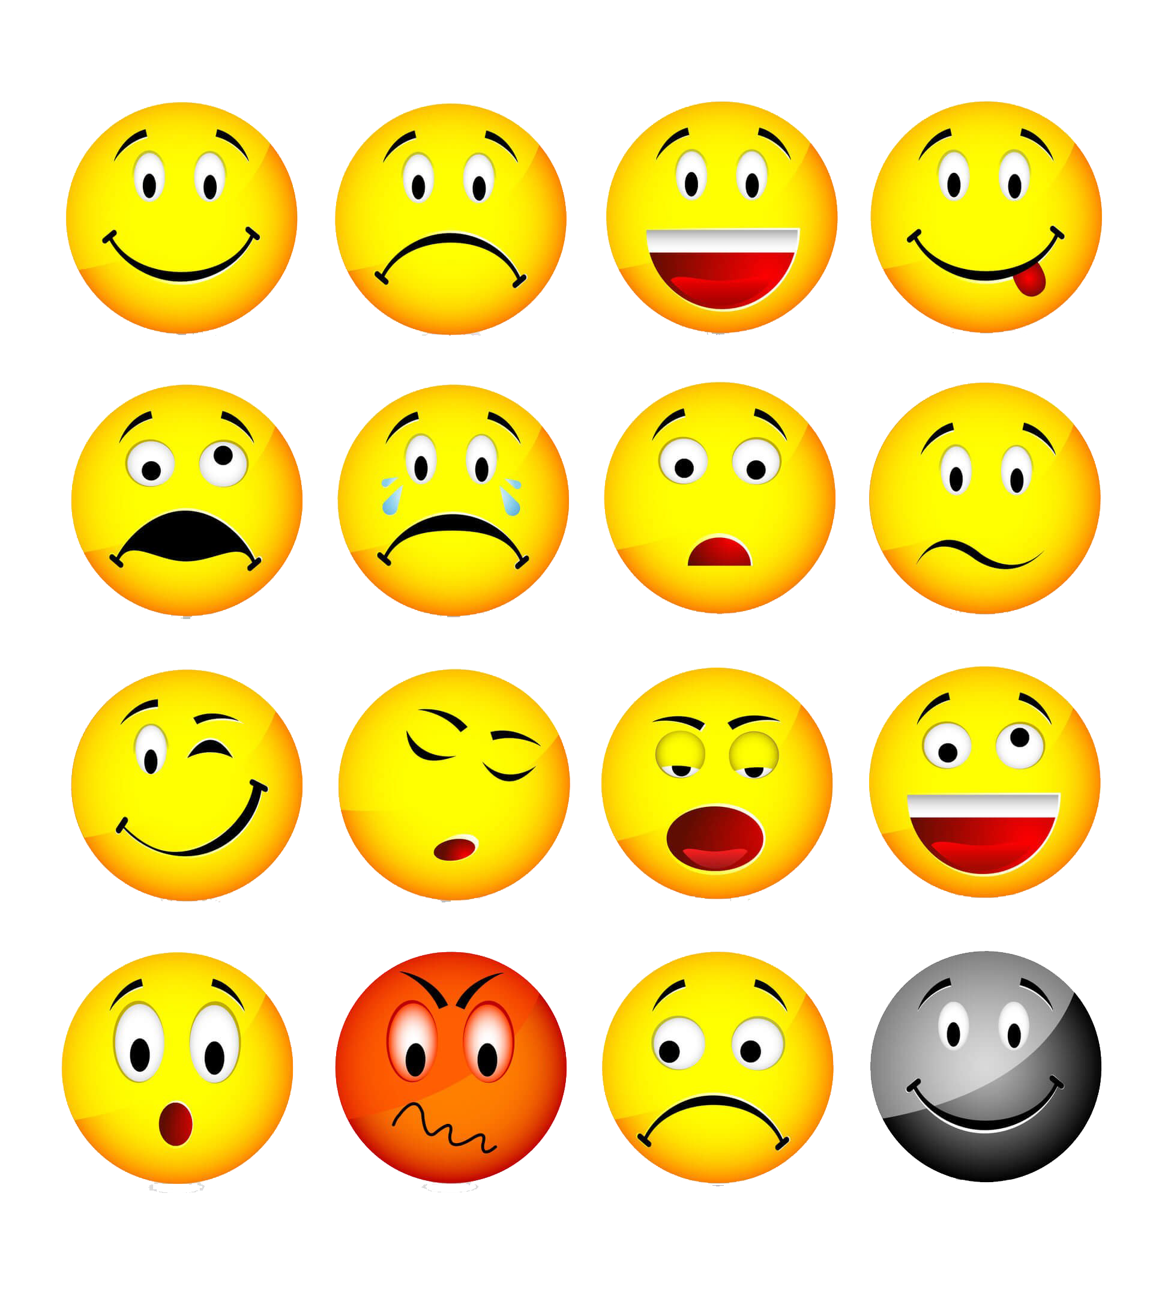
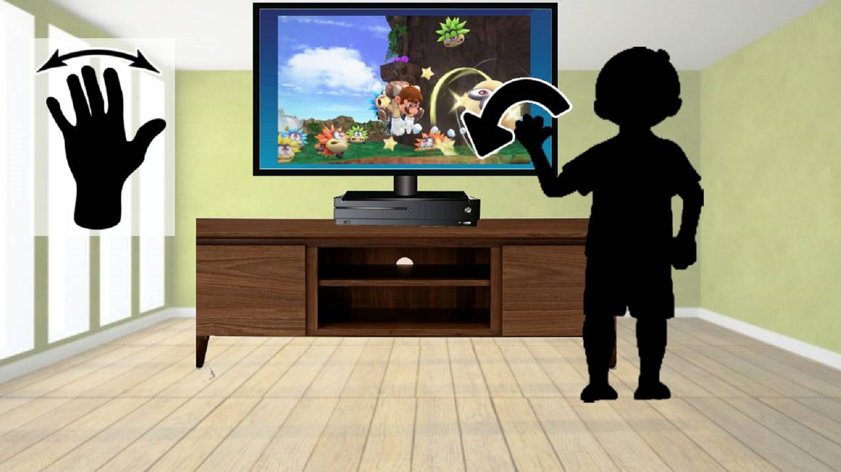
Emotion and Gesture Recognition

Slide 3
Motivation

Slide 4
Technology Used
Machine learning
Computer vision
Deep learning

Slide 5
End User

Slide 6
Who Can Benefit?

Slide 7
Output

Slide 8
Future Scope
Emotion and gesture recognition technology can be applied to virtual reality, gaming, and even self-driving cars to improve user experience and safety.
It can be combined with other technologies such as robotics to create more intuitive and responsive machines.
As privacy concerns surrounding facial recognition technology grow, researchers are exploring ways to incorporate other forms of biometric data for emotion recognition, such as heart rate and skin conductance.

Slide 9

Thank you

