Slide 1

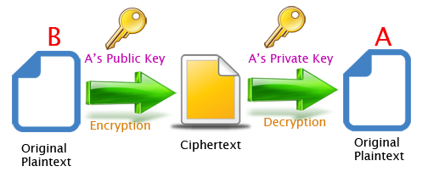
RSA Algorithm

Slide 2

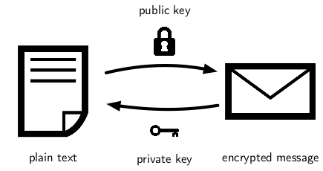
Introduction
RSA algorithm is an asymmetric cryptography algorithm.
Asymmetric means that it works on two different keys i.e. Public Key and Private Key.
As the name describes that the Public Key is given to everyone, and the Private key is kept private.
The idea of RSA is based on the fact that it is difficult to factorize a large integer.
The public key consists of two numbers where one number is a multiplication of two large prime numbers. And private key is also derived from the same two prime numbers.
So, if somebody can factorize the large number, the private key is compromised.
Therefore, encryption strength totally lies on the key size and if we double or triple the key size, the strength of encryption increases exponentially.

Slide 3
Main Steps In RSA Algorithm
Generating Key
Encryption and Decryption

Slide 4
Steps to Generate Key
Select two Prime Numbers (P,Q)
Calculate Product (P*Q)
Calculate Totient (T) (P-1)*(Q-1)

Slide 5
Rules For Key Selection
Public Key selection (E)
Private key selection (D)
Must be Prime
Must be less than Totient
Must NOT be a factor of the Totient
Product of D and E, divided by T must result in a remainder of 1
(DE) MOD T = 1

Slide 6
Rule for Encryption and decryption
Encryption:
Message E MOD N = Cipher Text
Decryption:
Cipher D MOD N = Message

Slide 7
Advantage
Security
Key exchange
Quick and effective
Digital signatures: RSA algorithm can be used for digital signatures, which means that a sender can sign a message using their private key, and the receiver can verify the signature using the sender’s public key.
Widely used: Online banking, e-commerce, and secure communications are just a few fields and applications where the RSA algorithm is extensively developed.

Slide 8
Diadvantage
Slow processing speed
Large key size
Limited use in some applications
Complexity
Key Management
Vulnerability to Quantum Computing
Vulnerability to side-channel attacks: RSA algorithm is vulnerable to side-channel attacks, which means an attacker can use information leaked through side channels such as power consumption, electromagnetic radiation, and timing analysis to extract the private key.

Slide 9



