Slide 1

Optical Fiber Communication
Presented by: Chandana MN
20030141CSE060
B Rupa Sravya
L20030141CSE101
Assigned by: Dr.Sridhar T

Slide 2
Multiplexing

Slide 3
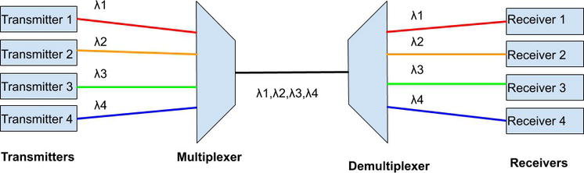
Introduction
Multiplexing is the sharing of a medium or bandwidth. It is the process in which multiple signals coming from multiple sources are combined and transmitted over a single communication/physical line.
Multiplexing is the process of combining multiple signals into a shared channel used for tapping the full potential of the optical links.

Slide 4

Types of Multiplexing
Time-Division Multiplexing (TDM)
Frequency Division Multiplexing (FDM)
Wavelength Division Multiplexing
Space-division multiplexing (SDM)

Slide 5
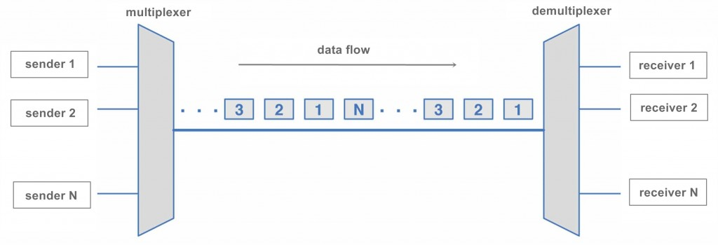
Time-division multiplexing
Widely used in electrical and wireless systems.
Time-division multiplexing is defined as a type of multiplexing wherein, time is shared. Each connection occupies a portion of time in the link.
In Time Division Multiplexing, all signals operate with the same frequency (bandwidth) at different times.
Different optical data streams sequentially share the same optical channel for a limited time.
Pulse interleaving allows efficient use of the full fiber capacity, enhancing overall data rates.
There are two types of Time Division Multiplexing :
Synchronous Time Division Multiplexing
Statistical (or Asynchronous) Time Division Multiplexing

Slide 6
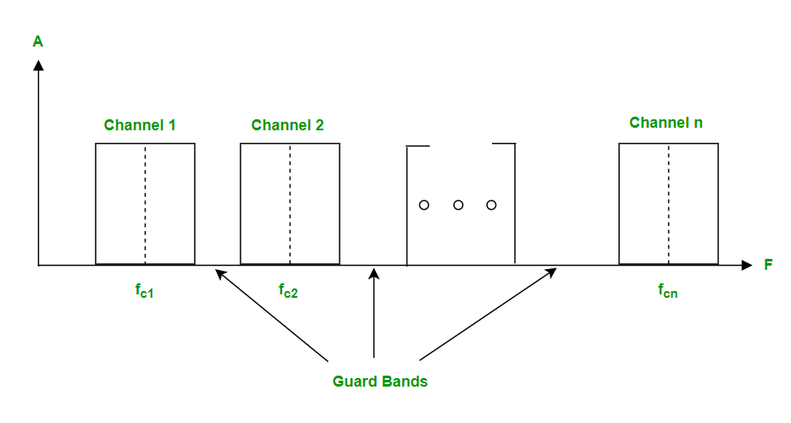
Frequency Division Multiplexing (FDM)
Frequency division multiplexing is defined as a type of multiplexing where the bandwidth of a single physical medium is divided into a number of smaller, independent frequency channels.
Frequency Division Multiplexing is used in radio and television transmission.
In FDM, we can observe a lot of inter-channel cross-talk, due to the fact that in this type of multiplexing the bandwidth is divided into frequency channels.
In order to prevent the inter-channel cross talk, unused strips of bandwidth must be placed between each channel.
These unused strips between each channel are known as guard bands.

Slide 7
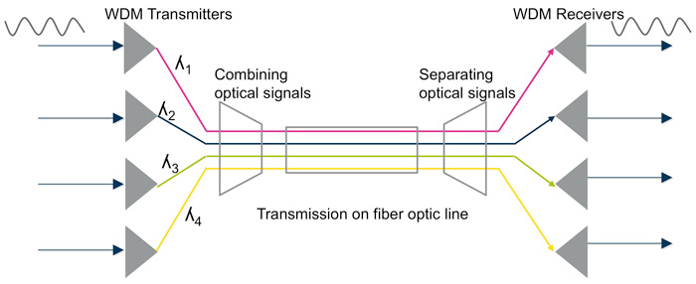
Wavelength Division Multiplexing
WDM is one of the optical multiplexing techniques that increases bandwidth by multiplexing a variety of optical carrier signals onto a single optical fiber by using different wavelengths.
Each signal at WDM wavelengths is independent of any protocol and any speed.
The WDM technology allows bidirectional communications simultaneously over a single optical fiber.
WDM increases the bandwidth and lowers the networking cost by reducing the needed fibers.
There are two different wavelength patterns of WDM systems, coarse (CWDM) and dense (DWDM).
CWDM and DWDM are based on the same concept of using multiple light wavelengths on a single fiber, but differ in the spacing of the wavelengths, numbers of channels, and the ability to amplify the multiplexed signals in the optical space.

Slide 8
Space Division Multiplexing
Space Division Multiplexing (SDM) is a technique used in wireless communication systems to increase the capacity of the system by exploiting the physical separation of users.
In SDM, multiple antennas are used at both the transmitter and receiver ends to create parallel communication channels.
These channels are independent of each other, which allows for multiple users to transmit data simultaneously in the same frequency band without interference.
The capacity of the system can be increased by adding more antennas, which creates more independent channels.
SDM is commonly used in wireless communication systems such as cellular networks, Wi-Fi, and satellite communication systems.
In cellular networks, SDM is used in the form of Multiple Input Multiple Output (MIMO) technology, which uses multiple antennas at both the transmitter and receiver ends to improve the quality and capacity of the communication link.

Slide 9


