Slide 1
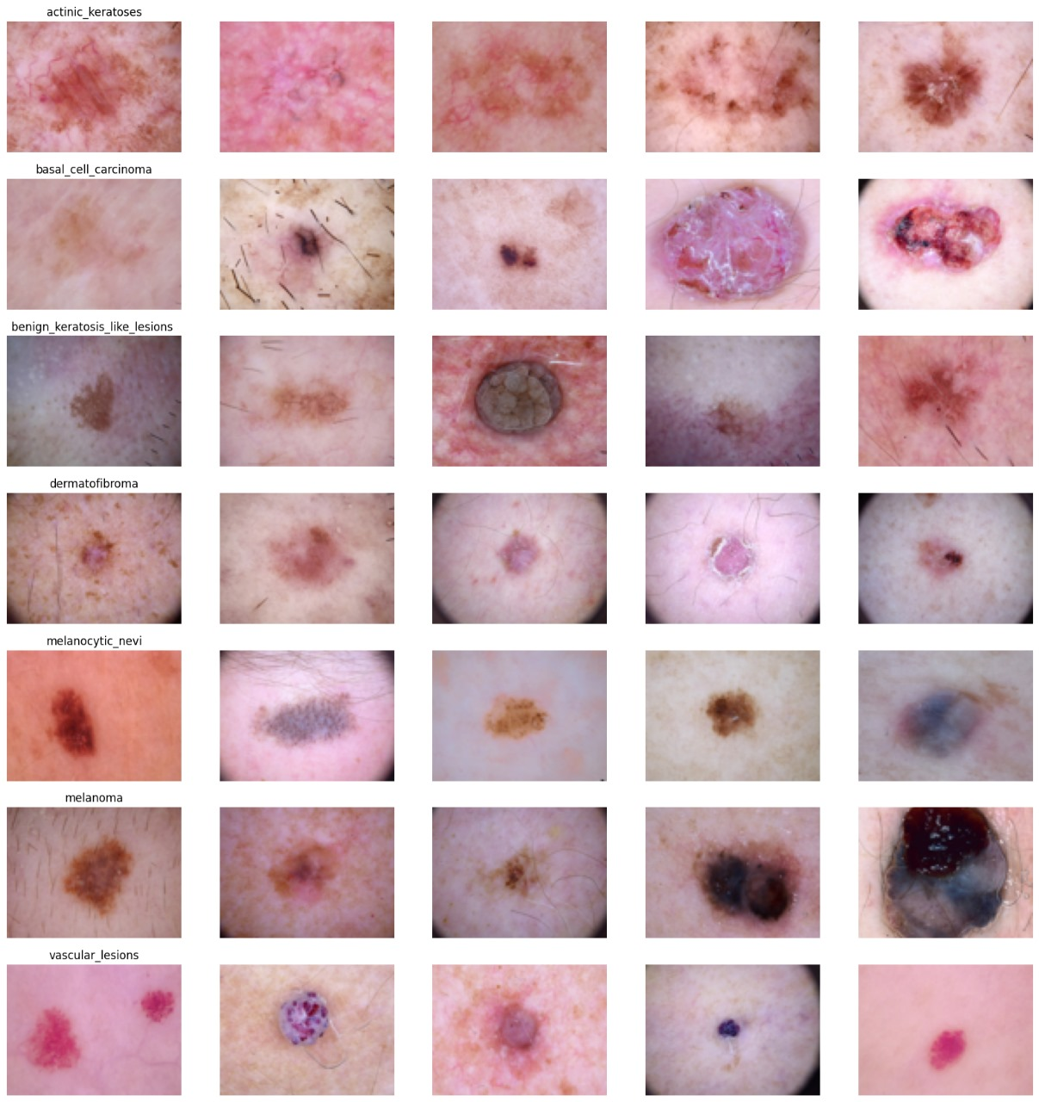

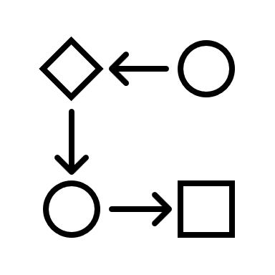
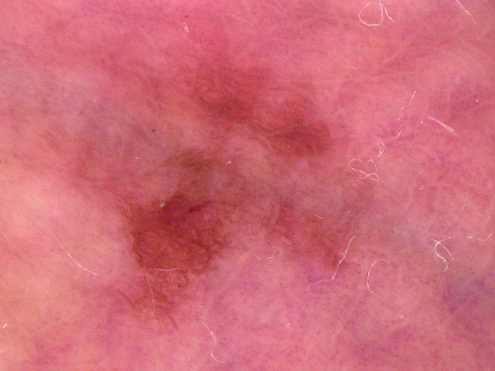



Slide 2
Data Set
Input Image
Pre-Processing
EfficientNetB1
Prediction Classes

