Slide 1

Computer
Vision based
Mouse
Submitted by
16501A0537
16501A0520
17505A0504
16501A0536

Slide 2
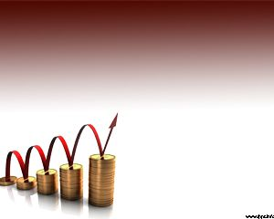
Agenda
Abstract
Introduction
Design
Implementation
Code
Conclusion
Future enhancements

Slide 3
ABSTRACT
As technology continues to develop , people have smaller and smaller electronic devices.
The problem statement for this project is to improve the human computer interaction and in particular vision based and object recognition. The aim is to control all operations of a mouse without the actual use of mouse.
The basic functions of a mouse i.e. left click, right click and double click using hand gestures are performed in this project.
The goal is to manage computers and other devices with gestures rather than pointing and clicking a mouse or touching a display directly.

Slide 4
INTRODUCTION
To design virtual mouse which detects hand gestures patterns instead of physical mouse.
Basically we use colored tips for detection which are captured by webcam
Here, the colored fingertip acts as an object which the web cam senses
The camera is positioned such that it recognizes the moment of finger tips and performs the operations of mouse
The application has been designed to be cost effective and uses low cost input tools like webcam for capturing hand as input.

Slide 5
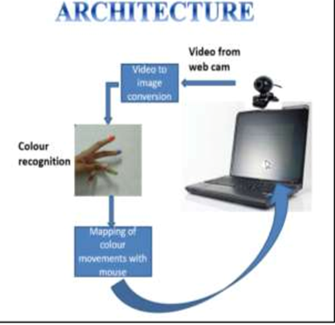

Slide 6
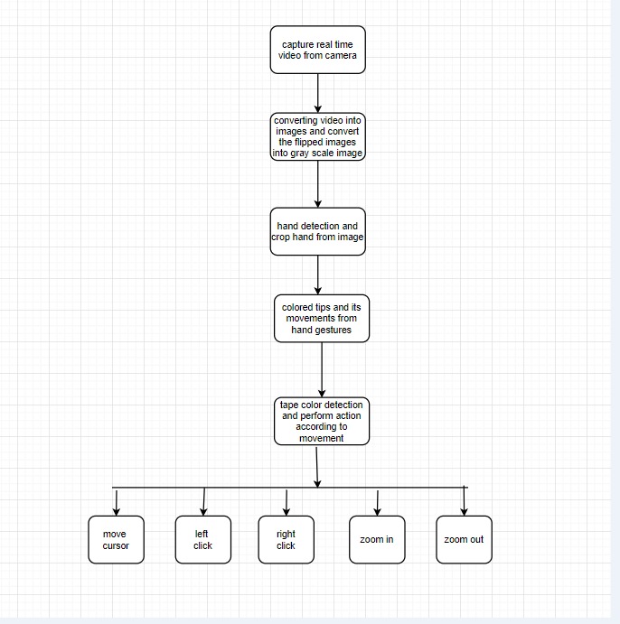
Design

Slide 7
Capture Video from Camera
Goal one :
cv2.VideoCapture()
a. Capturing real time video using Web-Camera.
b. Flipping of each image frame.
c. Conversion of each frame to a grey scale image.
# All packages needed for the program are imported ahead
import cv2
cap = cv2.VideoCapture(0)
while(1):
# Capture frame-by-frame
_, frameinv = cap.read()
# flip horizontally to get mirror image in camera
frame = cv2.flip( frameinv, 1)
# Our operations on the frame come here
hsv = cv2.cvtColor( frame, cv2.COLOR_BGR2HSV)
# Display the resulting frame
cv2.imshow('Frame', hsv)
cap.release()
cv2.destroyAllWindows()

Slide 8
Colour Ranges
Goal two :
calibrateColor()
import cv2
import numpy as np
# Create a black image, a window
kernel = np.zeros((300,512,3), np.uint8)
name = 'Calibrate'
cv2.namedWindow(name)
# create trackbars for color change
cv2.createTrackbar('Hue', name, 0, 255, nothing)
cv2.createTrackbar('Sat', name, 0, 255, nothing)
cv2.createTrackbar('Val', name, 0, 255, nothing)
# create switch for ON/OFF functionality
switch = '0 : OFF \n 1 : ON'
cv2.createTrackbar(switch, name,0,1,nothing)
while(1):
cv2.imshow(name,kernel)
k = cv2.waitKey(1) & 0xFF
break
# get current positions of four trackbars
hue = cv2.getTrackbarPos('Hue', name)
sat = cv2.getTrackbarPos('Sat', name)
val = cv2.getTrackbarPos('Val', name)
s = cv2.getTrackbarPos(switch,name)
if s == 0:
kernel[:] = 0
else:
kernel[:] = [hue,sat,val]
cv2.destroyAllWindows()

Slide 9
Remove Noise
# cv2.inRange function is used to filter out a particular color from the frame
# The result then undergoes morphosis i.e. erosion and dilation
# Resultant frame is returned as mask
def makeMask(hsv_frame, color_Range):
mask = cv2.inRange( hsv_frame, color_Range[0], color_Range[1])
# Morphosis next ...
eroded = cv2.erode( mask, kernel, iterations=1)
dilated = cv2.dilate( eroded, kernel, iterations=1)
return dilated

Slide 10
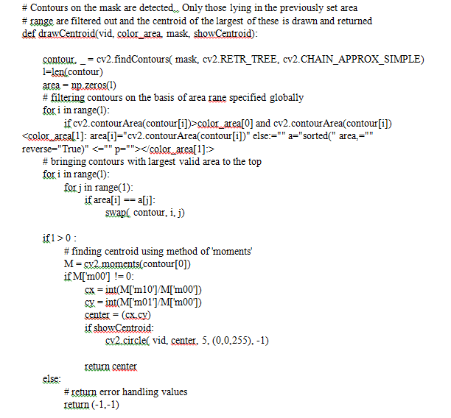

Slide 11
def chooseAction(yp, rc, bc):
out = np.array(['move', 'false'])
if rc[0]!=-1 and bc[0]!=-1:
if distance(yp,rc)<50 and distance(yp,bc)<50 and distance(rc,bc)<50 :
out[0] = 'drag'
out[1] = 'true'
return out
elif distance(rc,bc)<40:
out[0] = 'right'
return out
elif distance(yp,rc)<40:
out[0] = 'left'
return out
elif distance(yp,rc)>40 and rc[1]-bc[1]>120:
out[0] = 'down'
return out
elif bc[1]-rc[1]>110:
out[0] = 'up'
return out
else:
return out
else:
out[0] = -1
return out

Slide 12
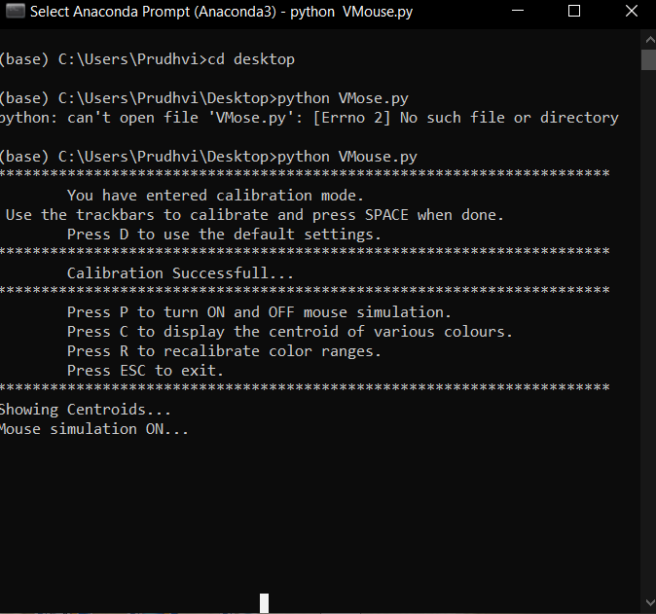

Slide 13
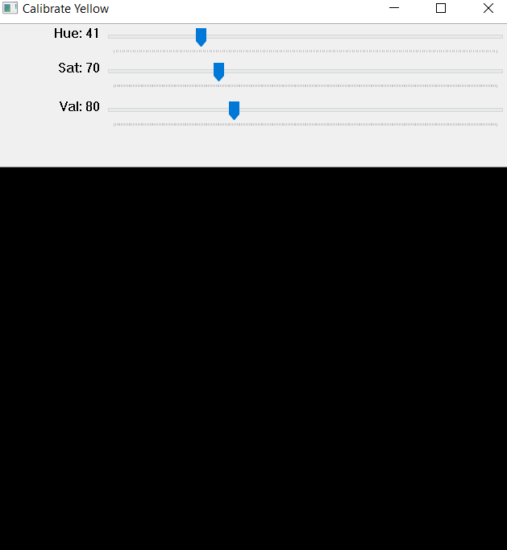

Slide 14
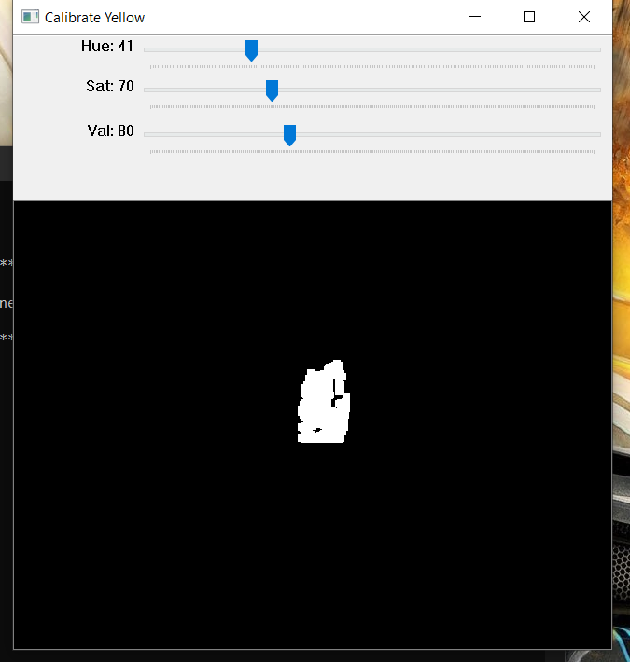

Slide 15
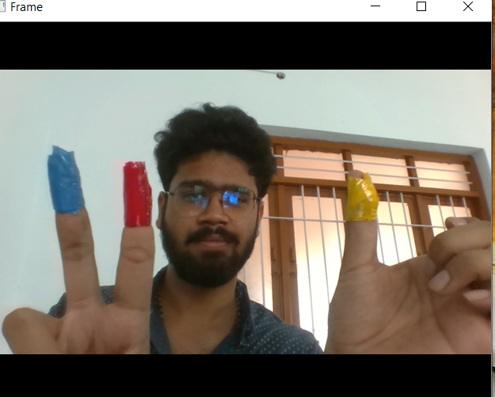

Slide 16
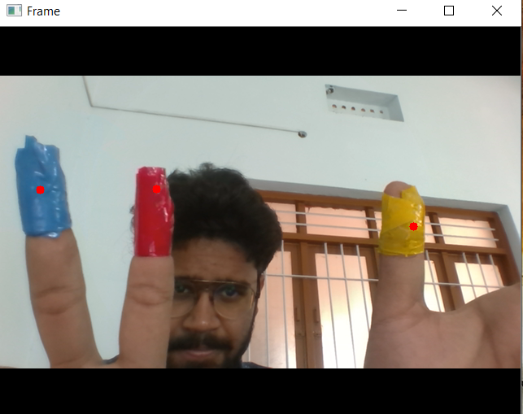

Slide 17
CONCLUSION
We are developing a system to control the mouse cursor using a real-time camera. This system is based on computer vision algorithms and can do all mouse tasks.
However, it is difficult to get stable results because of the variety of lighting and skin colors of human races.
This system could be useful in presentations and to reduce work space.
Various application programs can be written exclusively for this technology to create a wide range of applications with minimum requirements of resources.

Slide 18
FUTURE ENHANCEMENTS
In future, we are going to add Features such as enlarging and shrinking windows, closing window, etc. by using the palm and multiple fingers.
We can also open the browser or any drives (C: /D:/E: etc)with the help of hand gestures instead of moving the cursor.
we are going to add implement this for robots also. Then we can control robots by our gestures.

Slide 19
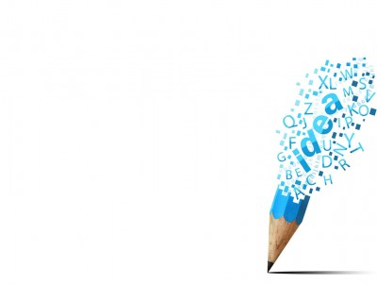
THANKING YOU

